Slide 1
Parallel Link-Based Ranking Algorithms
Hyperlink Induced Topic Search Algorithm
Pagerank
Sandhiya Shunmugavel and Sanjaey Shunmuga Sundaram

Slide 2
Why Link-Based Ranking ?
Ability to efficiently retrieve and rank relevant information is crucial
Enhances search result relevance using hyperlink structure
Complements content-based methods for better accuracy
Parallelizing Link Based Ranking Algorithms for Fast Tracking

Slide 3
Need for Parallel Link Based Algorithm
Web graphs contain millions to billions of nodes/links
Sequential execution is time-consuming and resource-heavy
Parallel computing enables scalability and faster convergence
MPI & OpenMP allow efficient processing of large-scale data

Slide 4
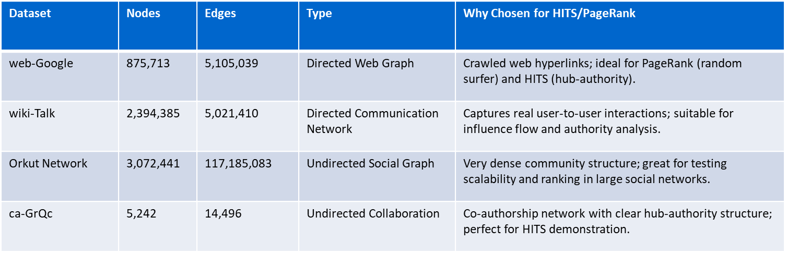
Dataset Used :
Notes:
web-Google graph dataset is ideal for both PageRank and HITS because it mimics how actual web pages link to each other. PageRank reflects how likely a user is to land on a page by randomly surfing the web, while HITS can help us find hub pages that link to many authorities and authority pages that are widely linked.
Next is the wiki-Talk network.
This is a directed graph where each edge represents a message sent from one Wikipedia user to another.
The third dataset is the Orkut social network, from the now-defunct Google social platform.
It is extremely large, with over 3 million users and more than 117 million connections.
Although the graph is undirected, we treat it as bidirectional to apply both HITS and PageRank's where each edge represents a message sent from one Wikipedia user to another.
ca-GrQc (Collaboration Network)

Slide 5
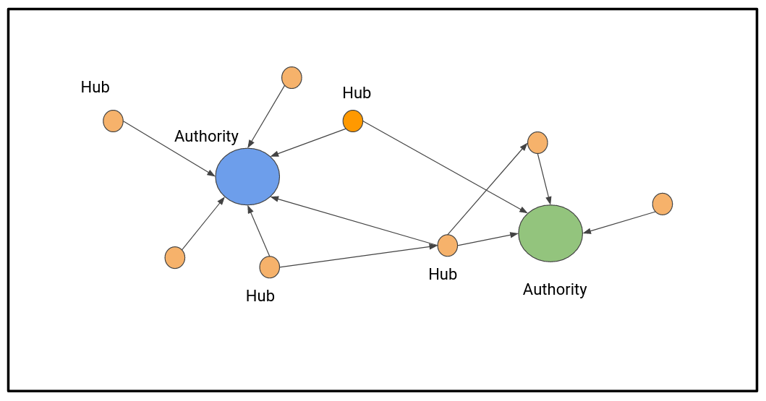
Hyperlink Induced Topic Search Algorithm
Web link structures to discover and rank the webpages relevant for a particular search.
A web page is named as HUB if the page point to various hyperlinks and as AUTHORITY if the web page is pointed by many hyperlinks.

Slide 6
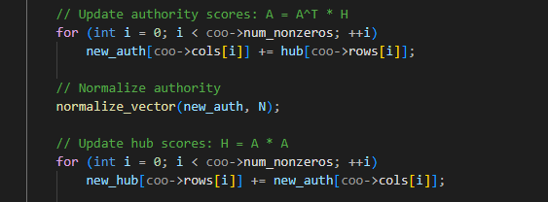
Algorithm Steps
Initialize the hub and authority of each node with a value of 1
For each iteration, update the hub and authority of every node in the graph
The new authority is the sum of the hub of its parents
The new hub is the sum of the authority of its children
Normalize the new authority and hub

Slide 7
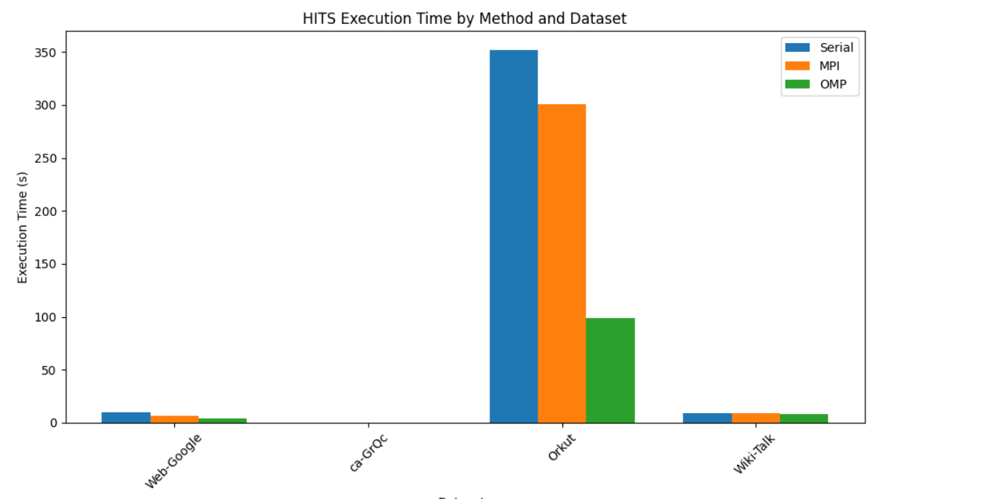
Parallelize HITS

Slide 8
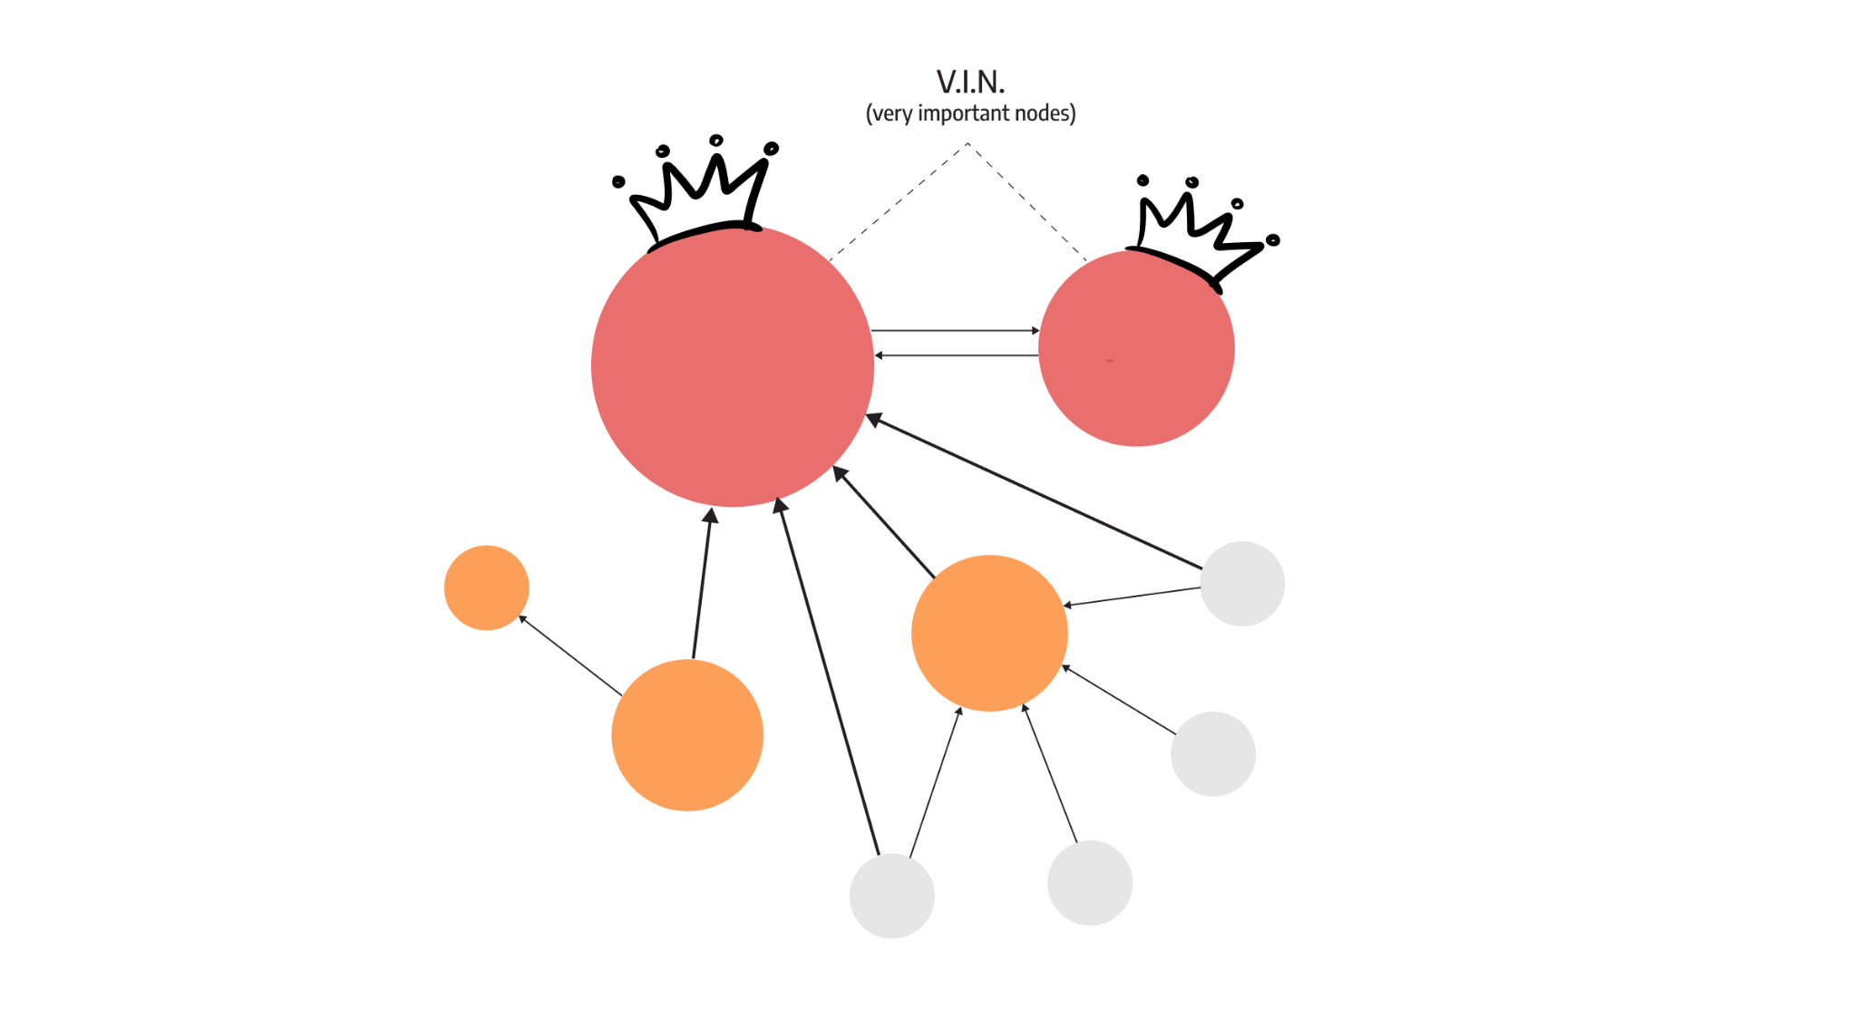
Page Rank
It was the original algorithm that Google search used to rank websites in their search engine results.
Page Rank works by counting the number and quality of links to a page to determine a rough estimate of how important a particular website is.
Notes:
Now let’s talk about PageRank, one of the most iconic algorithms developed by Google to rank web pages.
PageRank works on the idea that if a page is linked by many other pages — especially ones that are themselves important — then it must be a valuable or important page.
In simple terms, it’s like academic citation. If many important papers cite one particular paper, then that paper is likely influential.

Slide 9
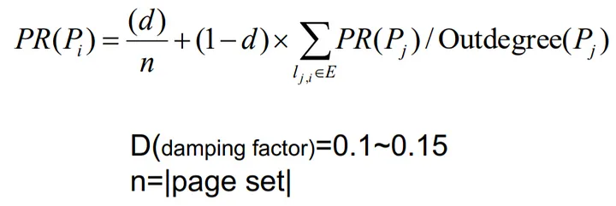
Algorithm Steps
Each node starts with equal rank.
In each iteration, the rank is distributed from a page to its linked pages based on its out-degree.
A damping factor simulates the probability of continuing to click links vs jumping to a random page.
The process repeats until the PageRank values converge (i.e., changes become very small).
Notes:
At the beginning, every node or web page is assigned an equal rank.
Then, in each iteration, it distributes its current rank to all the pages it links to.
So if a page has 3 outgoing links, it gives one-third of its rank to each of the three target pages.
To avoid the algorithm getting trapped in loops or dead ends, PageRank uses something called a damping factor, typically set to 0.85.
This factor simulates a user who, with 85% probability, continues clicking links, and with 15% probability, jumps to a random page.
●The process continues iteratively, redistributing the rank, until the values converge — meaning, the rank scores no longer change significantly from one iteration to the next.

Slide 10
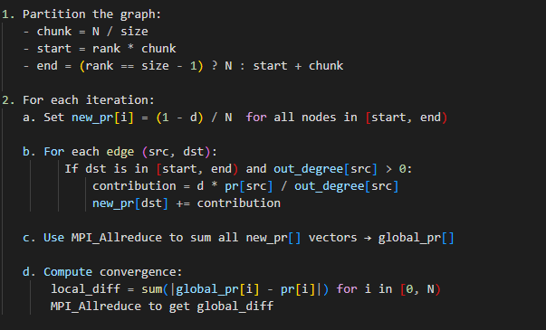
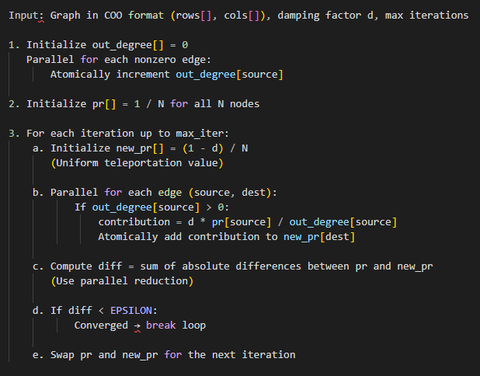
Parallel Page Rank -MPI and OpenMP
MPI OpenMP
Notes:
PageRank is highly iterative and computationally expensive on large graphs.
To speed it up, we implemented two parallel versions Shared Memory using OpenMP and Distributed Memory with MPI
In the OpenMP version, we parallelized the main computational loops using multithreading.
Key loops like out-degree counting, vector initialization, and rank propagation are parallelized using #pragma omp parallel for.
For MPI, we take a distributed approach by partitioning the nodes across processes.
Each process is responsible for a chunk of nodes — this is done using block partitioning.
In each iteration:
1.Every process locally computes PageRank updates for its own nodes.
2.To synchronize the global view of the PageRank vector, we use MPI_Allreduce to aggregate the partial results across processes.
3.We also compute the convergence metric using another MPI_Allreduce.

Slide 11
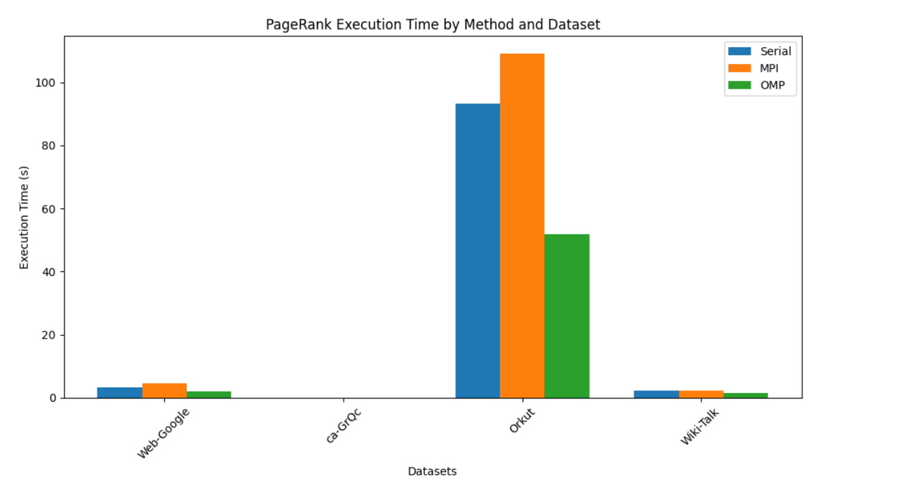
Parallelize Page Rank
Notes:
As we can see, OpenMP consistently outperforms MPI across all datasets. For example, in the Web-Google dataset, OpenMP completes execution in about 2.5 seconds, while MPI takes nearly double that time.
The most noticeable difference is with the Orkut dataset. This is likely the largest or most complex dataset in our comparison.
Here, OpenMP executes in around 52 seconds, whereas MPI takes over 110 seconds—more than twice as long.
This large gap can likely be attributed to the overhead in MPI's message-passing model, especially on shared-memory systems. In contrast, OpenMP benefits from shared memory, offering better performance for these types of computations.
Even in the smallest dataset, ca-GrQC, both methods complete almost instantly, which makes sense given the minimal workload.

Slide 12
Main Takeaways and Next Steps
1
Demonstrated performance gains through parallelization using MPI and OpenMP
Takeaways
2
Execution time reduced significantly compared to serial versions
3
Reinforced the importance of parallel computing in handling web-scale data
1
Implement GPU-based acceleration using CUDA for even faster performance
Next Steps
2
Scale to real-world web graphs (e.g., Common Crawl, Wikipedia dumps)

Slide 13
References
Authoritative Sources in a Hyperlinked Environment
https://en.wikipedia.org/wiki/HITS_algorithm
The Pagerank Citation Ranking : Bringing Order to the Web

