Slide 1



FLOWLENS AI — WHERE DOES THE PROCESS ACTUALLY SLOW DOWN?
Universal Process Intelligence + Predictive ML + What-If Simulation + Gemini AI
Registration
Verification
Processing
Approval
PS 17 | DATA SCIENCE | HACKGENIX 2026

Slide 2
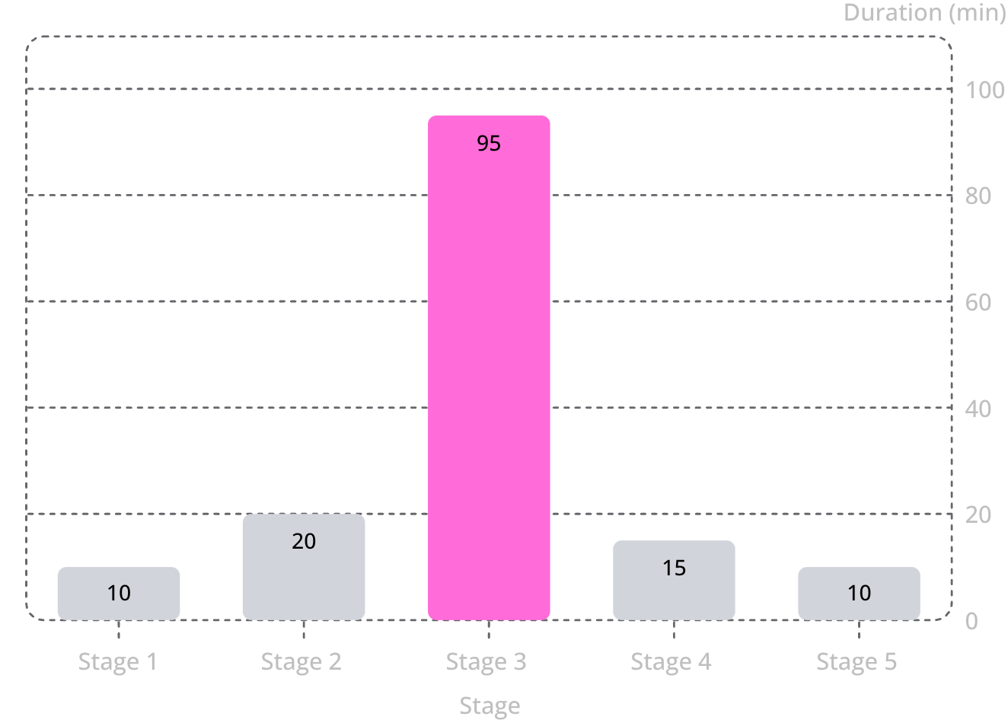


The Delay Is Not Always Where You Think It Is
Why averages lie
Hidden stage-level delays
Overall averages mask which stage is actually causing the slowdown.
Wrong optimization target
Managers may invest effort improving the wrong stage entirely.
Dynamic bottlenecks
Bottlenecks shift with workload, resources, and time of day.
Intervention gap
Knowing where the delay occurs is not enough — we need to know what change will actually reduce it.
The real question is not "Is the process slow?" It is "WHERE, WHY, and WHAT SHOULD WE CHANGE?"

Slide 3






FLOWLENS 4-TIER PROCESS INTELLIGENCE
Deterministic Engine → Predictive ML → What-If Simulation → Gemini AI
🔍 DETERMINISTIC
Exact Bottleneck DNA, cycle & queue metrics
🤖 PREDICTIVE ML
Congestion forecast, anomalies & remaining time
⚡ WHAT-IF SIM
Kingman queue modeling & migration dynamics
🧠 GEMINI AI
Contextual executive narration of verified facts
Input
Output
Universal CSV event logs (Healthcare, Banking, Logistics, etc.)
Verified bottleneck + ML forecast + simulation + Gemini narrative
Deterministic tracks what is happening. ML forecasts what is likely next. Simulation tests interventions. Gemini explains verified evidence.

Slide 4
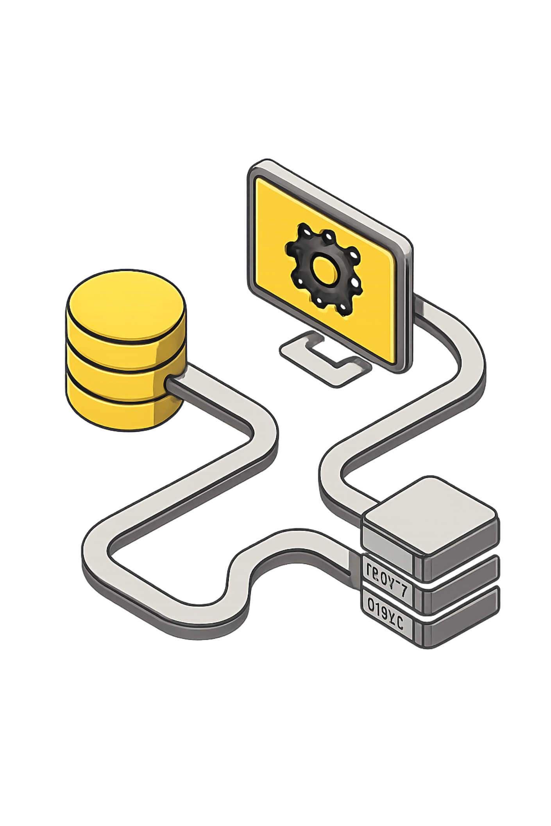




FULL-STACK ARCHITECTURE
Decoupled Next.js (Vercel) + FastAPI Python ML Microservice
Cloud-native decoupled architecture: Next.js on Vercel with graceful fallback + containerized Python ML microservice.
Full-Stack Architecture
Every layer serves one goal
Transform raw event timestamps into a clear, data-driven recommendation a manager can act on immediately.
Deterministic Engine
Predictive ML Service
TypeScript · Next.js 16
Python · FastAPI · Scikit-learn
Simulation & GenAI
Executive Dashboard & Data
Kingman Math · Google Gemini API
React 19 · Tailwind · Supabase PostgreSQL

Slide 5






Beyond Bottleneck Detection
Traditional Analytics vs. FlowLens AI Engine
Scalability
A domain-independent engine that learns from process event data rather than relying on fixed bottleneck rules.
Traditional | FlowLens AI Engine
Shows overall delay | Pinpoints exact 6-signal Bottleneck DNA
Reports what happened | Root-cause attribution (resource & queue)
Static analysis | Predictive ML (forecasting & anomalies)
Identifies problem | Tests interventions via Kingman simulation
Historical view only | Gemini AI executive narration & actions
DETERMINISTIC → PREDICTIVE ML → SIMULATION → GEMINI
Healthcare
Manufacturing
Logistics
Banking
Customer Ops

Slide 6
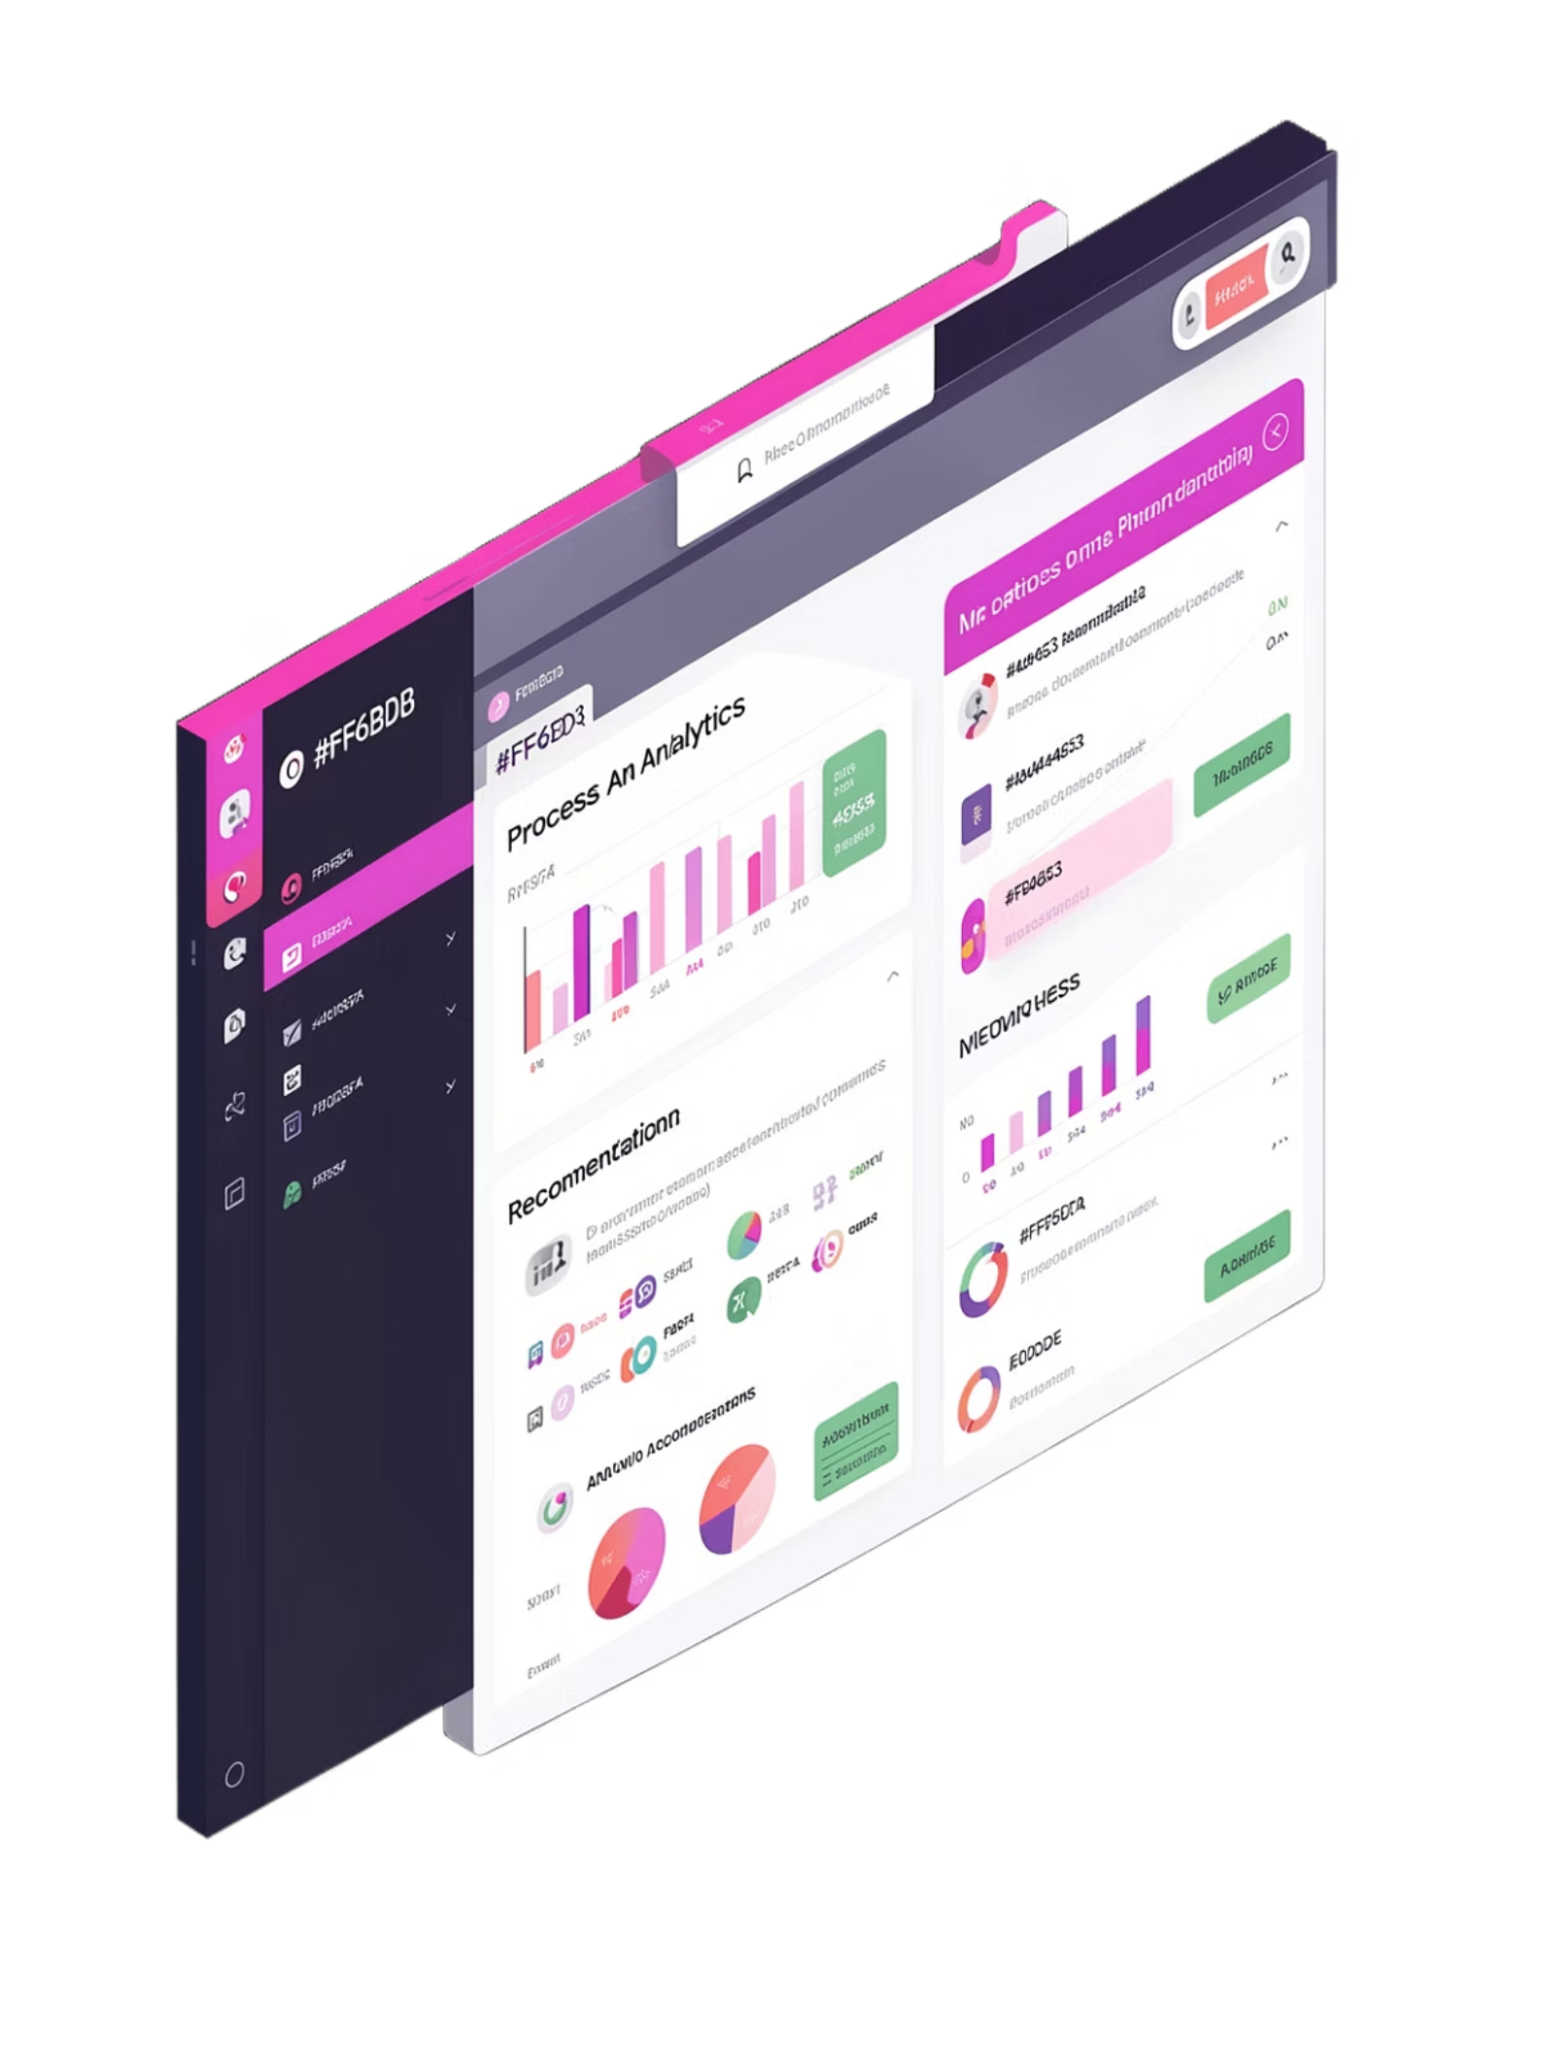
FROM "WE HAVE A DELAY" TO "HERE'S WHAT TO DO."
📊 PROCESS INSIGHT
Cases Analyzed: 10 (Verified Benchmark)
Avg Cycle Time: 5h 45m
🔴 BOTTLENECK: VERIFICATION
Bottleneck Score: 62.5
Waiting DNA: 94.2% Queue Delay
❓ ROOT CAUSE EVIDENCE
Hidden queue buildup (15m processing vs 200m queue wait)
⚡ INTERVENTION & SIMULATION
+2 Resources to Verification
Simulated Cycle Time: ↓ 64% (New Bottleneck: Review)
One process. One hidden bottleneck. One verified data-driven intervention.
TEAM HACKGENIX
PS 17 | HACKGENIX 2026

