Slide 1

TEAM NME : PRIME SQUAD
TEAM MEMBERS :
1. SANJAI PRASATH M
2. KESAVAN S
3. MOURIYA M
TONO-GUN
“Early Eye Pressure Check, Anywhere”

Slide 2
TONO GUN: Miniature Non-contact Air-Puff Tonometer for Measuring IOP
Impact & Market Size
Glaucoma is a leading cause of irreversible blindness
80+ million people worldwide, many undiagnosed
India has large rural population with limited eye screening access
Early IOP screening can prevent lifelong vision loss

Slide 3
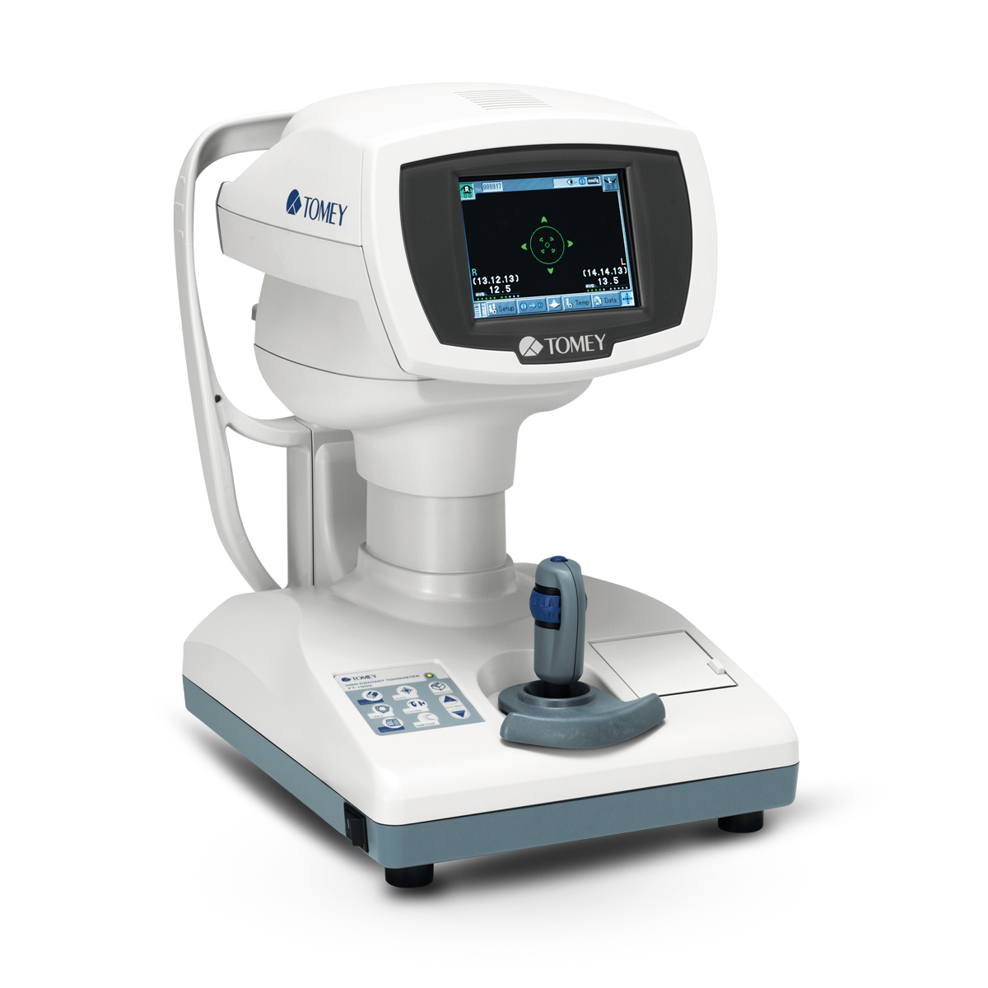
Problem & Existing Solutions
Pain Points:
Late glaucoma detection
Fear, shame, and hesitation during hospital visits
Expensive & bulky eye pressure systems
Existing Solutions:
Goldmann / air-puff tonometers
Clinic-dependent, costly, not portable
Gap:
No easy, accessible way for frequent IOP screening

Slide 4
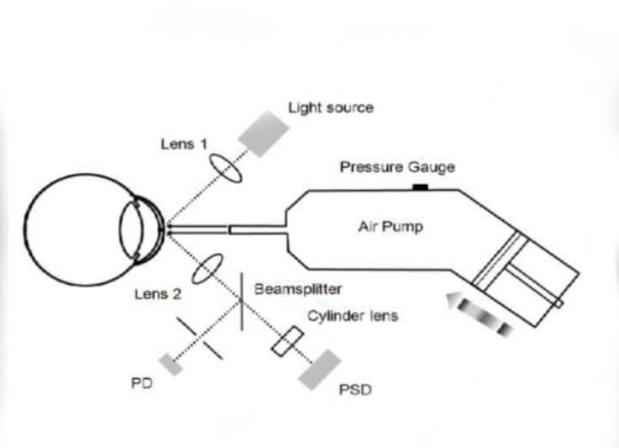
Solution – TONO-GUN (Proposed Concept)
Compact, non-contact air-puff device for measuring intraocular pressure (IOP)
Uses a controlled air puff to gently deform the cornea without touching the eye
Optical system (light source, lenses, beam splitter) detects corneal deformation
Pressure sensor measures the air pressure at the point of corneal flattening
Converts measured pressure into IOP value (mmHg)
Quick, painless, and hygienic screening process
Portable design suitable for clinics, camps, and point-of-care use
Enables frequent and early glaucoma screening

Slide 5
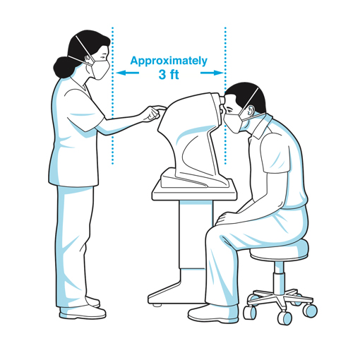
User Suffering & Why It Matters
User Suffering:
Patients avoid check-ups due to fear of judgement
Vision loss detected only at late stage
Rural patients travel long distances
Impact:
Permanent blindness
Loss of independence & income
Increased healthcare burden

Slide 6
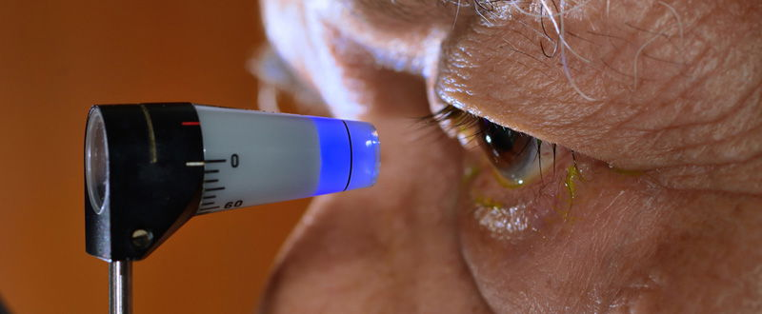
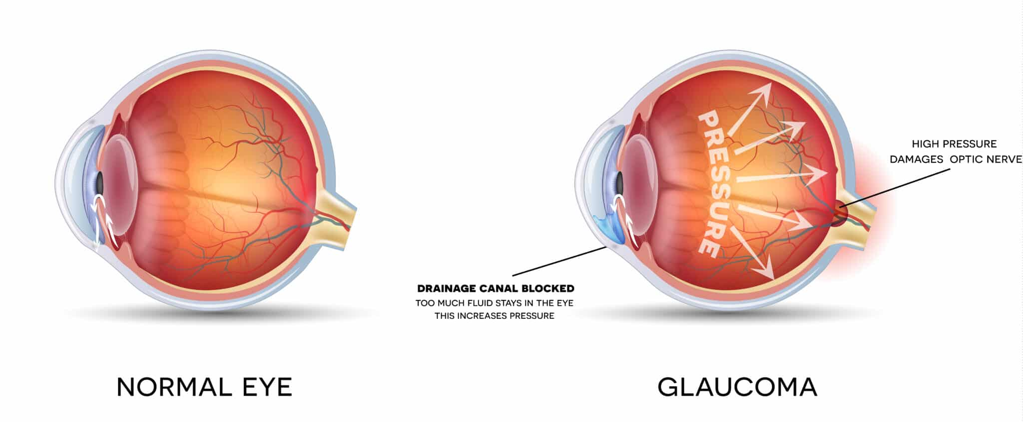
Target Customers
Primary Users:
Glaucoma patients (40+ age)
Eye doctors & optometrists
Customers:
Hospitals & clinics
Vision care centres
NGOs & rural screening programs

Slide 7
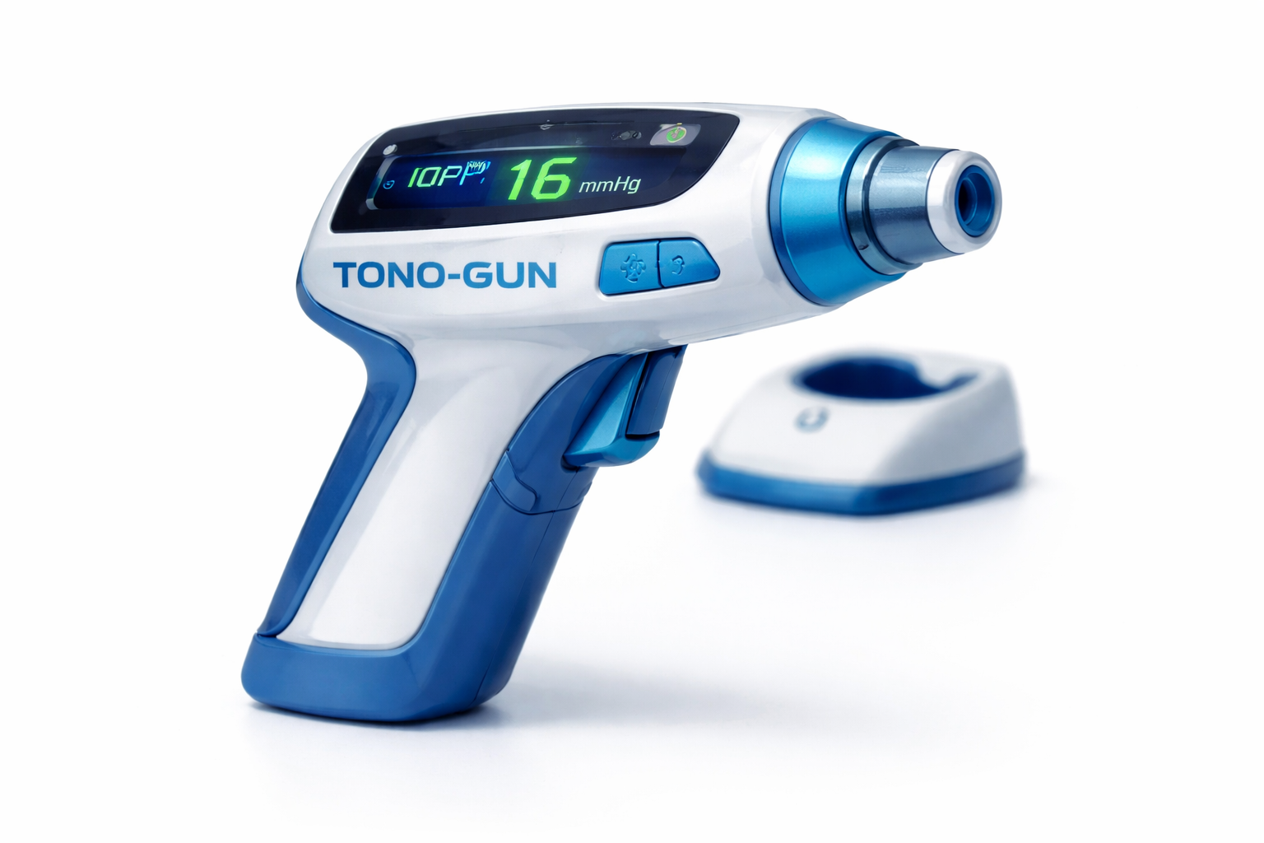
Revenue Stream
Device sales to clinics & hospitals
Bulk supply to screening camps & NGOs
Maintenance & calibration services
Future upgrade versions
Model: One-time device + recurring service

Slide 8
Competitor Analysis – Tonometers
Parameter | Goldmann Applanation (Keeler, US) | Standard Air-Puff Tonometer | TONO-GUN (Proposed)
Contact / Non-contact | Contact | Non-contact | Non-contact
Accuracy | Very high (gold standard) | Moderate–high | Targeted for screening
Anesthesia Required | Yes | No | No
Portability | No (slit-lamp based) | No (table-top) | Yes (handheld)
Cost | High | High | Low–cost focused
Ease of Use | Needs trained doctor | Needs clinic setup | Easy, minimal training
Patient Comfort | Moderate | Good | Very good
Suitable for Rural / Camps | No | Limited | Yes
Purpose | Clinical diagnosis | Clinical screening | Frequent & early screening

Slide 9
Requirements & Timeline
Key Requirements:
Compact air-puff system
Safe pressure range
Simple display
Portable power source
Timeline:
Month 1: Design & component selection
Month 2: Prototype development
Month 3: Testing & calibration
Month 4: User validation & refinement

Slide 10
THANK YOU
Thank you for your time and attention.
We welcome your questions and feedback.

