Slide 1
"Exploring IIS Server"
Internet Information Services

Slide 2
IIS Server Process
IIS (Internet Information Services) handles incoming HTTP requests by receiving and routing them to the appropriate website or application based on host headers, performing authentication and authorization checks, and then processing the requests through designated modules and handlers, finally sending the generated responses back to clients.
The request processing pipeline in web servers, including IIS, consists of multiple stages, such as request parsing, authentication, URL routing, request handling, and response generation, with each stage responsible for processing and transforming incoming HTTP requests before sending responses to clients.

Slide 3
Application pools in IIS provide a process isolation mechanism, and worker processes within these pools execute web applications separately, enhancing server stability and security by isolating potential issues and failures to specific applications or sites.

Slide 4
IIS Configuration
IIS Manager provides a graphical interface for configuring and managing Internet Information Services, including settings for websites, application pools, security, authentication, and URL rewrite rules, making it easier to customize and administer your web server.
Website setup in IIS involves configuring a site's root directory, application settings, and authentication methods. Bindings define how the site listens for incoming requests by specifying IP addresses, ports, and hostnames. SSL certificates, on the other hand, secure the site by encrypting data transmitted between the server and clients, typically through HTTPS, enhancing security for web communication.

Slide 5
Common configuration tasks in IIS include defining custom error pages, URL rewriting, setting up authentication methods, and managing MIME types. Security settings encompass configuring access control, IP restrictions, and request filtering to safeguard web applications and data from unauthorized access and threats.

Slide 6
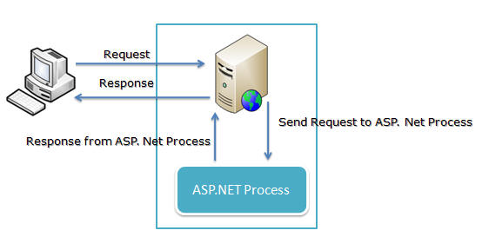
Architecture

Slide 7
Pros and Cons of IIS
Pros:
Native integration with Windows.
Strong security features.
Support for ASP.NET.
Cons:
Licensing costs
Compatibility issues with non-Windows technologies.

