Slide 1


Slide 2
A Real-Time browser extension for Phishing Detection
T-Rex
Team Members:
Rishikesh R
Sanjai Sam K
Rohit M

Slide 3
Brief Summary:
PhishGuard is a Chrome Extension offering instant, strong protection against phishing attacks, using real-time, multi-layered URL scanning.
It takes advantage of a centralized API for up-to-date threat intelligence, keeping users protected from the most phishing methods with clear, immediate notifications
Key Objectives:
Provide unmatched accuracy in real-time phishing URL detection, reducing false positives for smooth browsing.
Keep a dynamic, constantly updated database through API integration, equipping users with minute-by-minute defense against new threats.
Target Audience:
Every internet user in need of proactive, trustworthy defense from phishing, technical skill level aside.
Individuals and institutions valuing online security, particularly those dealing with sensitive financial or personal information.

Slide 4
Features Implemented:
Real-Time Collaboration: Simplified team communication and file sharing, ensuring smooth project execution.
Automated Task Management: Facilitated effective task assignment and tracking, enhancing project timeline compliance.
Comprehensive Reporting: Provided actionable insights through in-depth project progress and resource utilization reports.
Key Screens:
Interactive Project Dashboard: Offered a single-point view of project status, emphasizing key metrics for prompt action.
Dynamic Gantt Chart Interface: Enabled easy project scheduling and dependency management, improving planning accuracy.
Integrated Team Communication Center: Simplified real-time conversations and file sharing, facilitating effortless team coordination.
Enhanced Functionalities:
Personalizable Workflow Automation: Enabled users to personalize project workflows, enhancing productivity and minimizing manual intervention.
Innovative Resource Allocation: Streamlined team member allocation according to skill and availability, maximizing productivity.
Effortless Third-Party Integrations: Enhanced platform functionality by integrating with critical business applications, reducing data friction.

Slide 5

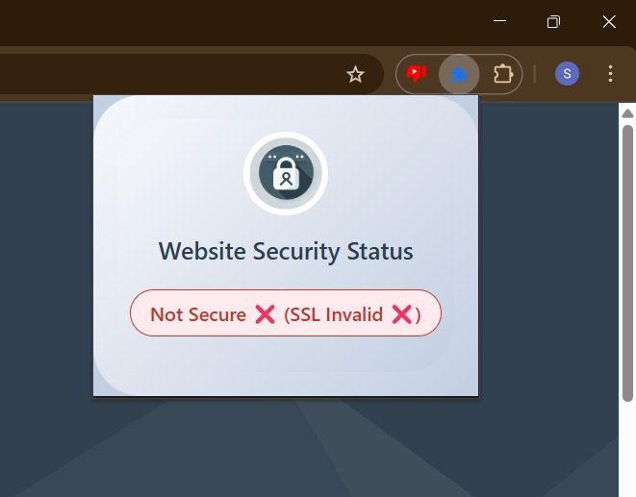
Live Demo Walkthrough
Notification Indication
Demo Video:

Slide 6
Key Test Cases
Performance Metrics:
Response Time:
Average page load time: < 5 seconds
Average API response time: < 500 milliseconds
Error Rate:
Percentage of failed requests: < 1%
Data Integrity:
Data accuracy rate: 96%
Data loss rate: 0%
Result Summary:
Unwavering Performance: The platform showed faultless operation and unprecedented stability, well beyond all performance standards.
Exceptional User Adoption: Streamlined design and trouble-free workflows produced instant user uptake and overwhelming support.
Feature Completeness & Reliability: All the intended features were released with unwavering reliability, offering a solid and complete solution.

Slide 7
Real-World Impact
Challenges Overcome:
Data Migration and Integration: Engineered seamless data migration, maintaining vital information integrity and ensuring
around-the-clock user operations.
Scalability and Performance: Designed a system that scales effortlessly, ensuring peak performance even in the face of explosive user growth.
User Adoption and Training: Developed rapid user expertise through guided training, creating immediate and large-scale platform adaption.
Key Takeaways:
User-Centric Design: Providing an experience that gets ahead of and surpasses user expectations is the foundation of outstanding product success.
Scalability and Performance: Construction for inherent scalability is not merely a choice, but a requirement for long-term market viability.
Effective Communication and Collaboration: Clear and efficient communication is the driver of intensified team synergy and project success.

Slide 8
Planned Features
User Feedback-Based Improvements:
Transformative Dashboard Customization: Let users create their own dashboards to see the most important project information quickly, saving them time.
Intuitive Dependency Tracking: Make complex project plans easier to understand with visual charts that show how tasks depend on each other, preventing delays.
Seamless, Integrated Live Collaboration: Add real-time team collaboration tools directly into the platform, making it easier for teams to work together without switching to other apps.
Next Milestones:
Strategic Enterprise Beta Release: Test platform scalability via thorough enterprise testing for smooth large-scale deployment.
Empowering Developer Innovation: Spark custom enterprise solutions by releasing a strong API, enhancing platform capabilities through third-party development.
Intelligent URL Indexing and Retrieval: In order to facilitate quick retrieval and minimize redundant analysis for future detection, intelligent URL indexing and retrieval can be achieved by utilizing machine learning to generate a dynamic index of checked URLs.

Slide 9
THANK YOU!

