Slide 1

BIAN Platform
Biozeen Industry Academy Network: the website and member platform, role by role
Connect · Collaborate · Innovate · Grow
Notes:
This deck walks through the BIAN platform for each kind of user: visitors, organisation and individual members, experts, and Biozeen staff. Every screen shown is from the working application with its sample data.

Slide 2
One platform connecting industry, academia and talent
12
7
4
17
screens from the BIAN website design, all built
member categories, each with its own access
staff roles, plus custom roles and permissions
page-builder blocks for publishing without code
Public portfolio site · member portal · admin workspace · visual CMS · feedback analytics · live notifications
Built with React, Node.js and MongoDB. Every access rule is enforced on the server and covered by automated tests.
Notes:
The platform covers the full design: the public portfolio, a member portal for every category, and an admin workspace. Content is published through a visual block editor, so the team can update the site without developers.

Slide 3





Five kinds of user, one sign-in
Visitors
Organisation members
Individual members
Experts
Biozeen staff
Browse public pages, search, contact the secretariat, register
Startups, academia and industry: post requirements, find experts, manage a company profile
SMEs, alumni, students and professionals: opportunities, learning, events
Listed in the Experts Network with visibility they control
Administrators, content editors and publishers, membership managers
Notes:
Everyone signs in on the same page. What you see afterwards depends on your roles: members land on the Member Portal, staff on the Admin workspace. Category is who you are; roles decide what you can do.

Slide 4
Public website and joining
What visitors see, and how they become members
Notes:
Section: the public site and the registration journey.

Slide 5
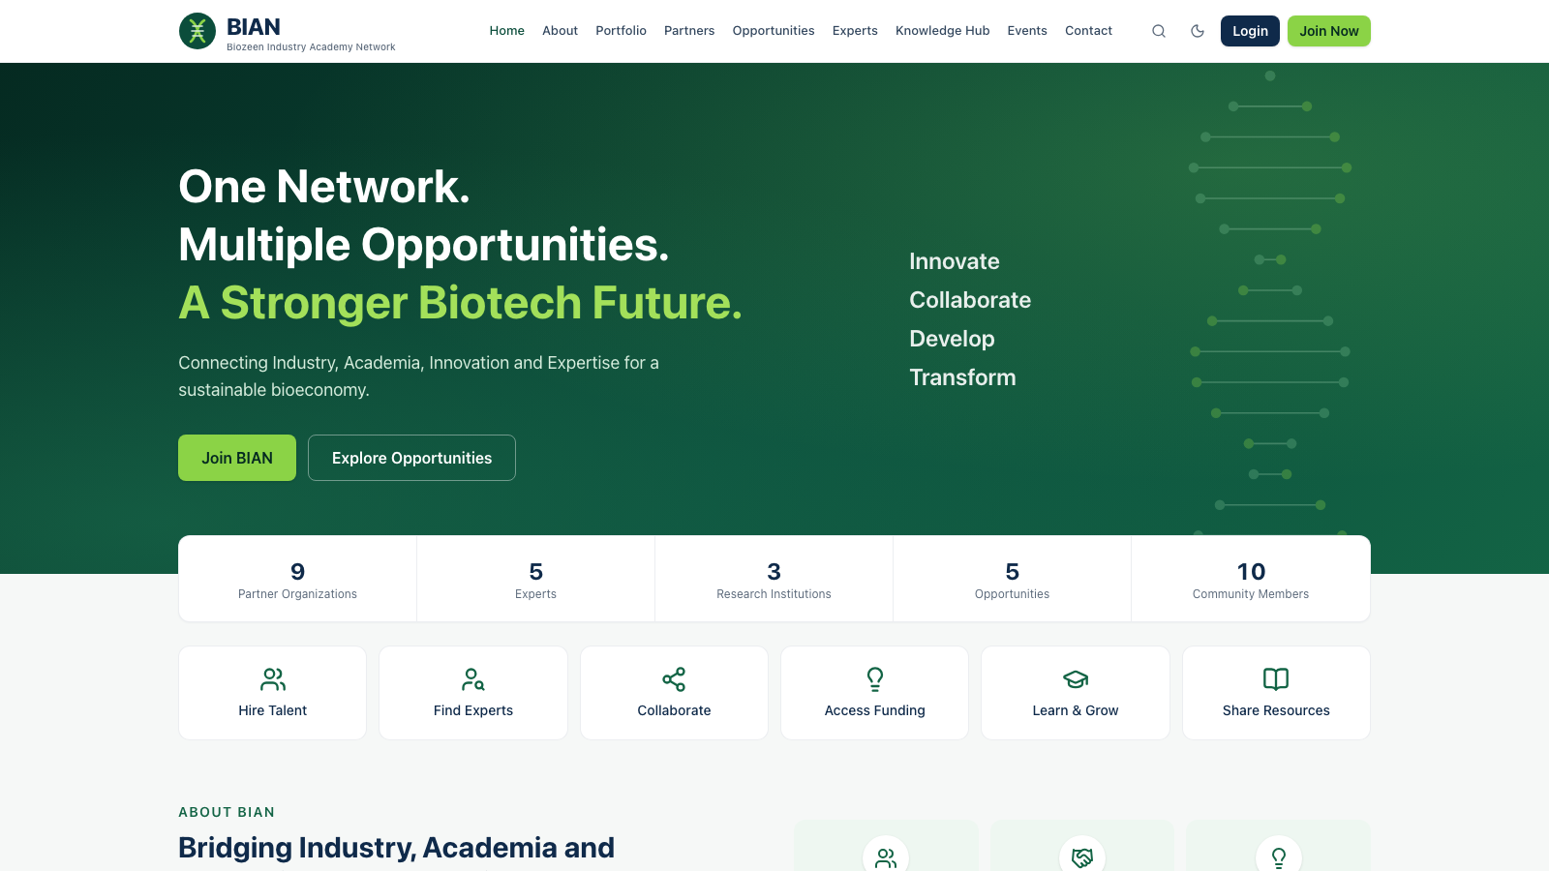
The public site shows BIAN's network to everyone
Homepage with live network numbers, latest opportunities, partners and events
Partner Ecosystem by tier: founding, knowledge, industry, innovation
Opportunities, Knowledge Hub, Experts, Events searchable and filterable
Contact & Collaboration Center for enquiries to the secretariat
Site-wide search across every section
Notes:
The homepage numbers are counted live from the database, not typed in. Members-only items still appear in lists with a Members badge, which encourages visitors to join.

Slide 6
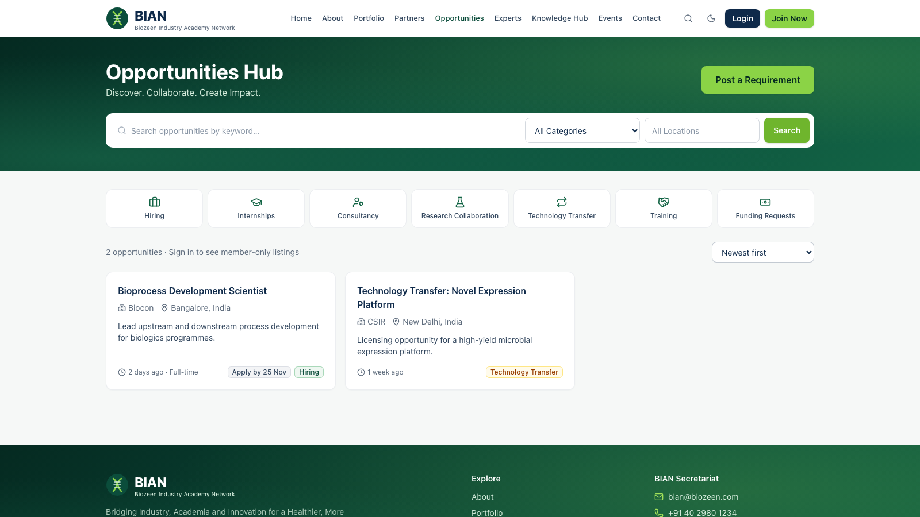
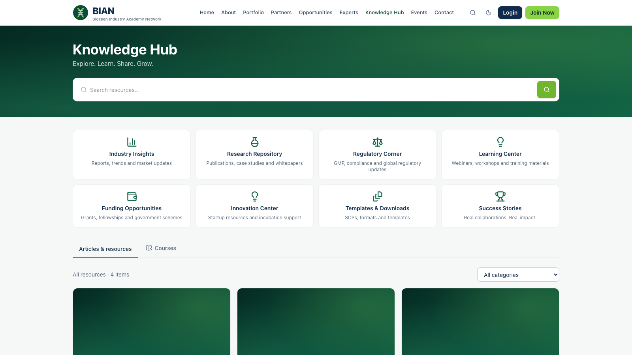
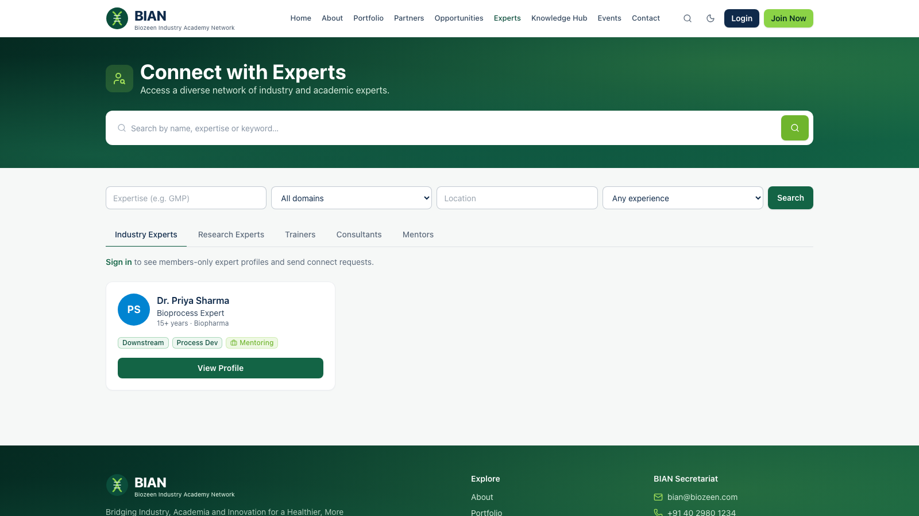
Visitors see what exists; members-only items say so
Opportunities Hub
Knowledge Hub
Experts Network
Jobs, internships, funding and technology transfer
Insights, research, regulatory corner and courses
Public expert profiles with skills and availability
Notes:
Each listing has an audience: public, all members, selected roles, selected organisations or administrators only. The server applies this to lists, detail pages, search and file downloads alike.

Slide 7
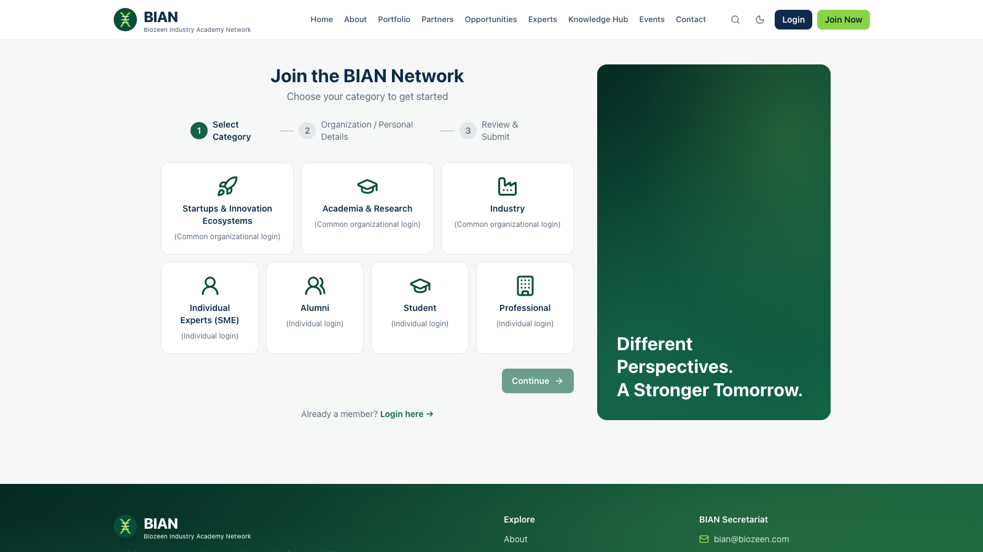
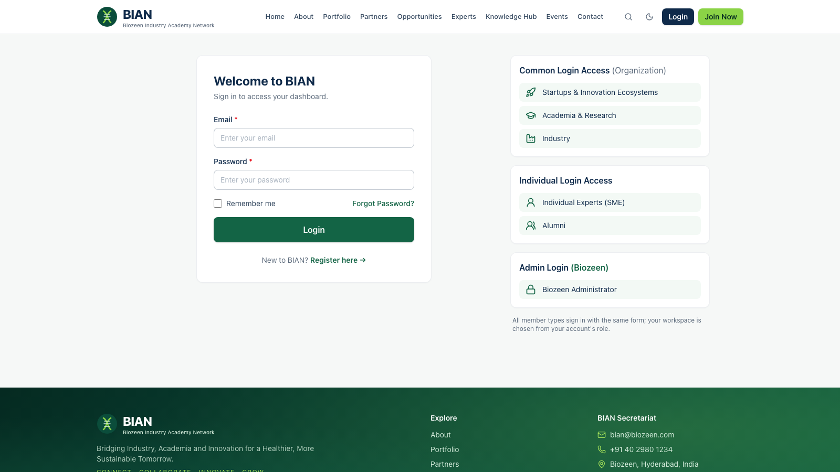
Joining: three steps, then verification and approval
1
2
3
4
5
Choose category
Add details
Review & submit
Verify email
Approved
Organisation or individual
Personal or organisation details
Accept terms and send
Link sent by email
Team reviews; member is notified
Optional sign-in code: a 6-digit code emailed after the password
Switched by LOGIN_OTP_ENABLED; email by EMAIL_ENABLED
Approval and verification can each be turned off
Notes:
Registration has the three steps from the design. Email verification and admin approval protect the network. With sign-in codes enabled, members enter a 6-digit emailed code after their password. It expires in 10 minutes and locks after 5 wrong tries. Until a mailbox is set up, email stays disabled and codes are written to the server log.

Slide 8
Members
Organisation members, individual members and experts
Notes:
Section: what each member category does on the platform.

Slide 9
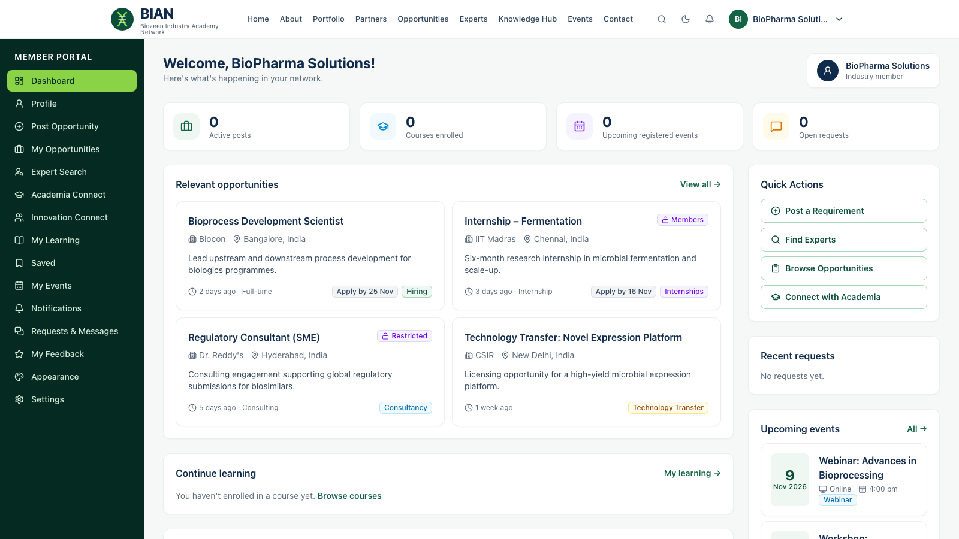
Organisation members work from one dashboard
For startups, academia and industry
Relevant opportunities, including members-only and category listings
Quick actions: post a requirement, find experts, connect with academia
Company profile feeds the public Partner Ecosystem once approved
Requests, events and learning in one place
Notes:
This is an industry member's dashboard. Badges such as Members and Restricted show listings that visitors can't open. The organisation's public profile appears in the Partner Ecosystem only after BIAN approves it.

Slide 10
Every category gets the Member role plus its own
Category | Signs in as | Roles on approval
Startups & Innovation Ecosystems | Organisation | Member + Startup & Innovation
Academia & Research | Organisation | Member + Academia & Research
Industry | Organisation | Member + Industry Member
Individual Experts (SME) | Individual | Member + Individual Expert
Alumni | Individual | Member + Alumni
Student | Individual | Member + Student
Professional | Individual | Member + Professional
Member lets everyone see members-only content, post opportunities for review and request expert introductions. The category role targets content at that group. Administrators can add or narrow roles at any time.
Notes:
Category and roles are separate. A student gets the Member and Student roles, so content can be aimed at students only, or at all members. Content can target any role or organisation.

Slide 11
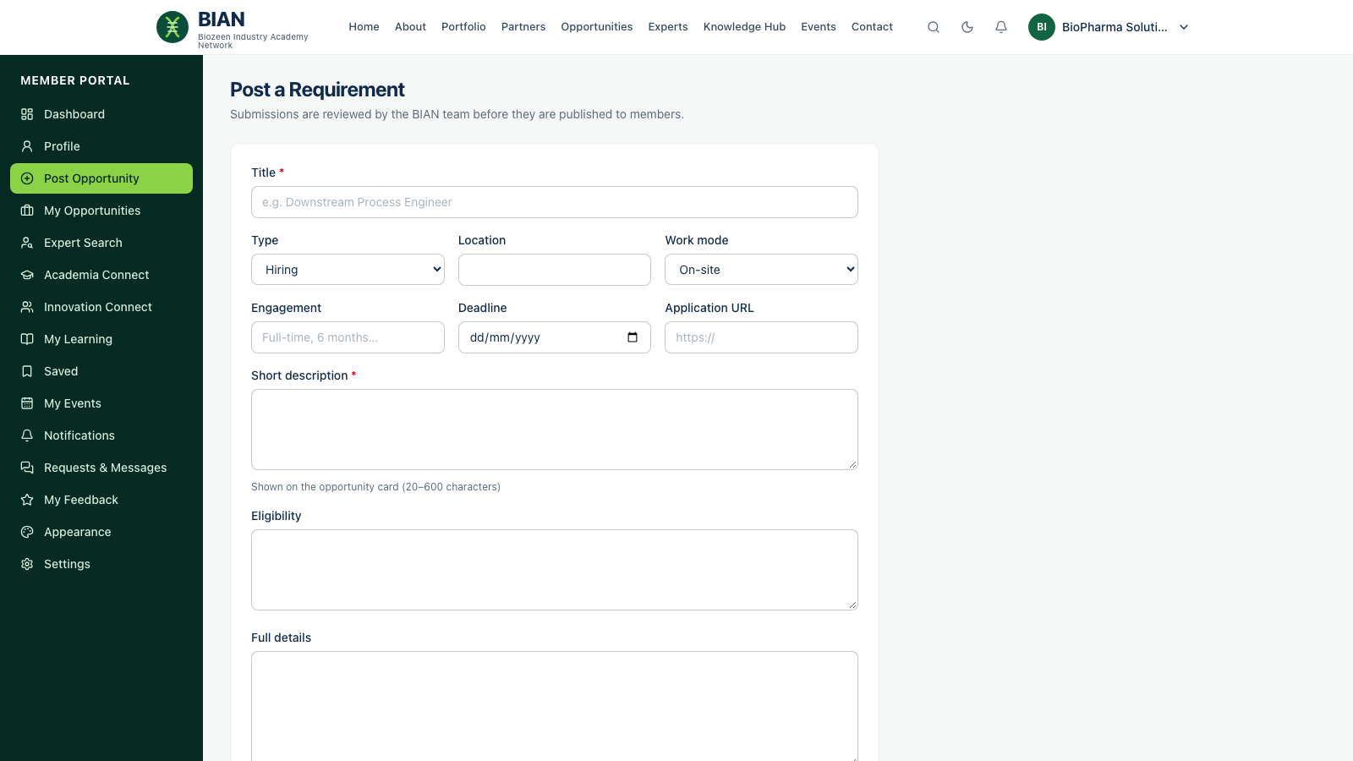




Member posts are reviewed before they go live
Member submits
Title, type, deadline, how to apply
Publishers notified
Live alert to everyone who can publish
Reviewed and published
Edited if needed, audience set
Everyone told
Submitter and the audience get a notification
Notes:
Member submissions never go live directly. They arrive as Pending review, publishers are notified in real time, and once published both the submitter and the target audience are notified.

Slide 12
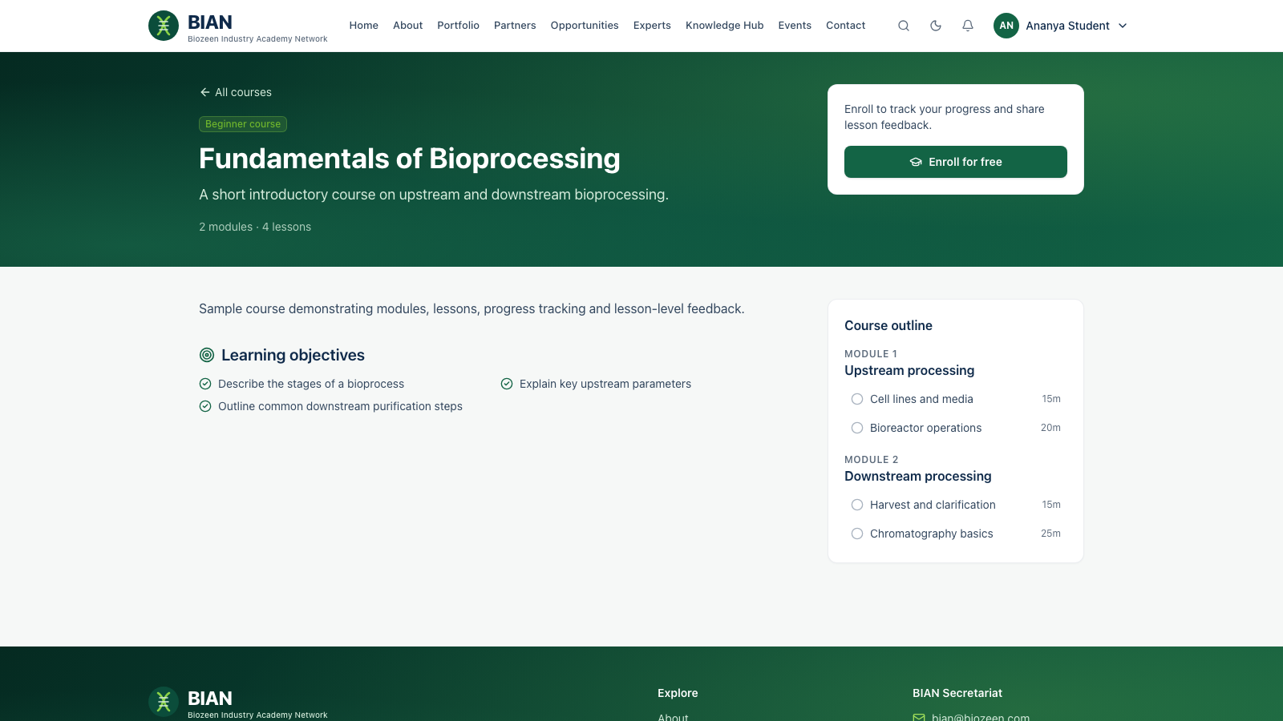
Students and individuals learn and track their progress
Courses with objectives, modules and lessons; free to enrol
Progress tracked lesson by lesson
Events: register; meeting links appear only after registering
Feedback on lessons, courses and events, optionally anonymous
Saved items and opportunity alerts
Notes:
Students and other individuals use the Knowledge Hub and courses. Lesson feedback goes into analytics that flag weak lessons for the content team.

Slide 13
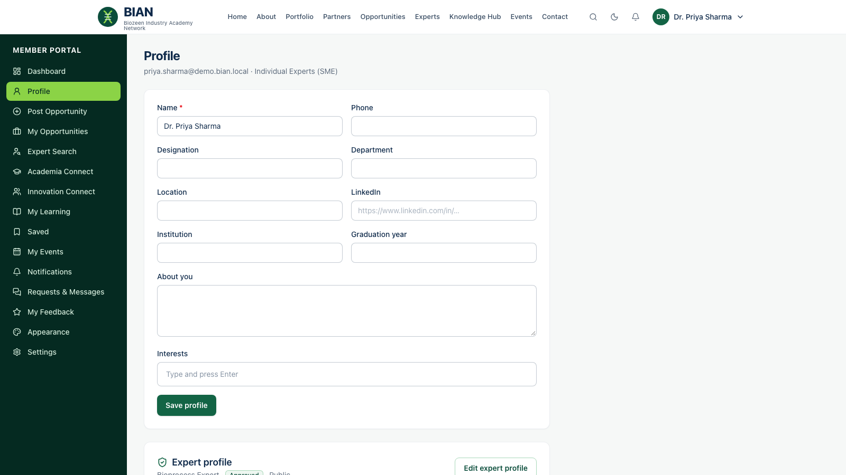
Experts control who sees them
Self-service profile: headline, skills, expertise, mentoring
Visibility: public, members only or hidden
Email shared only if the expert opts in
New profiles are reviewed; the expert is notified on approval
Connect requests go to the secretariat, protecting experts’ time
Notes:
Experts manage their own listing. Members request introductions with a purpose and message; the secretariat coordinates, so experts are never spammed directly.

Slide 14
Biozeen staff
Administrators, the content team and membership managers
Notes:
Section: the admin workspace and the staff roles that use it.

Slide 15
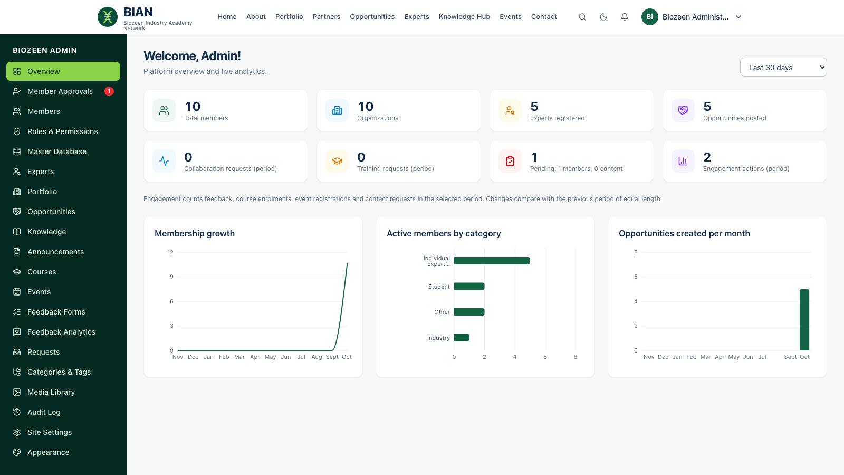
Administrators see the whole network at a glance
Live counts compared with the previous period
Charts: membership growth, members by category, opportunities
Badges for approvals, reviews and new requests
Roles & permissions: create roles from 16 permissions
Audit log of every change
Notes:
The Biozeen Administrator has every permission. Changing the period recalculates all figures. The platform always keeps at least one administrator and records every change in the audit log.

Slide 16
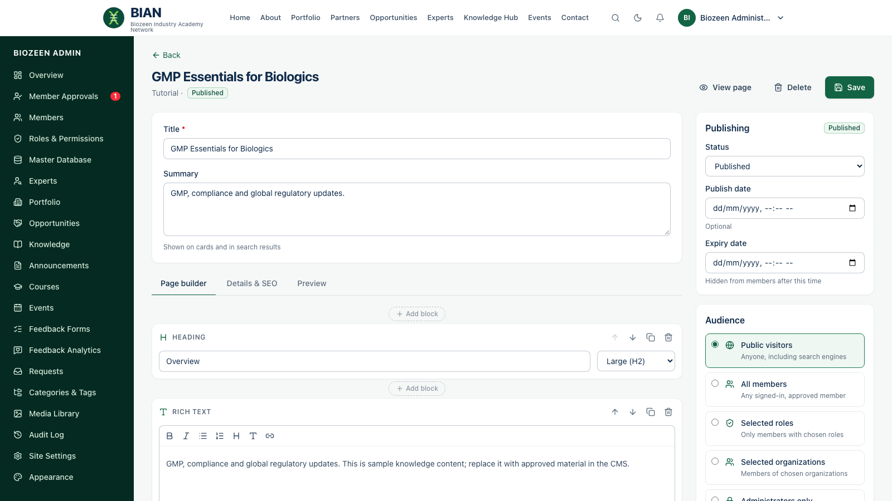
Content editors draft; publishers decide what goes live
Action | Editor | Publisher
Create and edit pages | ✓ | ✓
Build with 17 block types | ✓ | ✓
Submit for review | ✓ | ✓
Publish, schedule, archive | — | ✓
Delete | — | ✓
Every item has an audience, a publish and expiry date, and a preview before saving.
Notes:
The visual CMS lets the team build pages from blocks: headings, rich text, images, galleries, video, downloads, tables, FAQs, calls to action and inline feedback forms. Editors cannot publish. Their review requests notify publishers.

Slide 17
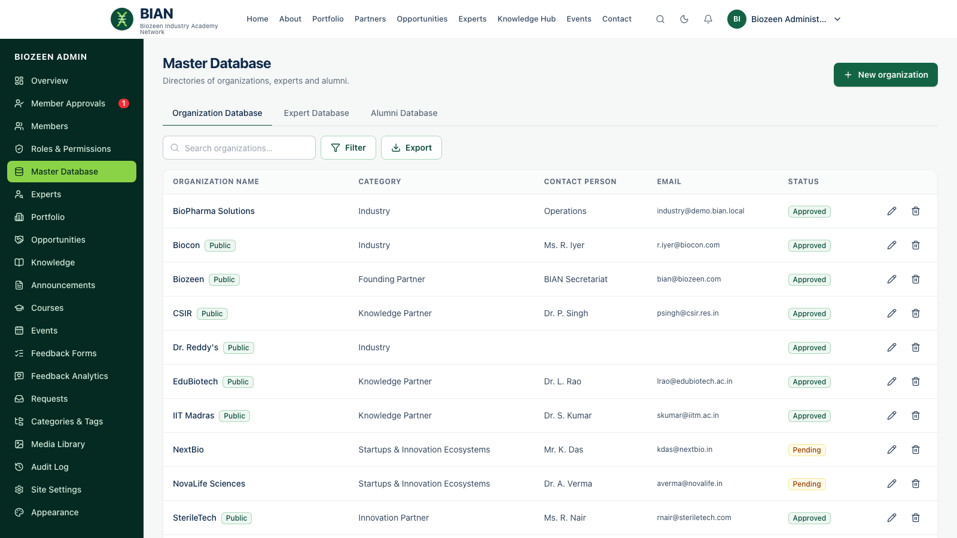
Membership managers handle approvals and records
Approvals with suggested roles by category
Members: edit roles, suspend (signs out at once), export CSV
Master Database: organisations, experts, alumni
Partner profiles go public only when approved
Notified of each new registration and expert profile
Notes:
Membership managers approve registrations and maintain the directories that feed the public Partner Ecosystem and Experts Network. Suspending a member ends their sessions and live connection immediately.

Slide 18
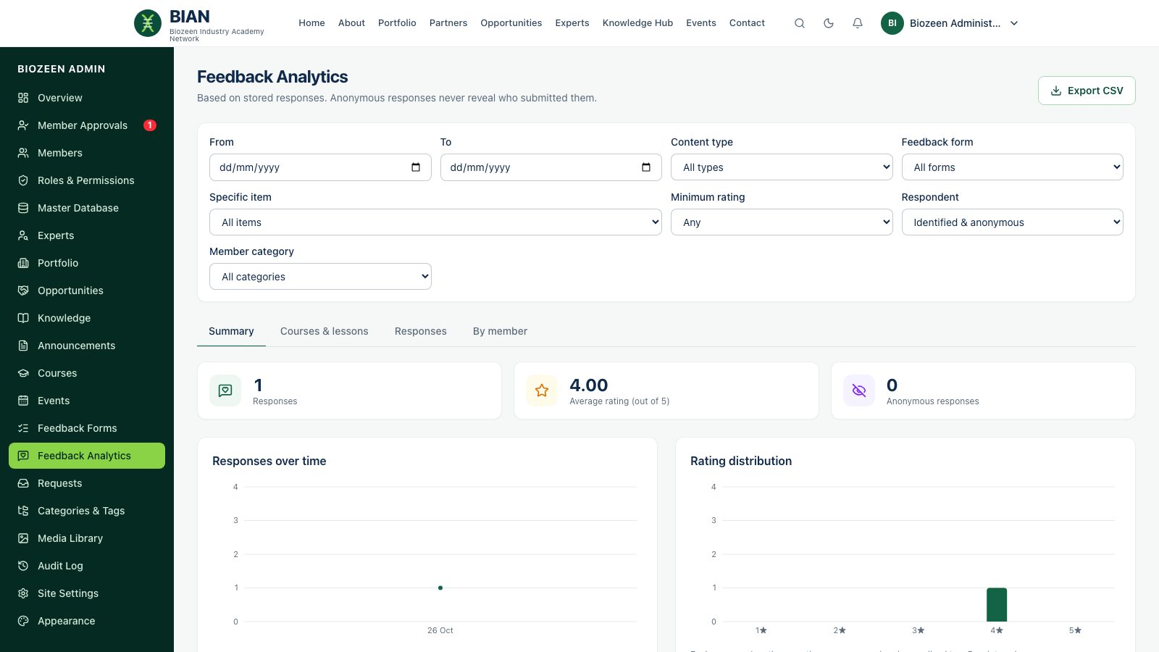
Feedback analytics show what works, lesson by lesson
Filter by date, item, form, rating, category
Trends and rating distribution
Courses & lessons: flags lessons rated below 3
Anonymous answers never reveal the sender
CSV export of filtered responses
Notes:
Feedback forms are versioned, so editing questions never corrupts earlier answers. Seeing who submitted identified feedback needs its own permission.

Slide 19
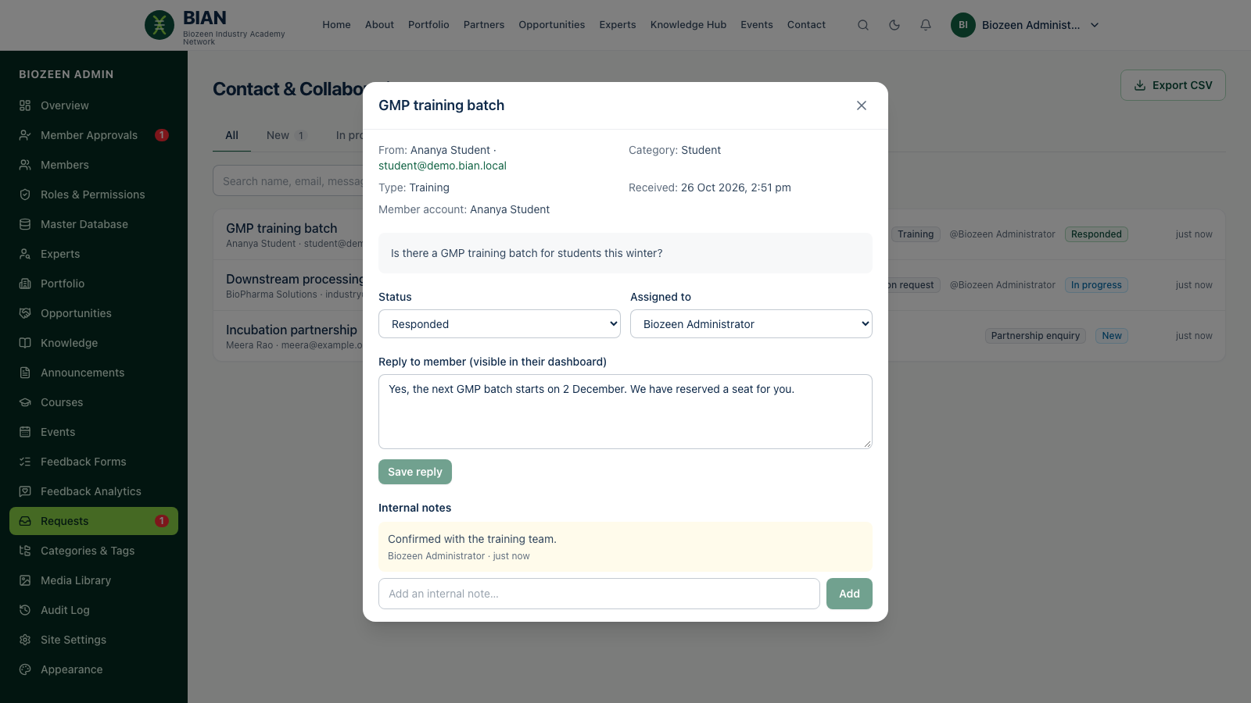
Every request is tracked from first message to reply
Contact, collaboration, partnership and expert-connect requests
Status new → in progress → responded → closed
Assign to a colleague; internal notes stay private
Replies appear in the member’s portal instantly
Notes:
Each request arrives as a live notification. Clicking it opens the request directly. Replies reach the member in real time.

Slide 20
Across the platform
Notifications, appearance, security and setup
Notes:
Section: features shared by every role.

Slide 21
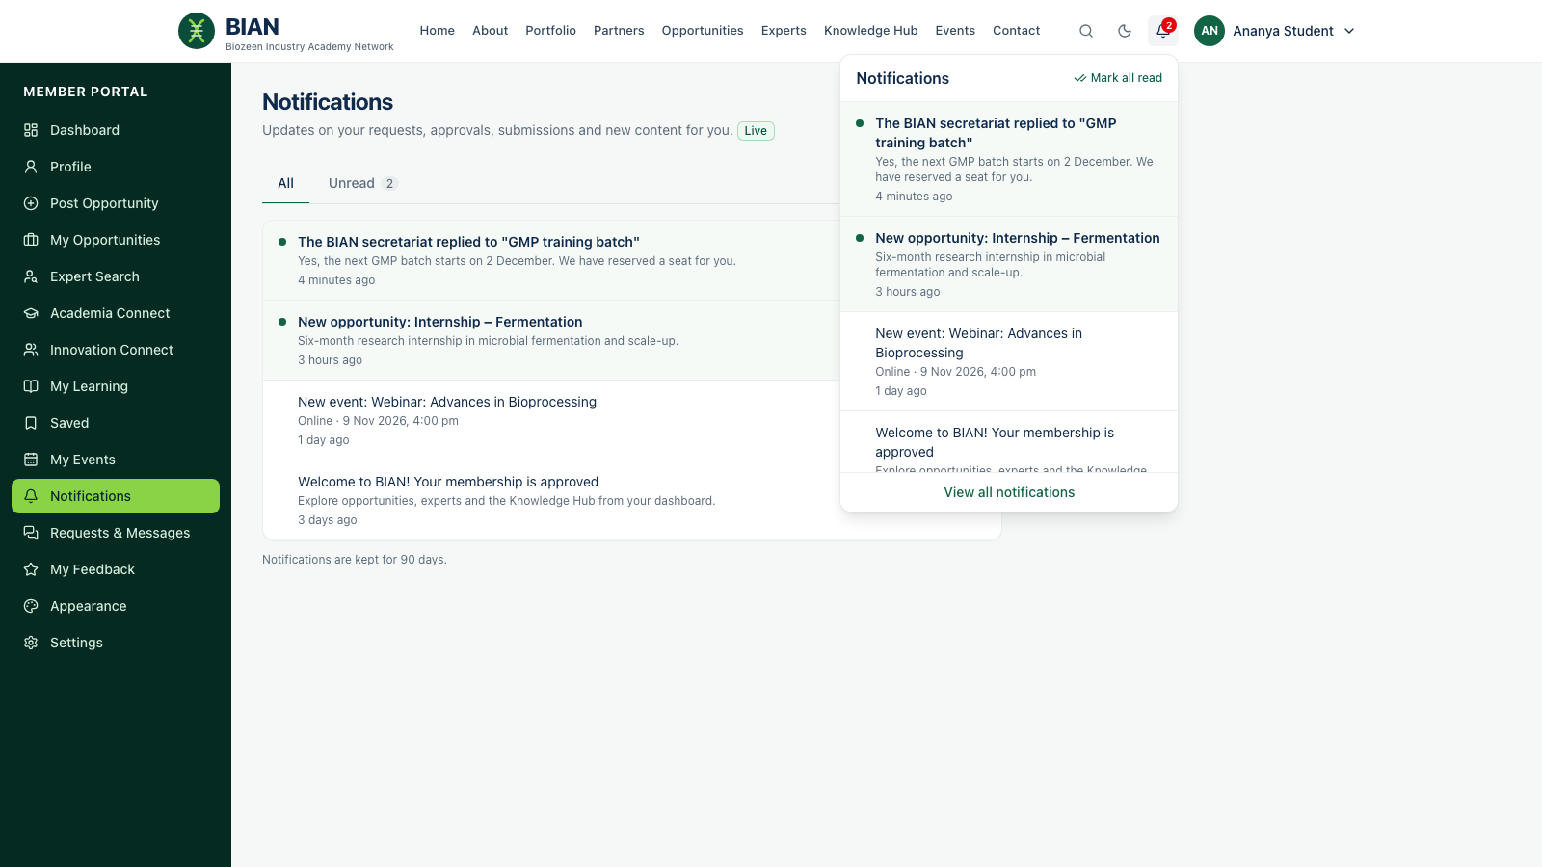
Notifications arrive live for every role
When… | Who is told
Membership approved | The new member
Request replied to | The member who asked
Submission published | The submitter
Announcement, opportunity, event | Its audience
New registration | Membership staff
New request | Request handlers
Item awaiting review | Publishers
Notes:
A bell with an unread badge sits in the header for every signed-in user. New notifications pop up instantly over a secure live connection that uses the same session as the site. They are kept for 90 days.

Slide 22
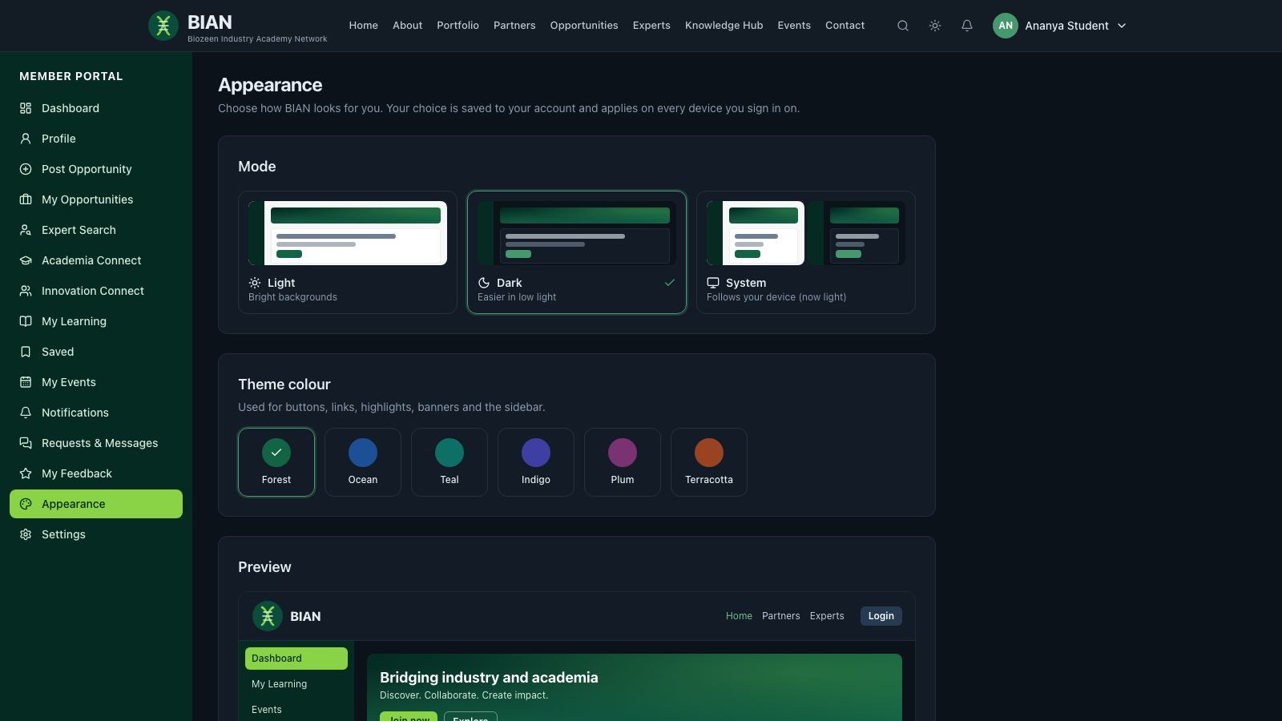
Each user picks a theme colour and light or dark mode
6 theme colours, Forest by default
Light, dark or system mode
Live preview before applying
Saved to the account: follows the user to any device
One-click light/dark toggle in the header
Notes:
Appearance is a per-user setting under Dashboard → Appearance. The whole interface, including charts, re-colours from the same design tokens, so dark mode is designed rather than inverted.

Slide 23






Access is enforced on the server, not just in the UI
Audiences on every item
Publication states
Public, members, roles, organisations or admins, applied to lists, search and files
Draft to archived, with scheduled publish and expiry
Sessions
Sign-in codes
httpOnly cookies, re-checked on every request; suspension takes effect at once
Optional emailed 6-digit code, rate-limited and single-use
Protected files
Anonymous feedback
Downloads follow the access of the page that uses them
Stores no identity, even for administrators
Notes:
The interface only reflects the rules; the API enforces them. 26 automated tests cover audience filtering, publishing rights, session revocation, protected files, feedback privacy, sign-in codes and notifications.

Slide 24


A new machine is ready with one command
Move the data
Switch features on
npm run db:export saves every collection and uploaded file to db/data
Commit db/data; on the new machine run npm run db:import
Or just start the server: an empty database fills itself from db/data, or from sample data
EMAIL_ENABLED + SMTP_* sends real emails; off = written to the log
LOGIN_OTP_ENABLED requires a sign-in code
REQUIRE_APPROVAL / _EMAIL_VERIFICATION control joining
AUTO_INIT_DB fills an empty database on first start
Notes:
This solves the missing-data problem when setting up on a different machine. The export uses MongoDB Extended JSON, so IDs and dates keep their types. All behaviour switches live in server/.env.

Slide 25
Before launch
Replace sample content and logos
Change the demo passwords
Connect a mailbox, then decide on sign-in codes
Review roles and permissions
Schedule database and upload backups
Notes:
The platform is functionally complete. Going live needs approved content in place of the sample data, real logos, a configured mailbox, production secrets and backups of the database and uploads. Role-by-role user guides are in docs/user-guides.

