Slide 1
BACHELOR'S THESIS DEFENSE
Forecasting Hourly PM2.5
in the Munich Region
A Champion/Challenger Framework for Feature-Group Importance
and a COVID-19 Counterfactual Analysis
Sanjal More
TUM School of Management — Bachelor's Thesis in Management & Technology
Supervisor: Zhenyu Wang │ Examiner: Prof. Ziyue Li

Slide 2
AGENDA
What We'll Cover Today
01
02
03
04
Motivation
Research Questions
Methodology
Results
Why PM2.5 forecasting matters — and the gap in the literature.
Two research questions this thesis sets out to answer.
Data, features, models, and a rigorous 3-phase framework.
Champion model, RQ1/RQ2 findings, contributions — and honest limitations.
1

Slide 3
01
SECTION 01
MOTIVATION
Why PM2.5 forecasting matters — and the gap in the literature

Slide 4
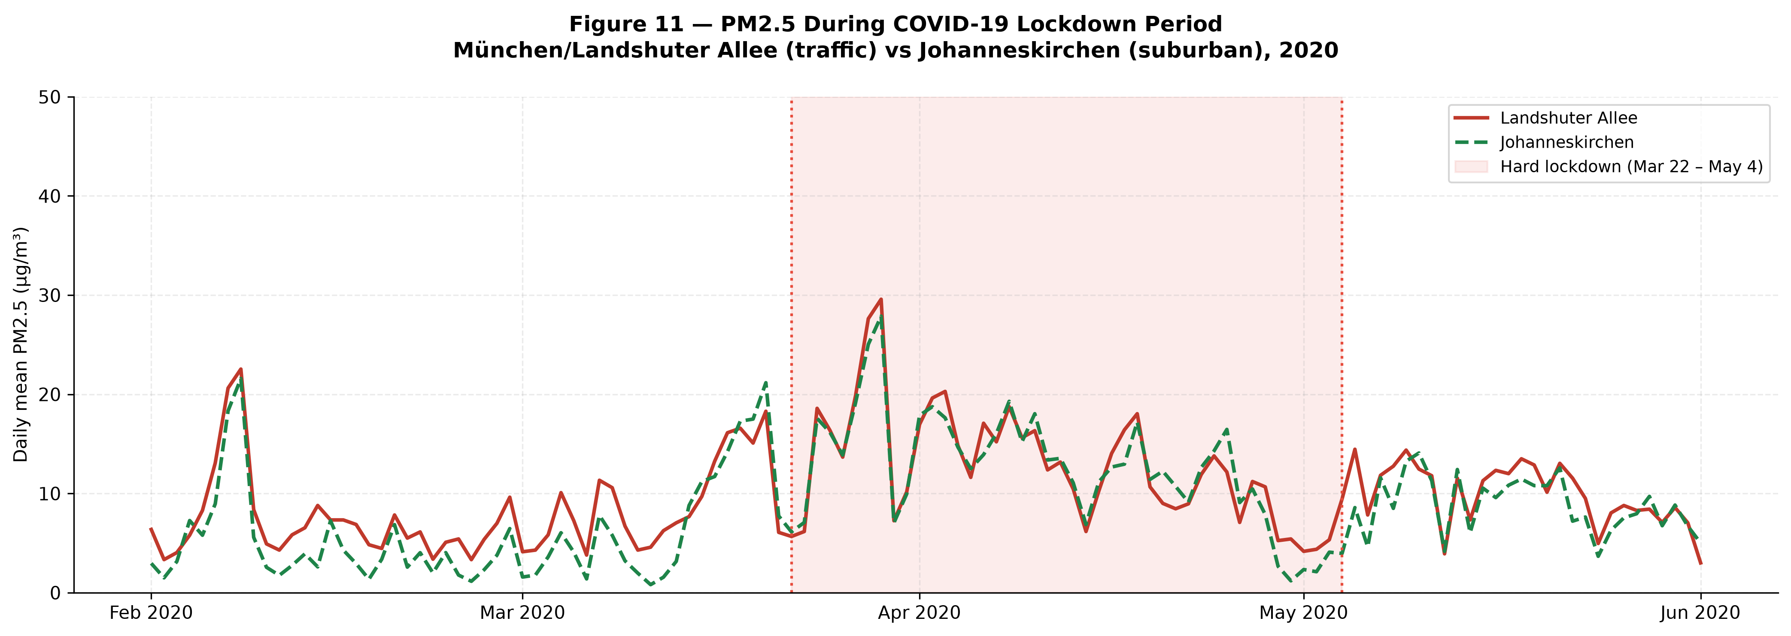
MOTIVATION
Why This Matters
PM2.5 is one of the leading global environmental health risks (WHO) — linked to respiratory and cardiovascular disease and premature mortality.
The Munich region: high population density, mixed emission sources (traffic, heating, industry), and a well-established monitoring network — a strong case study.
Accurate forecasting enables early warnings, policy evaluation, and targeted mitigation.
The literature gap: feature-group importance is rarely compared across model families under one controlled framework — and lockdown effects are rarely framed as a recursive counterfactual forecasting problem.
PM2.5 dropped sharply during the 2020 lockdown — the real-world signal motivating RQ2's counterfactual design.
2

Slide 5
02
SECTION 02
RESEARCH QUESTIONS
Two research questions this thesis sets out to answer

Slide 6
RESEARCH QUESTIONS
Two Research Questions
RQ1
RQ2
Which feature groups matter most for PM2.5 forecasting?
Can a recursive counterfactual quantify the COVID-19 lockdown's effect on PM2.5?
PM2.5 history · Co-pollutants · Meteorology · Temporal/calendar — tested via leave-one-group-out ablation (ΔMAE%) across 5 models and 7 stations.
Validated models are rolled forward through the lockdown window using their own predictions — a genuine counterfactual, not a simple before/after comparison.
3

Slide 7
03
SECTION 03
METHODOLOGY
Data, features, models, and a rigorous 3-phase framework

Slide 8
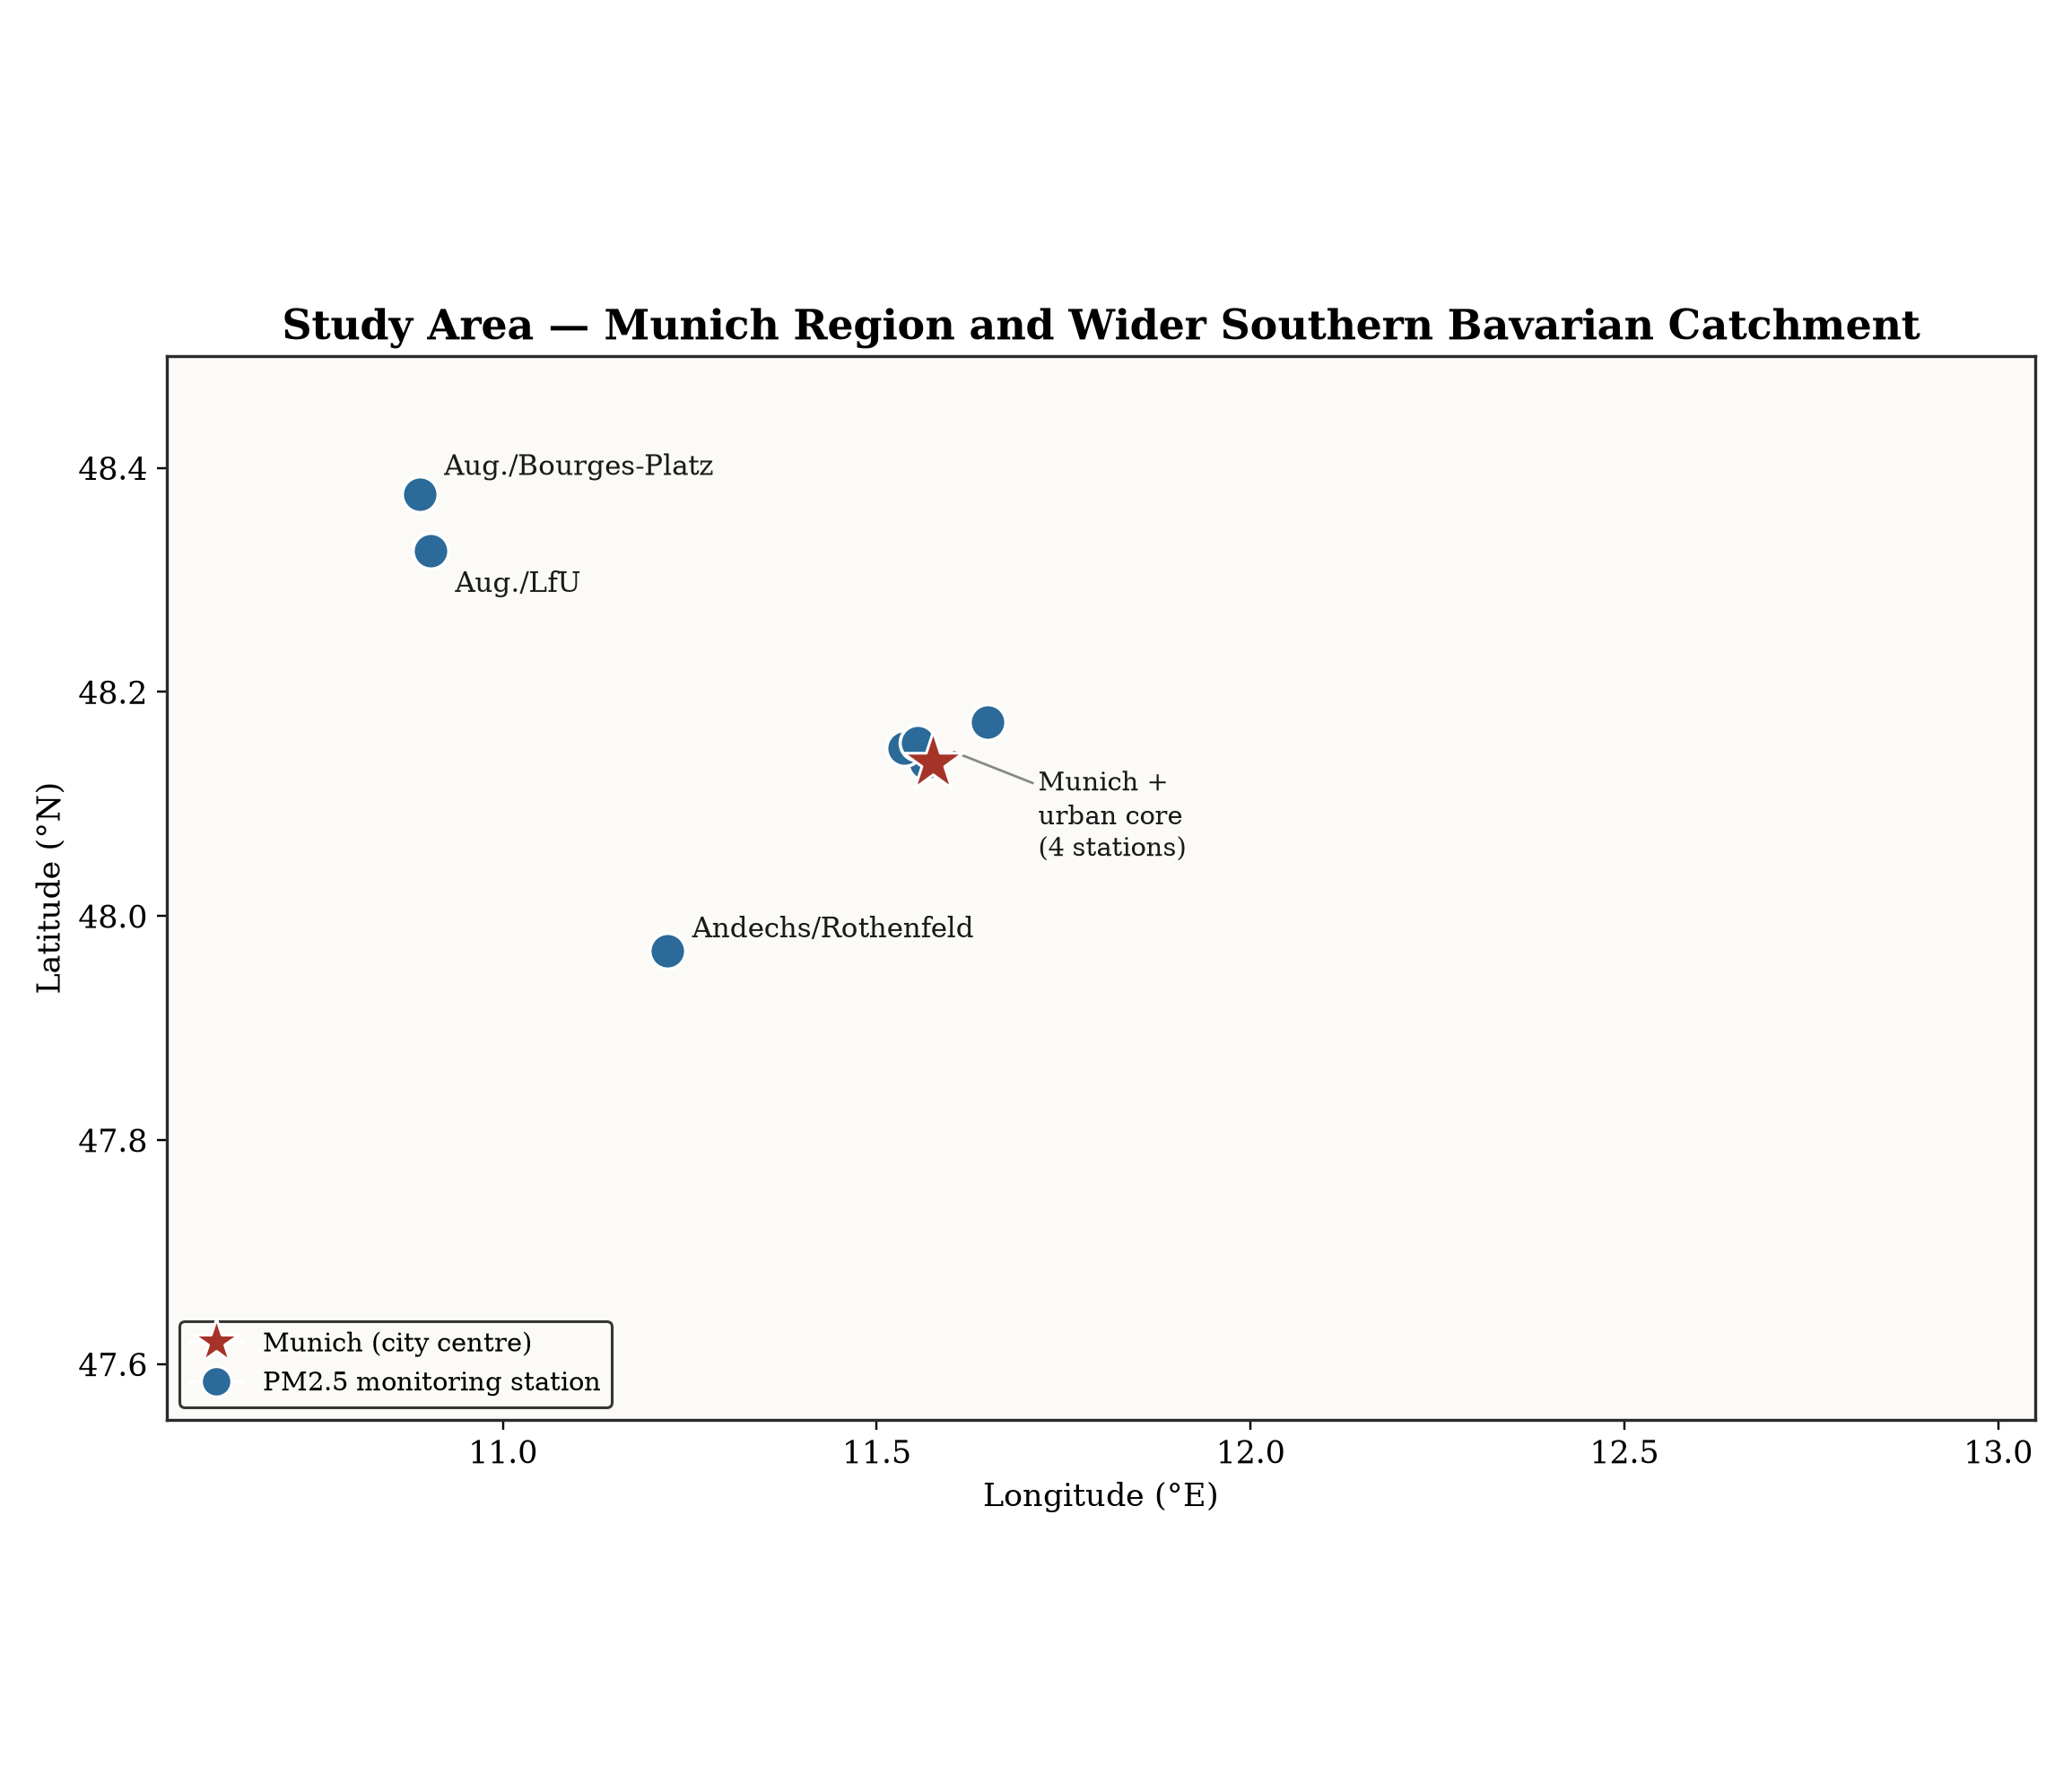
METHODOLOGY
Study Area & Data
Hourly UBA/DWD observations, 2019–2024 (6 years)
7 Munich-region stations — final scope, supervisor-confirmed
Station
Distance from ref.
München/Landshuter Allee
reference station
München/Stachus
2.5 km
München/Lothstraße
1.5 km
München/Johanneskirchen
8.7 km
Andechs/Rothenfeld
30.2 km
Augsburg/Bourges-Platz
~51 km
Augsburg/LfU
~55 km
4

Slide 9
METHODOLOGY
36 Engineered Features, Five Categories
PM2.5 Lags
Recent own-pollutant history at multiple horizons — the single strongest predictor group.
1
Rolling Statistics
Smoothed trends and local variability over sliding time windows.
2
Co-pollutants
NO2, O3, PM10, SO2 — co-measured at the same station.
3
Meteorology
Temperature, wind, humidity, pressure — DWD station 03379.
4
Temporal / Calendar
Hour-of-day, day-of-week, and seasonality encodings.
5
5

Slide 10
METHODOLOGY
Six Models, Three Architecture Families
Tree-Based Ensembles
Sequence Models
Baseline
CatBoost
DLinear
Persistence
XGBoost
PatchTST (adapted)
LightGBM
Identical hyperparameters across all three — for a fair comparison.
PatchTST is modified to accept covariates via concatenation before the linear head.
Naive last-value carry-forward — the floor every model must beat.
6

Slide 11
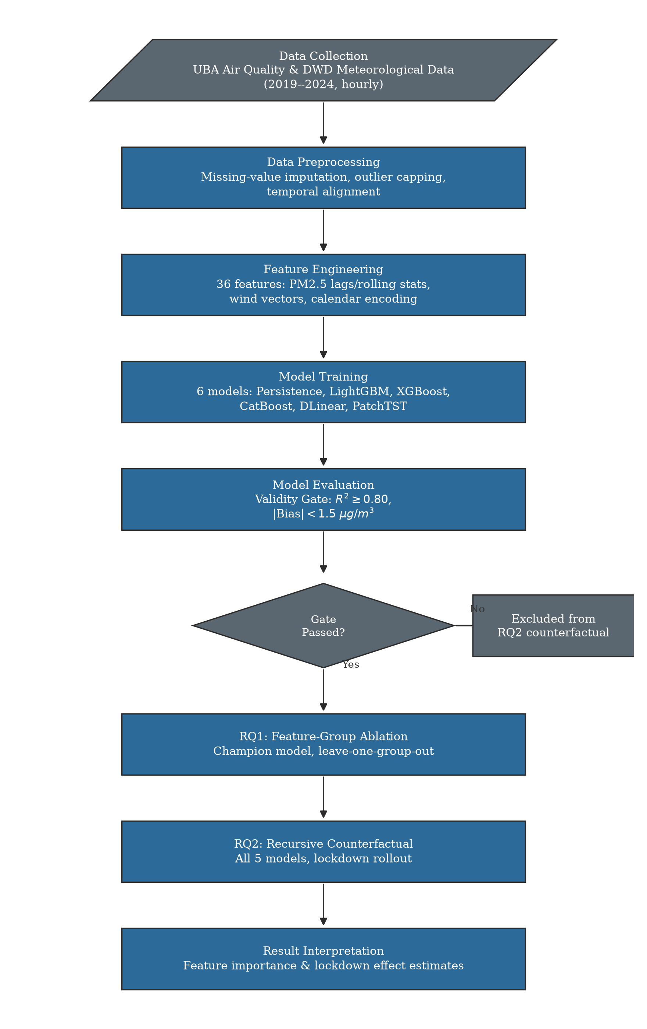
METHODOLOGY
A Three-Phase Experimental Framework
1
Champion/Challenger Benchmark
All 6 models compared under identical conditions, gated by the Validity Gate (R²≥0.80, |Bias|<1.5).
RQ1
Feature-Group Ablation
Leave-one-group-out ablation quantifies each feature group's contribution (ΔMAE%).
RQ2
Recursive Counterfactual
Validated models roll forward through the lockdown window on their own predictions.
Rigor: strict chronological train/test split (no shuffling). Models must pass the Validity Gate before being trusted for counterfactual extrapolation.
7

Slide 12
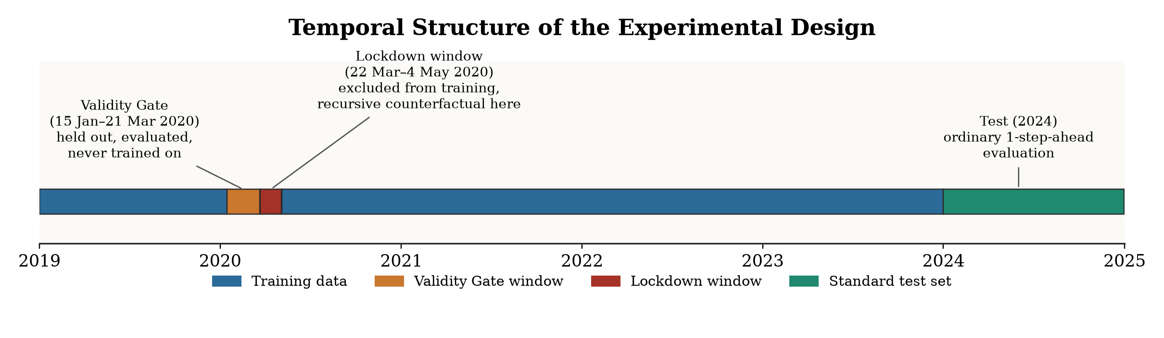
METHODOLOGY
Chronological Split & the Validity Gate
43,824 h
8,784 h
R² ≥ 0.80
|Bias| < 1.5
Training window
Test window
Validity Gate threshold
µg/m³ threshold
8

Slide 13
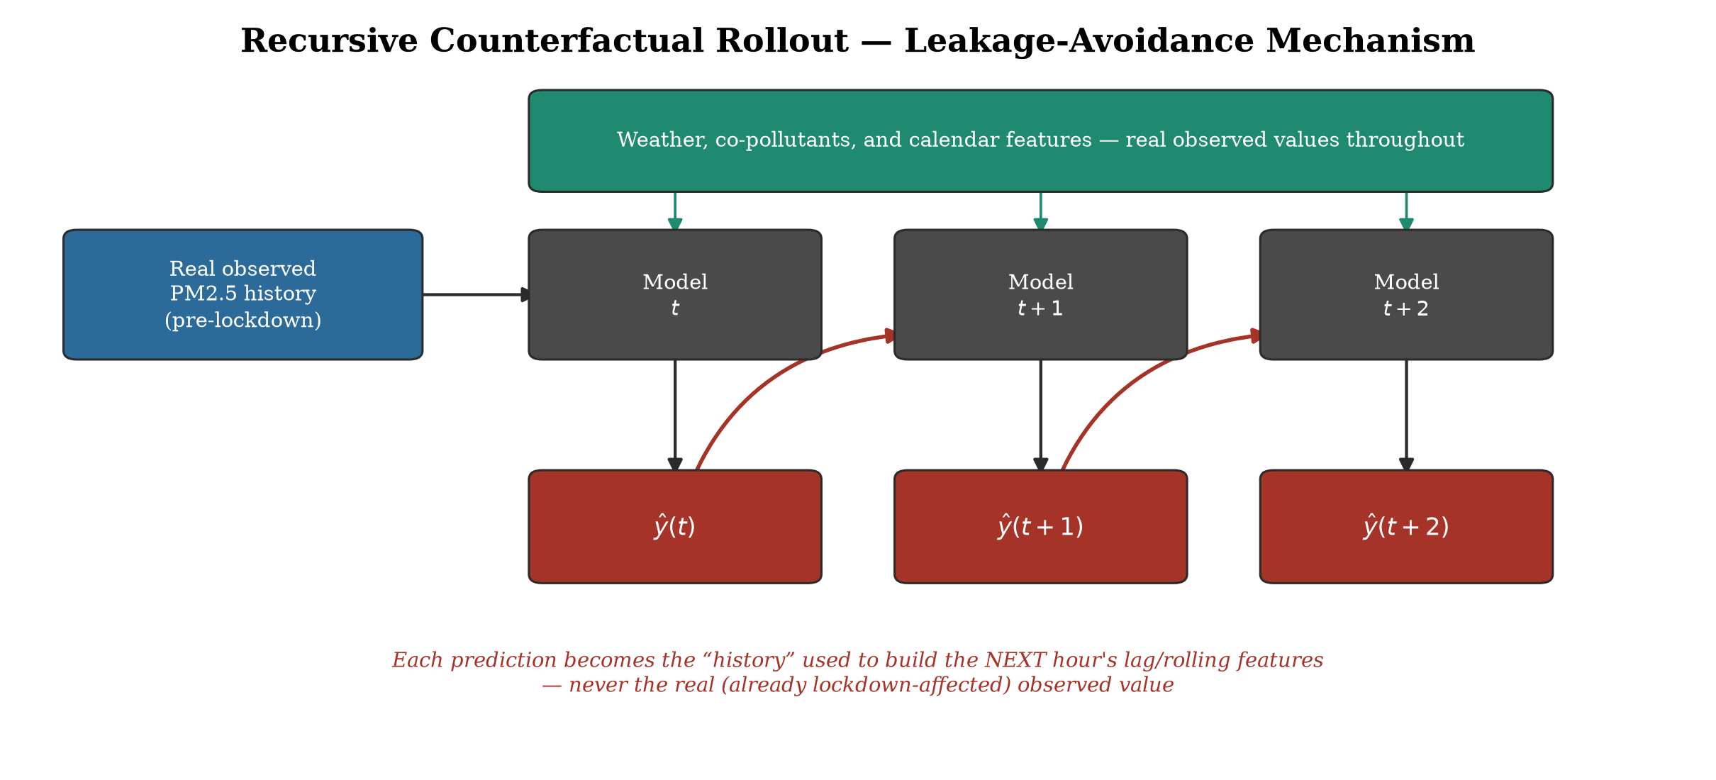
METHODOLOGY
RQ2 Method: Recursive Counterfactual Rollout
Roll the validated model forward through the lockdown window using its own predictions, not real lockdown observations.
Avoids mechanically shrinking the estimated effect toward zero.
Gated by Phase 1's Validity Gate — only trustworthy models are extrapolated.
Gap = counterfactual (no-lockdown) prediction minus observed lockdown-period PM2.5.
9

Slide 14
04
SECTION 04
RESULTS
Findings, contributions, and honest limitations

Slide 15
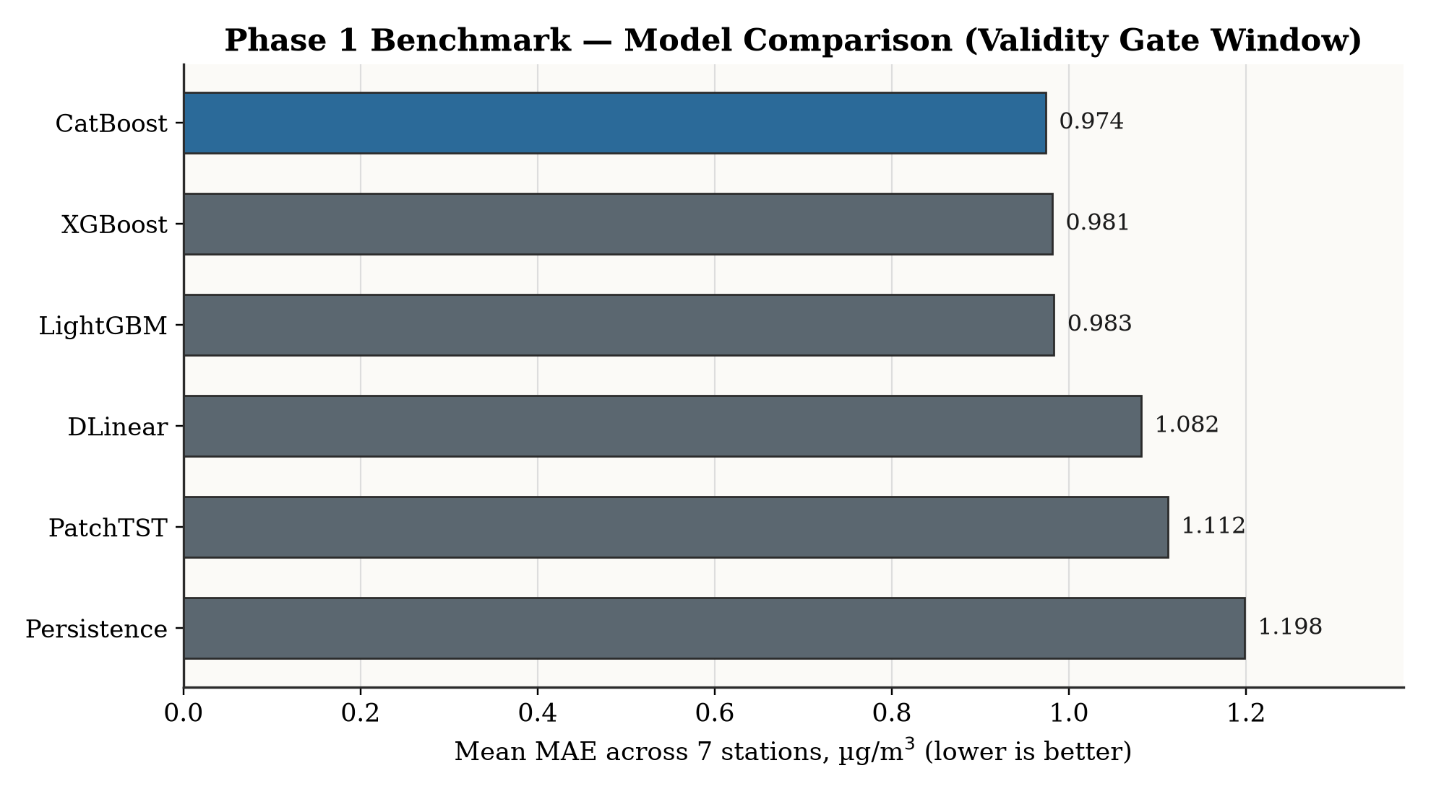
RESULTS
Champion Model: CatBoost
R² = 0.9537
Champion — CatBoost
CatBoost
0.9537
XGBoost
0.9532
LightGBM
0.9531
DLinear
0.9448
PatchTST
0.9436
Persistence
0.9180
Architecture class — not tuning — drives the hierarchy: trees > sequence models > persistence.
10

Slide 16
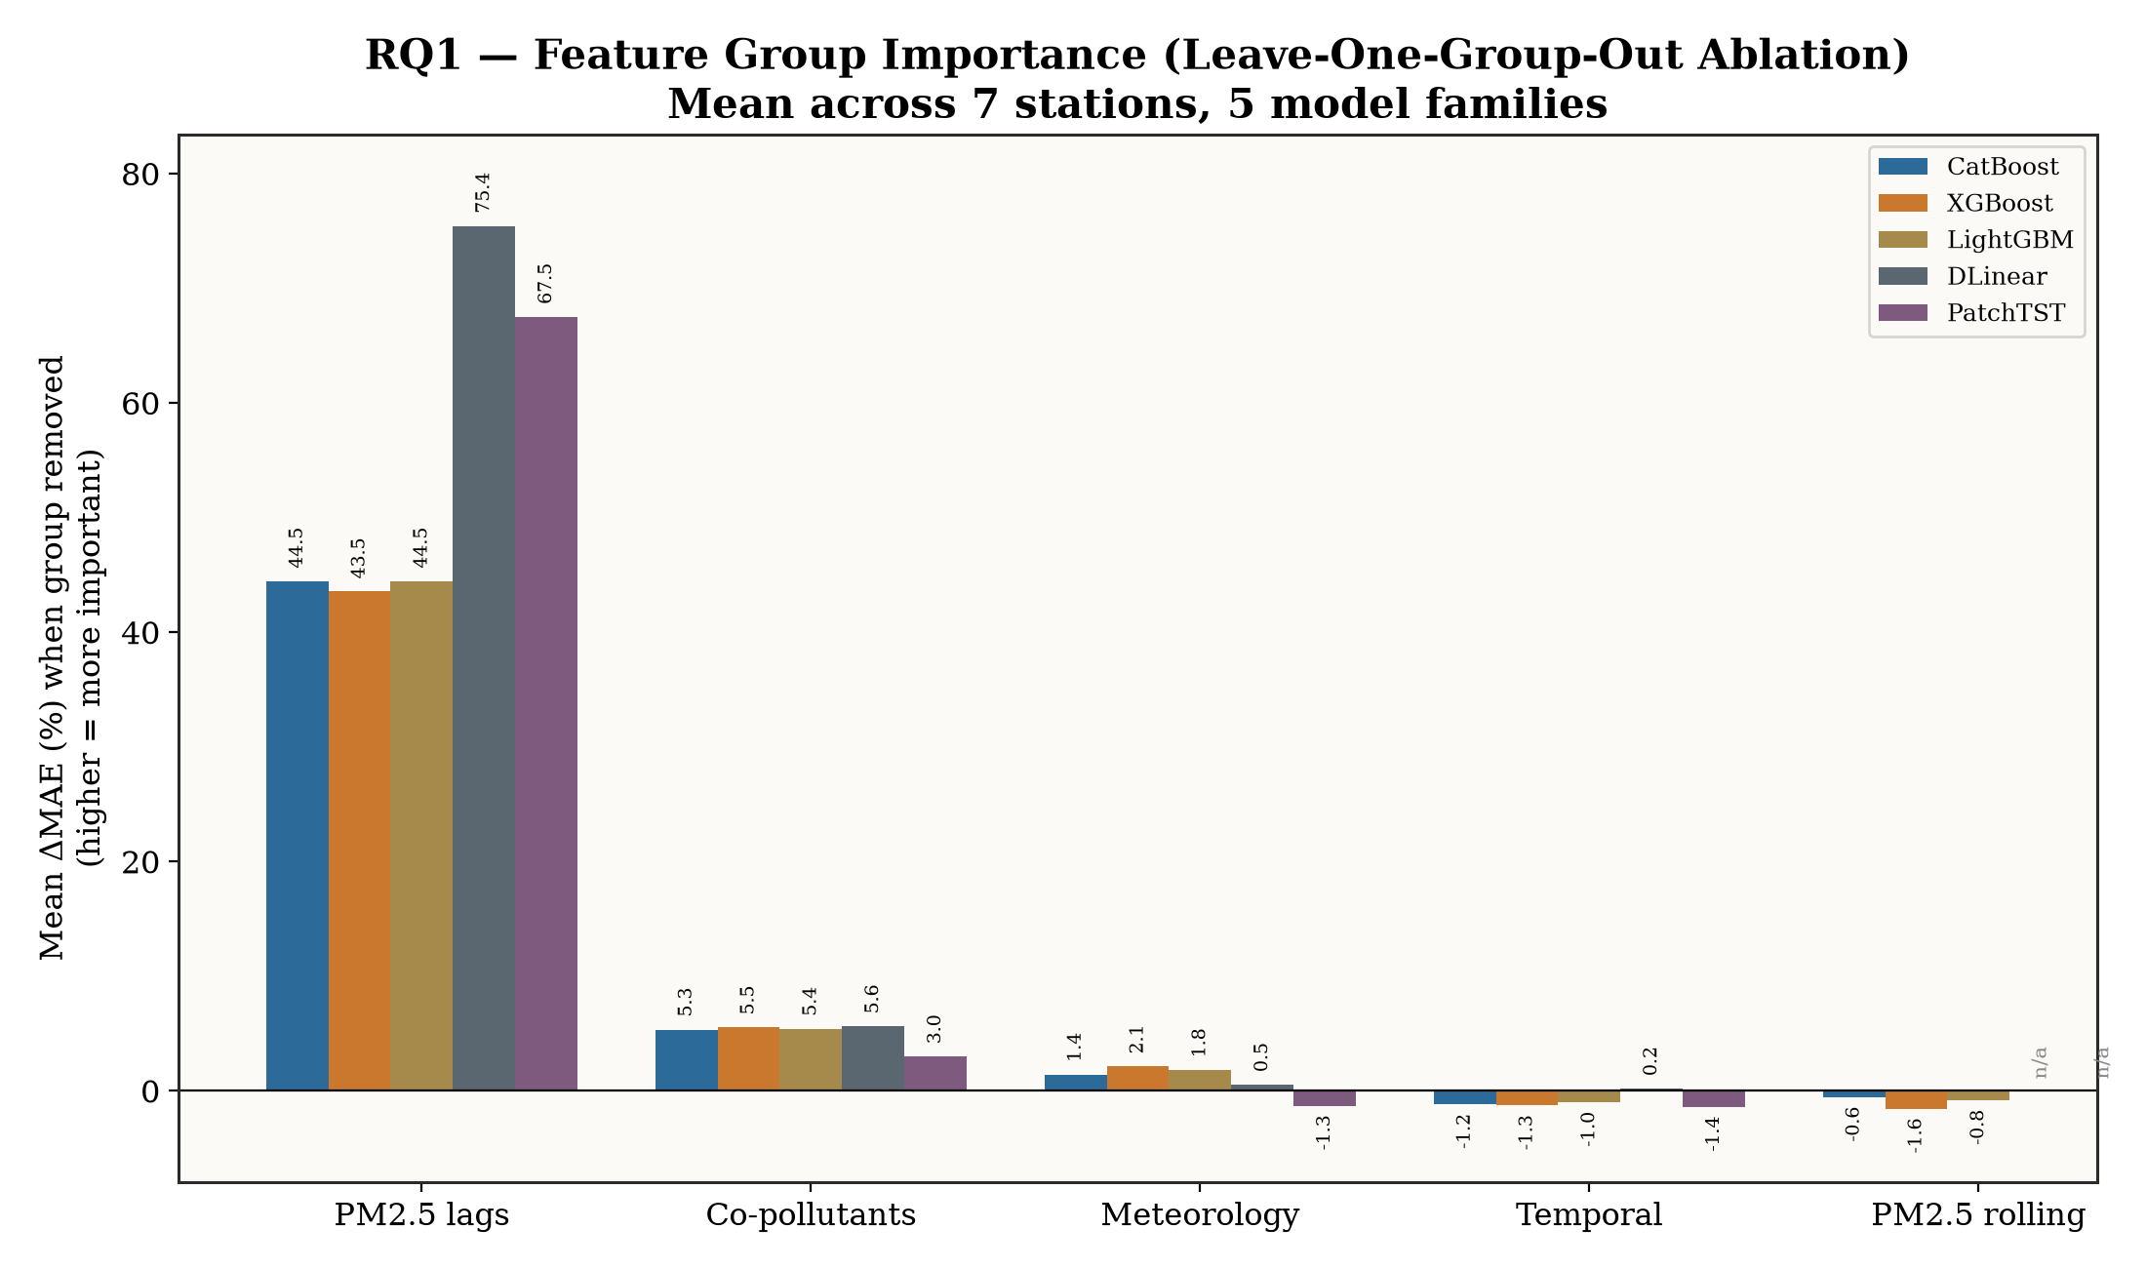
RESULTS
RQ1: PM2.5 History Dominates — Asymmetrically
PM2.5 history dominates everywhere — but far more for sequence models (~67–75%) than tree models (~44%).
A genuine architectural asymmetry: trees exploit auxiliary features via explicit splitting; sequence models can't reconstruct dynamics from environment alone.
Co-pollutants and meteorology contribute a modest, secondary signal.
11

Slide 17
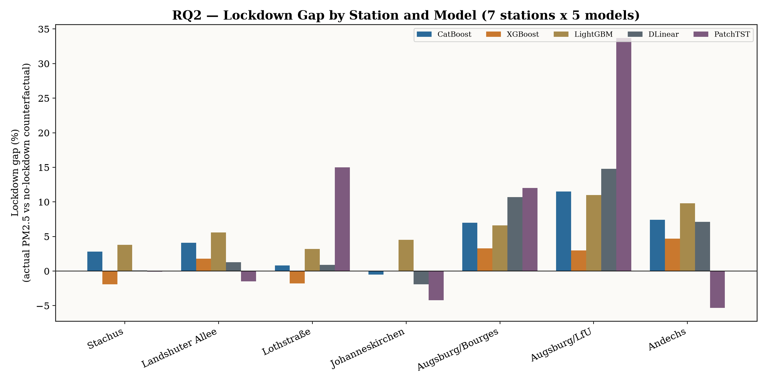
RESULTS
RQ2: A Real but Spatially Uneven Lockdown Effect
74%
+14.8%
−0.4%
of 35 runs (7 stations × 5 models) show a positive lockdown effect
strongest — Augsburg/LfU
weakest — Johanneskirchen (only 1 of 5 models agree)
12

Slide 18
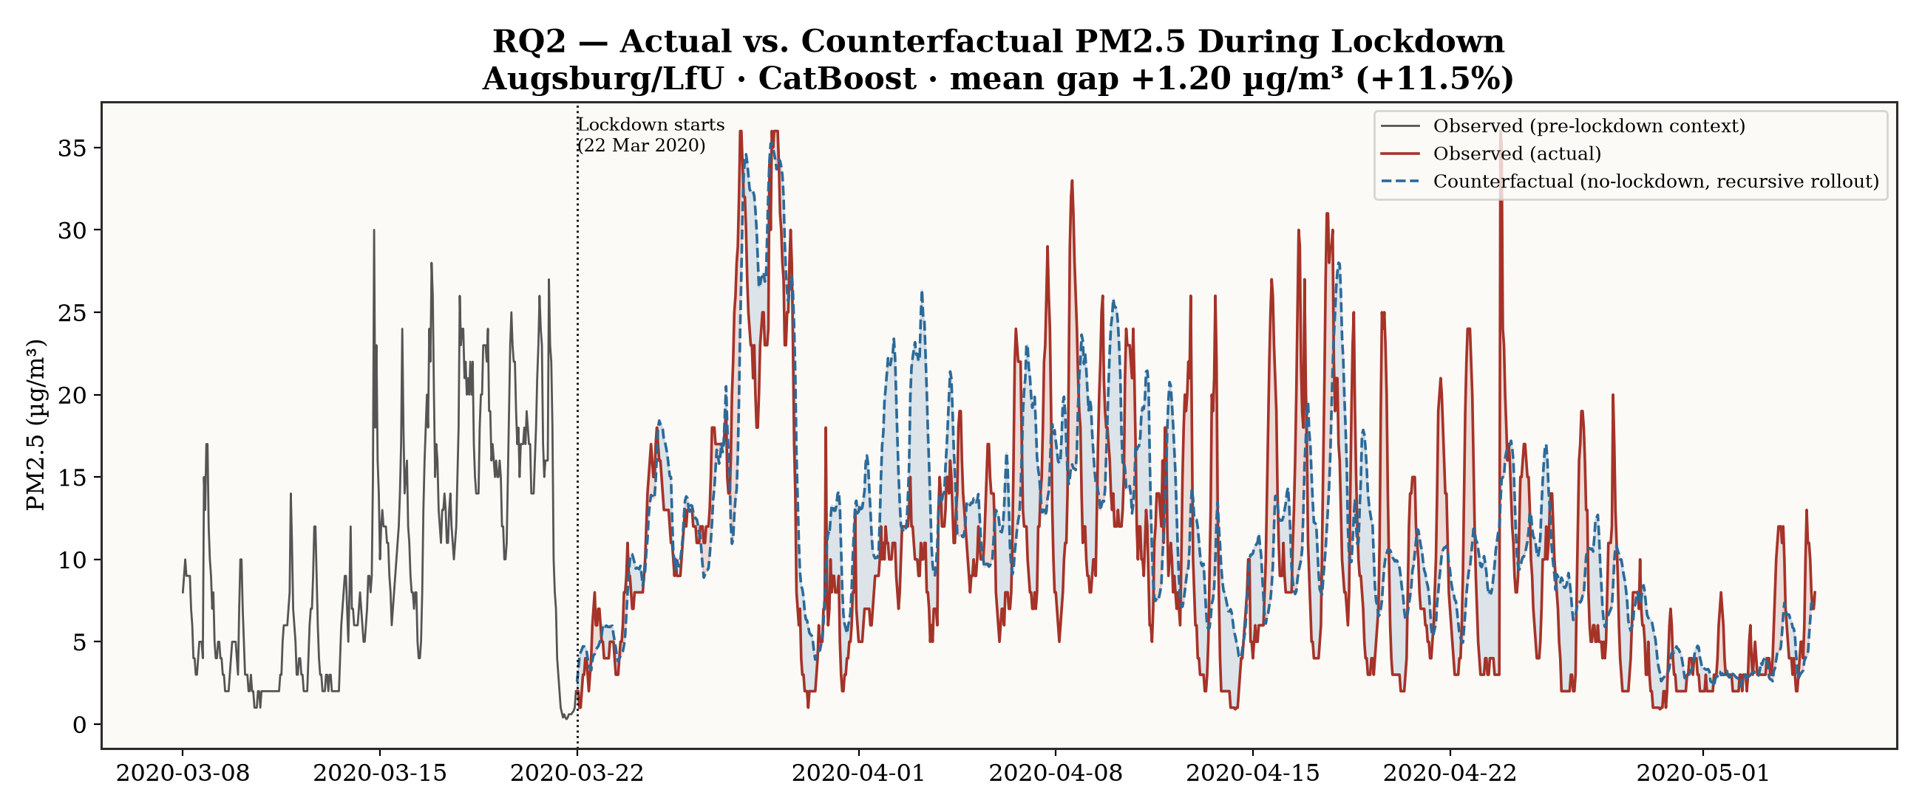
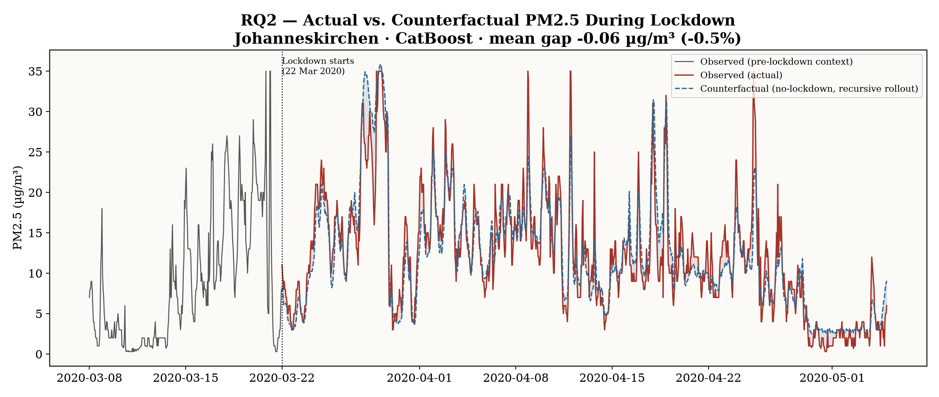
RESULTS
Illustrative Examples (CatBoost)
Augsburg/LfU: +1.20 µg/m³ (+11.5%)
Johanneskirchen: −0.06 µg/m³ (−0.5%)
The counterfactual gap tracks local traffic exposure vs. background-transport dominance.
13

Slide 19
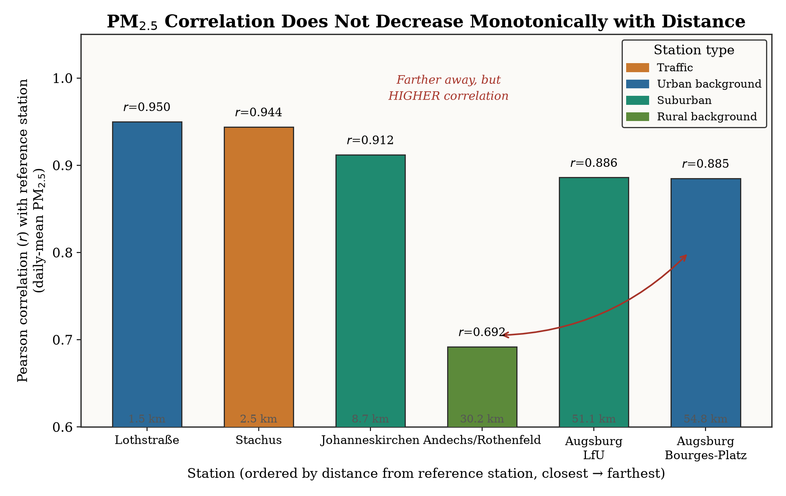
RESULTS
Beyond the Headline Numbers
1
A real negative finding
PatchTST's weaker performance isn't undertraining — 100 epochs was worse than 30 (R² 0.944→0.941). Rules out a common reviewer critique.
2
A methodological contribution
Correlation with distance is non-monotonic — rural Andechs correlates more weakly than distant Augsburg. A defensible, evidence-backed argument for station-selection criteria beyond raw proximity.
3
Honesty as rigor
Preprocessing leakage measured at ≤2.4% (negligible) and disclosed, not hidden. PM2.5>PM10 inconsistencies characterized, not silently filtered. Recursive-rollout error accumulation named explicitly as a property of the method.
Correlation vs. distance: station environment type matters more than raw proximity.
14

Slide 20
RESULTS
Limitations — Named, Not Hidden
Limitations
Future Work
7-station scope — a deliberate, defensible trade-off under time constraints, supervisor-confirmed.
No formal significance testing on RQ2 gaps — a single lockdown event, point estimates only.
Recursive-rollout error compounding — disclosed, not hidden, and examined against the RQ2 results.
Statistical significance testing for the RQ2 lockdown gap.
Extending the station network beyond the current 7 stations.
Testing the framework on other policy-relevant events.
15

Slide 21
CONCLUSION
Both Research Questions Answered
RQ1
Answered: Yes.
RQ2
Answered: Yes.
Feature-group importance differs substantially — and systematically — by model architecture (trees vs. sequence models).
A recursive counterfactual detects a real lockdown effect, but it is not uniform across space — local traffic exposure is the driving factor.
16

Slide 22
Thank You
Questions?
Sanjal More — TUM School of Management

