Slide 1
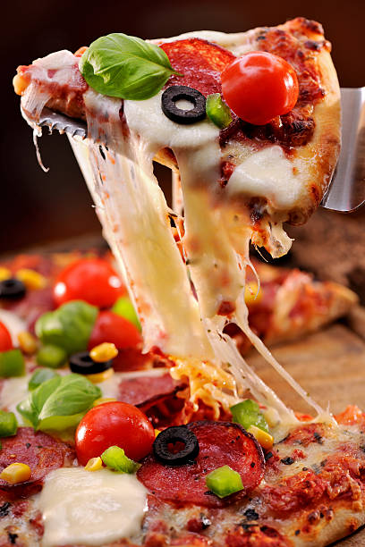
Plato Pizza - Sales Performance Analysis
A Data-Driven Approach to Understand What Sells, When, and Why!
Project by : Sanjana Kumari

Slide 2
Business Objective
Identify top-performing and underperforming pizzas to guide product decisions
Analyze customer buying patterns across days, hours, and seasons
Assess sales trends by category and size to optimize pricing and promotions

Slide 3
Data Overview
Source: Order-level sales data from Plato Pizza
Timeframe: Full year of transactions (2015)
Dataset Size: 48,620 rows covering 21,350 unique orders
Key Fields: Order date & time, pizza name, category, size, quantity, unit price, and total price
Format: CSV file processed via SQL and visualized in Tableau

Slide 4
Data Cleaning (SQL)
Checked and handled null or missing values in key fields
Converted text-formatted price values to numeric for accurate analysis
Parsed order_date and order_time into proper date/time formats
Created a clean, analysis-ready view for downstream insights

Slide 5
SQL-Based Exploratory Analysis
Analyzed peak hours, top weekdays, and low-demand periods
Identified best and worst-performing pizzas by quantity and revenue
Calculated AOV (overall and day-wise) to spot spend patterns
Used GROUP BY, ORDER BY, and time/date functions for insights
Explored sales by size and category to understand customer choices

Slide 6
Visualization in Tableau
Designed two focused dashboards: Overview and Pizza Performance
Used KPIs, bar, pie, heatmap, and area charts for clear visual storytelling
Applied interactive filters for product, category, date, and time-based insights
Enabled navigation between dashboards using a dynamic button
Ensured clean layout, consistent formatting, and actionable summaries

Slide 7
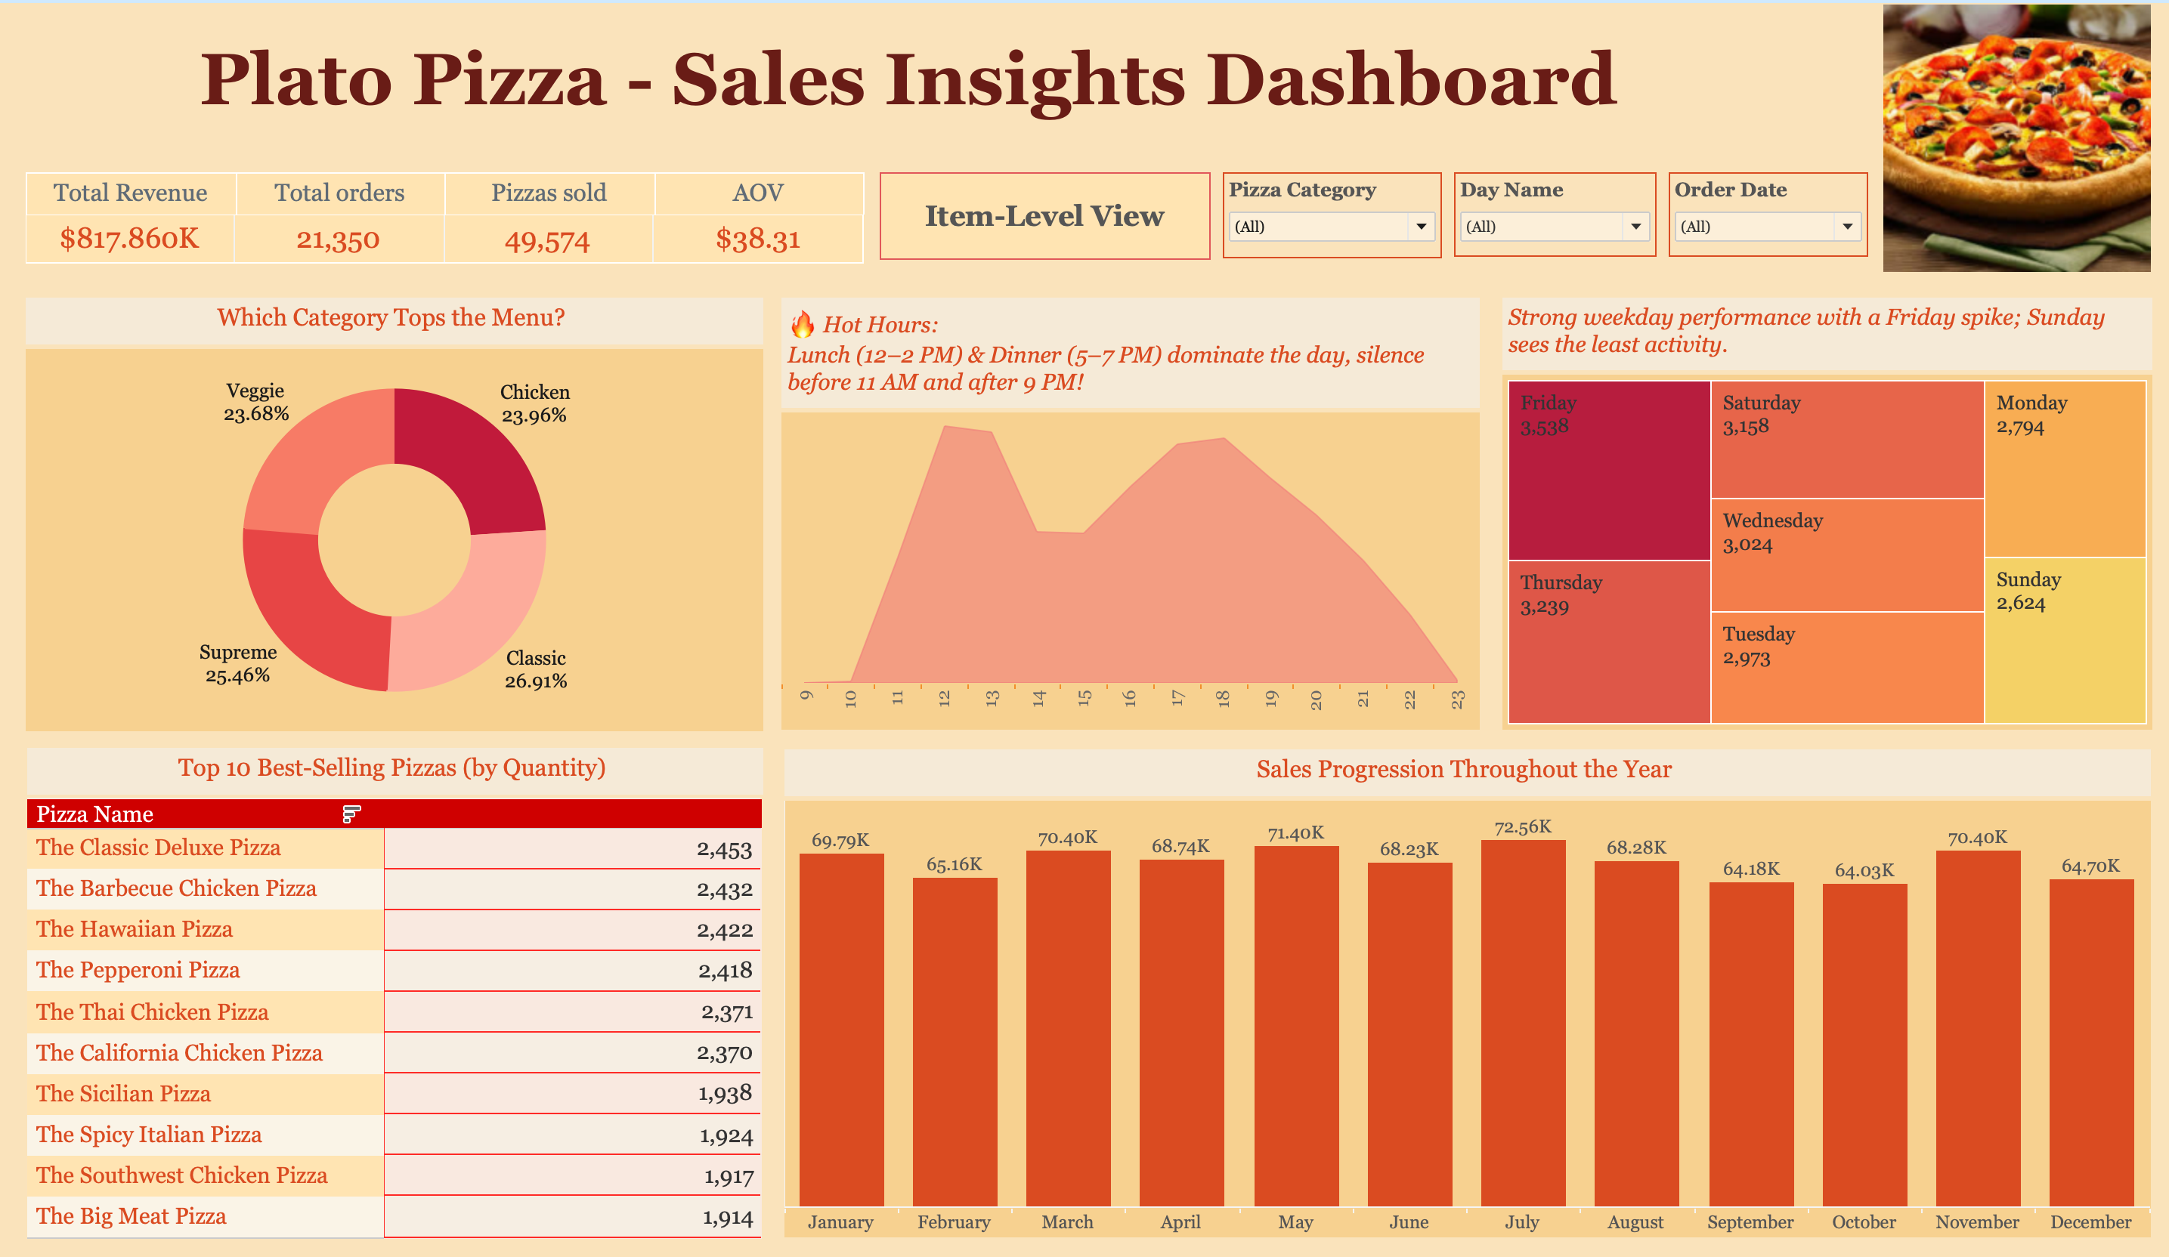

Slide 8
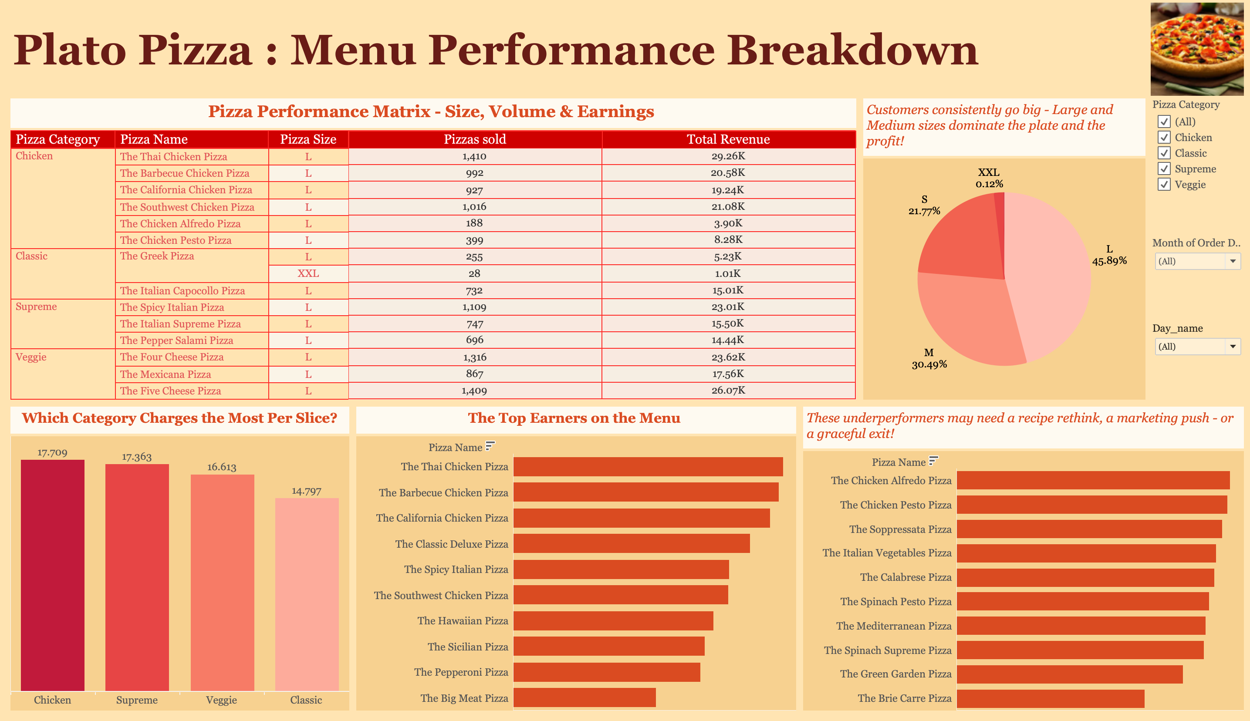

Slide 9
Key Metrics
Total Orders: 21,350 Represents the total number of unique customer orders placed in the year.
Total Pizzas Sold: 49,574 Indicates total quantity of pizzas sold across all categories and sizes.
Total Revenue: $817,860.05 Cumulative revenue generated from pizza sales before applying any costs.
Average Order Value (AOV): $38.31 Revenue per order on average, calculated as total revenue ÷ total unique orders.

Slide 10
Weekly & Hourly Performance
Friday recorded the highest order volume, while Sunday was the lowest
Consistent weekday demand observed from Tuesday to Thursday
Peak order times were between 12-2 PM and 5-7 PM, aligning with lunch and dinner hours
Minimal activity before 11 AM and after 9 PM, indicating potential for targeted promotions during off-peak hours
Insights support better staff scheduling and time-based marketing strategies

Slide 11
Best & Worst Pizzas
The Classic Deluxe Pizza was the top-selling item with 2,453 units sold
Other top performers included Barbecue Chicken, Hawaiian, and Pepperoni pizzas
The Brie Carre Pizza recorded the lowest sales with only 490 units sold
Several low-performing variants showed consistently weak demand across the year
Insights help identify which pizzas to promote, reformulate, or remove from the menu

Slide 12
Sales by Category & Size
Classic and Supreme pizzas contributed the highest revenue among all categories
Large-sized pizzas dominated sales, followed by Medium and Small
XXL pizzas generated the least revenue, indicating limited customer interest
Insights suggest maintaining focus on popular sizes and reviewing underperforming ones
Category-wise trends help refine product mix and pricing strategy

Slide 13
Monthly Sales Trend
July recorded the highest monthly revenue, indicating strong seasonal demand
October had the lowest sales, suggesting potential for promotions or campaigns
Overall revenue remained steady across months, with slight dips in early fall

Slide 14
Conclusion
The analysis highlights clear sales patterns, with peak activity on Fridays and during lunch and dinner hours
Large and Classic category pizzas are consistent top performers, driving majority revenue
Underperforming variants, especially XXL sizes, present opportunities for menu optimization
Day-wise AOV trends reveal potential for targeted upselling on low-spend days like Sunday
Overall, the insights enable data-driven decisions across product strategy, operations, and marketing

Slide 15
Thank You

