Slide 1

INTERNSHIP EVALUATION
Presented by
Name:
Rasha Rehman
Roll No:
B23CN098
Branch:
CSE (Networks)
1 / 12

Slide 2

Organization Profile
Detail
Information
Organization
Blackbucks Education Pvt. Ltd.
Mode
Offline Internship
Duration
8 Weeks (29 May 2026 – 29 July 2026)
Role Assigned
Java Full Stack Engineer
Project Delivered
Online Auction & Bidding Platform
Trusted By
NEAT – National Educational Alliance for Technology
Certificate ID
BBEDINT2026ST05145
2 / 12

Slide 3
Problem Statement
PROJECT TITLE: Online Auction & Bidding Platform
An online auction system provides a digital platform for buying and selling goods through competitive bidding. It connects sellers and buyers globally, facilitating efficient, transparent, and real-time transactions.
• Limited Reach: Traditional auctions are geographically restricted, limiting participation to local bidders only and reducing the potential market size for sellers.
• Time Constraints: Physical auctions are time-consuming, requiring in-person attendance at fixed schedules, making them impractical for many participants.
• Lack of Transparency: Manual auction processes often lack clear rules and traceable records, leading to disputes and non-transparent dealings.
• No Real-Time Updates: Existing systems do not provide instant bid updates, causing poor user experience and enabling unfair last-second bid sniping.
• Security Concerns: Many platforms lack robust authentication and authorization mechanisms, making them vulnerable to unauthorized access and fraudulent activities.
• Scalability Issues: Traditional systems struggle to handle concurrent users and high-frequency bidding transactions efficiently.
3 / 12

Slide 4
Objectives
• Global Accessibility: Create a web-based platform accessible to bidders and sellers worldwide, eliminating geographical barriers and expanding market reach.
• Real-Time Bidding: Implement WebSocket-based live bid updates so all users see bid changes instantly without page refresh.
• Fair Bidding Mechanism: Develop a countdown timer with auto-extension on new bids to prevent last-second sniping and ensure fair competition.
• Secure Authentication: Integrate JWT (JSON Web Token) based stateless authentication with role-based access control for Buyers, Sellers, and Admins.
• Seller Verification: Build an approval workflow to ensure only verified sellers can create auction listings, preventing fraud.
• Scalable Architecture: Design a client-server architecture using React and Spring Boot that can handle concurrent users and high-frequency transactions.
4 / 12

Slide 5
Technologies Used
• Frontend — React.js: Component-based JavaScript library for building dynamic, responsive user interfaces with reusable UI components.
• Backend — Spring Boot (Java): Robust framework for RESTful API development, business logic processing, and server-side application management.
• Database — MySQL: Relational database management system for efficient storage, retrieval, and management of users, auctions, bids, and transaction data.
• Real-Time Communication — WebSockets (STOMP): Enables bidirectional, full-duplex communication for instant bid updates, live timers, and push notifications.
• Authentication — JWT (JSON Web Tokens): Stateless, token-based authentication for secure session management with automatic expiration.
5 / 12

Slide 6
Methodology
• User Registration & Authentication: Users sign up and log in securely; JWT tokens are issued for stateless session management across all requests.
• Role-Based Access Control: Three distinct roles — Buyer, Seller, Admin — each with specific permissions and protected API endpoints.
• Seller Verification: An approval workflow ensures only verified sellers can create auction listings, preventing fraudulent activities on the platform.
• Auction Lifecycle Management: Create → Schedule → Activate → Live Bidding → End → Winner Declaration.
• Real-Time Bidding Engine: WebSocket-powered live bid broadcasts; all connected clients receive instant updates whenever a new bid is placed.
• Anti-Sniping Timer: Countdown timer automatically extends when a bid is placed in the final seconds, preventing unfair last-moment bidding.
• Data Persistence & Optimization: MySQL database with optimized queries for high-frequency bid reads/writes and complete audit logging.
6 / 12

Slide 7
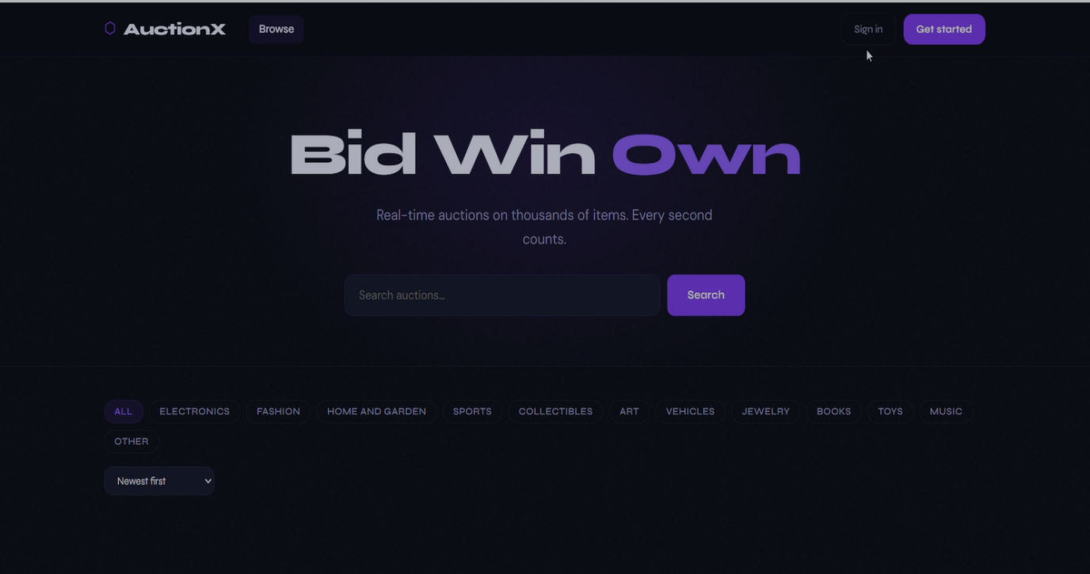
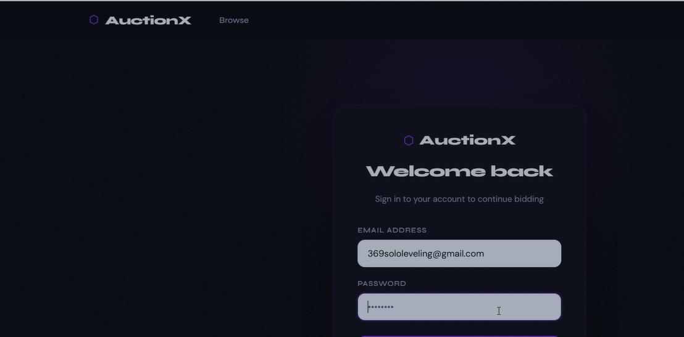
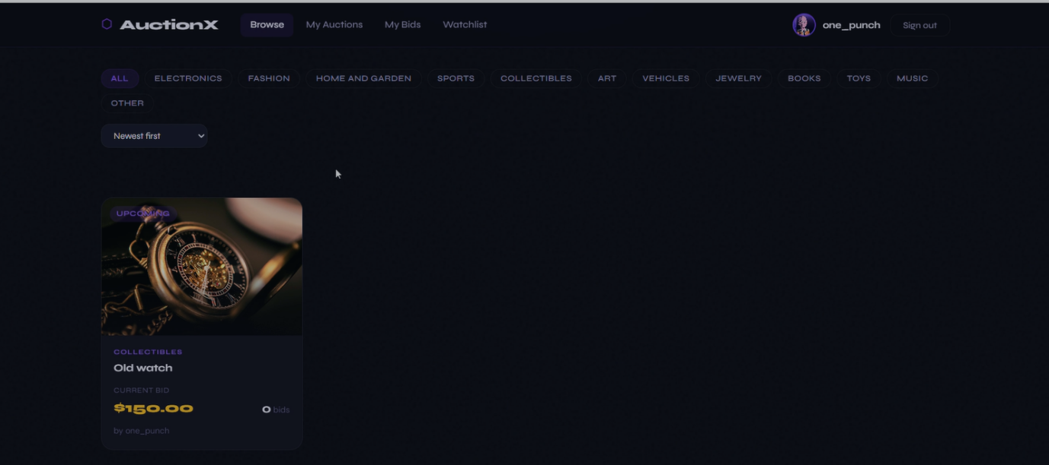
Results
Homepage
Login Page
Dashboard — Browse Auctions
7 / 12

Slide 8
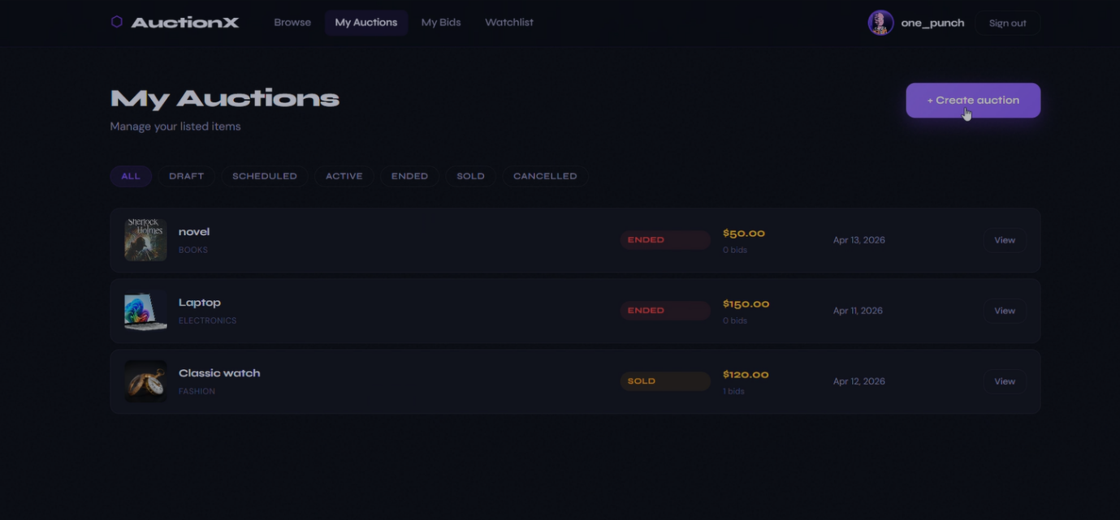
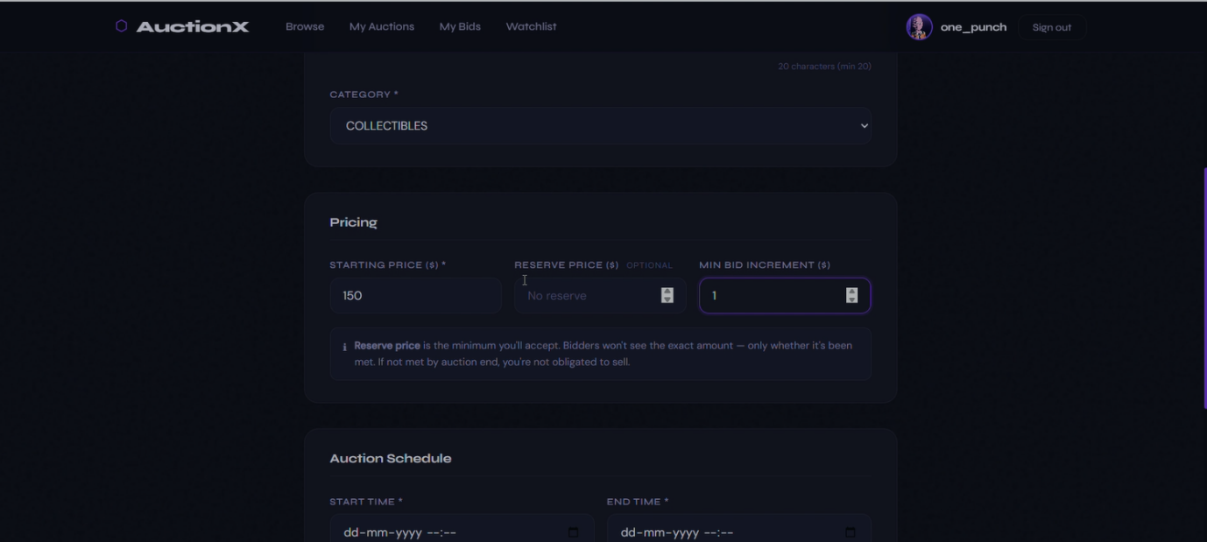
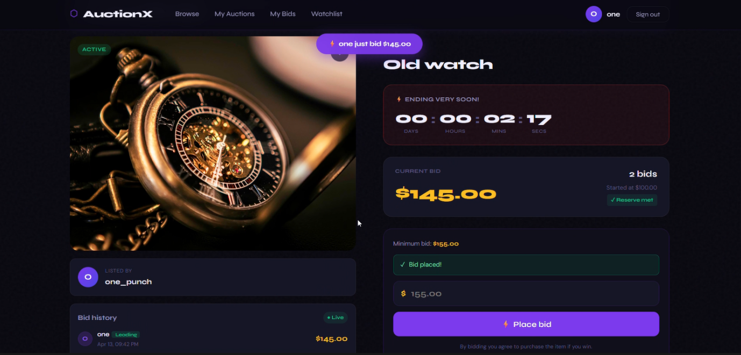
Results (contd.)
My Auctions — Seller Dashboard
Create Auction — Listing Form
Live Auction — Real-Time Bidding
8 / 12

Slide 9
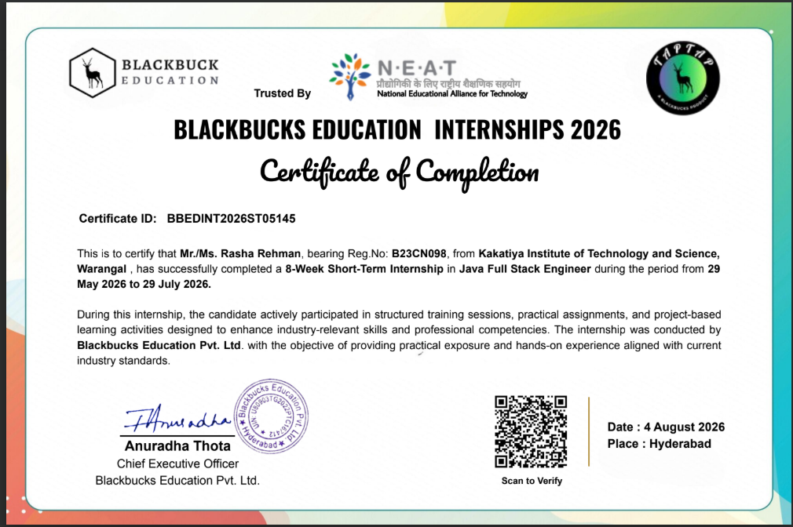
Certificate
9 / 12

Slide 10
Challenges & Learning Outcomes
Challenges Faced
Learning Outcomes
• Real-Time Synchronization: Ensuring consistent bid data across multiple concurrent WebSocket connections without race conditions.
• Timer Management: Implementing a reliable countdown timer with automatic reset logic synchronized across all connected clients.
• Database Concurrency: Handling simultaneous bid writes to prevent data conflicts under high load.
• Authentication Flow: Integrating JWT token lifecycle (issuance, validation, refresh, expiration) seamlessly with the frontend.
• Seller Verification: Designing a multi-step approval process balancing security with user onboarding experience.
• Full-Stack Development: Gained hands-on experience designing and integrating React frontend with Spring Boot backend and MySQL database.
• WebSocket Protocol: Learned to implement bidirectional real-time communication using STOMP over WebSocket for live features.
• Security Best Practices: Understood JWT-based authentication, RBAC implementation, and secure API design patterns.
• Database Design: Learned normalized schema design and optimized queries for high-frequency transactional workloads.
• Agile Development: Practiced iterative development, code reviews, and continuous testing throughout the project lifecycle.
10 / 12

Slide 11
Future Enhancements
• Payment Gateway Integration: Enable direct online payments via UPI, credit cards, and net banking for seamless post-auction transactions.
• Mobile Application: Develop native Android and iOS apps for on-the-go auction participation with push notifications.
• AI-Powered Recommendations: Suggest relevant auctions to users based on browsing history, interests, and past bidding behavior.
• Cloud Deployment: Deploy on AWS or Azure for auto-scaling, high availability, and improved global performance.
• Email & SMS Notifications: Automated alerts for bid updates, auction endings, winning notifications, and seller verification status.
• Fraud Detection System: AI-based anomaly detection to identify suspicious bidding patterns and fake user accounts.
• Multi-Language Support: Internationalization support to expand platform reach to non-English speaking users.
11 / 12

Slide 12
THANK YOU!
Online Auction & Bidding Platform
Mohammad Rasha Rehman | B23CN098 | CSE (Networks)
Blackbucks Education Pvt. Ltd. • Offline Internship • 8 Weeks
12 / 12

