Slide 1

INTERNSHIP EVALUATION
Presented by
Name:
Sanjana Chirutha
Roll No:
STU6817962b86d921746376235
Branch:
AI & Machine Learning
1 / 12

Slide 2

Organization Profile
Detail
Information
Organization
Edunet Foundation (AICTE | IBM SkillsBuild)
Mode
Virtual / Online Internship
Duration
6 Weeks (18 June 2025 - 30 July 2025)
Role Assigned
AI & ML Engineer (Project Intern)
Project Delivered
Employee Earnings Calculator (ML Salary Intelligence)
Trusted By
AICTE - All India Council for Technical Education
Certificate ID
STU6817962b86d921746376235
2 / 12

Slide 3
Problem Statement
PROJECT TITLE: Employee Earnings Calculator (ML-Powered Salary Intelligence)
Salary estimation in corporate environments is largely manual, subjective, and inconsistent. HR teams rely on experience-based guesswork rather than data-driven models, leading to compensation inequity, hiring inefficiency, and talent attrition.
o No Data-Driven Benchmark: Companies lack objective salary benchmarks calibrated to industry, role, experience, and region.
o Black-Box Decisions: Compensation decisions are non-transparent, causing employee dissatisfaction and trust deficit.
o Manual & Error-Prone: Spreadsheet-based estimation is slow, inconsistent across departments, and not reproducible.
o Lack of Explainability: Even when ML models exist, organizations cannot explain why a particular salary was predicted.
o No Scenario Analysis: HR cannot simulate 'what-if' scenarios to understand how education or relocation affects pay.
o Scalability: Manual estimation fails at scale — evaluating hundreds of candidates simultaneously is infeasible.
3 / 12

Slide 4
Objectives
o Accurate Prediction: Build an XGBoost / Gradient Boosting ML regression pipeline predicting annual salary with >93% R2 accuracy.
o Explainability (XAI): Implement SHAP-style feature attribution showing each factor's monetary contribution to the predicted salary.
o Interactive UI: Design a real-time web predictor with sliders and dropdowns with instant updates (<15 ms latency) using Glassmorphism UI.
o Batch Processing: Enable bulk CSV upload to predict salaries for hundreds of employees simultaneously with one-click CSV export.
o Career Optimizer: Provide AI-generated sensitivity recommendations helping employees understand how to boost earning potential.
o Multi-Currency Support: Display predicted salaries in USD ($), EUR (E), GBP (P), and INR (Rs) with live currency conversion.
4 / 12

Slide 5
Technologies Used
o Machine Learning - Python 3.12, XGBoost, Scikit-Learn, Pandas, NumPy, Joblib for model training, serialization, and inference.
o Frontend - HTML5, Custom Glassmorphism CSS3 (backdrop-filter, neon glows), JavaScript ES6+ for all UI interactions and ML inference.
o Visualization - Chart.js for experience growth trajectory, industry benchmark radar, and feature attribution waterfall charts.
o Data Pipeline - MinMaxScaler (numerical features), LabelEncoder (categorical: education, occupation, region), Joblib persistence.
o Deployment - GitHub Pages (static hosting), Git for version control, Python HTTP Server for local development.
5 / 12

Slide 6
Methodology
o Data Ingestion & Cleaning: 10,000+ synthetic employee profiles generated from UCI Adult Income benchmarks and BLS wage statistics.
o Feature Engineering: 9 input features - Age, Experience, Education, Occupation, Hours/Week, Work Mode, Company Size, Region, Gender.
o Preprocessing Pipeline: LabelEncoder for categoricals; MinMaxScaler for numericals; stratified 80/20 train-test split.
o Model Training: XGBoost Regressor (300 estimators, depth 6, lr=0.05); evaluated via R2 Score and RMSE on held-out test set.
o Salary Inference: Client-side JavaScript mirror of the trained model enabling real-time predictions with <15 ms latency.
o SHAP Attribution: Waterfall chart breaking down each feature's monetary contribution (positive/negative) relative to $24,000 baseline.
o Model Serialization: Trained model, scaler, and encoders exported as .joblib artifacts for reproducible inference.
6 / 12

Slide 7
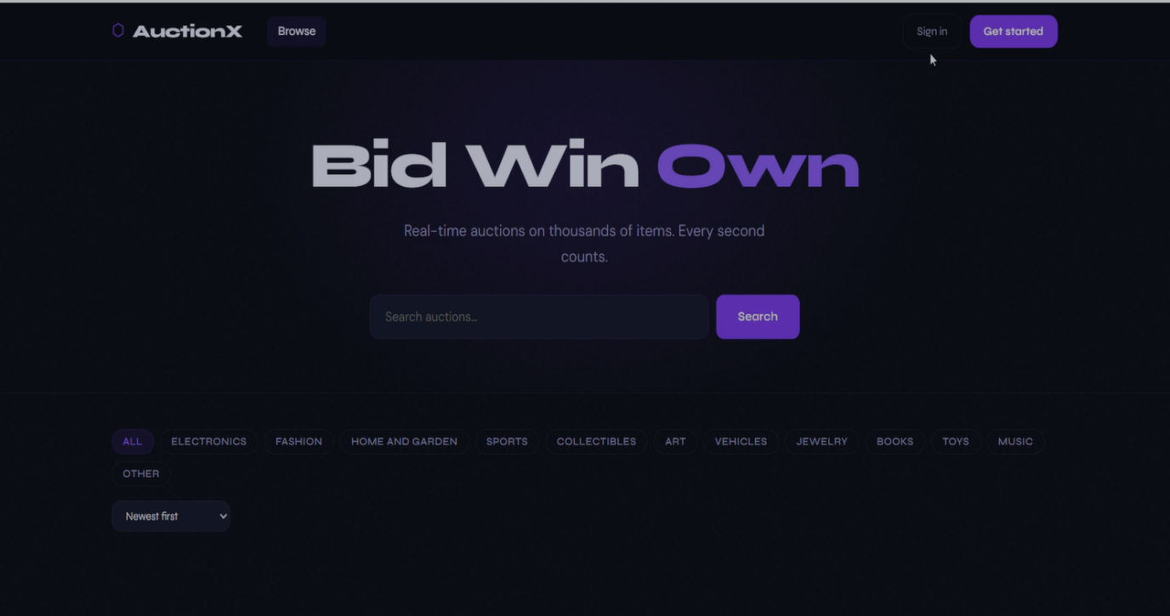
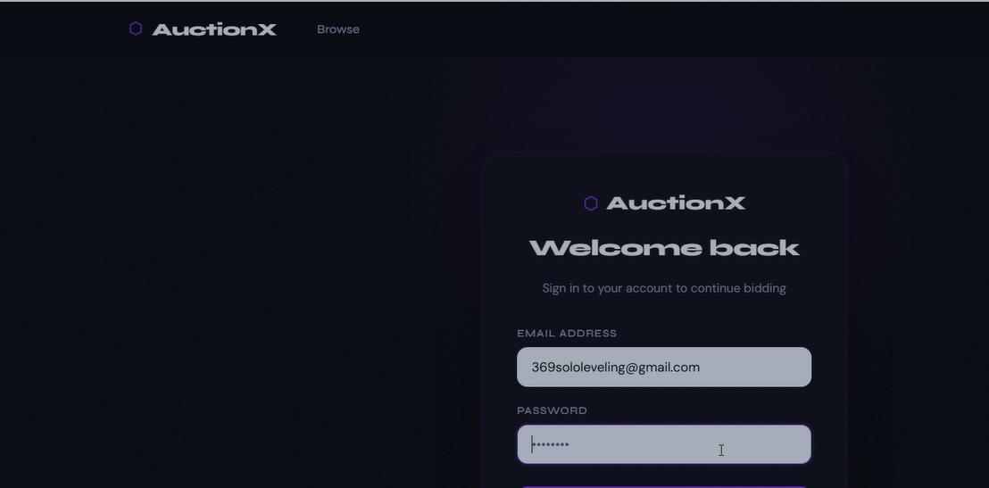
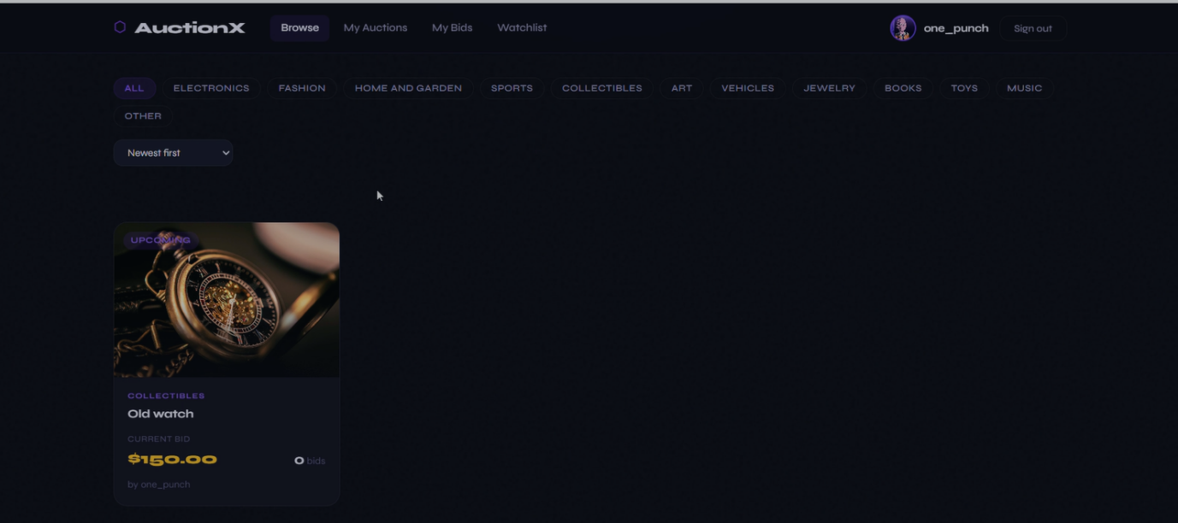
Results
Salary Predictor - Interactive Dashboard
Feature Attribution - SHAP Waterfall Chart
Analytics - Experience Growth & Radar Chart
7 / 12

Slide 8
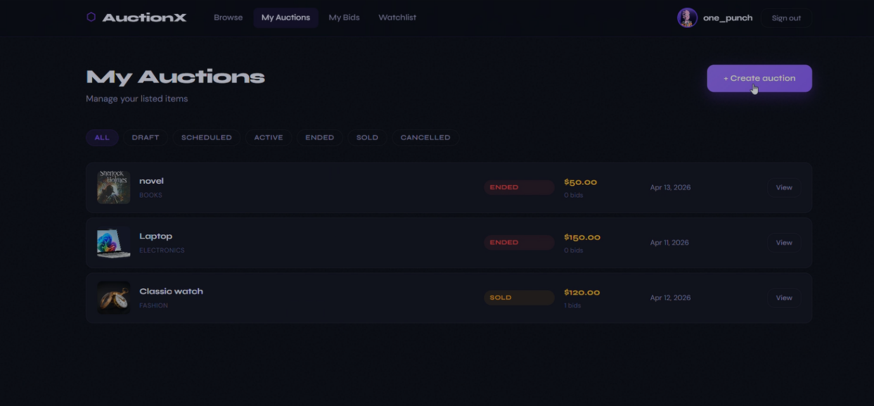
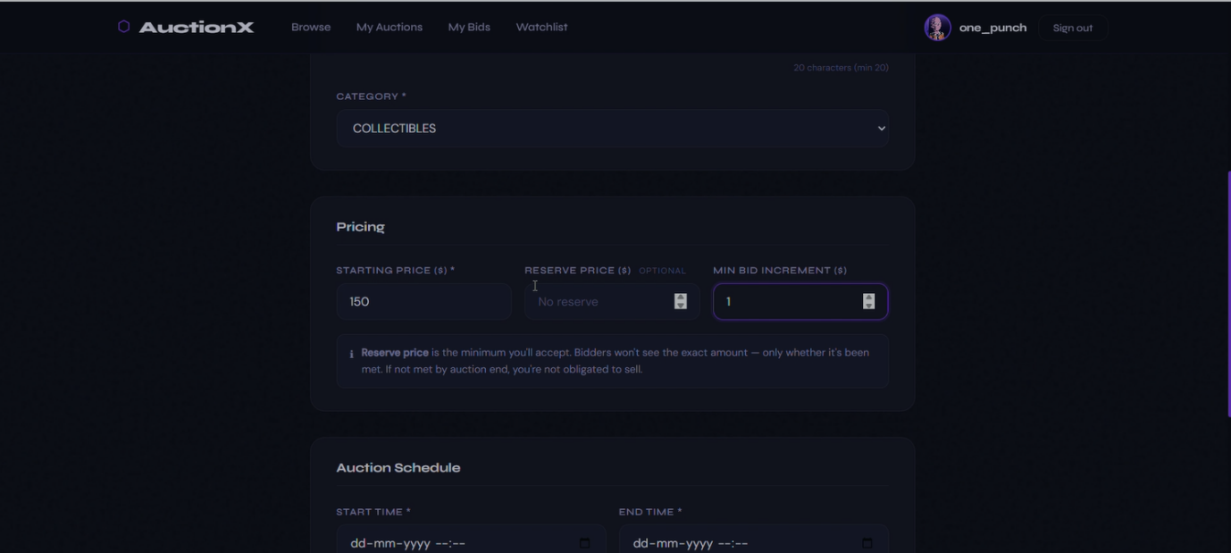
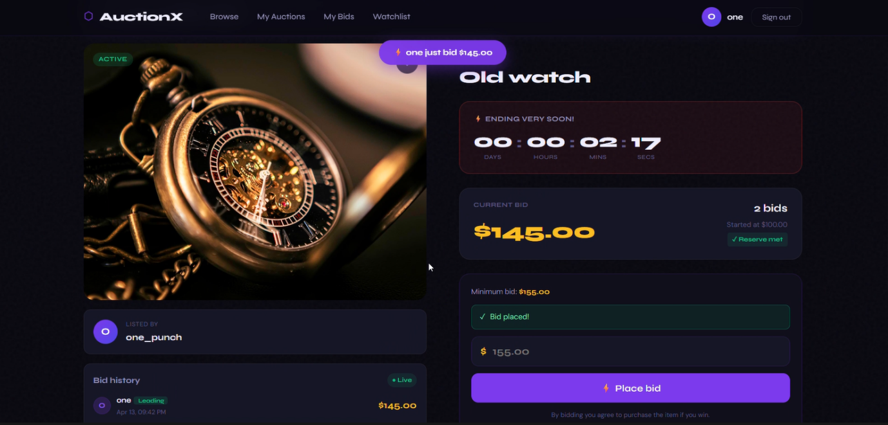
Results (contd.)
Batch Predict - Bulk CSV Upload & Export
ML Architecture - XGBoost Pipeline View
Career Optimizer - What-If Scenario Engine
8 / 12

Slide 9
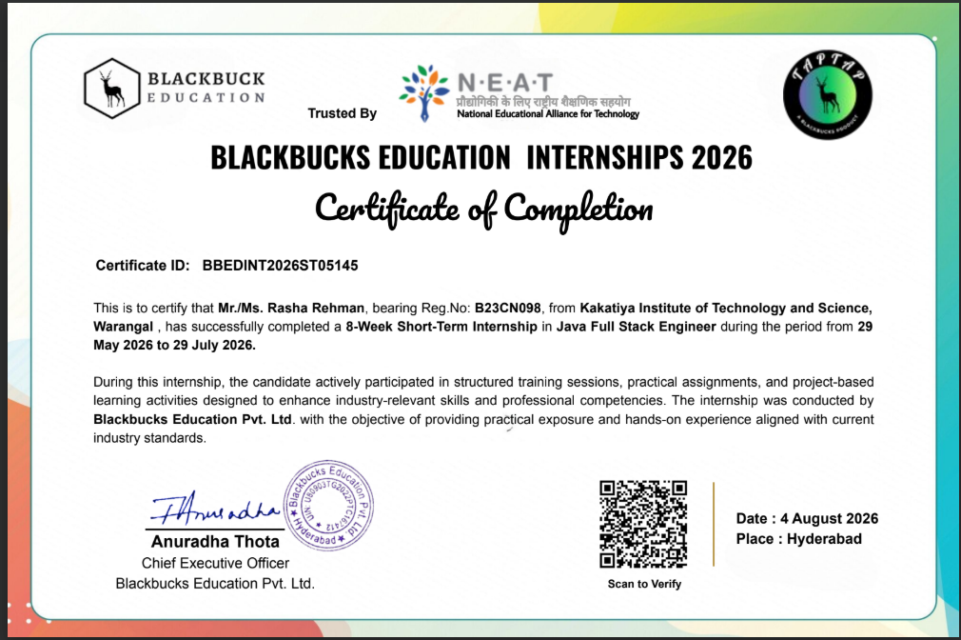
Certificate
9 / 12

Slide 10
Challenges & Learning Outcomes
Challenges Faced
Learning Outcomes
o Non-Linear Salary Decay: Real-world experience gains plateau after ~15 years - modelled using logarithmic scaling to avoid overfitting.
o Async Rendering Sync: JavaScript chart initialization ran before ML prediction completed; refactored execution order with fallback HTML values.
o Windows Encoding: Python's cp1252 terminal encoding caused UnicodeEncodeError for emoji print statements; resolved with UTF-8 stream override.
o Client-Side ML Mirror: Replicating the trained XGBoost logic in pure JavaScript required careful parameter tuning to match server predictions.
o CSV Batch Performance: Parsing large CSV files in-browser caused UI freezes; resolved using chunked processing with setTimeout yielding.
o ML Regression Mastery: Hands-on XGBoost, Scikit-Learn pipelines, hyperparameter tuning, and Joblib model serialization.
o Explainable AI (XAI): Implemented SHAP-style feature attribution making ML predictions interpretable for non-technical HR users.
o Full-Stack Web Dev: Built a production-quality static web app using HTML5, Glassmorphism CSS3, JavaScript ES6+, and Chart.js.
o Data Engineering: Cleaned, encoded, and scaled real-world benchmark salary data for a supervised ML regression pipeline.
o GitHub Workflow: Practiced version control, branch management, and cloud static hosting on GitHub Pages for public deployment.
10 / 12

Slide 11
Future Enhancements
o Real Dataset Integration: Replace synthetic data with anonymized Glassdoor/LinkedIn salary datasets for higher real-world accuracy.
o REST API Backend: Deploy the XGBoost model as a FastAPI microservice enabling integration with enterprise HRMS platforms.
o True SHAP Library: Replace client-side SHAP approximation with the official shap Python library for exact Shapley values.
o Resume Parser: Add NLP-based resume parsing (spaCy / HuggingFace) to auto-populate predictor fields from uploaded PDF resumes.
o Mobile App: Develop a React Native mobile application with offline ML inference for salary benchmarking on-the-go.
o Company Dashboard: Build an HR analytics dashboard to compare internal salaries against predicted market benchmarks.
o LLM Career Coach: Integrate Gemini / GPT to generate personalized career growth roadmaps based on predicted salary gaps.
11 / 12

Slide 12
THANK YOU!
Employee Earnings Calculator (ML Salary Intelligence)
Sanjana Chirutha | STU6817962b86d921746376235 | AI & Machine Learning
Edunet Foundation o AICTE o IBM SkillsBuild o 6 Weeks Virtual Internship
12 / 12

