Slide 1

HUMAN ACTIVITY RECOGNITION
TEAM NO: 06
Sl.No. | Student Name | USN | Roll Num. | Division
1 | Sanjana Hubballi | 01fe21bcs022 | 505 | E
2 | Rakshita Wagh | 01fe21bcs280 | 545 | E
3 | Suman Patil | 01fe21bcs281 | 344 | C
4 | Srajana Naik | 01fe21bcs364 | 569 | E
Guided by: Dr. Padmashree Desai

Slide 2

Index
Introduction
Motivation
Literature Survey
Problem Statement
Objectives
Scope and Constraints
Functional and Non-Functional Requirements
Proposed system
Use Case Diagrams
Data Description
Project Management(Gantt Chart)

Slide 3
Introduction
Activity recognition is a versatile technology with applications in various fields, such as healthcare, activity monitoring and more.
As people get aged, their physical abilities can change, leading to an increased risk of accidents, falls and the need for ongoing care.
Human Activity Recognition involves the development of algorithms that can accurately monitor and interpret the daily activities and movements of older individuals.
Proposed project aims to use senior citizens accelerometer data to understand and recognize activities such as walking, standing, shuffling, ascend and descent stairs, lying and sitting.

Slide 4
Motivation
Need of efficient Human Activity Recognition systems such as:
i) improve the quality of life for humans.
ii) reduce their burden and provide a foundation for healthcare professionals.
Accelerometer data of human activities enhances the classification perception.
Deploying activity recognition on edge AI device ensures real-time health monitoring which can improve the quality of life.
Using low-power device motivates the need for energy efficiency, portability, cost considerations.

Slide 5
Literature Survey
[1] HUMAN ACTIVITY RECOGNITION FOR ELDERLY PEOPLE USING MACHINE AND DEEP LEARNING APPROACHES- MAY 2022.
The author focuses on providing assistance to elderly people by monitoring their activities in different indoor and outdoor environments.
Gyroscope and accelerometer data collected from a smartphone.
The proposed work aimed to develop an automatic activity monitoring system that will automatically detect the activity of elderly people.
The proposed Long Short-Term Memory Network gave the best accuracy of 95.04%. However, Support Vector Machine gave 89.07% accuracy.
Research gap:Need for improvement of the proposed models by validating with larger datasets and with more activities.

Slide 6
Literature Survey
[2] ACCELEROMETER BASED HUMAN ACTIVITY RECOGNITION FOR PATIENT MONITORING USING DEEP NEURAL NETWORK-2020
Recognizing activities using DNN typically for hospitalized patients.
Data was collected with 20 volunteers (18-65 years) with single triaxial accelerometer mounted on trunk to measure six activities: lying, upright posture, walking, wheelchair transport, stairs ascent and descent.
DNN reached accuracy of 94.52% whereas SVM reached accuracy of 83.35%.
Data is collected from laboratory settings, so the performance of the model in this controlled setting may not be accurate.
Studying the data collected in non- laboratory settings and assessing the performance of algorithms in real-world applicabilities is the significant research gap.

Slide 7
Literature Survey
[3] A STUDY ON HUMAN ACTIVITY RECOGNITION USING GYROSCOPE, ACCELEROMETER, TEMPERATURE AND HUMIDITY DATA-IEEE,2019
This research explores the recognition of both frequent and infrequent 10 different human activities using smartphone sensors and advanced techniques.
Samsung Galaxy S4 series was employed which contains accelerometer sensor,Gyroscope sensor,Humidity and Temperature sensor.
The four algorithm used for recognising activities were k-nearest neighbour,Random forest,Support vector machine and Conventional deep neural network.
The random forest achieved highest accuracy of 99.86%.

Slide 8
Literature Survey
[4] HUMAN ACTIVITY RECOGNITION USING ANDROID SMARTPHONE-2016
An application was created using the accelerometer data for classification, which supported online training and classification.
There are 6 arm postures, standing, sitting, walking, running, jumping, lying and 5 body postures, neutral, forward bend, backward bend, side bend and twist.
The performance of two classification algorithms is analyzed, k-Nearest Neighbour and Clustered KNN in an online activity recognition system.
The overall performance for clustered KNN classification is 92% accuracy considering all activities.

Slide 9
Literature Survey
[5] HUMAN ACTIVITY RECOGNITION USING NEURAL NETWORKS-IEEE,2014
This research paper aimed to advance the field of human activity recognition and health monitoring by introducing a data acquisition module prototype.
Artificial Neural Networks (Levenberg-Marquardt Optimization algorithm) was used for processing this sensor data.
6 Arm posture (using smartwatch-embedded accelerometers),5 body postures(using chest-fixed Chronos watch) and 10 activities are defined.
The best result was obtained from 2-layer feed forward network, achieving the recognition rate of 100% ,99.96%,99.08%.

Slide 10
Observations from Literature survey
Papers | Model Accuracy
Human activity recognition for elderly people using machine and deep learning approaches | Long Short-term memory network- 95%
Accelerometer based human activity recognition for patient monitoring using deep neural network | DNN - 94.52%
A study on Human Activity Recognition using Gyroscope,Accelerometer, Temperature and Humidity Data | Random Forest - 99.86%
Human activity recognition using android smartphone | Clustered KNN - 92%
Human Activity Recognition using neural networks | 2 Layer Feed Forward Network- 99.08%

Slide 11
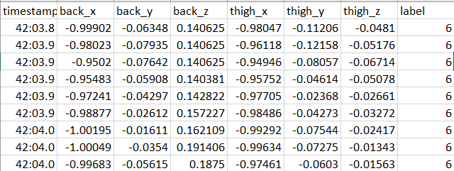
Problem Statement
Develop an AI based system with low power consumption for recognizing the human activities using sensor data.
AI based system
Random forest
(Adafruit feather M0 adalogger)
A:The person is Sitting.
Q:In which activity the person is involved?

Slide 12
Objectives
Build an AI model to recognize human activities such as walking, shuffling, standing, stairs(ascending), stairs(descending), sitting, lying based on accelerometer data.
Deploy and test on the real time development board(Adafruit Feather M0 Adalogger)
Optimize the model for low power consumption.

Slide 13
Scope and Constraints
The project will focus on recognising human activities like walking, shuffling, standing, stairs(ascending), stairs(descending), sitting, lying .
This model will be deployed on Adafruit feather M0 adalogger.
Ethical guidelines must be followed when dealing with personal data to protect privacy of individuals.
Algorithmic limitations may impact the recognition of specific activities or introduce errors in the recognition process.

Slide 14
Functional & Non-Functional requirements
Functional Requirements:
The user shall be able to give the input as the accelerometer data.
The system shall be able to analyze the accelerometer data.
The system shall be able to recognize human activities such as walking, sitting, standing, lying, stairs(ascend/descend) and shuffling.
Non-Functional Requirements:
The system should have low power consumption of less than 10 milliwatts to minimize battery drain.
The model should achieve 90% accuracy in human activity recognition.
The system should provide real-time activity recognition results with minimal latency,less than 100 milliseconds.

Slide 15
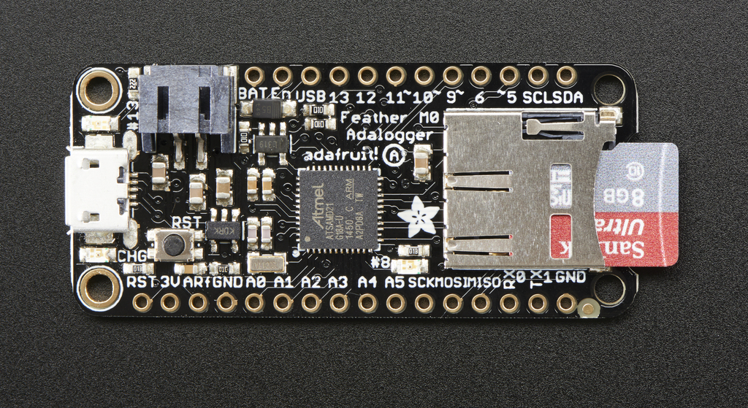
Proposed System
Training and Testing
Model Building(e.g, Random forest and SVM)
Accelerometer data
Development board(Adafruit Feather M0 Adalogger)
AI model recognizes the activities

Slide 16
Use case diagram
Human Activity Recognition
give the input
Analyze the accelerometer data
User
<<Include>>
- -- ->
Recognise the activities
System

Slide 17
Data Description
The dataset is of 15 older-adults wearing 2 accelerometers for 40 minutes on their right thigh and lower back during a semi-structured free-living protocol.
Attributes :
back_x: acceleration in x-direction (down) in the unit g.
back_y: acceleration in y-direction (left) in the unit g.
back_z: acceleration in z-direction (forward) in the unit g.
thigh_x: acceleration in x-direction (down) in the unit g.
thigh_y: acceleration in y-direction (right) in the unit g.
thigh_z: acceleration in z-direction(backward) in the unit g.
label: annotated activity code.

Slide 18
Data Description
The dataset contains the following annotated activities with the corresponding coding scheme:
1:walking
2:shuffling
3:stairs(ascending)
4:stairs(descending)
5:standing
6:sitting
7:lying

Slide 19
Project Management (Gantt Chart)
Task Id | Task name | Week 1 | Week 2 | Week 3 | Week 4 | Week 5 | Week 6 | Week 7 | Week 8 | Week 9 | Week 10
01 | Literature survey
02 | Problem statement
03 | Model building
04 | Training
05 | Testing
06 | Deploy on development board

Slide 20
References
Hayat, Ahatsham & Morgado-Dias, F. & Bhuyan, Bikram & Tomar, Ravi. (2022). Human Activity Recognition for Elderly People Using Machine and Deep Learning Approaches. Information (Switzerland). 13. 10.3390/info13060275.
Fridriksdottir E, Bonomi AG. Accelerometer-Based Human Activity Recognition for Patient Monitoring Using a Deep Neural Network. Sensors (Basel). 2020 Nov 10;20(22):6424. doi: 10.3390/s20226424. PMID: 33182813; PMCID: PMC7697281.
A. Barna, A. K. M. Masum, M. E. Hossain, E. H. Bahadur and M. S. Alam, "A study on Human Activity Recognition Using Gyroscope, Accelerometer, Temperature and Humidity data," 2019 International Conference on Electrical, Computer and Communication Engineering (ECCE), Cox'sBazar, Bangladesh, 2019, pp. 1-6, doi: 10.1109/ECACE.2019.8679226.
Usharani, J. and Sakthivel, U., 2016, May. Human activity recognition using android smartphone. In Proceedings of the 1st International Conference on Innovations in Computing & Networking (ICICN-16). Bengaluru (pp. 12-3).
S. Oniga and J. Sütő, "Human activity recognition using neural networks," Proceedings of the 2014 15th International Carpathian Control Conference (ICCC), Velke Karlovice, Czech Republic, 2014, pp. 403-406, doi: 10.1109/CarpathianCC.2014.6843636.

Slide 21
Thank You

