Slide 1

HUMAN ACTIVITY RECOGNITION
TEAM 06
NAME | Roll.No | USN
SANJANA HUBBALLI | 505 | 01FE21BCS022
RAKSHITA WAGH | 545 | 01FE21BCS280
SUMAN PATIL | 344 | 01FE21BCS281
SRAJANA NAIK | 569 | 01FE21BCS364
Guided by: Dr. Padmashree Desai

Slide 2

Review 1 Comments with actions initiated
Suggestions/ Comments in Review-1 | Action Taken
Refine Literature Survey (clarification regarding methodologies used in papers.) | Thoroughly studied and assessed referenced algorithms for project relevance.

Slide 3
Problem Statement
To develop an AI based system with low power consumption for recognising the human activities using sensor data (accelerometer data).
Objectives:
To develop model using ML algorithms to recognize human activities such as walking, sitting, lying, standing, stairs(ascending), stairs(descending) and shuffling.
To analyze the effectiveness of Machine learning models like Random forest, Support vector machine, K nearest neighbours.
To analyze the best ML model and convert it to tflite framework through keras using tensorflow.
To deploy AI model on development board(adafruit feather M0 adalogger).

Slide 4
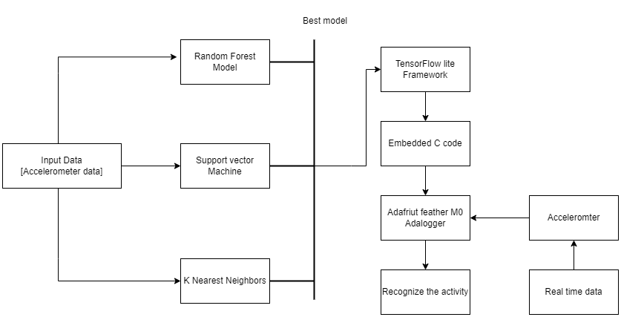
High-Level Design

Slide 5
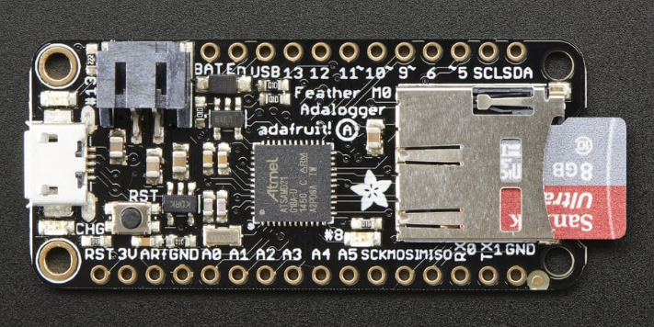
Adafruit feather m0 adalogger
It has an onboard battery connector, which enhances portability while maintaining a focus on low power consumption(150-300 microA)
Effectively managing the Arm Cortex, a 32-bit microcontroller core, and providing Tensorflow Lite support align with the machine learning algorithms.
The compact design and 8-10 second inference time make it a versatile tool, ensuring efficiency and responsiveness.

Slide 6
Sequence diagram
Sensor data
Activity recognition
Collect sensor data()
Analyze sensor data()
Recognize activity and display()

Slide 7
Data Description
The dataset is of 15 older-adults wearing 2 accelerometers for 40 minutes on their right thigh and lower back during a semi-structured free-living protocol.
Attributes :
back_x: acceleration in x-direction (down) in the unit g.
back_y: acceleration in y-direction (left) in the unit g.
back_z: acceleration in z-direction (forward) in the unit g.
thigh_x: acceleration in x-direction (down) in the unit g.
thigh_y: acceleration in y-direction (right) in the unit g.
thigh_z: acceleration in z-direction(backward) in the unit g.
label: annotated activity code.

Slide 8
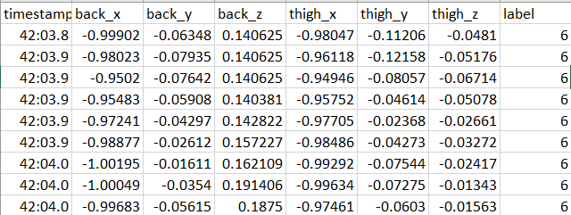
Data Description
The dataset contains the following annotated activities with the corresponding coding scheme:
1:walking
2:shuffling
3:stairs(ascending)
4:stairs(descending)
5:standing
6:sitting
7:lying

Slide 9
Implementation
SI.No | Module | Status | Relative Contribution
1 | Data Collection | Completed | 10%
2 | Data Analysis | Completed | 10%
3 | AI Model Building | In progress | 25%
4 | Model Deployment on Edge Device | Not-Completed | -
5 | Validation and Reporting | Not-Completed | -

Slide 10
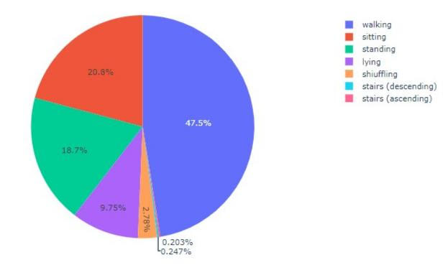
Implementation
Data Collection:Data has been collected from Kaggle.
Data Analysis:Analysis of null values, duplicate values and description of data.
From fig 1, ‘Walking’ is the most common activity compared to all others, which causes class imbalance.
Fig 1 - Pie chart showing the distribution of activities without balancing the dataset.

Slide 11
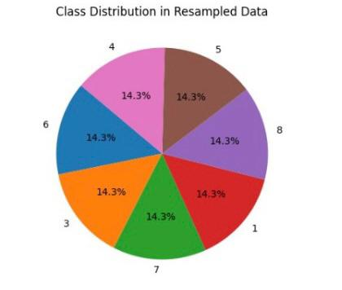
Implementation
To balance classes SMOTE (Synthetic Minority Oversampling Technique) has been used.
Fig 2 shows the distribution of classes after resampling the data.
Fig 2- Pie chart showing distribution of activities after resampling the data.

Slide 12
Implementation
Model Building: We used 80% of the resampled_data for training and 20% of the resampled_data for testing.
Three models are implemented to ensure the suitable model for further implementation.
Random Forest(RF):
Ensemble method that combines multiple decision trees.
It is robust and works well with large and diverse datasets.
Support Vector Machine(SVM):
SVMs are effective for high-dimensional data.
K Nearest Neighbours(KNN):
KNN is a simple algorithm and is robust to noisy data.

Slide 13
Results
ML Model | Training Accuracy | Testing Accuracy
Random Forest | 99.82% | 97.84%
Support Vector Machine | 80.10% | 80.22%
k Nearest Neighbour | 98.26% | 96.59%

Slide 14
Thank you

