Slide 1

COURSERA CAPSTONE – THE BATTLE OF NEIGHBORHOODS

Slide 2

Contents
Introduction
Data Description
Data Transformation
Methodology
Results
Conclusion

Slide 3
Introduction
The aim of this project is to select an ideal location for opening a shopping mall in the city of Toronto, Canada.
Stakeholders - who wants to invest in a shopping mall in the city.
Clustering methodology to cluster the neighborhoods.

Slide 4
DATA DESCRIPTION
Data Sources
Wikipedia
Foursquare.com
http://cocl.us/Geospatial_data

Slide 5
DATA Transformation
Dropped boroughs with unassigned values.
Neighborhoods which were unassigned are changed to the respective borough names.
Joined with the latitude and longitude data.
Venues in the neighborhoods is got through the Foursquare API for analysis.

Slide 6
METHODOLOGY
The data is segmented using k-means clustering in Python.
The neighborhoods are divided into 3 clusters which is calculated based on the similarity.

Slide 7
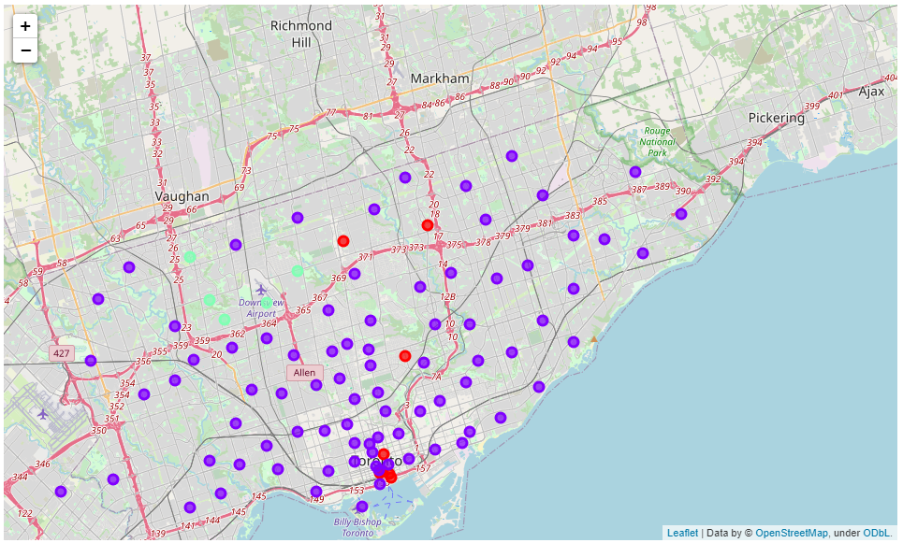

Slide 8
RESULTS
It can be been seen the cluster 1 has very few to no shopping malls present in it, cluster 0 has moderate number of shopping malls whereas cluster 2 has many.
On further analysis of clusters, it can been seen that the Boroughs like Scarborough, Etobicoke and Central Toronto are highly sparse.

Slide 9
CONCLUSION
As It can be seen from the model, building a shopping mall in the neighborhoods in cluster 2 is highly optimal as there are very few malls present and so, there are little to no competition in these areas. As previously discussed, targeting boroughs like Scarborough, Etobicoke and Central Toronto is highly recommended as not only in the sense that there are little competition in these areas but also people are more likely to visit the mall which are nearer to them, and that will attract more stores and thereby increase the profits of the stakeholders. From another perspective, if the stakeholders are already well established in similar cities, they can target neighborhoods in cluster 0 too, as there are only moderate number of competition and an already well-established name will give them an edge.

