Slide 1
Market and Retail Analytics - 2
Sanjana M 2OA0CSPH75

Slide 2
Index :
Understanding the available data
Market Basket Analysis
KNIME Workflow
Associations identified
Recommendations

Slide 3
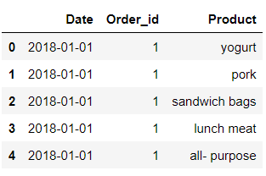
Understanding the available data : The given data has 3 columns and 20641 rows of entries with no null values. The parameters are a customer’s Date of purchase, OrderID and the Product. The raw data looks something like this: Data can be grouped by OrderID to get a list of Products purchased are the latest date. There are a total of 39 Products available to the customer, namely:
yogurt, pork, sandwich bags, lunch meat, all- purpose, flour, soda, butter, beef, aluminum foil, dinner rolls, shampoo, mixes, soap, laundry detergent, ice cream, toilet paper, hand soap, waffles, cheeses, milk, dishwashing liquid/detergent, individual meals, cereals, tortillas, spaghetti sauce, ketchup, sandwich loaves, poultry, bagels, eggs, juice, pasta, paper towels, coffee/tea, fruits, sugar

Slide 4
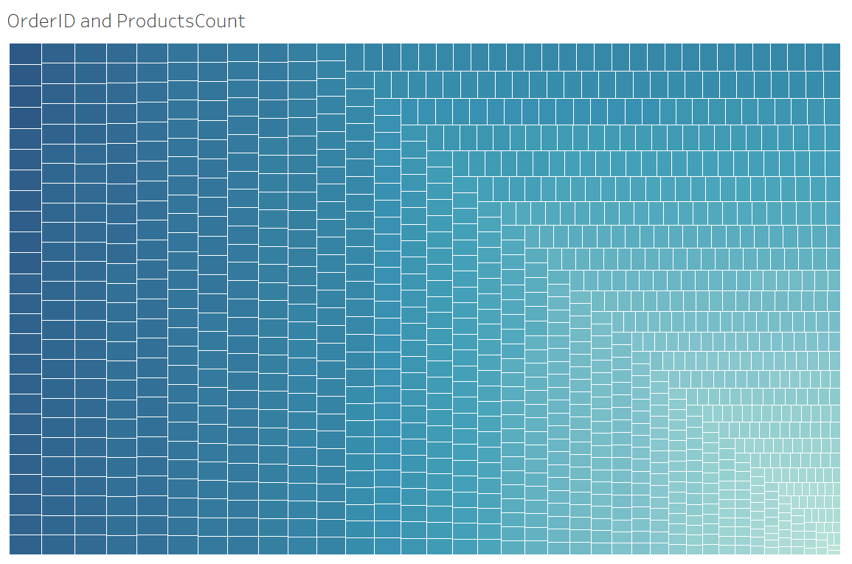
At the higher end, OrderID 226 has total of 34 purchased Products At the lower end, OrderIDs 408, 1139 have total of 3 purchased Products The difference is greater than 10 folds of lowest count. Customers with small basket size can be targeted to improve business.

Slide 5
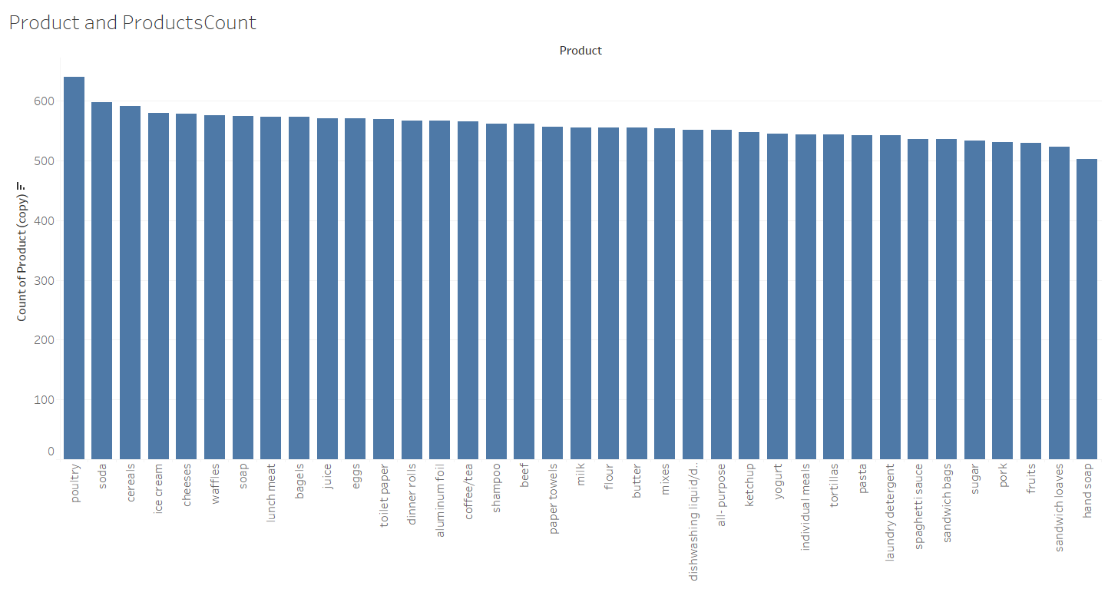
Out of the 39 Product types available at the store, Poultry is sold highest with a count of 640 Hand Soap is sold the least with a count 502 The drop is not very steep, indicating good choice of items available to the customers. The second highest selling product is the Soda with count of 597 The drop from highest to second-highest selling product is pretty significant and can be targeted

Slide 6
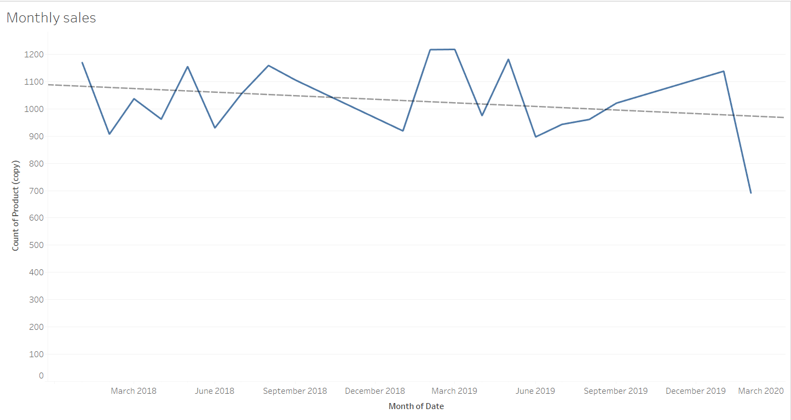
The below graph shows monthly sales There’s an upward trend in sales during the months of March-April, June-Sept The good sales always drop from May There’s no other significant repetitive pattern to recognise Over all, monthly sales has a declining trend line

Slide 7
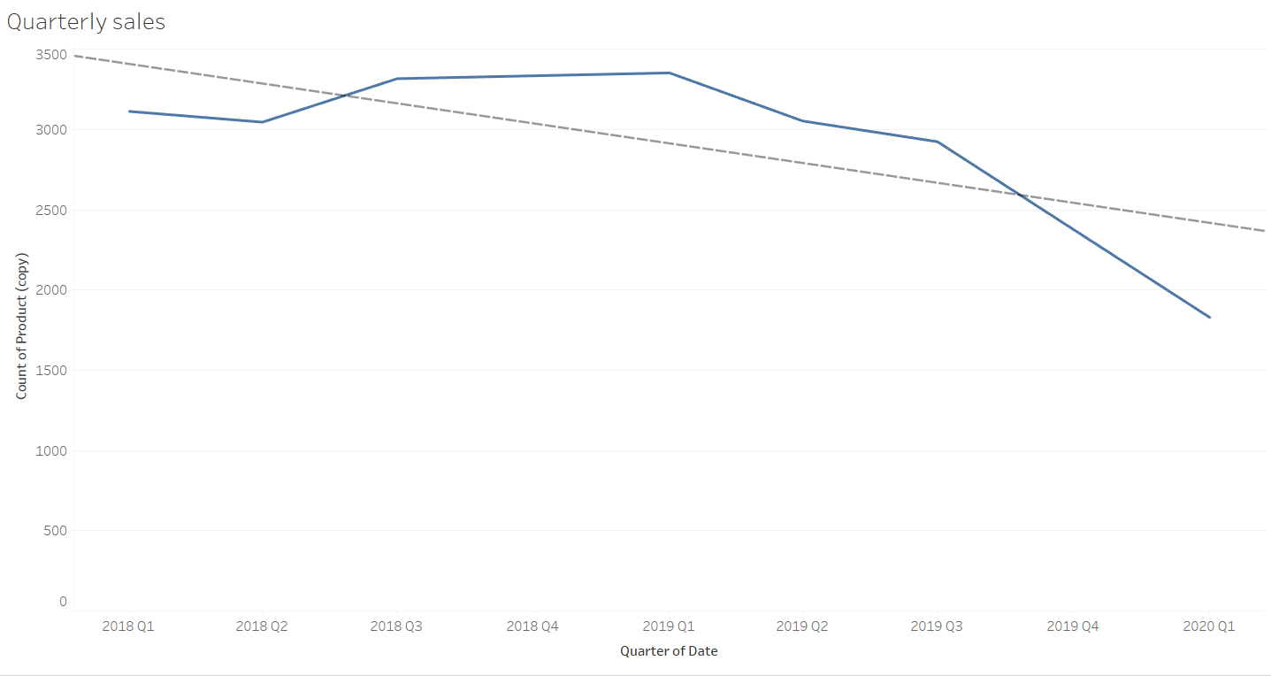
Quarterly sales for the store improved from 2018 Q2 – 2019 Q1 and faced decrement from there The over all look of quarterly sales in declining The drop is steeper than monthly sales

Slide 8
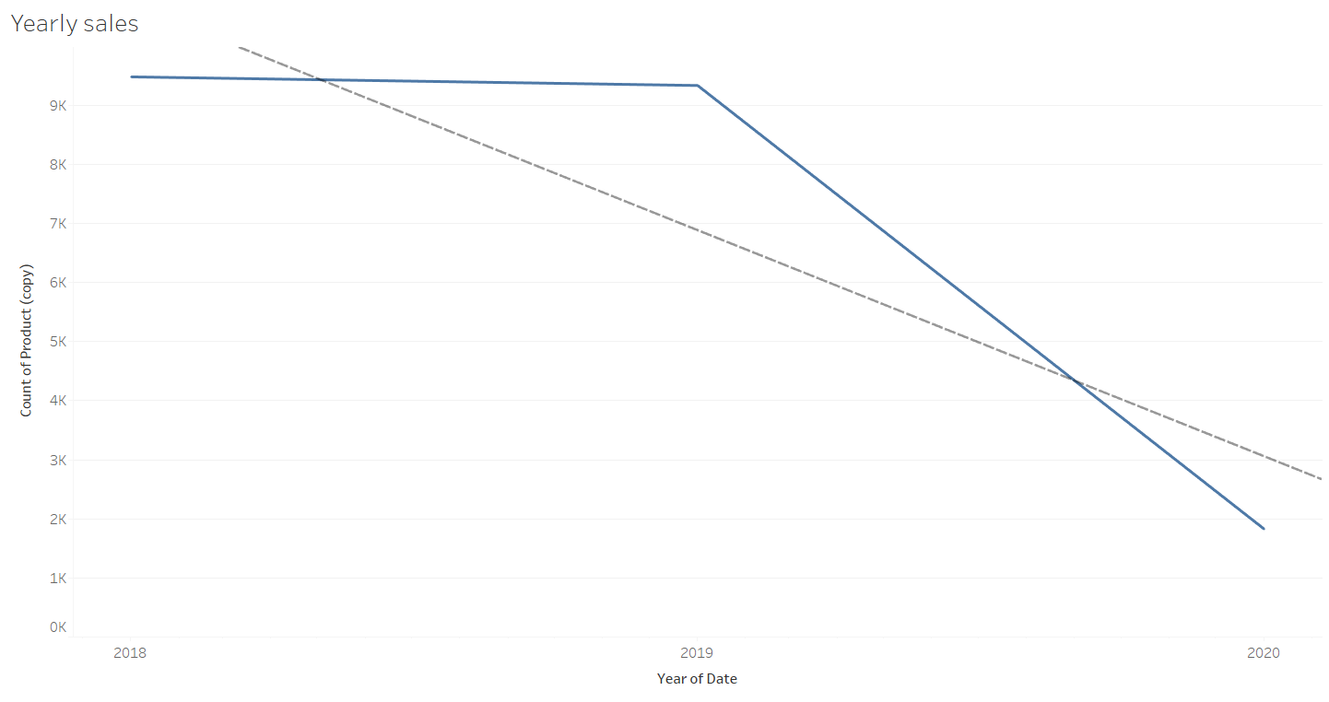
The business has insignificant drop from 2018-2019 But there is a very significant business drop in the year 2019 towards the beginning of 2020. Overall, the business is not doing well

Slide 9
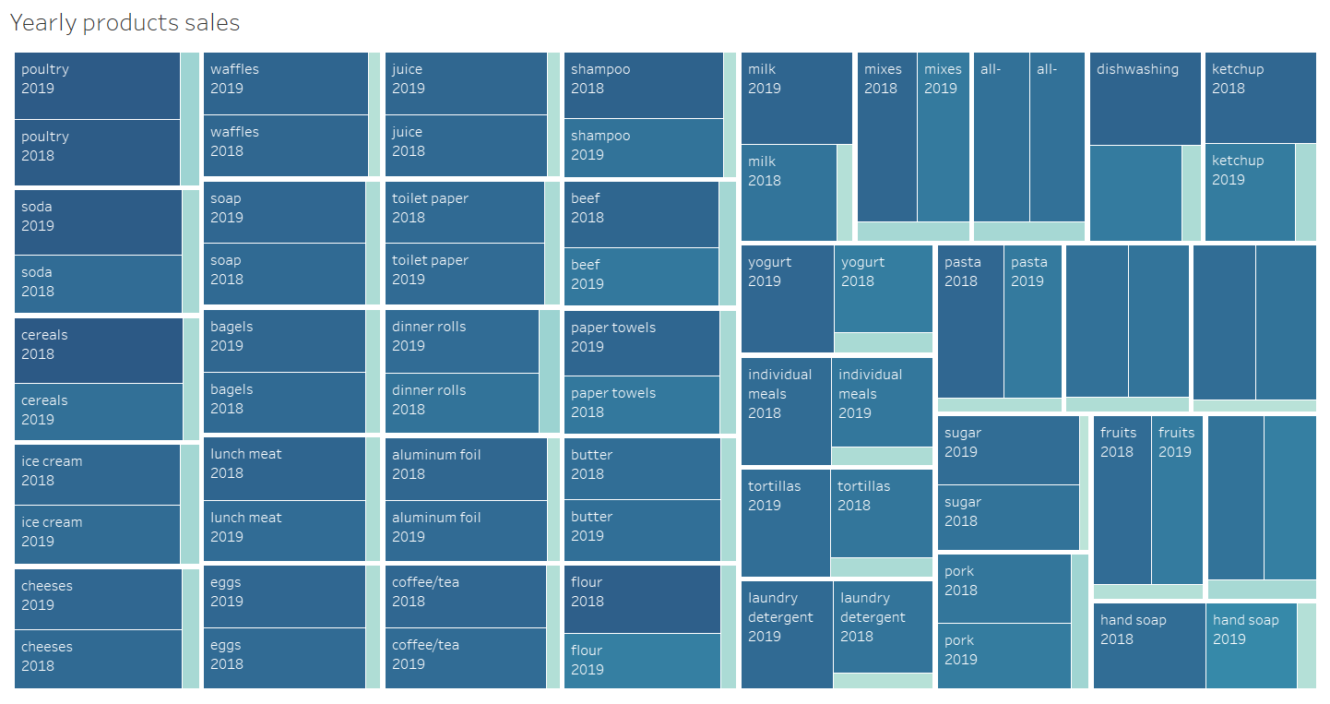
Yearly sales of products is shown below Poultry has highest sales and hand soap has the least sales through out Sales of Soda, Cereals, Paper towels, Flour , Beef, Sugar, Fruits, Hand soap and more have declined from 2018 to 2019 Products like Poultry, Ice cream, Cheeses, Coffee/Tea have stable sales There are no improvement in product sales seen This is a bad indication of business

Slide 10
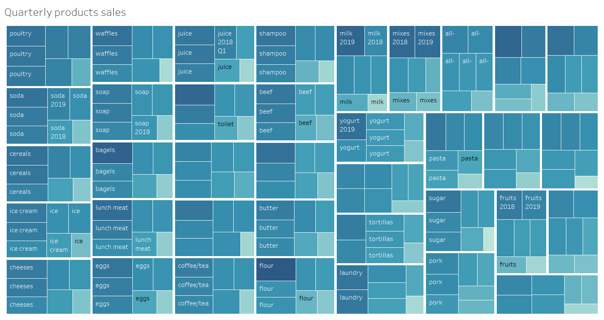
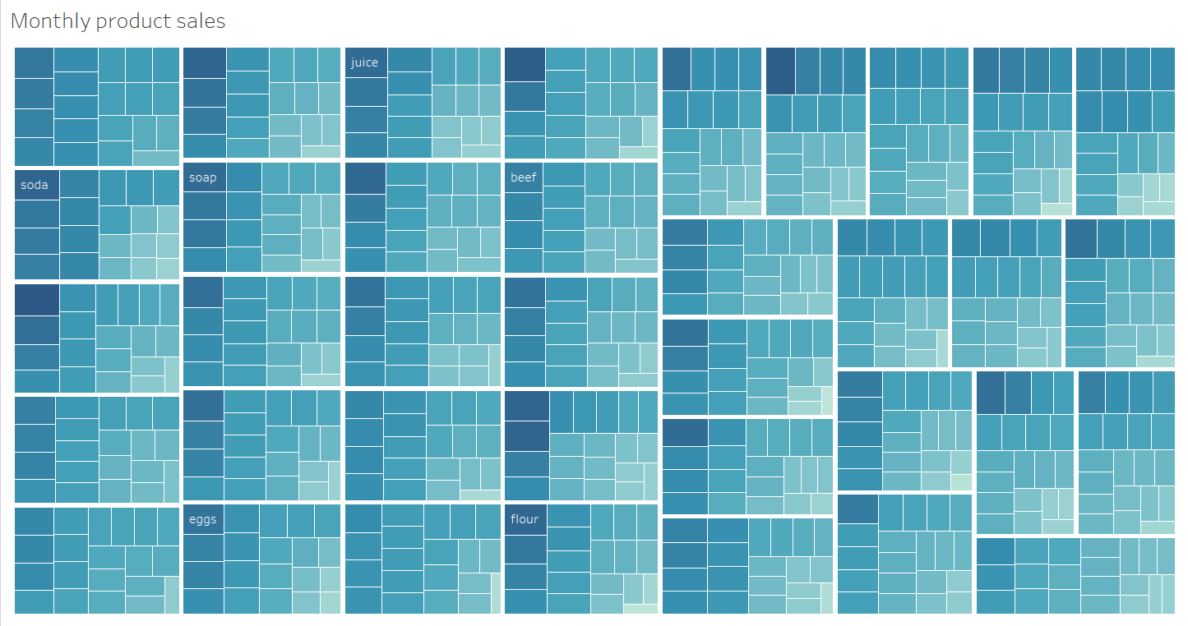
Quarterly and Monthly sales of each product is in declining trend. There are no products with stable or improved sales

Slide 11
Market Basket Analysis : Market Basket Analysis is a technique used to better understand customer purchasing patterns. It involves analysing data sets, to reveal product groupings, as well as products that are likely to be purchased together In market basket analysis, association rules are used to predict the likelihood of products being purchased together. Association rules count the frequency of items that occur together, seeking to find associations that occur far more often than expected. Eg: When a customer purchases All-purpose flour, eggs, butter there is a high chance of customer also purchasing milk, vanilla essence. Similarly, in this case, we recommend a product (with/without offers) to the customer based on the products that they have already chosen in the basket. This analysis is both beneficial to the customer and the business.

Slide 12
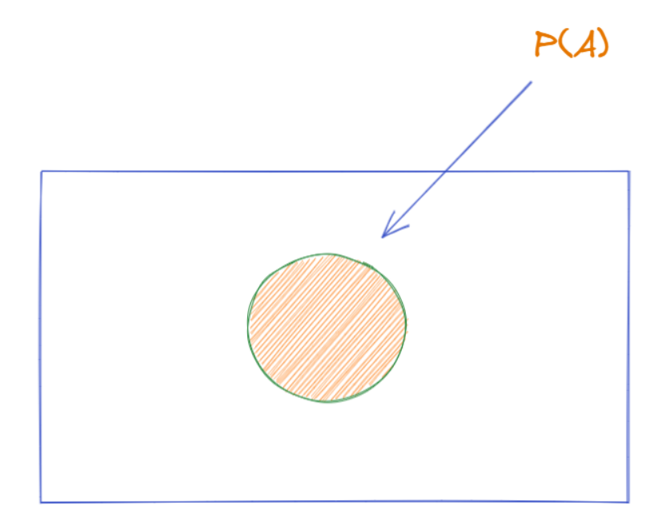
Support:
Within a dataset, i.e. a list of transactions, how many transactions contain item A, so it is just the probability of item A occurring. Statistically speaking, it is a frequentist's estimate of the probability.

Slide 13
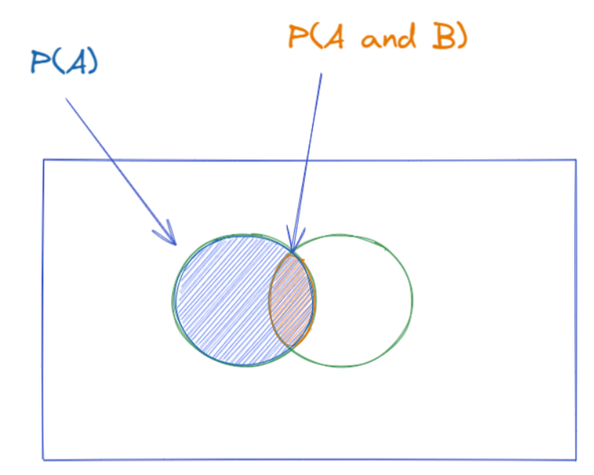
Confidence:
Out of the transactions that contains item A, how many also contains item B. The bigger the overlap, the greater the confidence we have that people who are buying item A also buys itemB. Statistically speaking, it is (estimated) conditional probably of item B given item A, i.e. P(B|A).

Slide 14
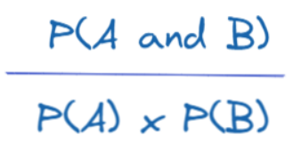
Lift:
The ratio between Confidence of A and Support B, it is less intuitive with the description, so let's try to visualize it better. First let's see the formula below.

Slide 15
Basket | Product1 | Product2 | Product3
1 | Cereal | Honey
2 | Cereal | Water | Honey
3 | Water | Diaper
4 | Cereal | Honey
5 | Water | Diaper
6 | Cereal | Honey | Diaper
7 | Cereal | Honey
8 | Honey | Diaper
9 | Honey | Cereal
Example: setA : Water+Cereal setB: Honey in this data set, setA occurs 1 time setB occurs 7 times setA+setB occurs 1 time Total baskets are 9 Support: setA/Total baskets = 1/9 = 0.1111 Higher the Support, more popular is the set Confidence: setA+setB / setA = 1/1 = 1 Support and Confidence used to set the thresholds Lift: Confidence / (setB/Total) = 1/(7/9) = 1.285 If a customer buys setA, buying setB increases by 1.285%

Slide 16
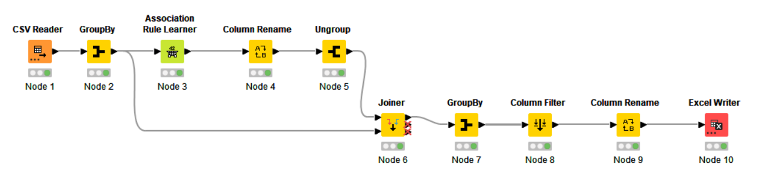
KNIME Workflow:

Slide 17
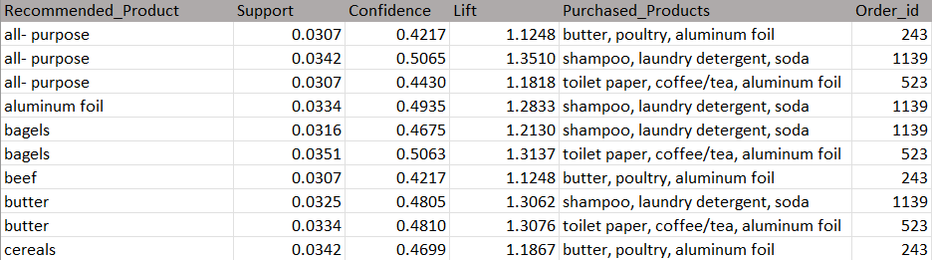
Associations identified :
The probability of a customer buying butter, poultry & aluminium foil is 0.0307% The probability of a customer buying all-purpose given that the customer has already preferred butter, poultry & aluminium foil is 0.4217% If a customer has purchased butter, poultry & aluminium foil, we recommend the customer to buy all-purpose too. Probability of this rule being recoganised in 1.1248%

Slide 18
Recommendations :
Customers who have purchased butter, poultry, aluminum foil together, we can recommend all-purpose, cheeses on an offer as a meal-combo. On purchase of toilet paper, coffee/tea, aluminum foil, we can recommend butter and bagels as a brekfast-combo Buy-one-get-one-free offer on cereals will increase its sales, which will in-turn increase sales of milk Year long sale on shampoo, laundry detergent, soda and paper towel recommendation can be given. Since these products have high shelf-life, sales of these products are of low frequency. This will help boost the product movement
There are 3 main sets found: butter, poultry, aluminum foil shampoo, laundry detergent, soda toilet paper, coffee/tea, aluminum foil On purchase of all these products, a bumper offer on fruits and sandwich loaves can be given This will push the least-sold short-shelf-life products and also attract customers

