Slide 1

Department of Information Technology A.P. Shah Institute of Technology G.B.Road,Kasarvadavli, Thane(W), Mumbai-400615 UNIVERSITY OF MUMBAI Academic Year 2020-2021

Slide 2
A Project Report on
Healthchain:
An Electronic Health Profile Storage Using Blockchain Submitted in fulfillment of the degree of Bachelor of Engineering(Sem-8)
in INFORMATION TECHNOLOGY By Sanjana Nalawade ( 17104056 ) Sitanshu Mathukia (18204004) Kunal Jadhav ( 17104018 )
Under the Guidance of
Prof. Kiran Deshpande

Slide 3
1.Project Conception and Initiation

Slide 4
1.1 Abstract
With an ever-increasing population, the number of diseases is also increasing in today's world. Every year, approximately 60% of the population is diagnosed with a variety of health problems.
As a result, the number of health records is growing, some of which are stored digitally and others physically.
Maintaining a personal health record for an individual can also be time-consuming, as it runs the risk of being misplaced or damaged.
Our project focuses on making the entire process more convenient for patients and healthcare providers by digitising it.
It focuses on converting all health records into Electronic Health Records (EHR) and storing them on blockchain because it saves money and improves performance.
Healthchain is a platform that digitalizes the entire patient experience, from health records to medical bill payments, all in one place.
Healthchain also provides doctors with information about the patient's medical history.

Slide 5
1.2 Introduction
Blockchain technology has the potential to transform health care by placing the patient atthe center of the health system and increasing the security, privacy, and interoperability of health data.
This technology could provide a new model for health information exchange(HIE) by making electronic health records (EHRs) more efficient and secure.
EHRs contain critical and highly sensitive private information for diagnosis and treatment in healthcare.
These data are a valuable source of healthcare intelligence.
The sharing of healthcare datais an essential step toward making the healthcare system smarter and improving the qualityof healthcare service.
The five basic principles underlying the technology.
Distributed Database, Peer-to-Peer Transmission, Transparency with Pseudonymity, Irreversibility of Records, Logic Computation.

Slide 6

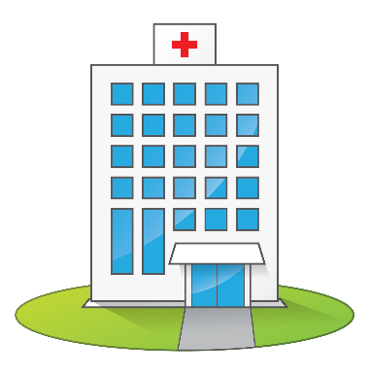
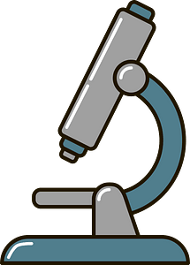
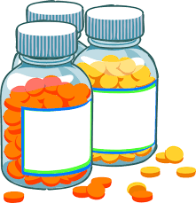

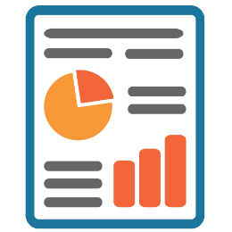
1.2 Introduction
Doctor
Hospital
Lab
Pharmacy
Insurer

Slide 7
1.4 Objectives
Collaboration Among Healthcare Organizations: It is made possible by providing the healthcare industry with a single, standardised, and consistent database of real-time patients secured with blockchain.
Safe Data Exchanges: Blockchain protects data while also providing comprehensive data sharing options, allowing patients to unlock only the data required by their healthcare providers while keeping the rest private and secure.
Valuable Insights for Better Care: Every day, a massive amount of health data is created; it can be a tedious task for patients to keep this data physically, as well as for doctors to go through this vast data every time, which can lead to missing important data in the process.
Complete healthcare services, including appointment scheduling, video calling, and electronic health record storage.

Slide 8
1.3.1 Existing System
EHR is a record of the care you receive from your doctors or medical facilities.
It is created and maintained by health care providers and contains information about health issues, medications, and treatments. If you visit a lot of doctors, you might have a lot of EHR.
The patient's data is stored in the cloud or on the local databases of various organisations by EHR systems.
Its goal is to convert paper-based medical records into electronic medical records.
The data could be stored in an encrypted format or not.
Some of this information is available to the patient, whereas others may be restricted to the organisation and cannot be shared.

Slide 9
1.3.2 Existing System
Practo
An app that can be used to get health checks done right away at the nearest pathology, connect with doctors in your area, and book an online appointment.
Practo is an online tool designed to assist doctors, labs, and hospitals in managing patient data.
It also assists patients by sending them digital reminders about doctor's appointments.
It offers two portals: practo ray and practo.com.
The former is a doctor management software for doctors that requires a monthly subscription, while the latter is a consumer portal that is free for both patients and doctors.

Slide 10
1.4 Problem Definition
Hospitals keep patient data in their database; similarly, lab reports are kept in the laboratories database, and medical bills are kept in the pharmacies database.
All of this dispersed data makes it difficult for the patient to maintain, store, and verify insurance claims.
Furthermore, hospitals are sometimes hesitant to share data with patients or other doctors from other hospitals; there is a lack of transparency in the traditional system, and there is a need for centralization and communication among the various entities.
Patient data is redundant on various organisations' individual databases, and the security of this data is jeopardised if the database experiences errors.
The flow of communication between patients and doctors is an essential component of medical treatment.
We all felt the need for digitalization during the covid situation, from online appointment booking to video call scheduling.

Slide 11
1.5 Scope
Helathchain in the form of a web application will provide ease to the healthcare providers and patients since it will be a one-stop location for all the records andmeeting, scheduling.
Healthchain also makes it easy for the healthcare providers to collaborate, example Doctor A can easilyread Doctor B’s prescription from the patients’ medicalhistory record and can proceed with diagnosis muchquickly.
Data being present at Healthchain also helps Insurancecompanies to verify the bills and records easily.
Data losses and redundancy will be minimized, as it is acentralized system that can be used at hospitals, clinics,and labs.

Slide 12
1.5 Scope
Security Issue and data tampering with the medicalrecords is minimized since the granular access to the data lies with the patients and only with the access from the patient the healthcare providers can add the data on the blockchain in an encrypted format.
Data analysis on the patients’ medical records which areof utmost importance to understand a patient’s medicalhistory, will help the healthcare providers with betterinsights which in turn will help for better diagnosis.

Slide 13
1.6 Technology stack
Ropsten
Html
Solidity
CSS
Front- End
MetaMask
JavaScript
Back-end
JITSI (WebRTC)
Nodejs
MYSQL
PHP

Slide 14
1.7 Benefits for environment & Society
Because it is entirely online, it can be accessed at any time and from any location.
Medical data is stored on the blockchain, which reduces the use of paper, which is susceptible to damage over time. In addition, digital storage makes it easier to access, search, and append data.
Blockchain has the advantage of not being controlled or owned by any entity, and because it is a decentralised system, transparency is maintained.
Patients can concentrate on their recovery rather than the hassle of managing, trans-porting, and storing medical data.
During appointments, patients may forget to convey a medical history that could haveassisted the doctor in making a better diagnosis; this is overcome by using healthchain,which provides valuable insights to the patients’ medical history.

Slide 15
1.7 Benefits for environment & Society
The challenges of result shifting and data snooping are addressed by blockchain tech-nology. The system allows for the transfer of time-stamped permanent records ofclinical trials and research outcomes, reducing the occurrences of fraud and error inclinical test records.
The medical record is the most comprehensive record of a person’s identification andmust be handled with care. Blockchain technology has proven to be extremely effectivein ensuring the integrity and security of medical records. Because blockchain-encrypteddata cannot be changed or deleted.

Slide 16
2. Project Design

Slide 17
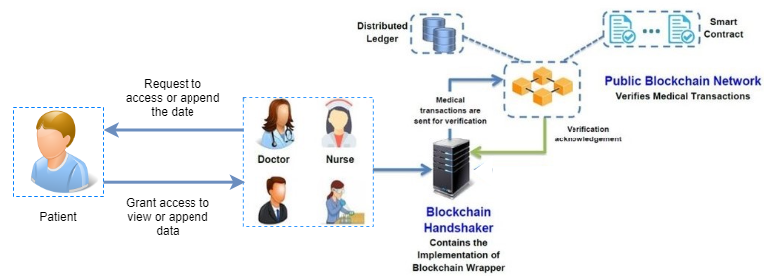
2.1 Proposed System

Slide 18
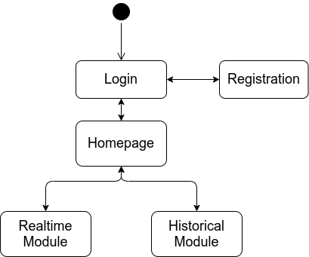
2.2 Design(Flow Of Modules)

Slide 19
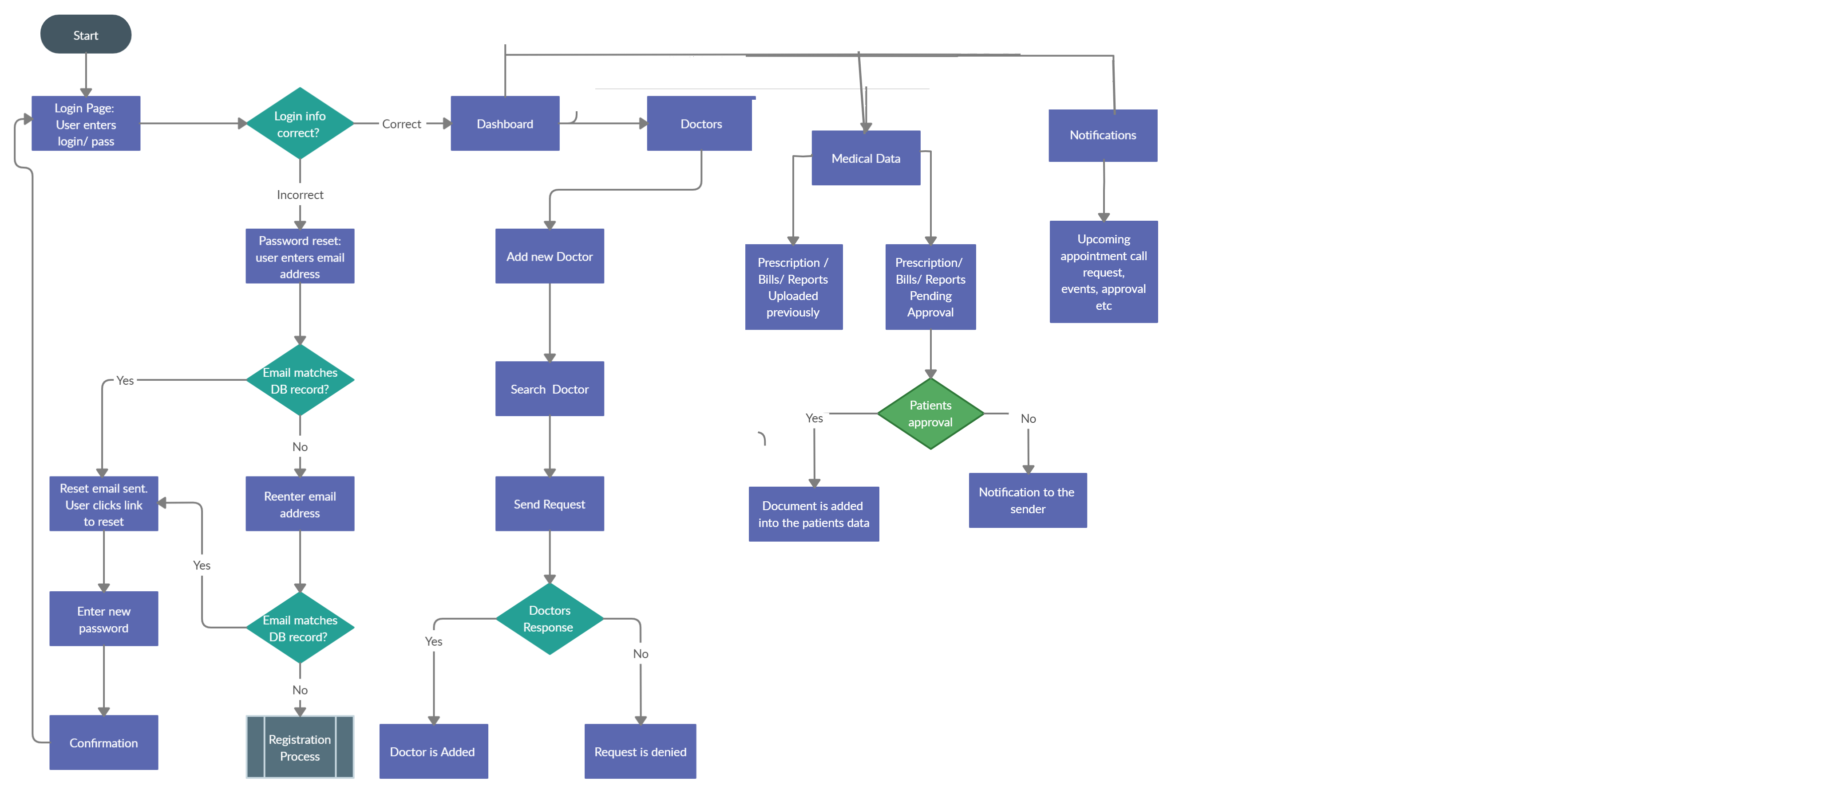
2.2 Design(Flow Of Modules)
Patient

Slide 20
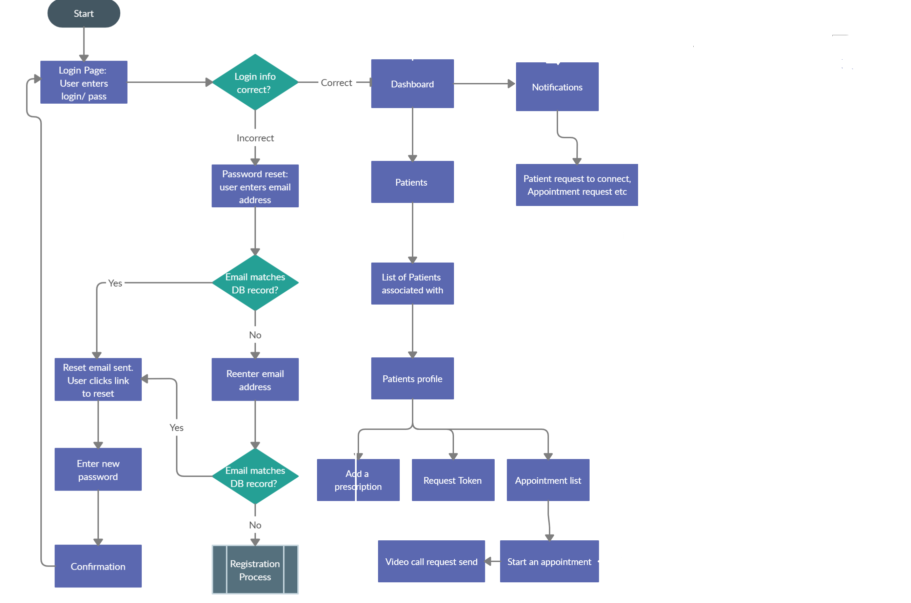
2.2 Design(Flow Of Modules)
Doctor

Slide 21
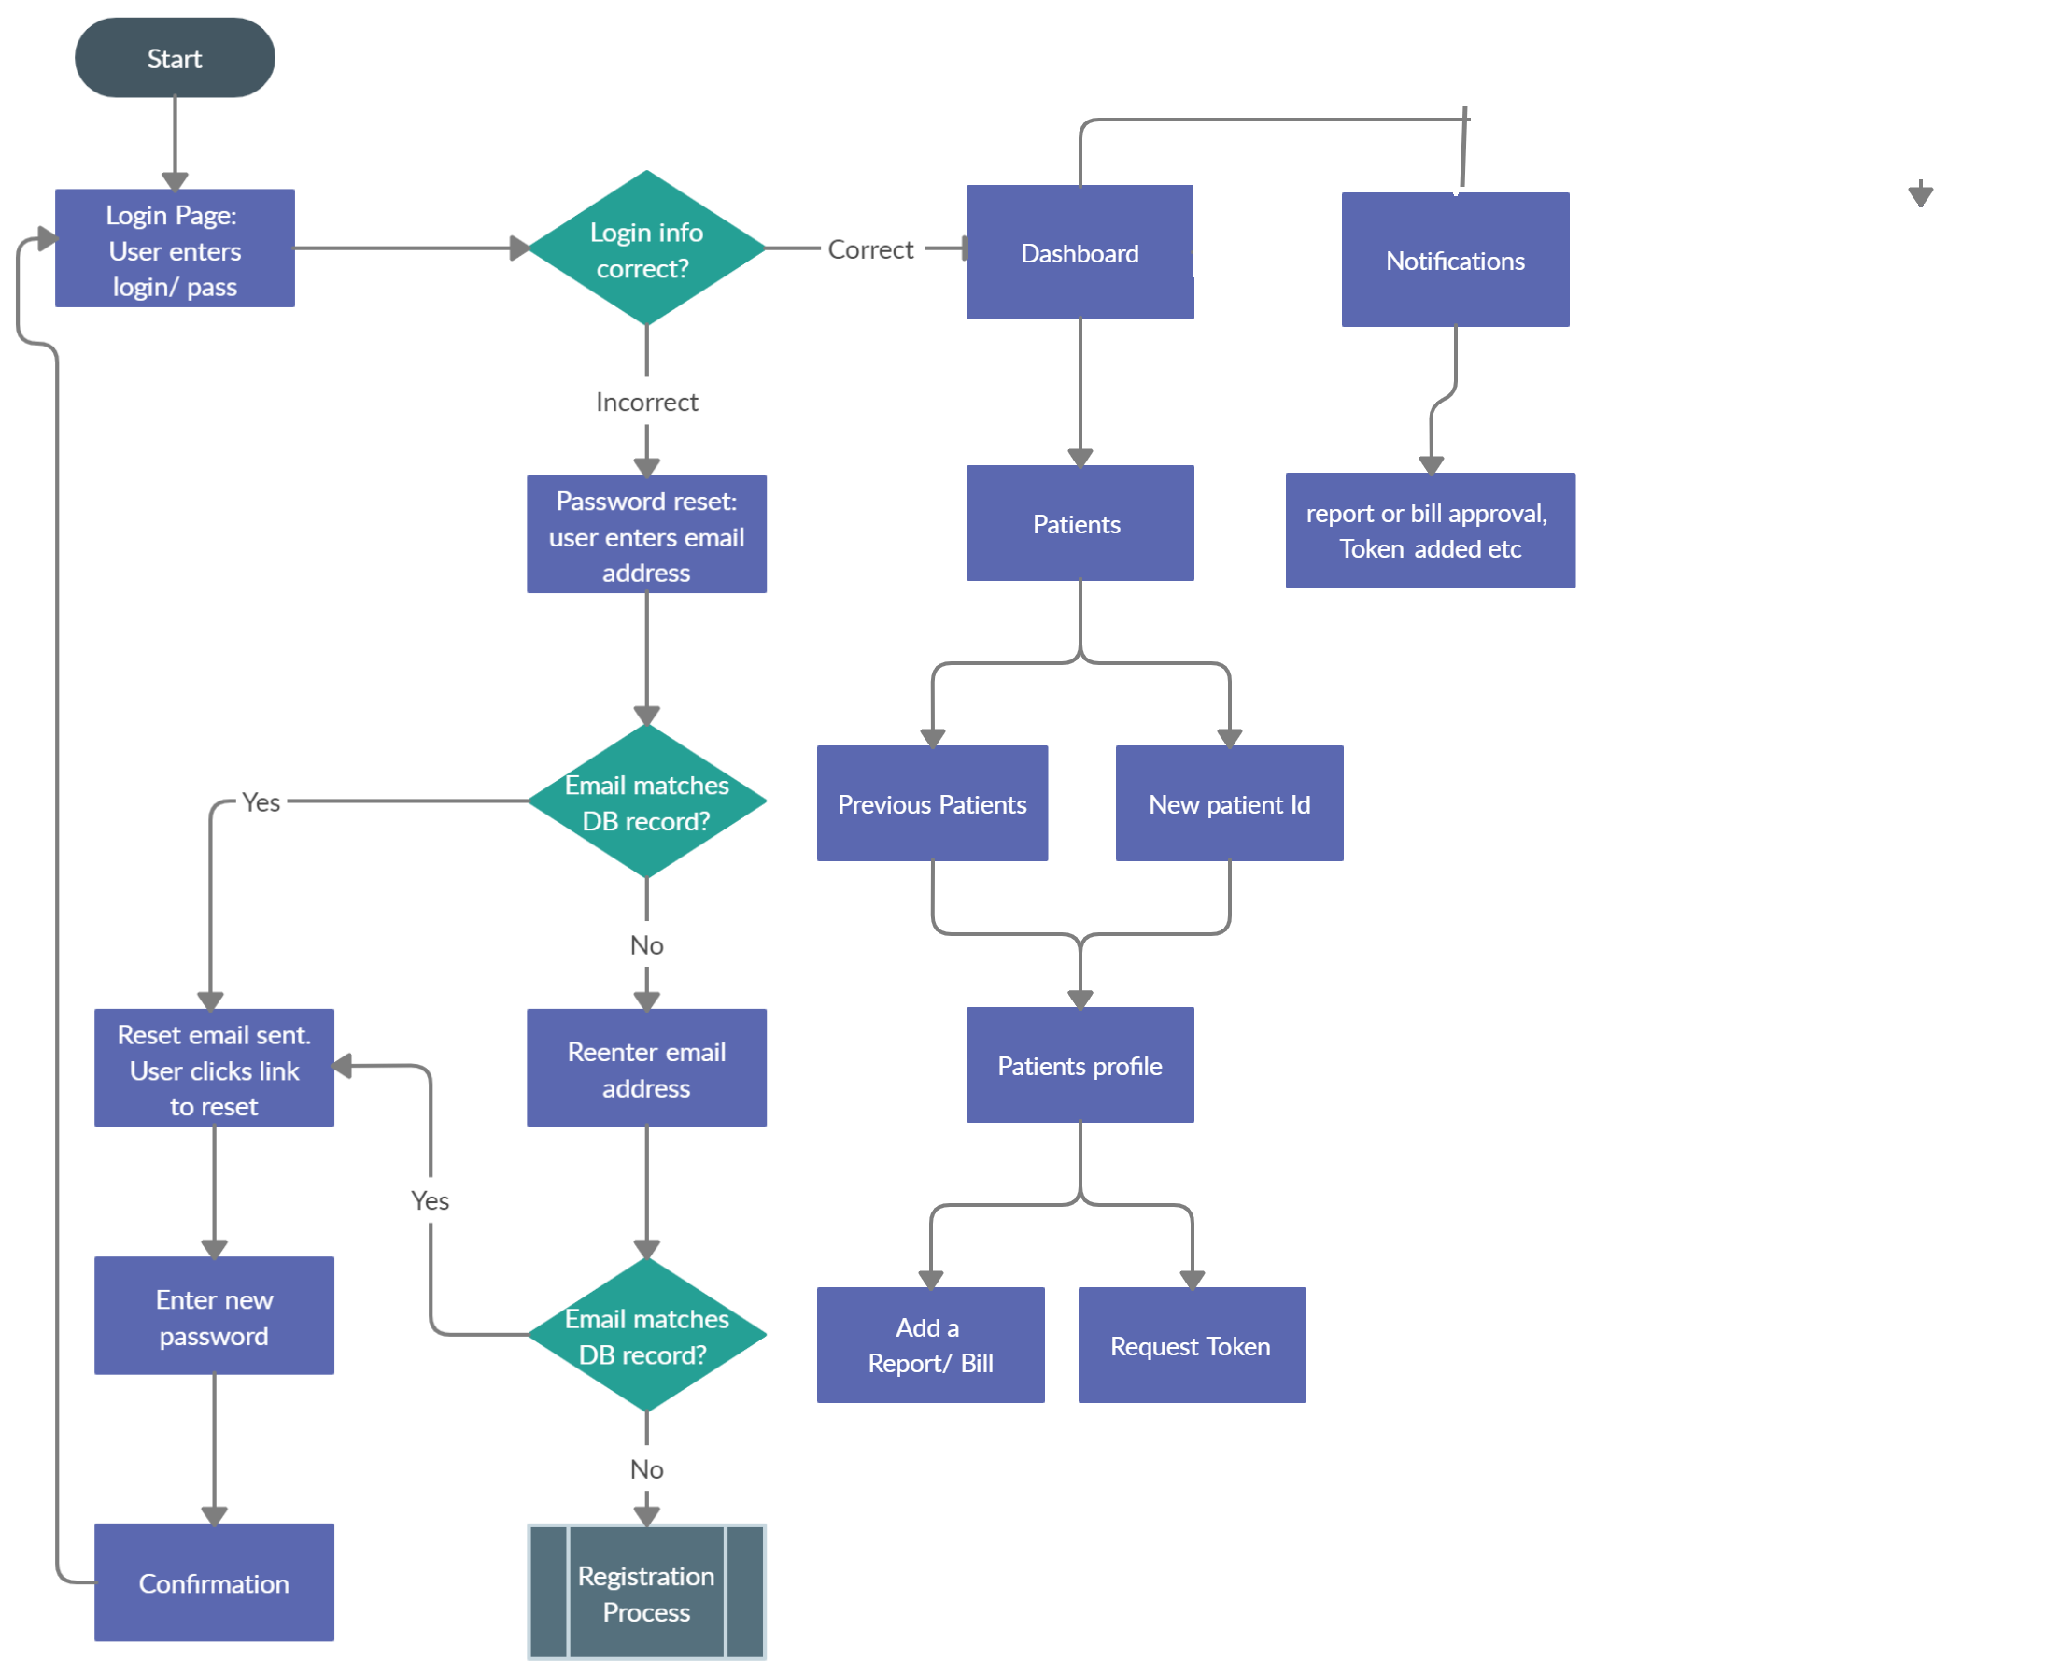
2.2 Design(Flow Of Modules)
Labs

Slide 22
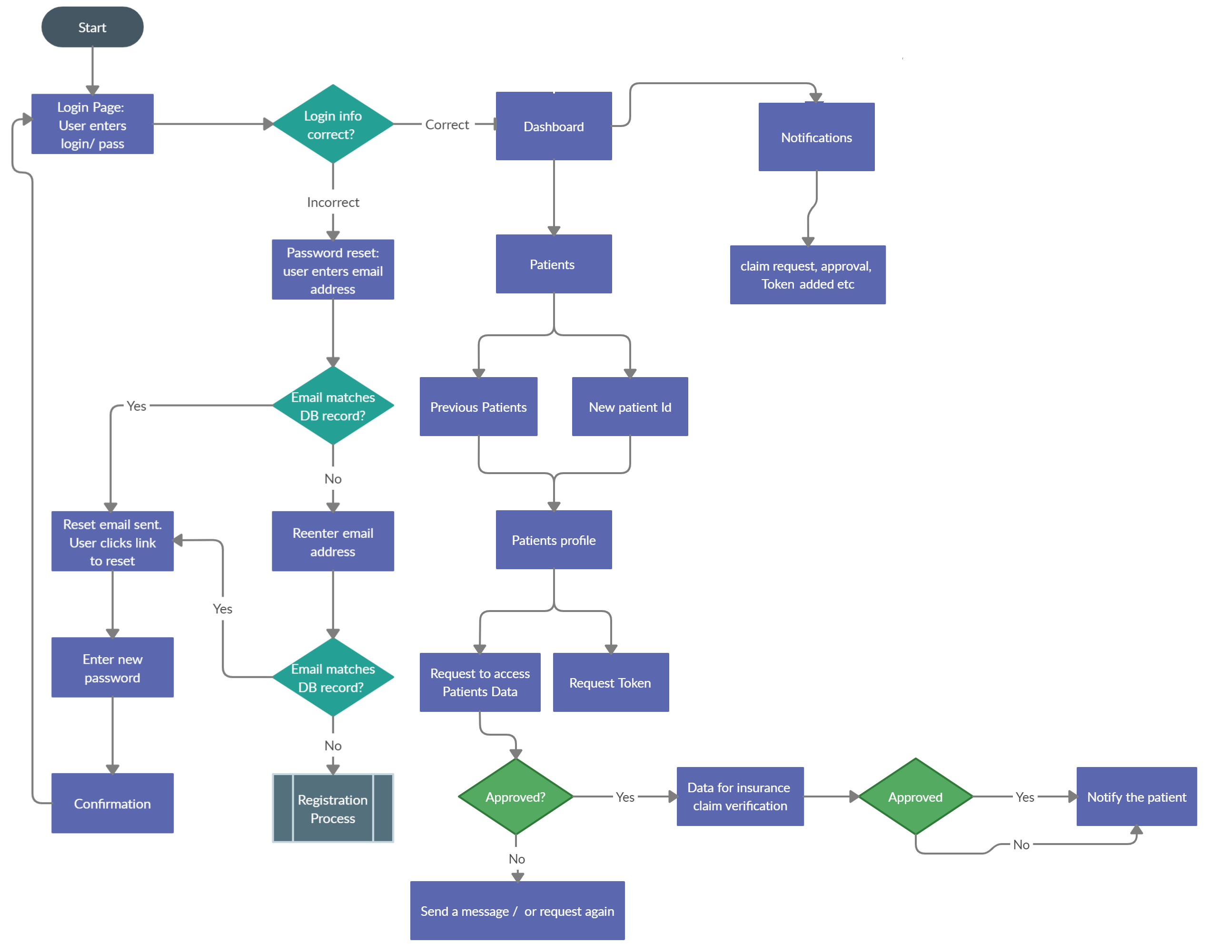
2.2 Design(Flow Of Modules)
Insurer

Slide 23
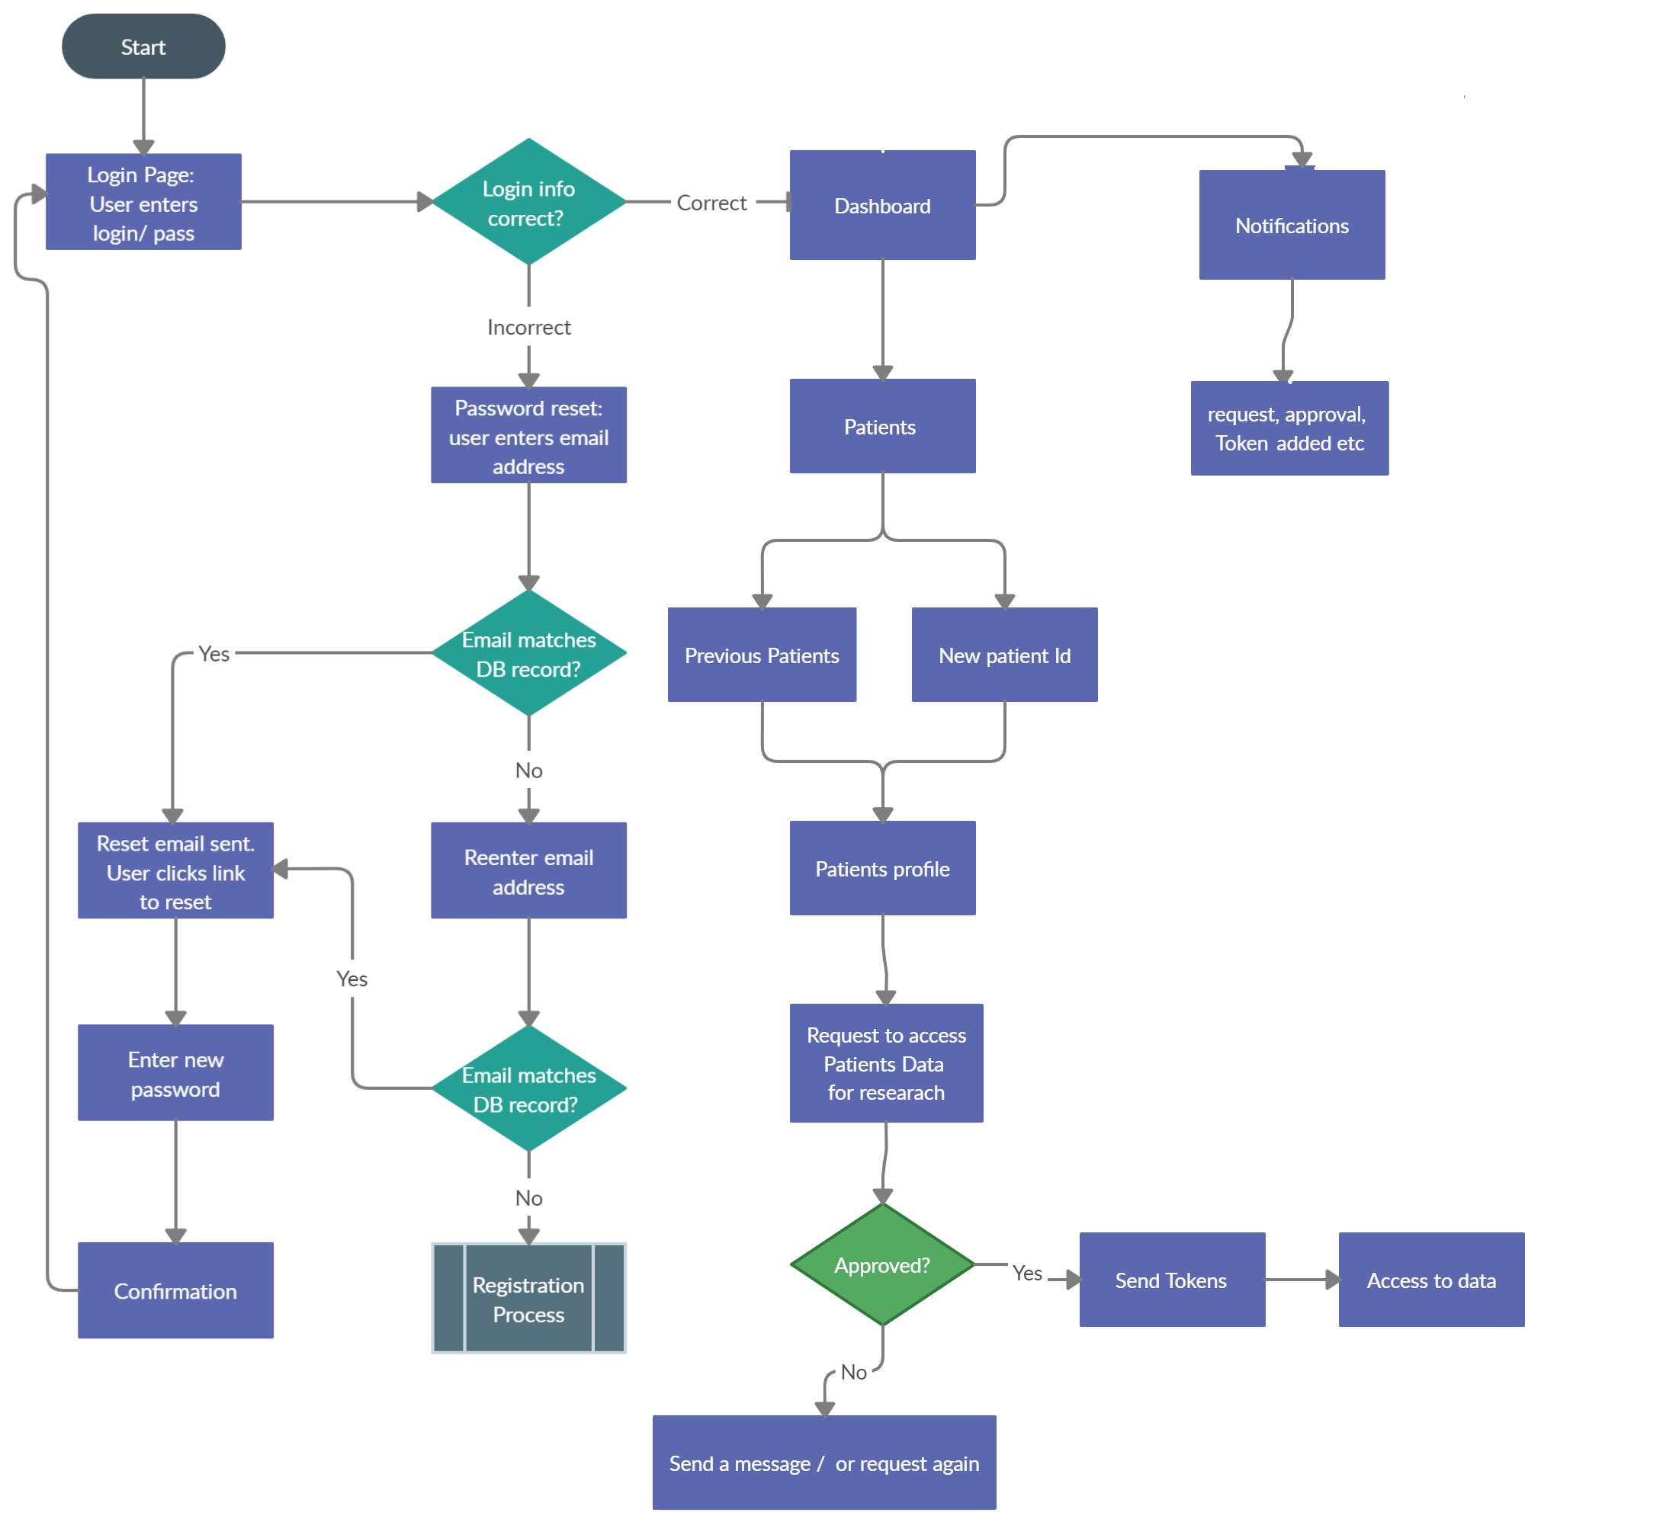
2.2 Design(Flow Of Modules)
Pharmaceutical

Slide 24
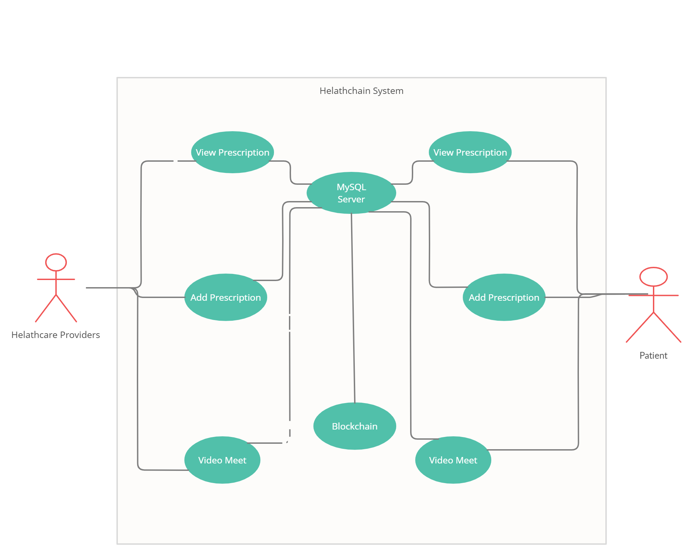
2.3 Description Of Use Case

Slide 25
3. Conclusion and Future Scope

Slide 26
3.1 Conclusion
In this project, Healthchain is proposed as an online healthcare framework that provides a complete solution for electronic health records and service management.
The blockchain framework for EHR management is intended to give patients ownership and control over their EHRs.
Patients can securely control access to documents and track how records are used, as well as allow secure record transfer and reduce the ability of unauthorised actors.
It aims to solve the current digital problems in the healthcare sector by providing centralization, security, and features such as video calls, making Healthchain the one-stop application for all your health documents and services.

Slide 27
3.2 Future Scope
In the future, we intend to learn more about a better payment system; currently, tokens are used, but a better module for the same item can be developed.
Machine learning and automation can be applied to medical data to predict patients' health problems in real time. It will assist healthcare providers in providing more efficient and immediate healthcare services.
Healthchain is a simple blockchain-based application for EHRs that meets some basic requirements. More functionalities and roles, as well as more extensive testing, are required for it to be used by a hospital network.
Before large-scale production deployments, more research will be needed to determine the scalability, security, and cost-effectiveness of blockchain technology.

Slide 28
2.7 References
[1] Cristiano Andr ́e da Costa Andr ́e Henrique Mayer.Electronic health records in a Blockchain:A systematic review - Andr ́e Henrique Mayer, Cristiano Andr ́e da Costa, Rodrigo daRosa Righi, 2020.url:https://journals.sagepub.com/doi/full/10.1177/1460458219866350.
[2] Suveen Angraal, Harlan M. Krumholz, and Wade L. Schulz. “Blockchain Technology”.In:Circulation: Cardiovascular Quality and Outcomes10.9 (2017), e003800.doi:10.1161/CIRCOUTCOMES.117.003800.url:https://www.ahajournals.org/doi/abs/10.1161/CIRCOUTCOMES.117.003800.
[3] Gaby G. Dagher et al. “Ancile: Privacy-preserving framework for access control and in-teroperability of electronic health records using blockchain technology”. In:SustainableCities and Society39 (2018), pp. 283–297.issn: 2210-6707.doi:https://doi.org/10.1016/j.scs.2018.02.014.url:https://www.sciencedirect.com/science/article/pii/S2210670717310685
4] T. K. Dasaklis, F. Casino, and C. Patsakis. “Blockchain Meets Smart Health: To-wards Next Generation Healthcare Services”. In:2018 9th International Conferenceon Information, Intelligence, Systems and Applications (IISA). 2018, pp. 1–8.doi:10.1109/IISA.2018.8633601

Slide 29
Thank You

