Slide 1
Team No: 70
Team Name:ByteBuilders
Team Member1: Sanjana S N
Team Member2: Archana A L
Team Member3: Ananya A S
Team Member4: Chaithra M

Slide 2
Problem Statement:
An organization has a lot of bills that require somebody to manually key in. Use Gen Ai to read and fill pre defined templates.
In many organizations, processing bills and invoices is still a manual task. Employees are required to read printed or scanned bills and manually enter details like invoice number, date, vendor name, tax, and total amount into spreadsheets or accounting systems. This process is time-consuming, repetitive, and prone to human errors — especially when dealing with large volumes of documents or bills with inconsistent formats.
Moreover, bills from different vendors have varied layouts, making traditional rule-based data extraction unreliable. This leads to inefficiencies, delays in payments, and errors in financial reporting.
The problem we aim to solve is: ❝ How to automatically and accurately extract structured information from unstructured bill images using OCR and Generative AI, reducing manual effort while improving speed and accuracy

Slide 3
Solution Approach:
To address the challenges of manual bill processing, we propose an intelligent system that combines Optical Character Recognition (OCR) with Generative AI to automatically extract structured information from scanned bills or invoice images.
Here’s how the solution works:
1. 🖼 Upload Bill (Image/PDF) The user uploads a scanned bill or photo of an invoice through a web interface or API.
2. 🔍 Text Extraction using OCR EasyOCR is used to extract raw text from the image, regardless of font or layout differences.
3. 🧠 Structured Parsing using Generative AI The extracted text is passed to a lightweight generative language model (Phi-2), which intelligently identifies and extracts key fields such as invoice number, date, vendor name, GST number, total amount, and line items.
4. 🧾 Output in Standard Format The result is returned as a structured JSON and Excel sheet, ready for database storage, accounting software, or manual review.

Slide 4
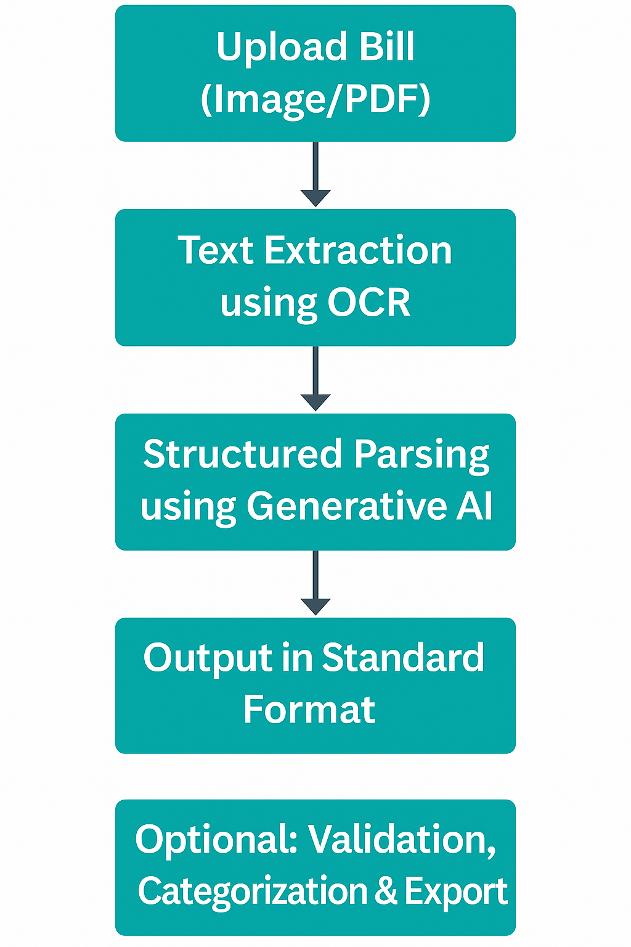
Flow Chart:
Tech Stack:
Frontend: React.js
Backend: FastAPI
Database: Postgre SQL
AI/ML Models: OpenCV, EasyOCR,Whisper.
Deployment as a Web API using FastAPI and accessible through a React-based frontend. Can be integrated with Google Colab for quick testing

Slide 5
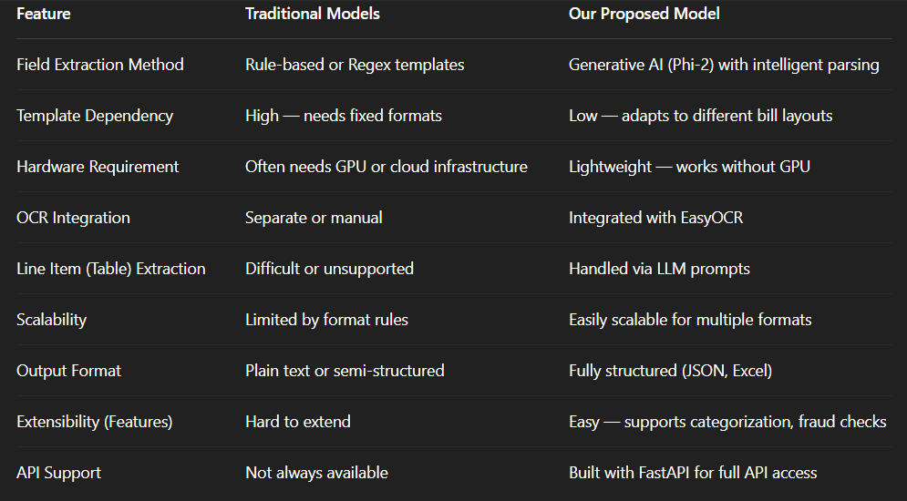
How our model is different from existiong models??

Slide 6
Dataset, Model, and Implementation
Dataset Used:
Custom dataset containing Publicly Available Invoice.
Models Used:
EasyOCR: Lightweight and efficient deep learning-based OCR.
Implementation Steps:
Preprocessing: Image enhancement.
Text Extraction: OCR-based handwriting recognition.
Applications
Corporate Finance Automation→ Automatically extracts and organizes invoice data for seamless
accounting and auditing.
2. Retail & Supermarket Chains→ Analyzes itemized bills to track sales, detect fraud, and understand
customer buying behavior.
3. Freelancer/Consultant Bill Tracker→ Helps freelancers manage expenses and generate project-based
billing summaries.
4. Reimbursement & Claims Management→ Streamlines employee bill verification and policy-based
reimbursement approvals.
5. Government Procurement→ Ensures vendor bill compliance, prevents duplication, and supports
transparent spending.

Slide 7
THANK YOU

