Slide 1

FINAL YEAR PROJECT
Job Market Intelligence
& Skill Demand Analytics
JOB MARKET SIGNALS
Data Analytics + Machine Learning
Presented by
Sanjana Singh | URN: 231390690107
Under the guidance of Mr. Harkesh Gulia
Skills • Roles • Salary
Global Institute of Technology & Management
B.Tech • Computer Science & Engineering • 2025–2026

Slide 2
01 / THE CHALLENGE
Problem Statement & Objectives
Turn scattered job-posting data into practical signals for career decisions.
THE PROBLEM
PROJECT OBJECTIVES
Job information is abundant—
but hard to compare.
01
Map demand
Analyze roles, locations and industries.
02
Extract skills
• Skill requirements vary across roles and industries.
• Salary information is incomplete and uneven.
• Manual review makes market patterns difficult to spot.
Rank frequently requested skills.
03
Model outcomes
Predict salary and classify job text.
04
Find skill gaps
Compare a skill set with target-role needs.
JOB MARKET INTELLIGENCE • B.TECH CSE • 2025–2026
02

Slide 3
02 / APPROACH
Methodology & Workflow
A repeatable pipeline from raw postings to interpretable insights.
01
02
03
04
05
06
07
Dataset
Clean
Explore
Extract
Model
Interpret
Present
30,000 postings
18 useful fields
EDA & trends
152-skill keyword list
Regression + classifier
Predictions & gaps
Power BI dashboard
Quality checks matter at every stage: remove unusable records, document assumptions, and interpret model outputs cautiously.
DATA → INSIGHT → DECISION
JOB MARKET INTELLIGENCE • B.TECH CSE • 2025–2026
03

Slide 4
03 / DATA FOUNDATION
Dataset Description
LinkedIn Job Postings (2023–2024) • Kaggle dataset: arshkon/linkedin-job-postings
30,000
18
8,713
~29%
sampled postings
useful columns
salary records
salary coverage
Random sample, seed 42
Industry field merged in
Postings with salary data
8,713 of 30,000 postings
IMPORTANT FIELDS
DATA QUALITY NOTES
• Job title and description
• Location, industry and employment attributes
• Salary fields where provided
• Rows without a description were removed
• Salary is missing for most postings
• Findings reflect a sample, not the entire market
JOB MARKET INTELLIGENCE • B.TECH CSE • 2025–2026
04

Slide 5
04 / TOOLKIT
Tools & Technologies
Tools documented in the project README—kept focused on the implemented workflow.
Python
Pandas + NumPy
Matplotlib + Seaborn
Core analysis & modeling
Cleaning, transformation, numeric work
Exploratory charts
Scikit-learn
Jupyter Notebook
Power BI
Random Forest, TF-IDF, Logistic Regression
Experimentation & analysis
Interactive dashboard
Skill extraction uses keyword matching against a curated list of 152 skills.
JOB MARKET INTELLIGENCE • B.TECH CSE • 2025–2026
05

Slide 6
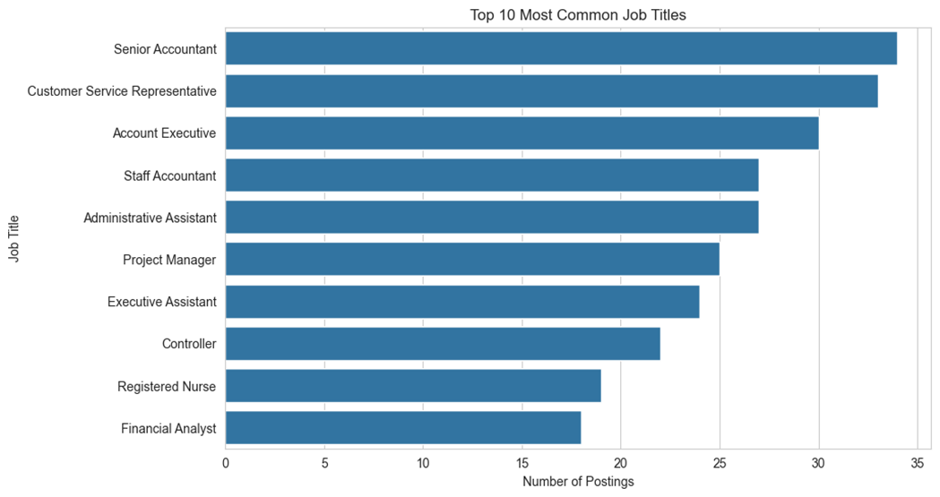
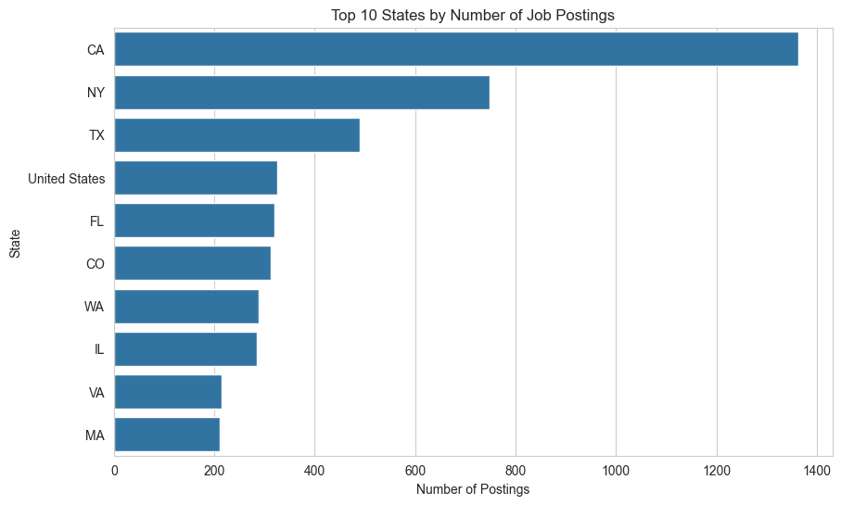
05 / EXPLORE
Exploratory Data Analysis (EDA)
Actual charts from the analysis: most common job titles and states by posting count.
TOP 10 JOB TITLES
TOP 10 STATES
Counts reflect the dataset used for these charts; state labels are shown as provided.
JOB MARKET INTELLIGENCE • B.TECH CSE • 2025–2026
06

Slide 7
06 / PREDICT & CLASSIFY
Machine Learning — Model Evaluation
REGRESSION • SALARY PREDICTION
CLASSIFICATION • INDUSTRY PREDICTION
MEAN ABSOLUTE ERROR (MAE)
ROOT MEAN SQUARED ERROR (RMSE)
R² SCORE
ACCURACY
$30,590.54
$43,070.94
0.289
71.0%
Average absolute salary prediction error.
Penalizes larger prediction errors more strongly.
Model explains about 28.9% of target variance on the evaluated data.
Classification accuracy = 0.710.
INTERPRETATION
• Salary prediction has a modest fit (R² = 0.289); estimates should be treated as approximate.
• MAE is the typical absolute error scale, while RMSE is higher because larger errors receive more weight.
• Classification accuracy is 71.0%; also check per-class precision/recall and the test-set setup before final submission.
JOB MARKET INTELLIGENCE • B.TECH CSE • 2025–2026
07

Slide 8
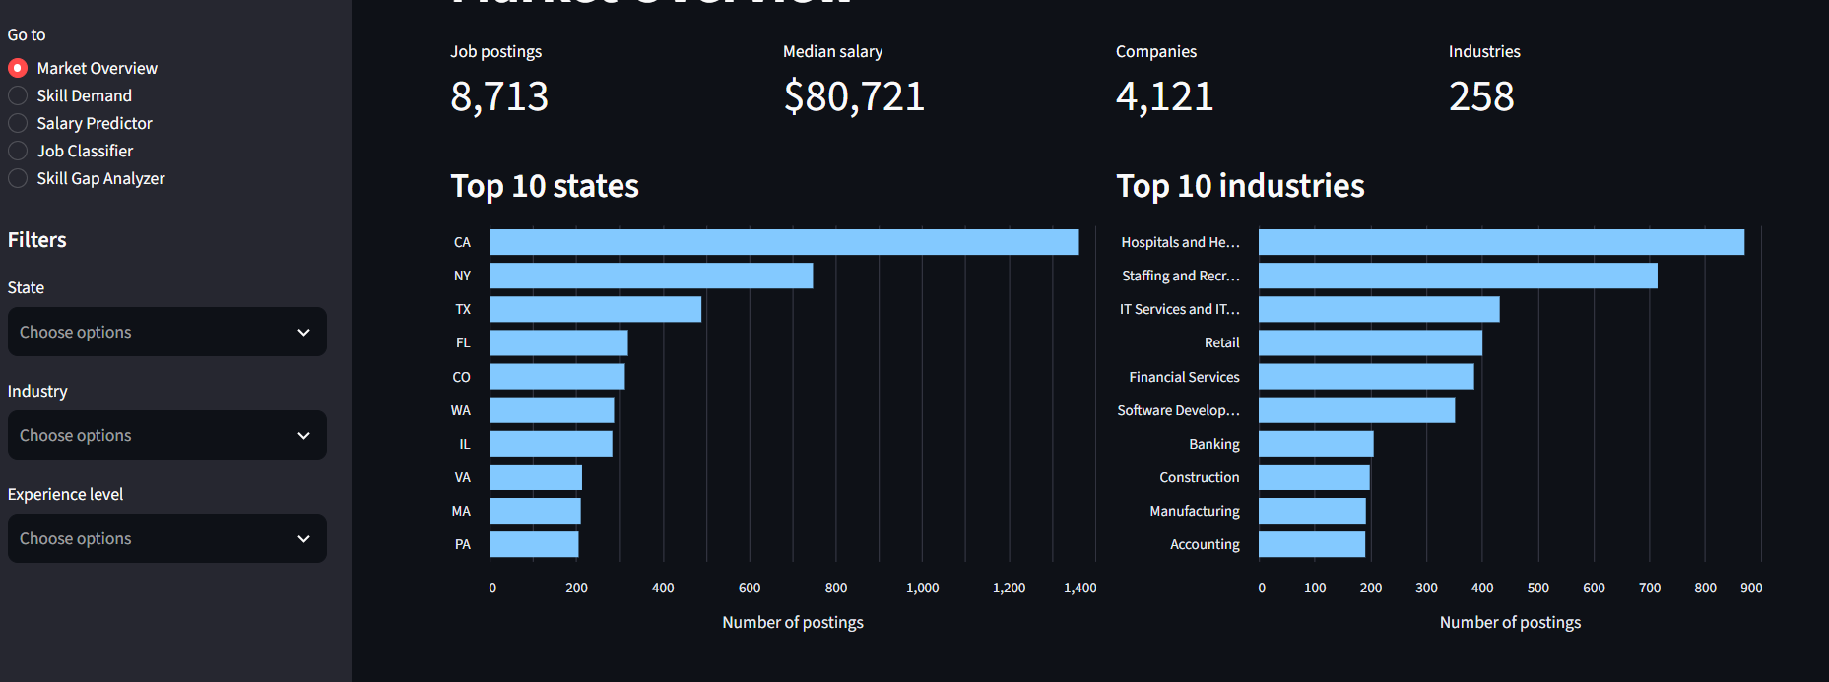
07 / COMMUNICATE
Project Demo: Power BI Dashboard
Dashboard view below is a designed concept, not a screenshot of the actual .pbix file.
JOB MARKET OVERVIEW
30K
8.7K
152
71%
Job postings
Salary records
Skill keywords
Classifier accuracy
SKILL DEMAND
SALARY MODEL PERFORMANCE
R²
0.29
MAE
≈ $30,500
JOB MARKET INTELLIGENCE • B.TECH CSE • 2025–2026
08

Slide 9
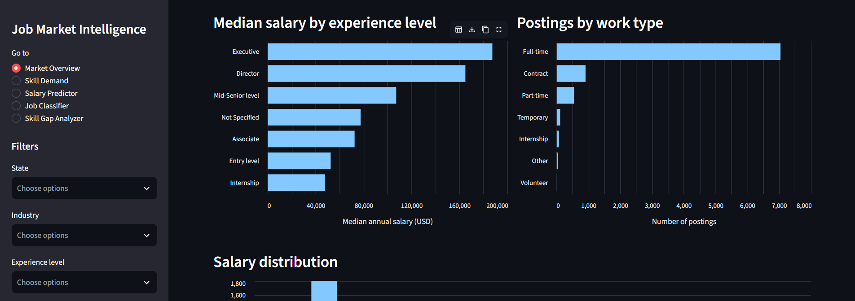
08 / COMMUNICATE
JOB MARKET OVERVIEW
30K
152
71%
Job postings
Skill keywords
Classifier accuracy
SKILL DEMAND
SALARY MODEL PERFORMANCE
R²
0.29
MAE
≈ $30,500
JOB MARKET INTELLIGENCE • B.TECH CSE • 2025–2026
08

Slide 10
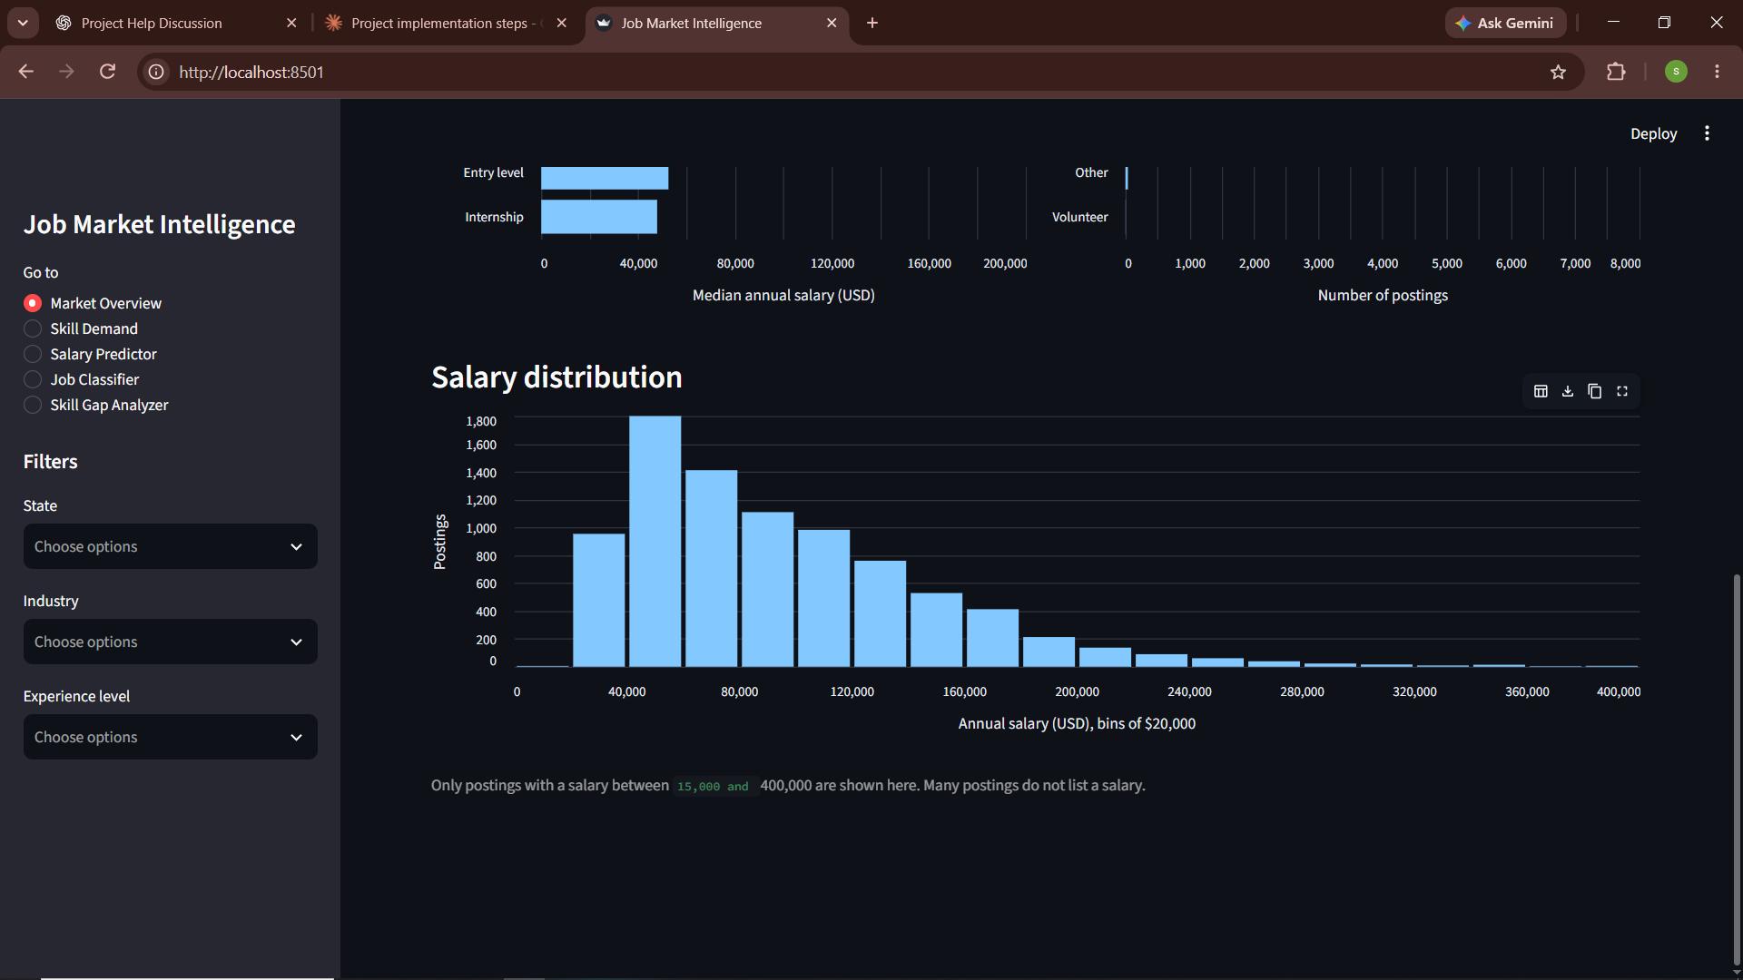

Slide 11
10 / INTERPRET RESPONSIBLY
Results, Insights & Limitations
What the project can tell us—and where caution is required.
KEY INSIGHTS
LIMITATIONS
NEXT IMPROVEMENTS
• Communication and leadership
appear prominently.
• Sales, customer service and Excel
are also common.
• SQL and Python appear in non-tech
industries.
• Salary is available for only ~29% of
records.
• Keyword matching can misread
context.
• A 30K sample may not represent
all jobs.
• Refresh with newer postings.
• Improve contextual skill extraction.
• Tune models and report error by
subgroup.
JOB MARKET INTELLIGENCE • B.TECH CSE • 2025–2026
11

Slide 12
09 / TAKEAWAY
From job postings to
career intelligence.
A practical pipeline for understanding skills, roles and salary signals.
01
Understand demand
Find recurring skill and role patterns.
02
Use models carefully
Classification is useful; salary estimates remain uncertain.
03
Act on skill gaps
THANK YOU
Use insights to guide learning and role targeting.
Questions & Discussion
Sanjana Singh • URN 231390690107 • B.Tech CSE

