Slide 1

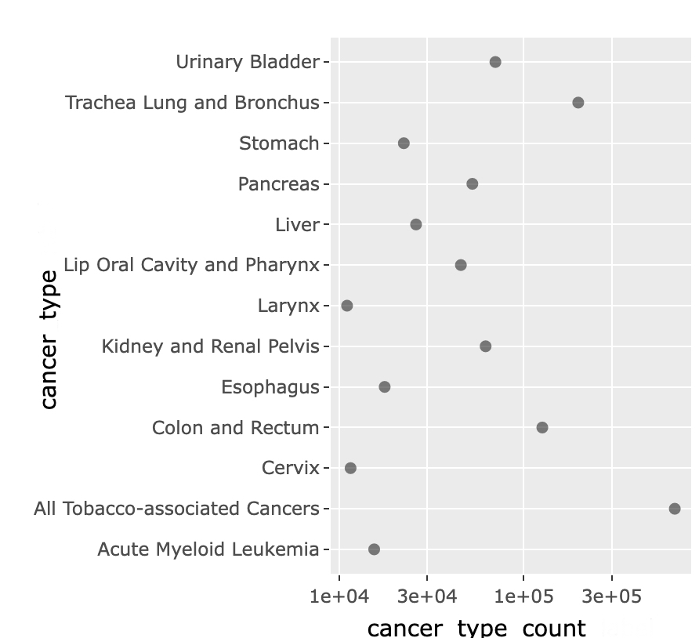
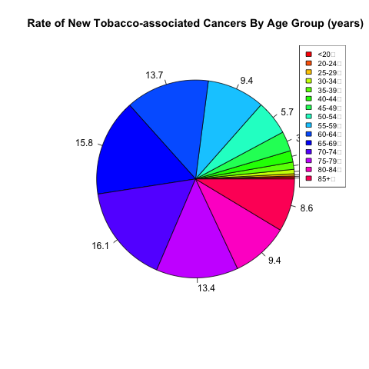
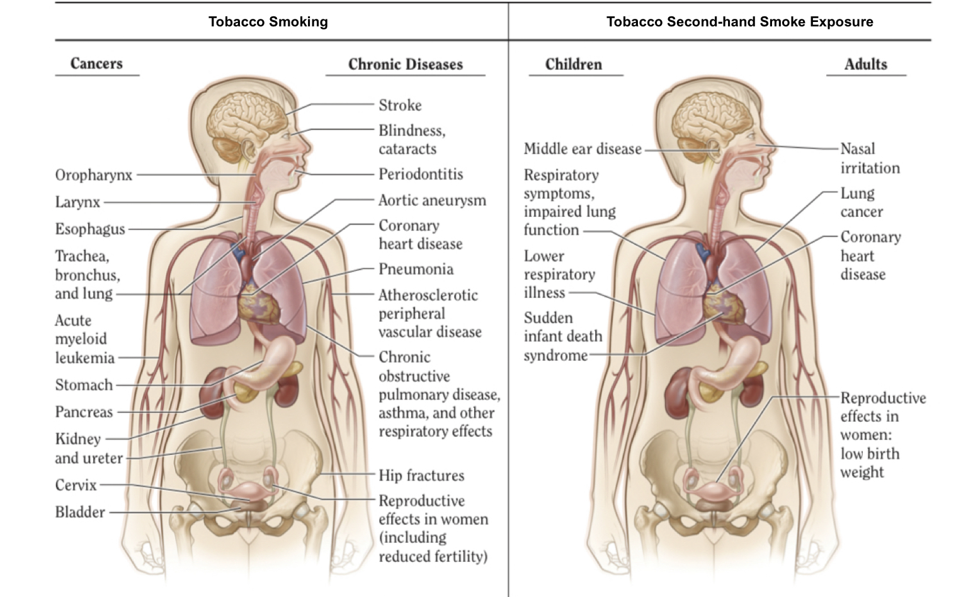
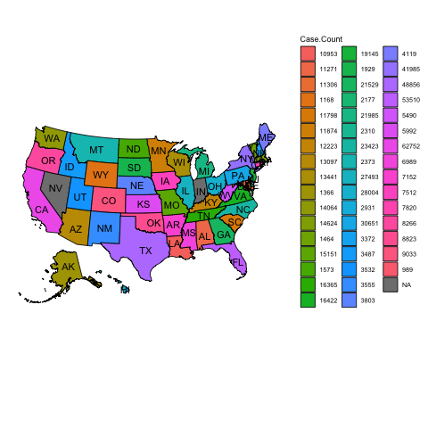
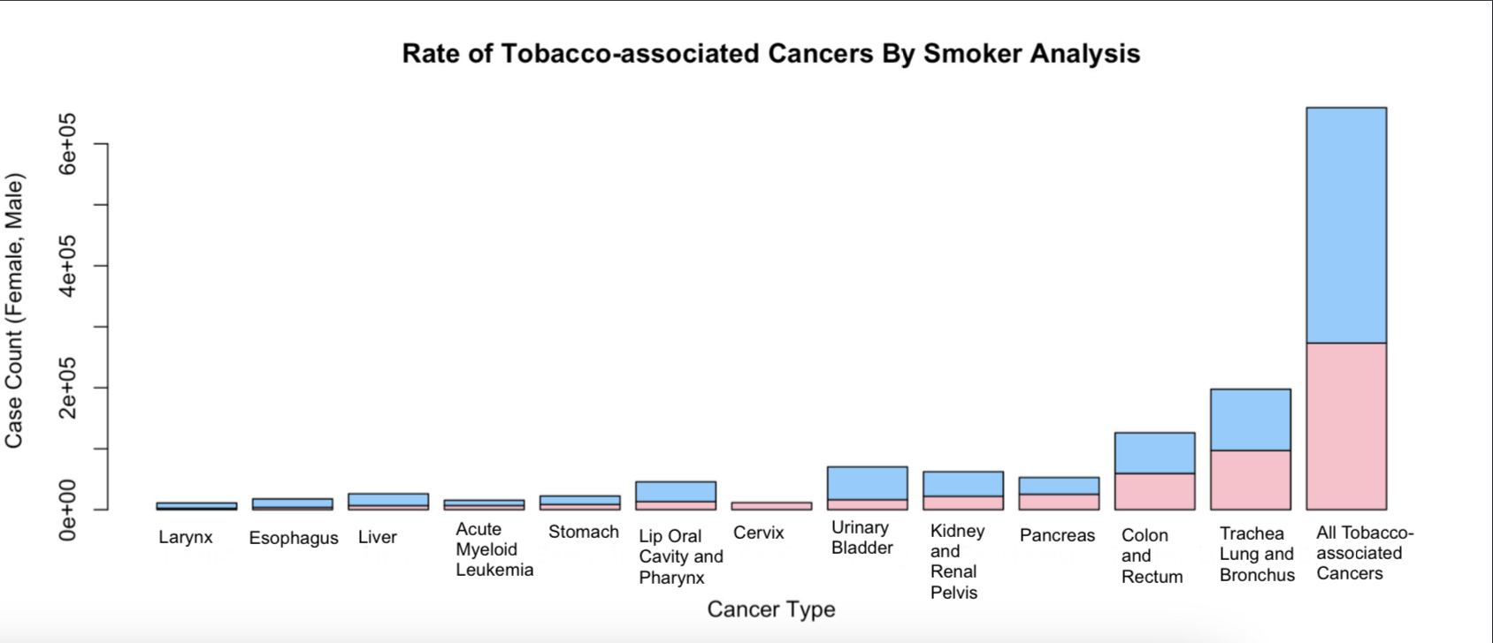
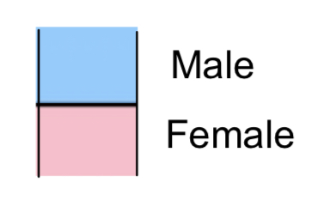
Sana Kausar Habiya and Sanjana Motte Vishwanatha
Northeastern Illinois University
Investigating the Connection Between Tobacco Use and Cancer: Bringing Tobacco's Impact to Light
BACKGROUND
RESULTS
CONCLUSION AND FURTHER RESEARCH
Tobacco smoke has at least 70 chemicals that cause cancer, also known as carcinogens. Approximately 600 compounds are added to tobacco to enhance flavor or nicotine absorption, some of which could contribute to dependence. Inhaling this mix of chemicals through smoke induces tissue injury and changes in the cellular environment that foster proliferation and transformation into cancer cells [1][2].
Fig. 1 : Rate of new Tobacco associated Cancer and New case count
Fig. 2 :
Our study clearly confirms the significant association between tobacco use and a number of cancers. The biggest preventable cause of cancer and cancer-related deaths worldwide continues to be tobacco use. There are regional variations in the incidence of malignancies linked to tobacco use in the United States, with California, Texas, and Florida having the highest rates. It's also been evident that tracheal, bronchial, and Lung Cancers were common in both males and females of all races and ethnic groups in the U.S. These findings emphasize the urgent need for efficient tobacco control policies and focused initiatives to lessen the incidence of malignancies linked to tobacco use.
Future studies should concentrate on long-term follow-up studies to estimate cumulative risks over time in order to better understand the effect of tobacco use on cancer incidence. Additionally, research on the effects of socioeconomic factors, genetic and biochemical mechanisms, and discrepancies across various racial and ethnic groups can be very insightful in establishing individualized preventative methods. Tobacco-related malignancies will decline as a result of evidence-based initiatives, which will be aided by assessing the efficacy of tobacco control measures and figuring out the causes of regional differences.
This study is extremely important because it highlights the urgent need for comprehensive tobacco control strategies by reiterating the well-established link between tobacco use and a number of malignancies. For focused preventive and early detection initiatives, it is helpful to examine age and gender trends as well as high-risk geographic locations. This study helps promote public health measures attempting to lessen the harmful effects of tobacco use by emphasizing the effect of tobacco smoking on cancer incidence and the significance of ongoing research and prevention efforts.
Smokers are up to 22 times more likely to develop lung cancer in their lifetime compared to non-smokers. However, people who do not use tobacco but who are exposed to second-hand smoke at home, work or in other public places also have an increased risk of developing lung diseases, including chronic respiratory diseases and lung cancer [3].
The rate of new cancers linked to tobacco use by age group and for all gender represent in Figure 2. Our research shows that the 50–79 age group has the highest prevalence of cancers associated with tobacco use.
The new cancers associated with tobacco use and the types of cancer are shown in Figure 1. The trachea, lung, and bronchus have been found to have the highest rates of all cancer types, followed by the colon and the rectum.
[1][2]
Tobacco use accounts for 25% of all cancer deaths globally and is the primary cause of lung cancer. It is the leading preventable cause of cancer and cancer deaths. It can cause not only lung cancer but also cancers of the mouth and throat, esophagus, stomach, kidney, pancreas, liver, bladder, cervix, colon and rectum, and a type of leukemia [4].
.
Fig. 3 New Tobacco associated Cases among all states in U.S.
AIMS
Provide a brief overview of the cancers most strongly associated with tobacco smoking, including lung, oral, esophageal, pancreatic, and bladder cancers.
Give an in-depth investigation of epidemiological data on the incidence of cancers brought on by tobacco use in the United States, with an emphasis on geographical variations, age, gender, races, and ethnicities.
Comparison of smokers across all racial and ethnic groups, genders by different types of cancers across all states in the US.
Figure 3 shows the overall number of newly diagnosed cases of cancer associated with tobacco use across all states in the United States. California, Texas, and Florida have the highest rates of tobacco-related cancer when compared to other states.
BIBLIOGRAPHY
DATA AND METHODS
Fig. 4 :
We used U.S. Cancer statistics as our primary data source for this study. We specifically investigated cancers associated with tobacco use. We included the 2020 dataset for tobacco-associated cancer, which includes all ages, gender, races and ethnicities and states in the United States.
To ensure compatibility and uniformity, the obtained datasets were thoroughly preprocessed. This entailed cleaning data, standardizing it, and geocoding addresses to generate spatial coordinates.
To investigate the relationship between tobacco usage and cancer incidence rates, a regression analysis was performed. Multiple regression models were created, taking into account potential confounding factors such as age, gender, and geographic areas in the United States.
To better understand the underlying mechanisms and dynamics of tobacco-related cancer, mathematical models were created. In order to represent the progression and impact of tobacco smoking on cancer development, these models included key factors and parameters.
High-risk locations and geographical clusters were identified using geospatial modeling approaches.
How tobacco smoke causes disease: The Biology and Behavioral Basis for Smoking-attributable Disease : a Report of the Surgeon General. (2010). Health and Human Services Department.
HHS (U.S. Department of Health and Human Services). The health consequences of smoking: A report of the Surgeon General. Atlanta, GA: Office on Smoking and Health; 2004.
USCS Data visualizations. (2020). CDC. https://gis.cdc.gov/Cancer/USCS/?CDC_AA_refVal=https%3A%2F%2Fwww.cdc.gov%2Fc%20ancer%2Fdataviz%2Findex.htm#/RiskFactors/
World Health Organization: WHO. (2021, February 3). World Cancer Day: know the facts – tobacco and alcohol both cause cancer. World Health Organization. https://www.who.int/europe/news/item/03-02-2021-world-cancer-day-know-the-facts-tobacco-and-alcohol-both-cause-cancer
Figure 4 compares the prevalence of new tobacco-associated cancer in male and female subjects of all races and ethnicities living in all states of the United States. What we discovered is that among both men and women, the Trachea, Lung, and Bronchus were the most frequently occurring cancers linked to tobacco use, followed by the Colon and Rectum.

