Slide 1

Seasonal Agricultural Performance Analysis
SANJANA RAWAT
HEMVATI NANDAN BAHUGUNA GARHWAL UNIVERSITY
AICTE STU ID : STU6a3d1814ca62f1782388756

Slide 2

PROBLEM STATEMENT
Agricultural activities are influenced by seasonal variations in environmental conditions, farming practices, resource availability and market conditions. As a result, agricultural performance may differ from one season to another. However, raw agricultural data does not clearly explain how agricultural performance changes across seasons or what patterns can be observed in different seasonal conditions. The problem is to analyze the given agricultural dataset and investigate seasonal differences in agricultural performance by identifying meaningful patterns, trends, relationships and variations within the available data.

Slide 3
Project Description
Objective: Analyze 4,000 farm records across 3 seasons (Kharif, Rabi, Zaid) & 8 states to identify seasonal patterns in agricultural performance.
Dataset: 28 parameters covering crops, environment, resources, and economics.
Methodology: Data cleaning → Exploratory analysis → Correlation, Seaborn) on Google Colab
Key Findings: analysis → Statistical testing
Tech: Python (Pandas, NumPy, Matplotlib)

Slide 4

WHO ARE THE END USERS?
Farmers → Crop selection, resource optimization
Policymakers → Evidence-based planning, subsidies
Agribusiness → Market opportunities, supply chain
Researchers → Methodology, case study

Slide 5

Technology Used
Language: Python 3
Libraries: Pandas, NumPy, Matplotlib, Seaborn, SciPy
Platform: Google Colab
Format: Jupyter Notebook

Slide 6
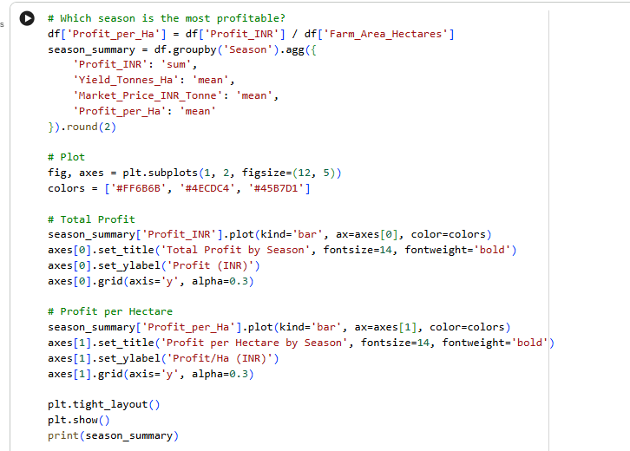
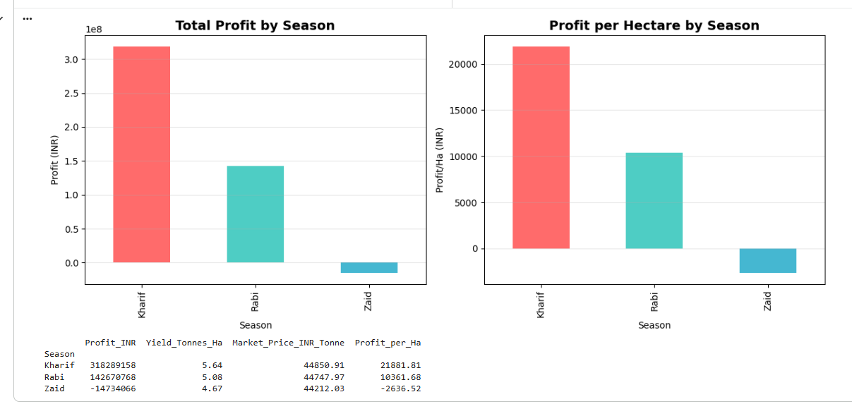
RESULTS

Slide 7
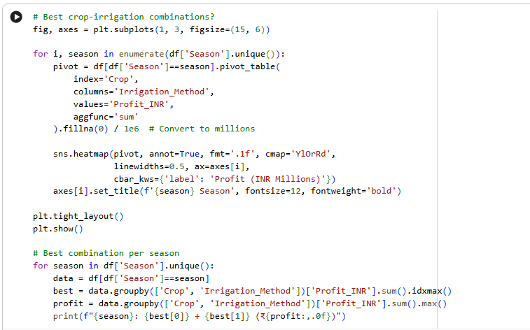
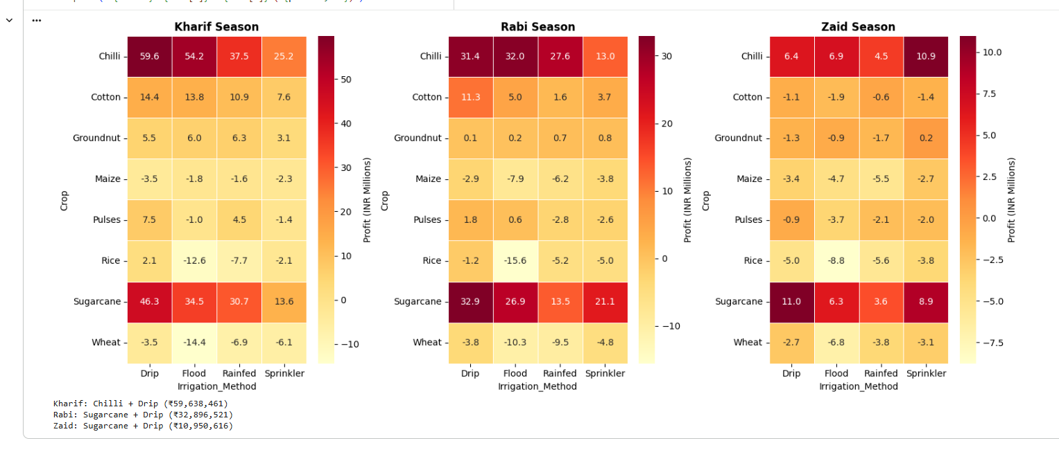
RESULTS

Slide 8
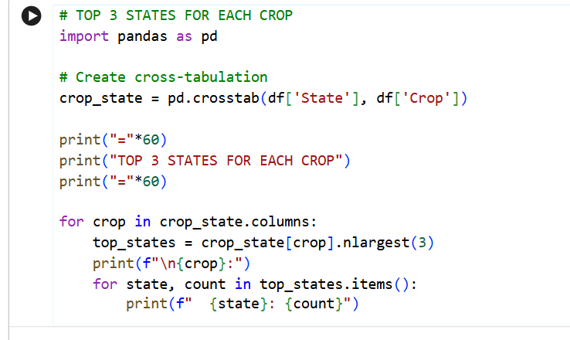
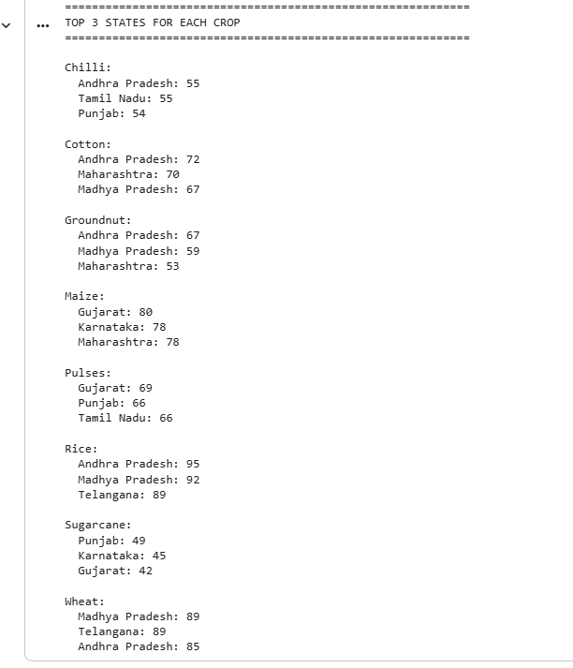
RESULTS

Slide 9
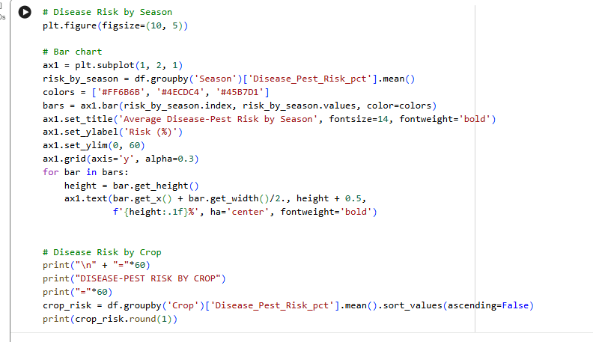
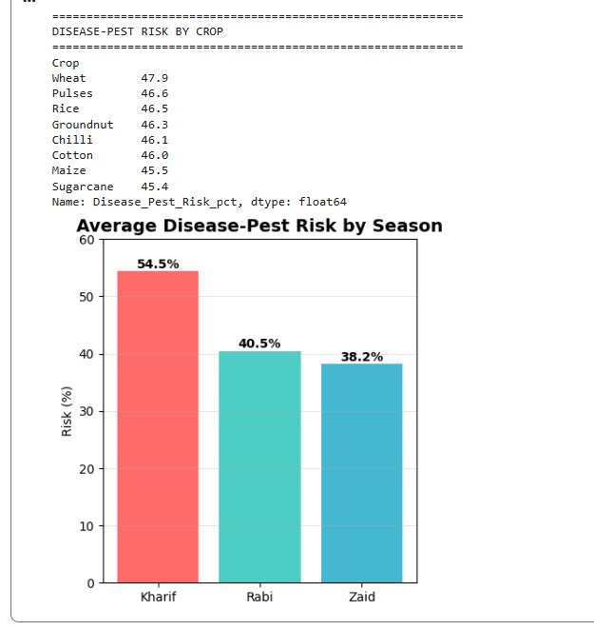
RESULTS
[Add screen shots of your code ]

Slide 10
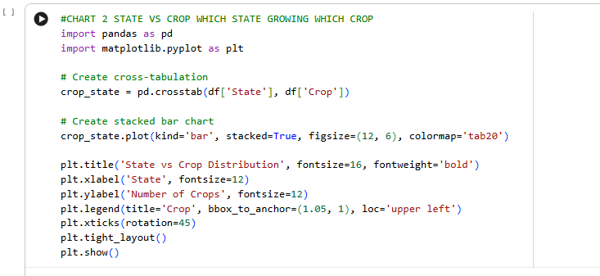
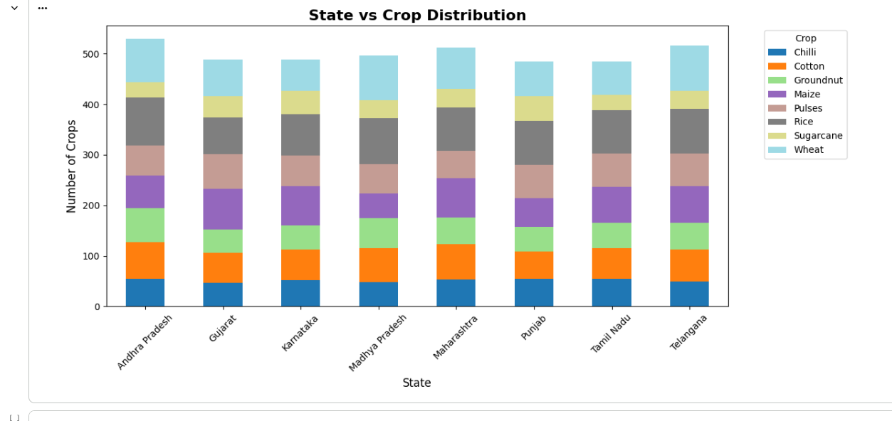
RESULTS

Slide 11
Future scope
AI-Powered Crop Recommendation System
IoT Sensors for Real-Time Farm Monitoring
Smart Irrigation & Precision Farming
Mobile App for Farmers (Crop Advisor + Market Info)
Climate Change Impact Assessment
Supply Chain & Price Forecasting
Data-Driven Agricultural Policy Support
Farmers' Knowledge Sharing Platform
Disaster Risk Management (Drought, Flood)
Export Market Analysis & Global Opportunities
Automated Pest & Disease Detection using AI

Slide 12
GitHub Link
Seasonal_agriculture_analysis

Slide 13

VOIS Course completion certificate - Course name- Data Visualization

Slide 14
Thank you
.
.

