Slide 1
Patient Case Similarity
PIP2001 Capstone Project
Final Review
Batch Number: CSD –G29
Roll Number | Student Name
20211CSD0142 20211CSD0001 20211CSD0198 | Mynampati Sri Ranganadha Avinash Sanjana S Acharya Dabbara Asritha
Under the Supervision of,
Prof. Himansu Sekhar Rout
Assistant Professor
School of Information Sciences
Presidency University
Name of the Program: Computer Science and Engineering(Data Science)
Name of the HoD: Dr. Saira Banu
Name of the Program Project Coordinator: Dr. H.M Manjula
Name of the School Project Coordinators: Dr. Abdul Khadar A

Slide 2
Content
Problem Statement
Analysis of Problem Statement
Timeline of the Project
References

Slide 3
Problem Statement Number:
Organization: ezDI
Category : Software
Problem Description : The objective of patient case similarity is to identify similar patients based on their medical reports. Identification of similar patient cases be useful for improving patient outcome, for treatment or drug recommendation to a new patient, prediction of clinical outcome, clinical decision support, research on those cases. Task: Applying machine learning algorithms to find similar patient cases from given dataset.
Difficulty Level: Complex

Slide 4
Analysis of Problem Statement
Context and Background:
What is Patient Case Similarity?
Why is it important?
Challenges in Healthcare:
Data Complexity: Medical records are often unstructured, and extracting meaningful insights can be complex.
Volume of Data: The growing volume of patient data (EMRs, reports) makes it challenging to identify relevant cases manually.
Need for Accurate Matching: Similarity must be accurate and reliable to ensure meaningful comparisons, as wrong matches could lead to incorrect treatments.
Key Objectives of the System:
Improve Patient Outcomes: By identifying past similar cases, doctors can recommend treatments that have been successful for similar patients.
Clinical Decision Support: Help doctors make more informed decisions based on data-driven insights.
Enhance Research: Enable researchers to study trends, treatments, and outcomes on a larger scale by comparing patient groups.

Slide 5
Analysis of Problem Statement (contd...)
Technical Challenges:
Data Processing: Extracting useful information from raw medical data, which could be in different formats
Case Similarity Algorithm: Applying machine learning to quantify how similar two cases are based on multiple features like medical history, diagnosis, treatments, etc.
Efficient Search: Ensuring that the system can handle large datasets and return relevant results quickly and efficiently.
Expected Outcomes:
Treatment Recommendations: Provide doctors with a list of treatment plans used for similar patients.
Predictive Outcomes: Help doctors anticipate potential clinical outcomes based on similar cases.
Research Opportunities: Open new areas of research by enabling large-scale patient case comparisons.

Slide 6
Analysis of Problem Statement (contd...)
Technology Stack:
Frontend: HTML, CSS, Bootstrap
Backend: Python Flask (for handling user requests, MongoDB integration, and routing)
Database: Excel
ML Libraries: Scikit-learn, TensorFlow/Keras, NLTK/SpaCy (for NLP and similarity matching)
Model Used: SVM

Slide 7
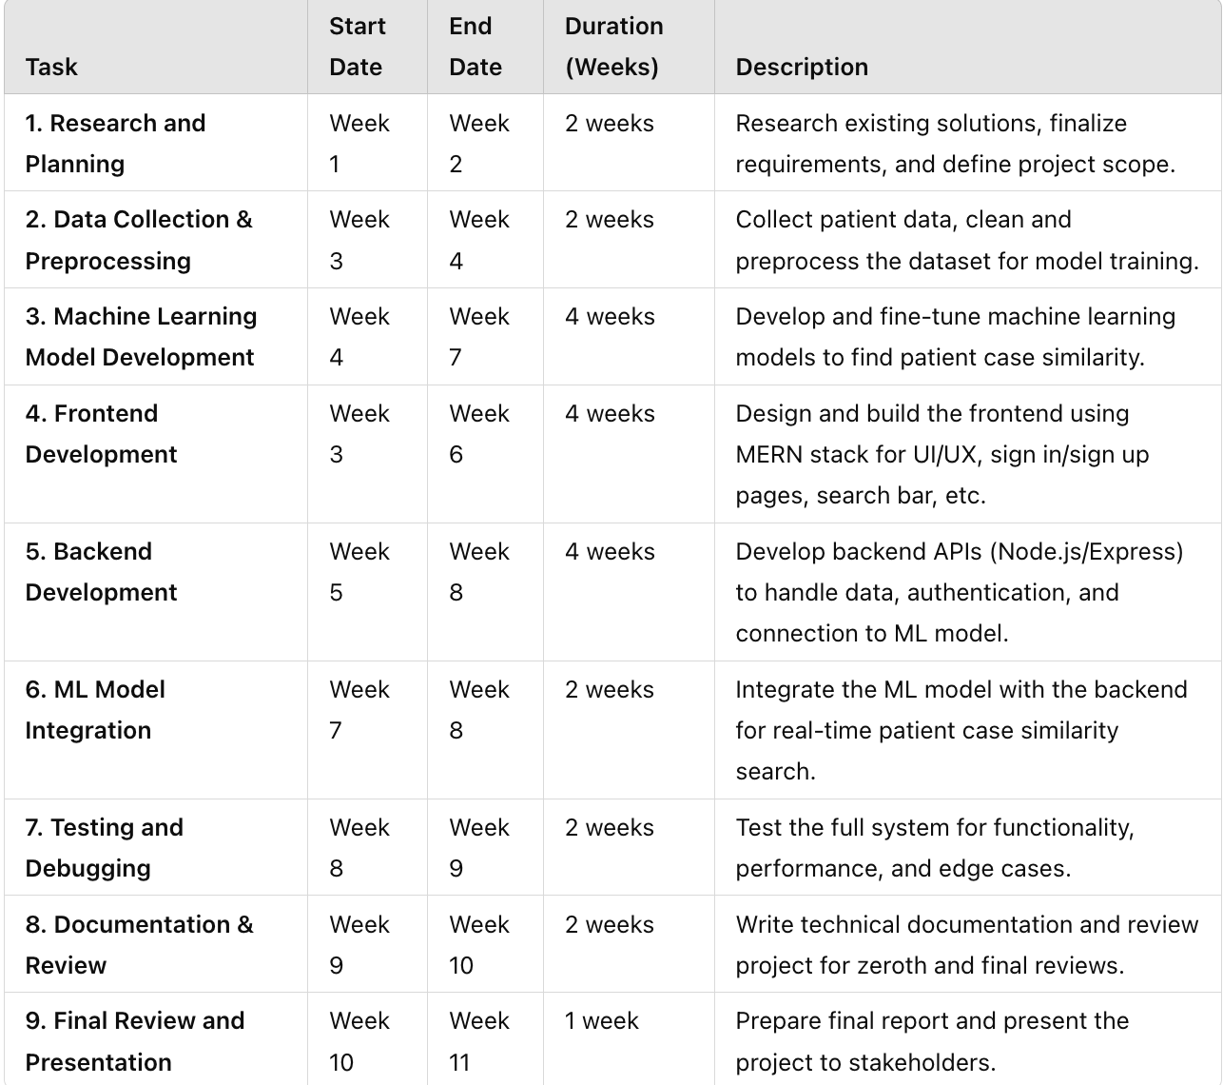
Timeline of the Project (Gantt Chart)

Slide 8
Outcomes
Disease Predictions based on Symptoms
Disease Description
Precautions suggestions
Diet Suggestions
Accuracy: 100%

Slide 9
References (IEEE Paper format)
P. R. Lichtenstein et al., "Multi-view patient similarity analysis using deep learning for clinical decision support," in Proceedings of the 11th ACM Conference on Bioinformatics, Computational Biology, and Health Informatics (ACM-BCB), New York, USA, 2020, pp. 304-311, doi: 10.1145/3388440.3412425.
M. Huang, J. Mei, J. Chen, and L. Zhang, "Patient similarity analysis for personalized healthcare: A survey," IEEE Access, vol. 7, pp. 152423-152433, 2019, doi: 10.1109/ACCESS.2019.2948272.
S. Wang, K. Jiang, J. Lee, and J. Luo, "A machine learning framework for similarity-based prediction in personalized healthcare," IEEE Journal of Biomedical and Health Informatics, vol. 22, no. 3, pp. 1014-1025, May 2018, doi: 10.1109/JBHI.2017.2760244.

Slide 10


