Slide 1

LIBRARY MANAGEMENT SYSTEM
K NIKHITHA -Team lead
SHARANYA
SANJANA
HARITHA SREE D

Slide 2
DIVISION OF THE PROJECT
NIKHITHA - Routing, User Management Module, Json-Login Registration
SHARANYA- Books Module
HARITHA SREE D- Homepage, Issue and Return Module
SANJANA- Fine Management Module and Unit Testing

Slide 3
Project Overview
User-friendly library interface
Store and manage book details
Issue and return books based on user activity
Calculate and generate fines for overdue returns
Built with Angular and JSON Server

Slide 4
Technology Stack
Layer - | Tools Used
Frontend - | Angular
HTTP Requests - | Angular HttpClientModule
Backend - | JSON Server (REST API)
Testing - | Jasmine
Storage - | localStorage

Slide 5
Core Functionalities
User Management: Register users and store user data in db.json
Book Management: Add, update, and delete book records
Issue/Return: Track book issuance and returns with due dates
Fine Calculation: Compute fines for overdue returns
Activity History: Log and display all user actions
Authentication: Secure access using route guards and localStorage

Slide 6
Application Modules
HomeComponent – Acts as the dashboard and main navigation hub
LibraryComponent – Displays and manages book details
UserManagementComponent – Administers user data and access control
IssueReturnComponent – Manages book issuing and returning operations
FineManagementComponent – Handles fine calculation and management for overdue books

Slide 7
Key Features
User registration and book data storage
Issue and return books
Fine calculation for overdue return
Persistent data using localStorage and JSON

Slide 8
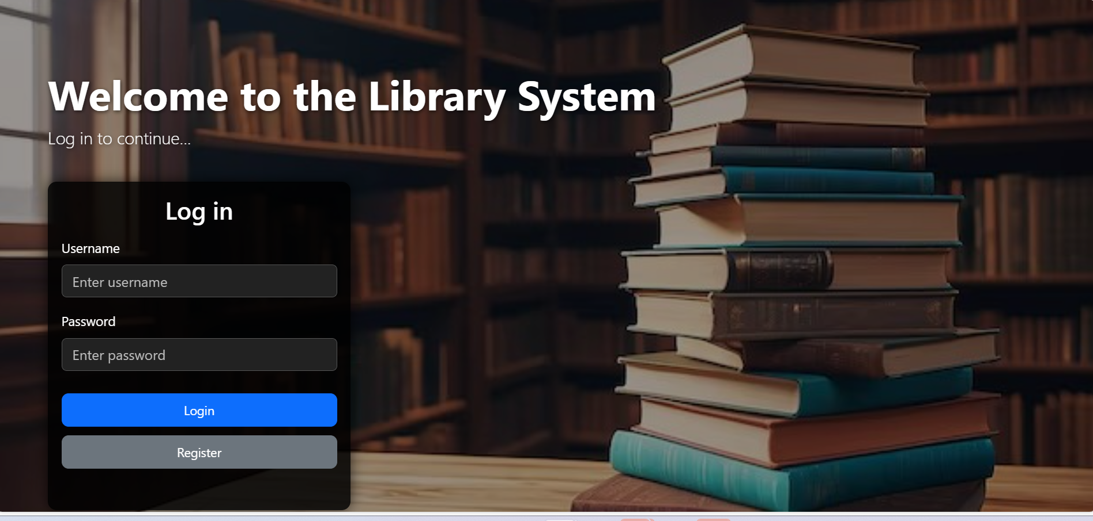
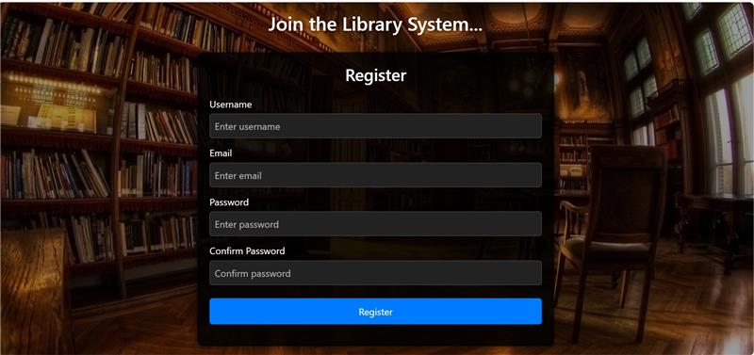
LOGIN & REGISTER PAGE

Slide 9
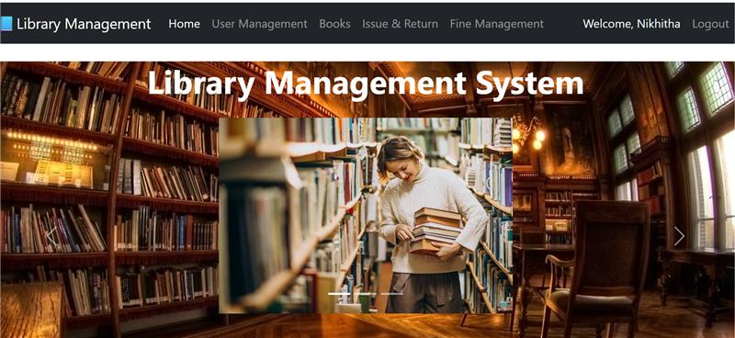
DASHBOARD PAGE

Slide 10
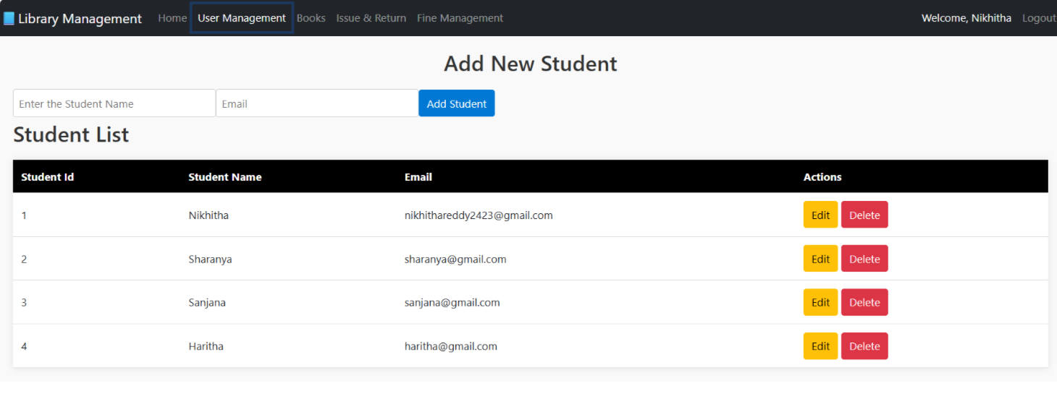
USER MANAGEMENT PAGE

Slide 11
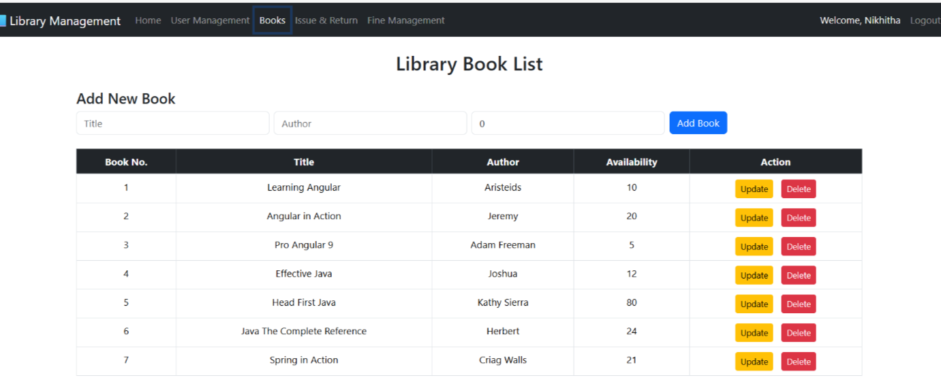
BOOKS PAGE

Slide 12
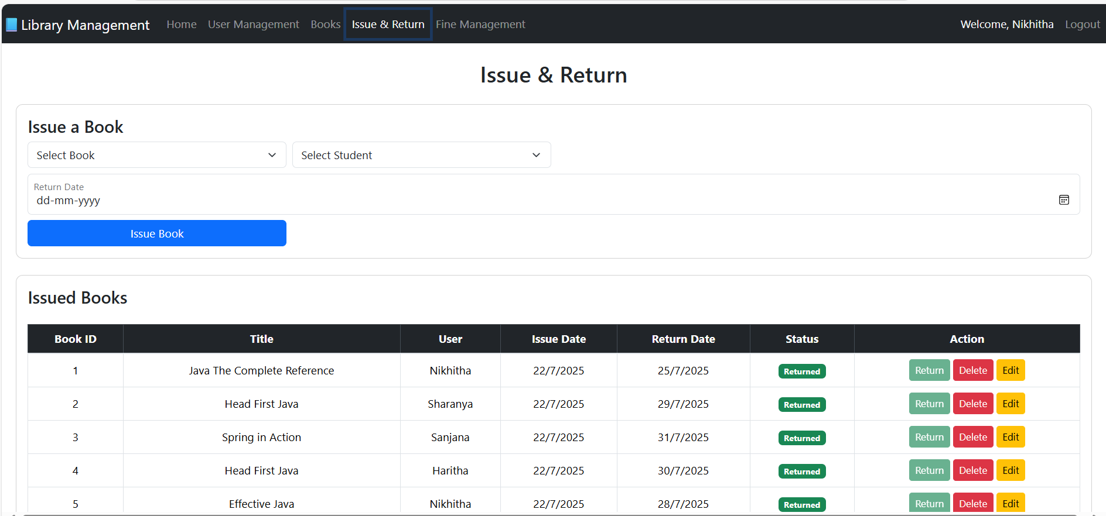
RETURN & ISSUE PAGE

Slide 13
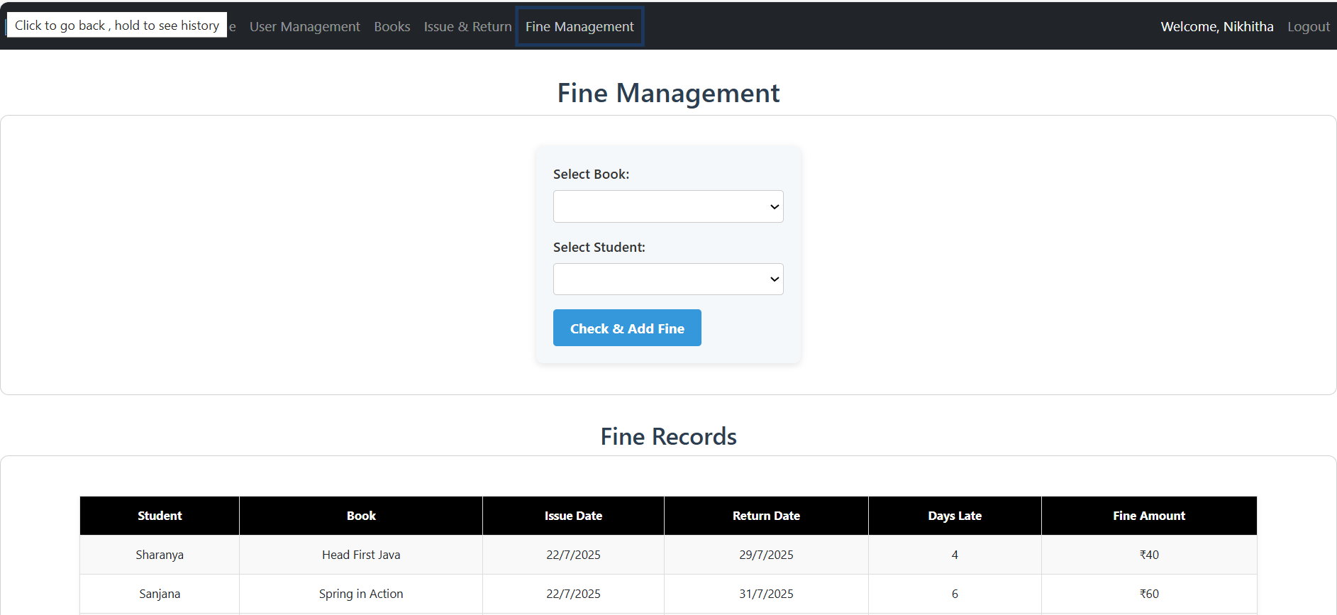
FINE MANAGEMENT PAGE

Slide 14
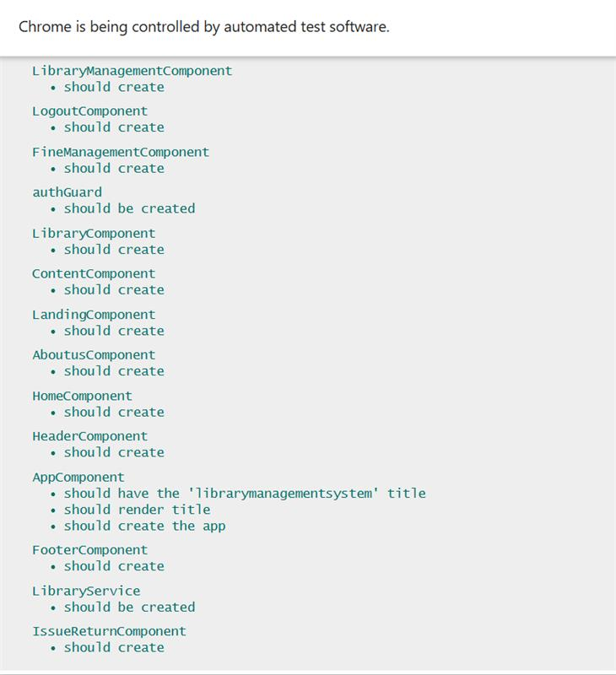
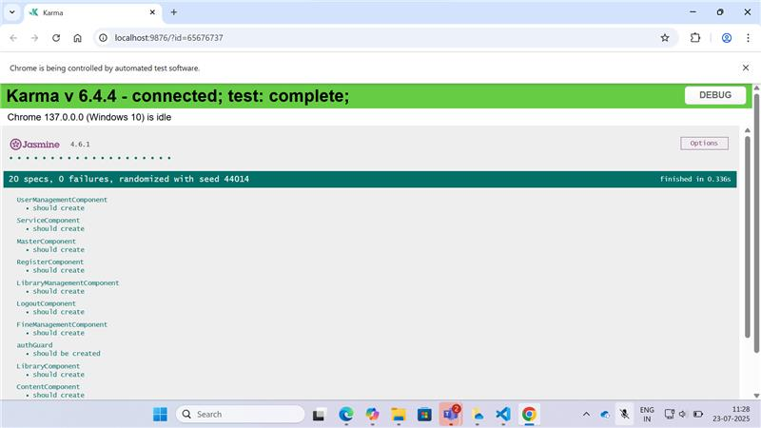
UNIT TESTING

Slide 15
Unit Testing
Component/Service | Issue | Fix Applied
LibraryComponent | Missing HttpClient | Added HttpClientTestingModule and LibraryService
MasterComponent | Standalone misuse | Moved to imports
AppComponent | Title not rendering | Fixed test logic and used shared fixture
HeaderComponent | Missing ActivatedRoute | Mocked ActivatedRoute
FineManagementComponent | Missing HttpClient | Added HttpClientTestingModule and LibraryService
LandingComponent | Missing HttpClient & ActivatedRoute | Mocked both
LibraryService | Missing HttpClient | Added HttpClientTestingModule
RegisterComponent | Standalone misuse & missing HttpClient | Fixed both

Slide 16
Backend Data Structure
{
"id": "1",
"title": "Pride and Prejudice",
"author": "Jane Austen",
"availability": 12
}
Books example
{
"id": "1",
"userName": "Nikhitha",
"email": "nikhithakomma@gmail.com",
"password": "12345678"
}
User example

Slide 17
Backend Data Structure
{
"id": "f97f",
"bookId": "2",
"title": "Core Java",
"user": "vineetha",
"issueDate": "21/7/2025",
"returnDate": "26/7/2025",
"returned": true
}
Issuedbooks example
{
"id": "3b45",
"studentName": "shiny",
"bookTitle": "Core Java",
"issueDate": "18/7/2025",
"returnDate": "23/7/2025",
"daysLate": 2,
"amount": 20
}
Fine example
{
"id": "9afe",
"name": "Sanjana",
"email": "s@gmail.com"
}
Students example

Slide 18

Achievements
Real-time, dynamic updates to book and user data
Transparent over-due logs
Reliable and unit-tested components
Scalable, modern web architecture

Slide 19
Thank you ......

