Slide 1
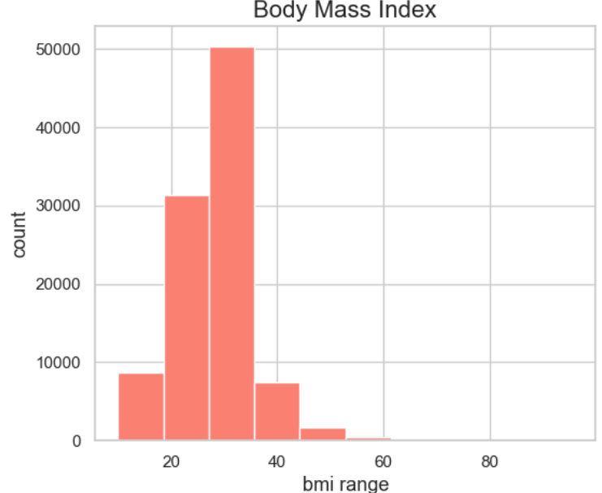
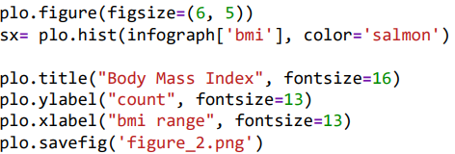
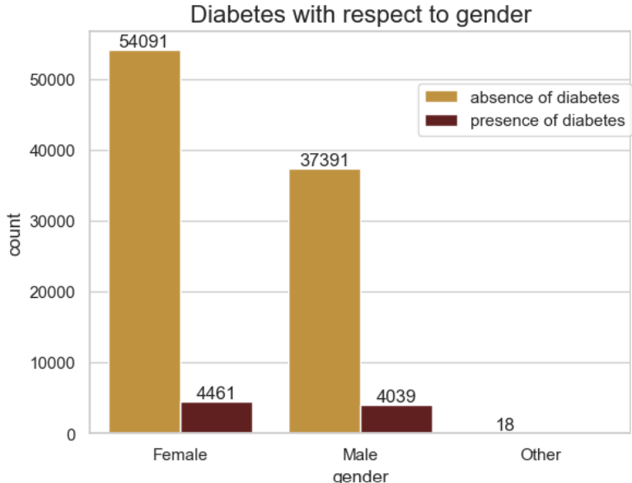
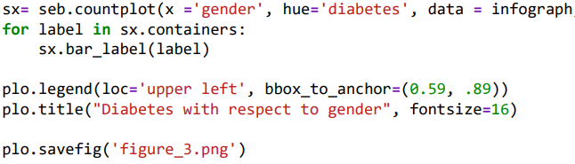
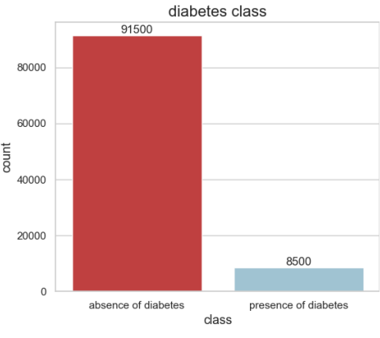
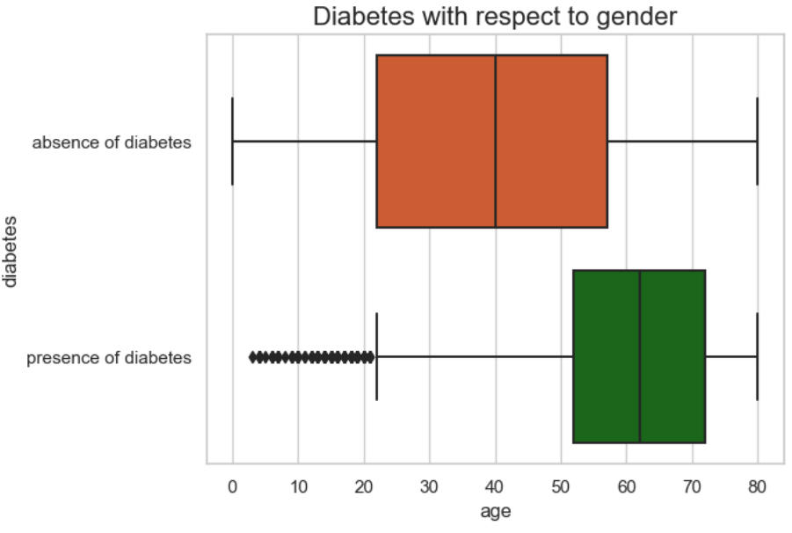


VISUALIZATION OF DIABETES IN PATIENTS
Name: Sanjana Dabbikar
Student ID: 22084524
Introduction
Methods
Diabetes is a disease that impacts millions of people across the world, and its incidence keeps increasing year by year.
The data must be understood by individuals and healthcare systems.
This data is used for visualization that condenses this information into digestible charts, graphs and maps making it easier to find patterns and trends despite being in raw form.
Charts and graphs that can easily be communicated to people with different technical expertise support better collaboration and decision-making.
The histogram below shows that the majority of patients have a BMI around 30, with this value being the average BMI for 50% of the patients. This implies that a significant proportion of the patient population falls into the obese category based on BMI classifications.
Dataset description
https://www.kaggle.com/datasets/iammustafatz/diabetes-prediction-dataset?resource=download
The above mentioned link is the dataset used for the visualization.
The Diabetes prediction dataset consists of medical and demographic information about patients along with diabetes status either positive or negative.
The data comprises factors such as age, gender, body mass index , hypertension and heart diseases history smoking background of the individual HbA1c level sugar glucose in blood.
This can help healthcare professionals to identify patients at risk for diabetes and create tailor-made treatment plans.
The count plot below displays separate bars for female and male, representing the count or frequency of diabetic patients in each category. The bar for female is higher, suggesting a higher count of diabetic patients compared to the bar for males.
Methods
The first visualization is done based on two classes of presence and absence of diabetes in one lakh patients. From the bar plot below, it can be inferred from the bar plot, which clearly shows that the bar representing the absence of diabetes is much higher than the one representing the presence of diabetes.
From the box plot below, it is observed that the box for diabetic patients is higher, indicating a higher median age compared to non-diabetic patients. This suggests that diabetic patients tend to be older on average.
Notes:
Prints as 33.1 x 46.8 (A0) at 100%. When printed using the library printing service, this will require trimming from 36 inch wide paper. To fill 36 inch paper roll, scale to 108.5% (prints as ~ 36 X 51).
For Medical Library: Print using standard margins (printing oversize makes uneven margins for whatever weird reason)

