Slide 1
QA BOT FOR RESEARCH PAPERS

Slide 2
Problem Statement
2.QA bot for Research Papers
Create a Q&A bot that can search through a large collection of research papers and provide accurate answers to questions, along with references to the relevant papers.

Slide 3
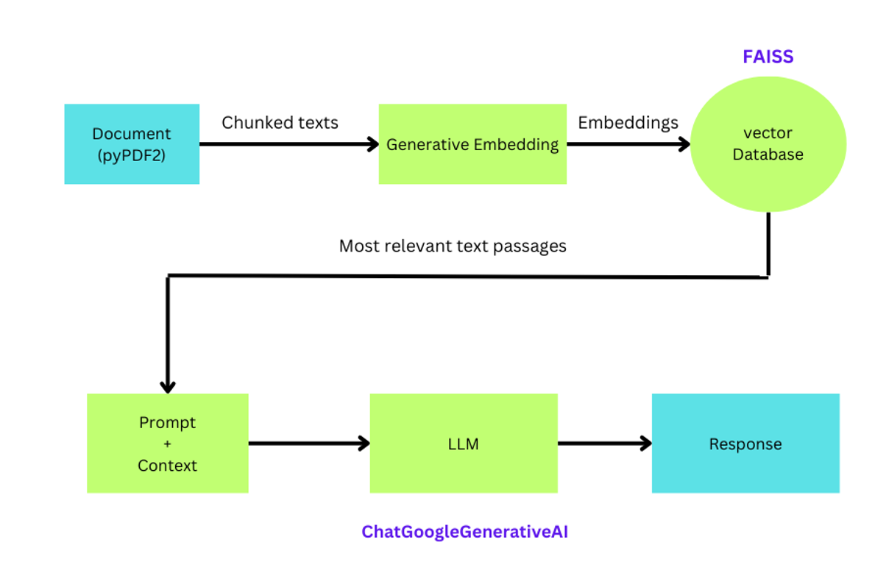
Proposed Methodology

Slide 4
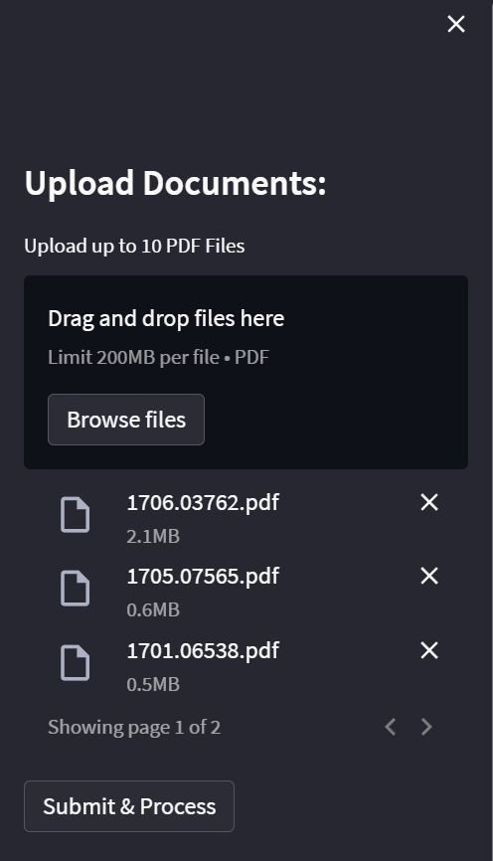
WORKING
Upload Documents:
Users can upload up to 10 PDF files at once, accommodating multiple research papers for analysis.

Slide 5
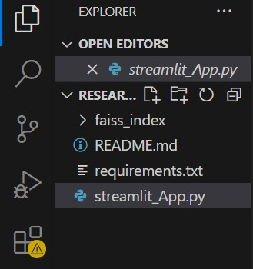
Processing:
PyPDF2 extracts text from the PDFs, which is then divided into manageable chunks.
Embeddings are generated from these chunks using LangChain, capturing the semantic meaning for context understanding.

Slide 6
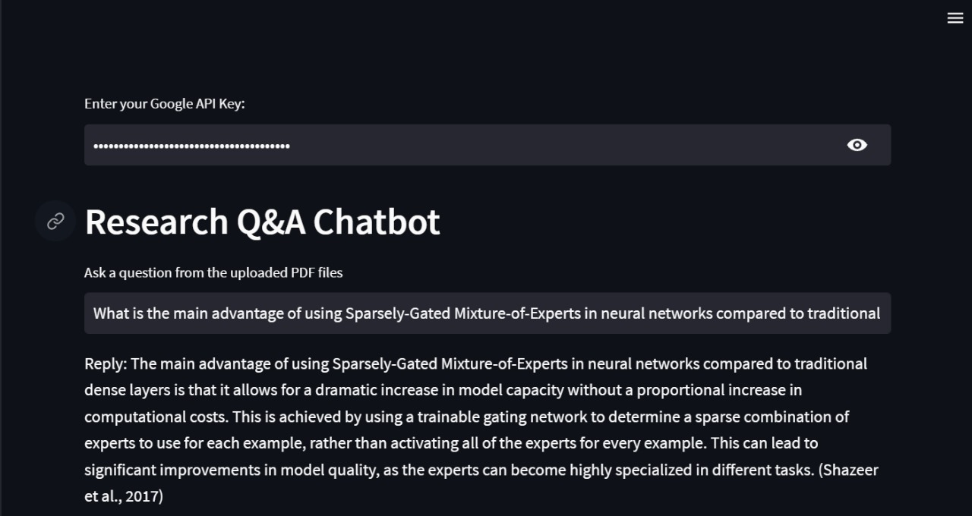
Ask a Question:
Users input queries, and the system searches through the embedded chunks using FAISS for efficient similarity searches.

Slide 7

Accurate answers are provided along with citations from the relevant documents.

Slide 8
THANK YOU

