Slide 1



Track : Health Care
Bangalore Section
IEEE Student Branch STB60213367
Project Title
Wellness Passport
Team :
Sanjana N
Priyanka M
Varsha P
Notes:
This template can be used as a starter file to give updates for project milestones.
Sections
Right-click on a slide to add sections. Sections can help to organize your slides or facilitate collaboration between multiple authors.
Notes
Use the Notes section for delivery notes or to provide additional details for the audience. View these notes in Presentation View during your presentation.
Keep in mind the font size (important for accessibility, visibility, videotaping, and online production)
Coordinated colors
Pay particular attention to the graphs, charts, and text boxes.
Consider that attendees will print in black and white or grayscale. Run a test print to make sure your colors work when printed in pure black and white and grayscale.
Graphics, tables, and graphs
Keep it simple: If possible, use consistent, non-distracting styles and colors.
Label all graphs and tables.

Slide 2

Project Overview
Wellness Passport is an application software designed to facilitate the Women and BPL sectors with best healthcare at minimized cost by authenticating the patient record with Wellness application request and there by providing the discount on medical cost.
This application will be maintained by third party agency which is authorized by the Ministry of Women and Child so that the application data are verified internally by the Govt. organization.
The application is divided into two major component, THE PATIENT who is solely responsible for uploading the patient history and the application request.
Wellness Passport agency responsible for verifying the application data with the patient history.
Notes:
What is the project about?
Define the goal of this project
Is it similar to projects in the past or is it a new effort?
Define the scope of this project
Is it an independent project or is it related to other projects?
* Note that this slide is not necessary for weekly status meetings

Slide 3

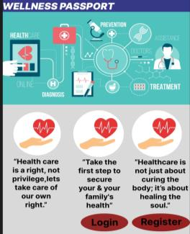
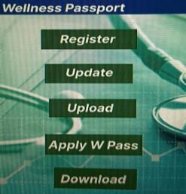
Project Flow : (Patient Module)
Patient download the W-PASS application from the open source
Patient register to the application and there by WPASS ID will be generated (Ex : S/K/BLR/WB/XXXXXX/01 [ South region/ State/ Bangalore city/Women+BPL/Adhar no/Count)
Upload the medical records
Update the information (optional)
Send the Application Request for Discount to W-PASS
Download the Approved/Rejected status form from W-PASS
Submit the downloaded status form to the Hospital to claim the discount.
Notes:
* If any of these issues caused a schedule delay or need to be discussed further, include details in next slide.

Slide 4
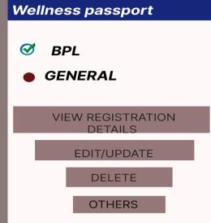
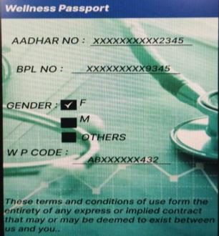
Project Flow : (W-Pass Module)
W-Pass Bill Board has 4 component
Women
BPL
General
Application
Women / BPL / General will reflect the Registration details of above categories
Admin reviews the application details and approves or rejects the application based on the medical history and authentication of category they have claimed
Notes:
* If any of these issues caused a schedule delay or need to be discussed further, include details in next slide.

Slide 5
Scope of the Project
Since WPASS aims to work in association with Ministry of Women and Child to facilitate the Women and BPL section, the scalability of the application is Huge.
The introduction of Third party (WPASS) act as bridge between the Govt. sector and the public there by authenticating the medical records and the category claim to provide the best of benefits under one platform.
Notes:
Duplicate this slide as necessary if there is more than one issue.
This and related slides can be moved to the appendix or hidden if necessary.

Slide 6
Future Enhancement
WPASS can act a verifying agencies to many authentication process during the medical treatment such as claiming insurance, issue of death certificates etc.
Notes:
Duplicate this slide as necessary if there is more than one issue.
This and related slides can be moved to the appendix or hidden if necessary.

Slide 7
THANK YOU

