Slide 1

Project Review-1
Prepared by
AI & IPA TP Group-61
190030447 G L Pranitha
190030485 G G Sanjana
190031413 R Sai Sivani

Slide 2
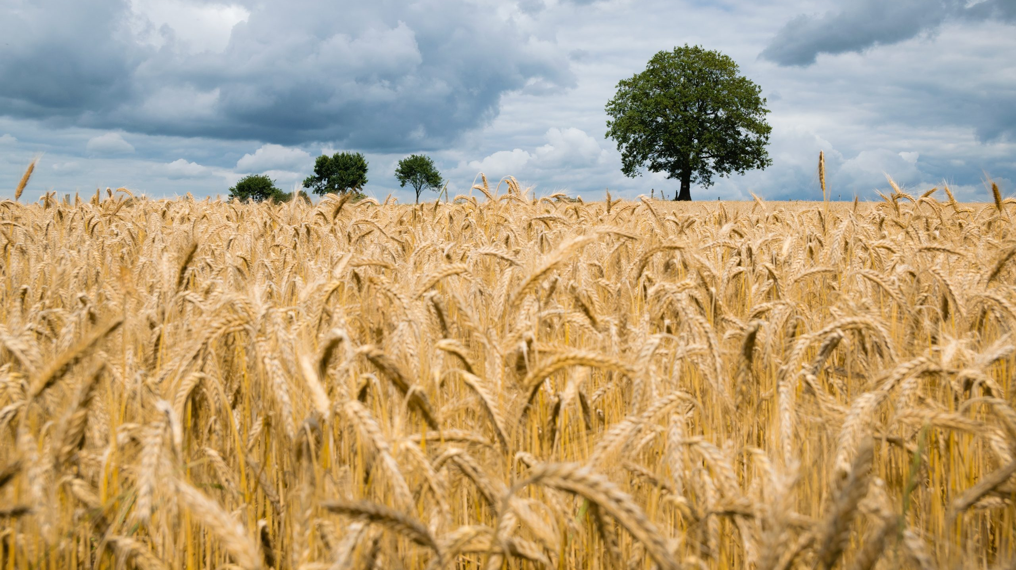
Crop Prediction using Machine Learning

Slide 3

Introduction

Slide 4
The project aims to help the farmers to predict plantation of a suitable crop for a better yield. Farmers are unaware of the crop which suits their soil quality, soil nutrients, and soil composition. The work proposes to help farmers check the soil quality depending on the analysis done based on the machine learning approach. Thus, the system focuses on checking the soil quality to predict the crop suitable for cultivation according to their soil type and maximize the crop yield. This project will be focused on the integrated nutrient management to enhance plant nutrition, identify specific parameters as indicators of soil quality, and describe the impact of soil quality improvements on increasing agronomic practice.

Slide 5
Experimental evidence is collected from the dataset such as the nutrients present in the soil and weather conditions. This prediction system is strongly helpful for farmers with an agricultural area of more than 5 acres to determine the suitable crop for cultivation in the specified area. The primary nutrients required by the plants are taken for study. Machine learning is a field of inquiry devoted to understanding and building methods that learn, that is, methods that leverage data to improve performance on some set of tasks. It is seen as a part of artificial intelligence. Therefore, the concept of soil quality or health, like that of human health, is difficult to understand.

Slide 6

ABSTRACT

Slide 7
India is the largest population country in the world and majority of people in India have agriculture as their occupation. Choosing best crop which results in maximum yield and profit is very important to every farmer in agricultural field. Farmers are growing same crops repeatedly without trying new variety of crops and they are applying fertilizers in random quantity without knowing the deficient content and quantity. So, this is directly affecting on crop yield and causes the soil acidification and damages the top layer. By introducing technology into agricultural sector, it results in higher yields. So, we have proposed a system using machine learning algorithms for betterment of farmers. Thus, the proposed system will analyze crop conditions and predict best crop based on machine learning techniques which then results in best crop and fertilizers as a solution by which farmers will be benefited.

Slide 8
Our system will suggest the best suitable crop for land based on pH, temperature, and weather parameters
The system provides information about the required content and quantity of fertilizers, required seeds for cultivation.
By utilizing our system farmers can cultivate a new variety of crop, may increase in profit margin, and can avoid soil pollution.
Farmers can be benefited by using our system which will improve crop productivity and profit of farmers.
Keywords - Machine Learning, Crop prediction, Rainfall prediction, Crop recommendation

Slide 9

Literature survey

Slide 10
Sanat Sarangi, Vinayak Naik (2019) has concluded that two supervised classification machine learning algorithms has been implemented in his study. Our system takes the necessary weather and soil properties data for a given coordinate automatically from an appropriate source. Another advantage is that the system worked on large regions and provides forecasts at a resolution compatible with best input data resolution, which in the case is originally from the soil data. The ability of forecasting crop before the beginning of the crop season. This provides users with the capability to perform strategy changes, like choosing a more robust genetic variation before planting or even changing the crop type, to accommodate for extreme climatic variations further ahead in the crop cycle.

Slide 11
Neha rale, Raxitkumar Solanki, DoinaBein, James Andro Vasko, Wolfgang Bein (2019) has concluded that their paper will review those various applications of machine learning in the farming sector. And provides an insight into the troubles faced by our Indian farmers and how these can be solved using these techniques. This method helps in increasing the farming sector in the countries and apply the more machine learning applications.

Slide 12
Rakesh Shirsath, Neha Khadke, Divya More, Pooja Patil, Harshali Patil (2017) has concluded that the aim of their paper is to propose and implement a rule-based system and predict the crop yield production from the collection of previous data. The algorithms used are KNN Algorithm, SVM Algorithm, Decision Tree method. The disadvantage is suitable only for using association rule and considered less data. The optimal and worst environmental condition can also be incurred. The model focuses on all type of farms, and smaller farmers can also be benefitted. This model can be further enhanced to find the yield of every crop, and for pesticide recommendation. Also, it can be modified to suggest about the fertilizers and irrigation need for crops

Slide 13

REQUIREMENTS ELICITATION

Slide 14
Software Details:
• Python modules with machine learning libraries
• Windows Operating System
• Google Colab
Hardware Details:
System with:
• i5 processor
• 256 MB RAM or higher

Slide 15

Existing system

Slide 16
The existing systems only predict yield based on input of total area of farmland in hectares, but these systems don’t predict best suitable and profitable crop. The accuracy of the existing system is low compared to our system.

Slide 17

Proposed system

Slide 18
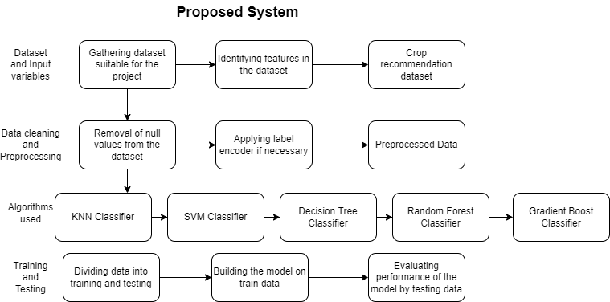

Slide 19

MODULES

Slide 20
Identifying dataset and their features
Data Cleaning and Preprocessing
Model Building
KNN Classifier
SVM Classifier
Decision Tree Classifier
Random Forest Classifier
Gradient Boost Classifier
Training
Testing

Slide 21

CONCLUSION

Slide 22
Different machine learning algorithms have been implemented on agricultural data to evaluate the best performing method. Based on the climatic input parameters the present study provided the demonstration of the potential use of machine learning techniques in predicting the crop suitable for the given conditions. The accuracy of predictions are above 95 per cent in all the crops selected in the study indicating higher accuracy of prediction. By providing climatic data of that place the model developed can be used by any user for predicting their crop suitable in the conditions .

Slide 23

THANK YOU

