Slide 1
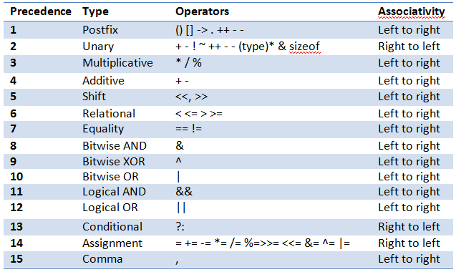
OPERATOR PRECEDENCE TABLE

Slide 2
Infix To Postfix
Step 1 :Scan all the symbols one by one from left to right in the given Infix Expression.
Step 2 : If the reading symbol is operand, then immediately append it to the Postfix Expression
Step 3 : If the reading symbol is left parenthesis ‘( ‘, then Push it onto the Stack
Step 4 : If the reading symbol is right parenthesis ‘)’, then Pop all the contents of the stack until the respective left parenthesis is popped and append each popped symbol to Postfix Expression.
Step 5 :If the reading symbol is operator (+ , – , * , /), then Push it onto the Stack. However, first pop the operators which are already on the stack that have higher or equal precedence than the current operator and append them to the postfix . If open parenthesis is there on top of the stack then push the operator into the stack.

Slide 3
Infix To Postfix
Step 1 :Scan all the symbols one by one from left to right in the given Infix Expression.
A
+
(
B
*
C
)
-
D
/
E

Slide 4
Infix To Postfix
Step 1 :Scan all the symbols one by one from left to right in the given Infix Expression.
A
+
(
B
*
C
)
-
D
/
E
Step 2 : If the reading symbol is operand, then immediately append it to the Postfix Expression

Slide 5
Infix To Postfix
Step 1 :Scan all the symbols one by one from left to right in the given Infix Expression.
+
(
B
*
C
)
-
D
/
E
Step 3 : If the reading symbol is left parenthesis ‘( ‘, then Push it onto the Stack.
Step 4 : If the reading symbol is right parenthesis ‘)’, then Pop all the contents of the stack until ‘)’each popped symbol to Postfix Expression.
Step 5 :If the reading symbol is operator + , – , * , / then Push it onto the Stack. However, first pop the operators which are already on the stack that have higher or equal precedence than the current operator and append them to the postfix .
A

Slide 6
Infix To Postfix
Step 1 :Scan all the symbols one by one from left to right in the given Infix Expression.
(
B
*
C
)
-
D
/
E
Step 3 : If the reading symbol is left parenthesis ‘( ‘, then Push it onto the Stack.
Step 4 : If the reading symbol is right parenthesis ‘)’, then Pop all the contents of the stack until ‘)’each popped symbol to Postfix Expression.
Step 5 :If the reading symbol is operator + , – , * , / then Push it onto the Stack. However, first pop the operators which are already on the stack that have higher or equal precedence than the current operator and append them to the postfix .
A
+

Slide 7
Infix To Postfix
Step 1 :Scan all the symbols one by one from left to right in the given Infix Expression.
B
*
C
)
-
D
/
E
Step 2 : If the reading symbol is operand, then immediately append it to the Postfix Expression
(
A
+

Slide 8
Infix To Postfix
Step 1 :Scan all the symbols one by one from left to right in the given Infix Expression.
*
C
)
-
D
/
E
Step 3 : If the reading symbol is left parenthesis ‘( ‘, then Push it onto the Stack.
Step 4 : If the reading symbol is right parenthesis ‘)’, then Pop all the contents of the stack until ‘)’each popped symbol to Postfix Expression.
Step 5 :If the reading symbol is operator + , – , * , / then Push it onto the Stack. However, first pop the operators which are already on the stack that have higher or equal precedence than the current operator and append them to the postfix .
(
A
B
+

Slide 9
Infix To Postfix
Step 1 :Scan all the symbols one by one from left to right in the given Infix Expression.
C
)
-
D
/
E
Step 2 : If the reading symbol is operand, then immediately append it to the Postfix Expression
*
(
A
B
+

Slide 10
Infix To Postfix
Step 1 :Scan all the symbols one by one from left to right in the given Infix Expression.
)
-
D
/
E
Step 3 : If the reading symbol is left parenthesis ‘( ‘, then Push it onto the Stack.
Step 4 : If the reading symbol is right parenthesis ‘)’, then Pop all the contents of the stack until ‘)’each popped symbol to Postfix Expression.
Step 5 :If the reading symbol is operator + , – , * , / then Push it onto the Stack. However, first pop the operators which are already on the stack that have higher or equal precedence than the current operator and append them to the postfix .
*
(
A
B
C
+

Slide 11
Infix To Postfix
Step 1 :Scan all the symbols one by one from left to right in the given Infix Expression.
-
D
/
E
Step 3 : If the reading symbol is left parenthesis ‘( ‘, then Push it onto the Stack.
Step 4 : If the reading symbol is right parenthesis ‘)’, then Pop all the contents of the stack until ‘)’each popped symbol to Postfix Expression.
)
Step 5 :If the reading symbol is operator + , – , * , / then Push it onto the Stack. However, first pop the operators which are already on the stack that have higher or equal precedence than the current operator and append them to the postfix .
*
(
A
B
C
+

Slide 12
Infix To Postfix
Step 1 :Scan all the symbols one by one from left to right in the given Infix Expression.
-
D
/
E
Step 3 : If the reading symbol is left parenthesis ‘( ‘, then Push it onto the Stack.
Step 4 : If the reading symbol is right parenthesis ‘)’, then Pop all the contents of the stack until ‘)’each popped symbol to Postfix Expression.
Step 5 :If the reading symbol is operator + , – , * , / then Push it onto the Stack. However, first pop the operators which are already on the stack that have higher or equal precedence than the current operator and append them to the postfix .
A
B
C
*
+

Slide 13
Infix To Postfix
Step 1 :Scan all the symbols one by one from left to right in the given Infix Expression.
D
/
E
Step 2 : If the reading symbol is operand, then immediately append it to the Postfix Expression
A
B
C
*
+
-

Slide 14
Infix To Postfix
Step 1 :Scan all the symbols one by one from left to right in the given Infix Expression.
/
E
Step 3 : If the reading symbol is left parenthesis ‘( ‘, then Push it onto the Stack.
Step 4 : If the reading symbol is right parenthesis ‘)’, then Pop all the contents of the stack until ‘)’each popped symbol to Postfix Expression.
Step 5 :If the reading symbol is operator + , – , * , / then Push it onto the Stack. However, first pop the operators which are already on the stack that have higher or equal precedence than the current operator and append them to the postfix .
A
B
C
*
+
D
-

Slide 15
Infix To Postfix
Step 1 :Scan all the symbols one by one from left to right in the given Infix Expression.
E
Step 2 : If the reading symbol is operand, then immediately append it to the Postfix Expression
/
A
B
C
*
+
D
-

Slide 16
Infix To Postfix
Step 1 :Scan all the symbols one by one from left to right in the given Infix Expression.
Step 6 : If The Expression have no symbol just pop out all the symbols of stack to postfix expression
/
A
B
C
*
+
D
E
-

Slide 17
Infix To Postfix
Step 1 :Scan all the symbols one by one from left to right in the given Infix Expression.
Step 6 : : If The Expression have no symbol just pop out all the symbols of stack to postfix expression
A
B
C
*
+
D
E
/
-

