Slide 1


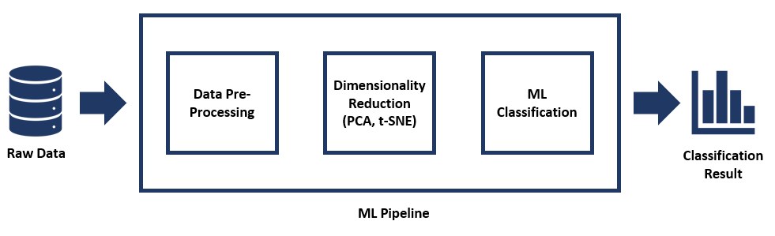
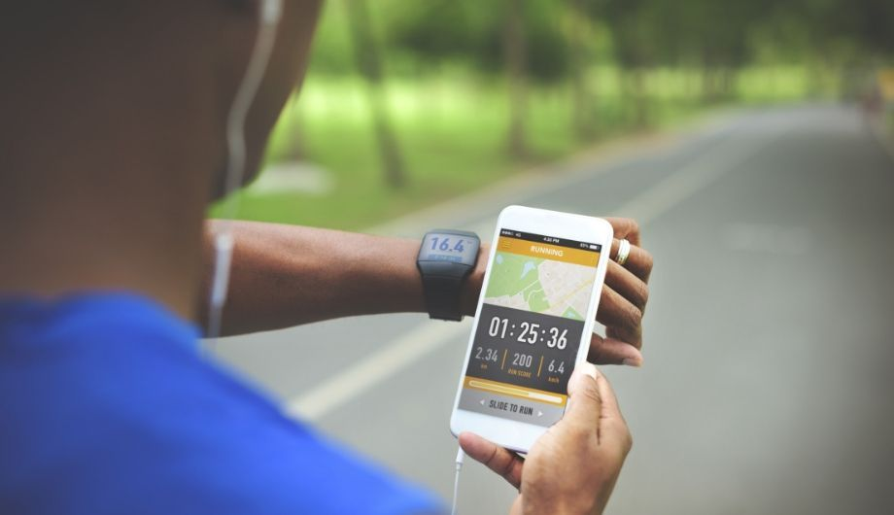

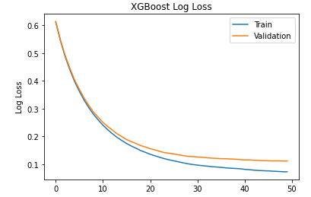
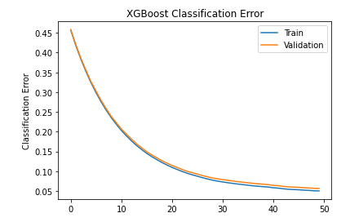
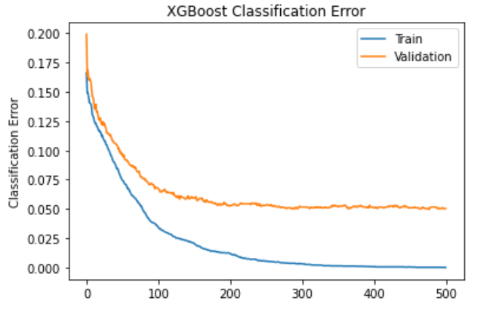
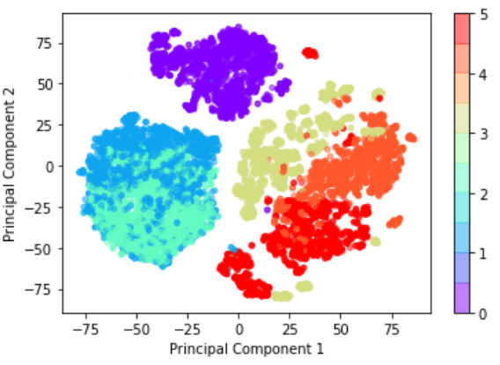
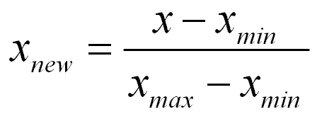
Empowering Smart Health Apps With Machine Learning
Siddharth Chadda: sidchadda@uvic.ca Tavanpreet Oberoi: tavanpreetoberoi@uvic.ca Hridya Divakaran: hridyadivakaran@uvic.ca Sanjana Arora: sanjanaa@uvic.ca
Motivation and Overview
Experiments
Model Summary
Nowadays people use their smartphones to keep a track of the number of calories consumed during the day, number of steps taken, kind of meals consumed, etc. Based on the collected data, a person’s obesity level is predicted. Further, using all the collected data, a user’s physical activity is classified into six categories being performed.
Metrics: Training Accuracy, Testing Accuracy and Validation Accuracy
Models Implemented: XGBoost, Random Forest, SVM
XGBoost achieves highest training and testing accuracies.
Regularization improved the XGBoost classifier performance.
RandomForest classifier using label powerset performed better in comparison with classifier chains of Naïve Bayes algorithm for classifying the data into different age groups.
Dimensionality Reduction: Principal Component Analysis (PCA) and t-Distributed Stochastic Neighbor Embedding (t-SNE).
Models Implemented: AdaBoost, Random Forest, XGBoost
GridSearch – 5-Fold Cross Validation is implemented for hyper-parameter tuning.
XGBoost Outperform all the implemented algorithms.
T-SNE is used to visualize clusters in 2-D
Model Name | Train Accuracy | Validation Accuracy | Test Accuracy
SVM | 95.41% | 95.97% | 95.03%
Random Forest | 100% | 97.39% | 96.92%
XGBoost | 100% | 97.63% | 95.98%
RF (Label Powerset) | 100% | 98.81% | 98.34%
KMeans | 26.85% | 25.11% | 26.71%
Approach | Model Name | Train Accuracy | Validation Accuracy | Test Accuracy
PCA | AdaBoost on PCA Data | 55.34% | 53.26% | 51.91%
 | Random Forest on PCA Data | 100% | 94.22% | 89.44%
 | XGBoost on PCA Data | 100% | 94.96% | 91.14%
t-SNE | Random Forest on t-SNE Data | 100% | 94.83% | 84.83%
 | XGBoost on t-SNE Data | 95.06% | 91.29% | 82.89%
Datasets
The first dataset used is from UCI Machine Learning Repository which has Obesity levels in individuals from the countries of Mexico, Peru. This Dataset is based on their eating habits and physical condition of these individuals. Dataset contains 17 attributes and 2111 records.
Second dataset is the Human Activity Recognition database. It was built from the recordings of 30 study participants performing daily physical activities like standing, walking etc., while carrying a waist-mounted smartphone with embedded sensors. This dataset has 563 columns and 10299 records.
Correlation
Correlation heat maps are used to remove features providing redundant information.
Data Normalization
Minmax scalar normalization technique is used for normalizing the range of features.
Dimensionality Reduction
Two dimensionality reductions are applied including Principal Component Analysis and t- Distributed Stochastic Neighbor Embedding
One-Hot Encoding
One Hot Encoding is done on categorical features.
Results
Data Preprocessing
The dataset is divided into 60% training, 20% testing and 20% validation data.
For the consumer health analysis, both the ensemble machine learning techniques random forest and XGBoost classifier achieve 100% training accuracy.
Unsupervised clustering machine learning algorithm, KMeans, performs very poorly on the dataset.
For Human Activity Recognition dataset, XGBoost achieves ~91% accuracy on test data. Training is done on PCA reduced dataset. While, t-SNE results are visualized, and clusters can be seen.
Figure 1. XGBoost Log Loss on Obesity Dataset.
Figure 2. XGBoost Classification Error on Obesity Dataset.
Future Works
Figure 3. XGBoost Classification Error on Human Activity Recognition.
Figure 4. t-SNE Clusters on Human Activity Recognition .
In the future we wish integrate smart bands and smart shoes sensor data for further improving the accuracy of our project.
References
[1] https://unsplash.com/s/photos/smartband
[2] https://www.reddit.com/r/Honor/comments/jo3ydr/what_is_your_favorite_home_workout_wear/
[3] https://miro.medium.com/max/1482/0*Srg7htj4TOMP5ldX.png

