Slide 1
Fake News Detection
By- Sanjana Balagar
Xueliu Fan

Slide 2
Motivation
The concept of fake news is as old as the news industry itself; satire, propaganda, and misinformation have all existed for a very long time. So material that cannot be confirmed, that lacks sources, and that could not be accurate is considered fake news.
The effect of fake news grew significantly in the twenty-first century! The amount of information that is constantly being added to the Internet has expanded to unfathomable heights throughout time, enabling it to serve as a platform for a great deal of undesired, false, and misleading material that may be created by anyone.
Such fake news can occasionally have fatal impacts, therefore spotting it quickly is crucial to preserving the trustworthiness of online social networks.
The word has also been used to describe satire news, which aims to inform viewers and offer hilarious commentary about real news and the mainstream media rather than mislead them into clicking on links and generating more traffic and profit.

Slide 3
Literature Survey
Paper Name | Methods | Dataset | Best Results
Sequential Short-Text Classification with Recurrent and Convolutional Neural Networks (J. Lee and F. Dernoncourt. NAACL, 2016) | CNN RNN | DSTC 4: Dialog State Tracking Challenge 4 MRDA: ICSI Meeting Recorder Dialog Act Corpus SwDA: Switchboard Dialog Act Corpus | CNN accuracy on MRDA dataset: 84.6% LSTM accuracy on DSTC 4 dataset: 66.2%
Research on Text Classification Based on CNN and LSTM (Y. Luan and S. Lin. ICAICA, 2019) | NA-CNN-LSTM or NA-CNN-COIF-LSTM, which has no activation function in CNN | 5,000 Rotten Tomatoes movie reviews | NA-CNN-LSTM accuracy: 99.2% CNN-COIF-LSTM accuracy: 98.98%
Text classification based on LSTM and attention (Bai. ICDIM, 2018) | LSTM units with attention weights | 11,849 microblogs | LSTM with attention accuracy: 85%

Slide 4
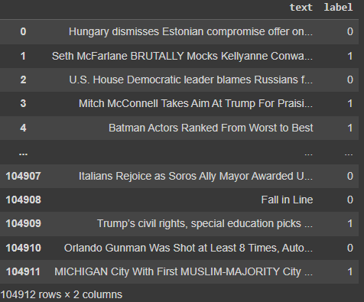
Data Collection
Data has been collected from three different domain
entertainment
healthcare
politics
The size of the data: 300MB, 105,000 rows
Features: title, context, web-info, etc. that is combined into text
Target variable: encoded to 0 and 1 where 0 says the news is fake and 1 says the news is not fake or true news
Notes:
Explain data and data source
Why
1: different words(word clouds -> three topics)
2: different length(histplot word length)
How
where

Slide 5
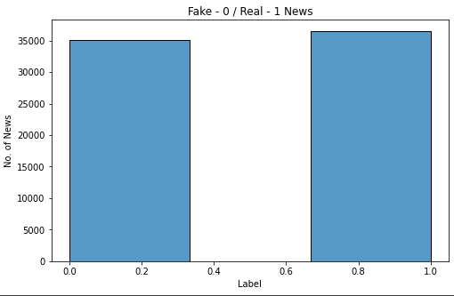
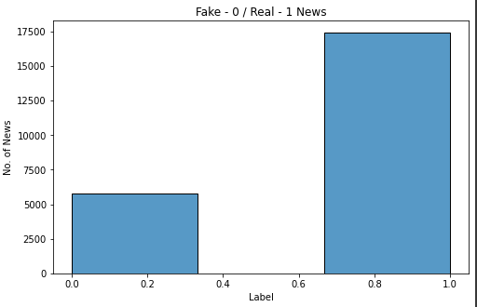
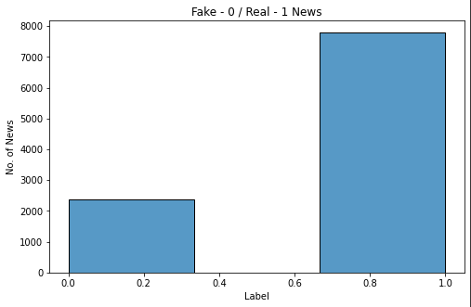
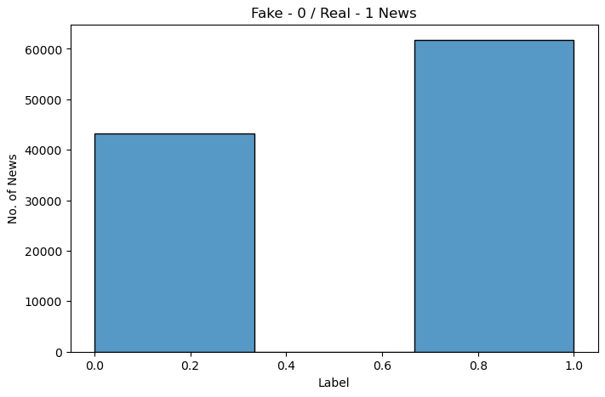
Label distribution
Politics
Entertainment
Healthcare
Mixed Dataset

Slide 6
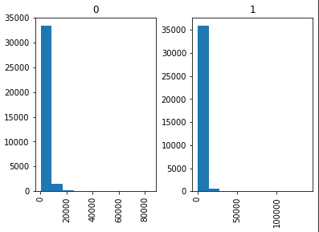
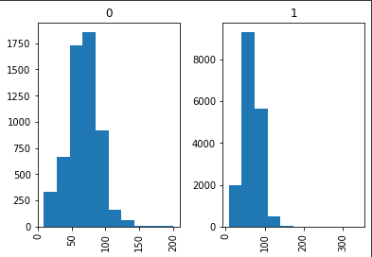
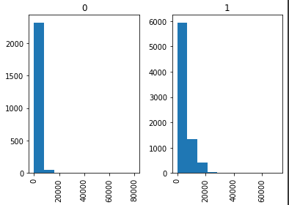
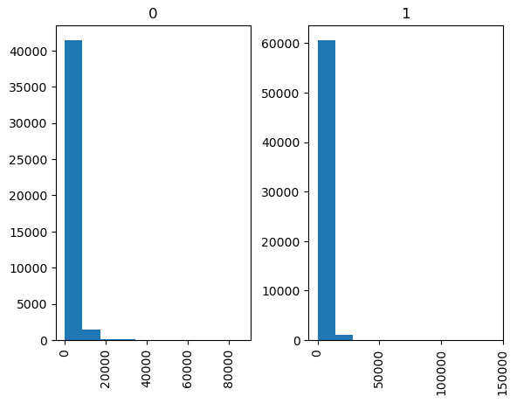
Character length analysis
The number of characters present in each text by labels
The number of characters in each dataset when the news is fake and not fake.
Politics
Entertainment
Healthcare
Mixed Dataset
Notes:
Politics has 75k data (rows), entertainment 23k data, and healthcare 15k data. There are longer sentences in politics data than the others, which means more dominating words are contained in politics dataset. It's challenging to do classification than for each dataset. Correspondingly, the character length in politics are longer than the rest.

Slide 7
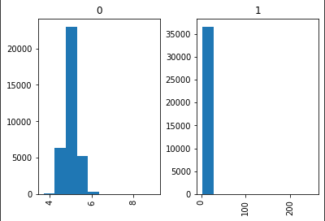
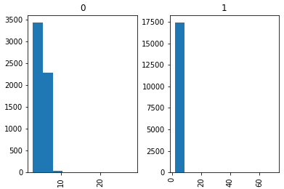
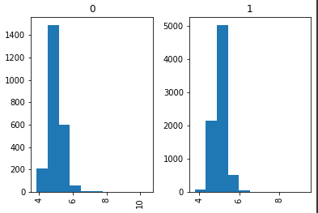
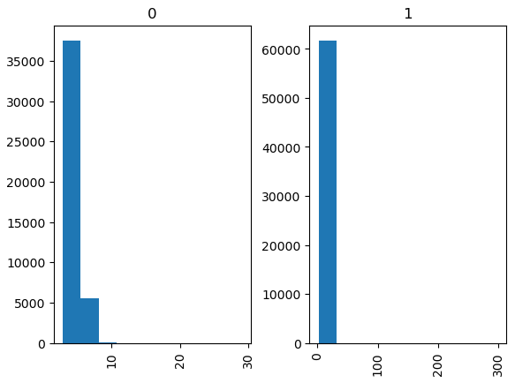
Word distribution
The word distribution of each dataset is shown in the histograms
These graphs give us an idea of the length of the text in each of the dataset
Politics
Entertainment
Healthcare
Mixed dataset

Slide 8
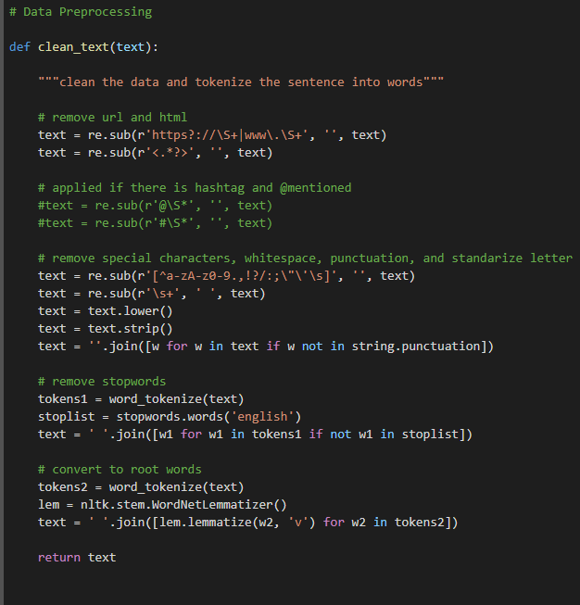
Data Preprocessing
Remove url/html
Remove special characters, punctuation
Standardize letters
Remove stopwords
Convert to root words
Remove missing values

Slide 9
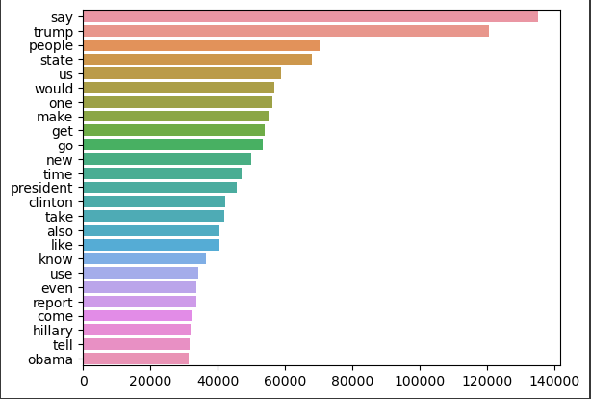
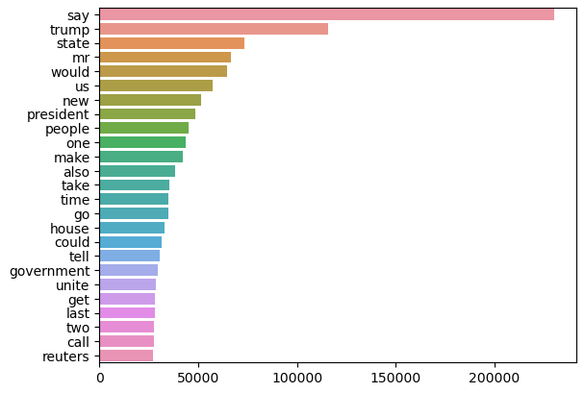
Words Frequency Analysis
Top popular words in true news
Top popular words in fake news
Analyze the words in the whole dataset after data preprocessing.
The most popular words in true news and fake news are both ‘say’ and ‘trump’.

Slide 10
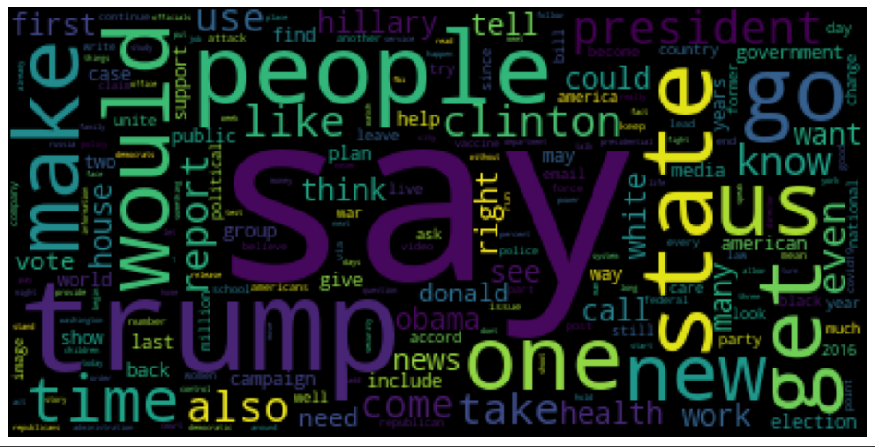
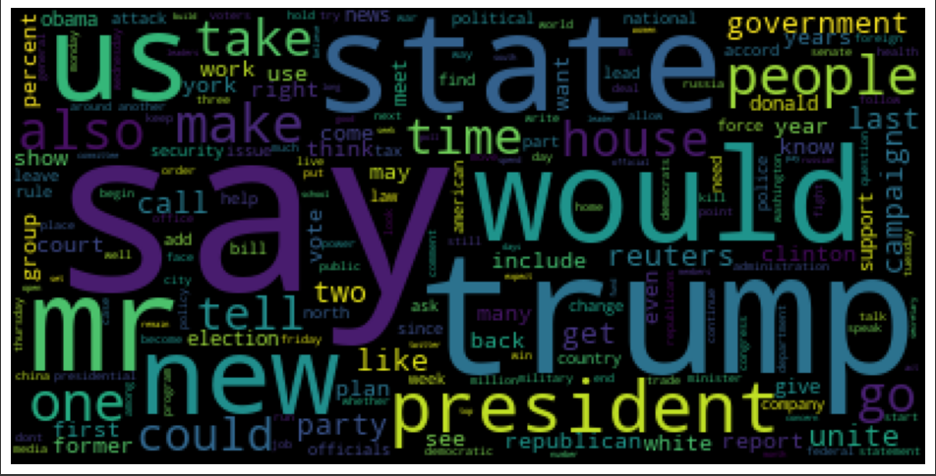
Word Cloud
We will know what are the most common words used in the news
Label 1 shows the words that are more frequently used when the news is true
Label 0 shows the words that are used more when the news is fake
Label = 1
Label = 0

Slide 11
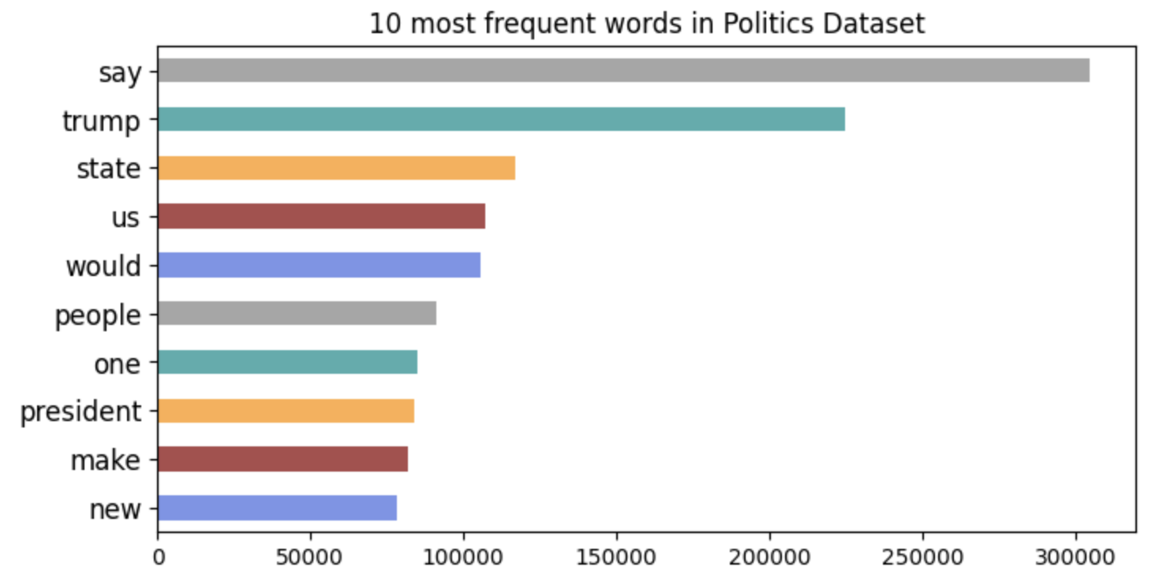
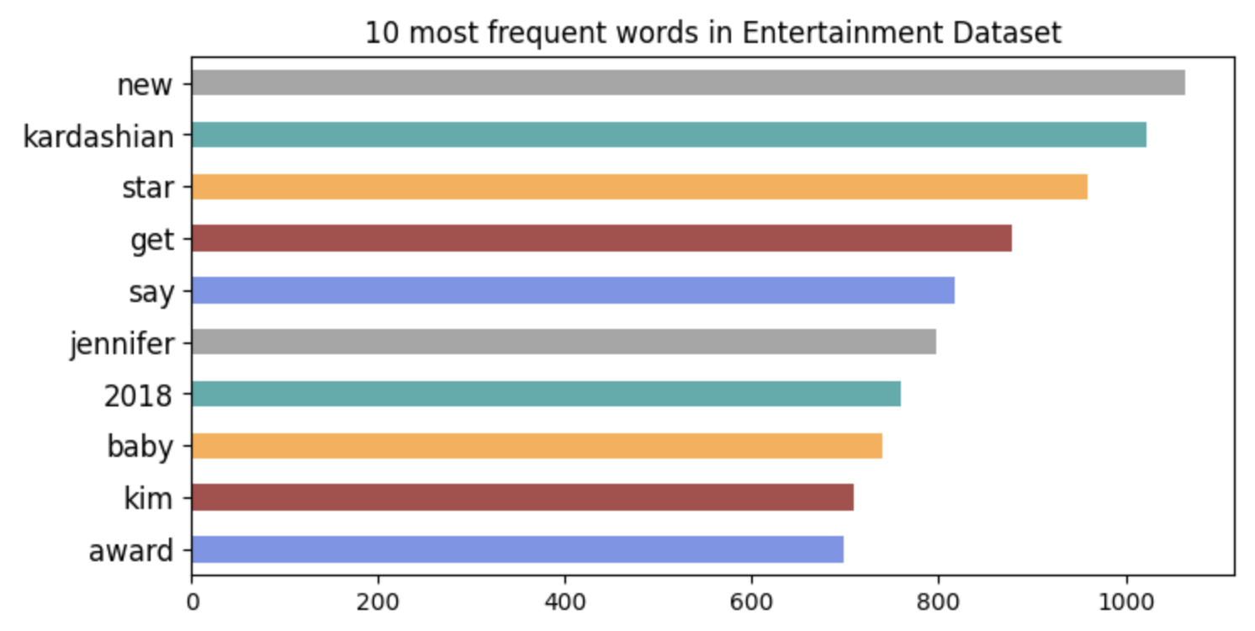
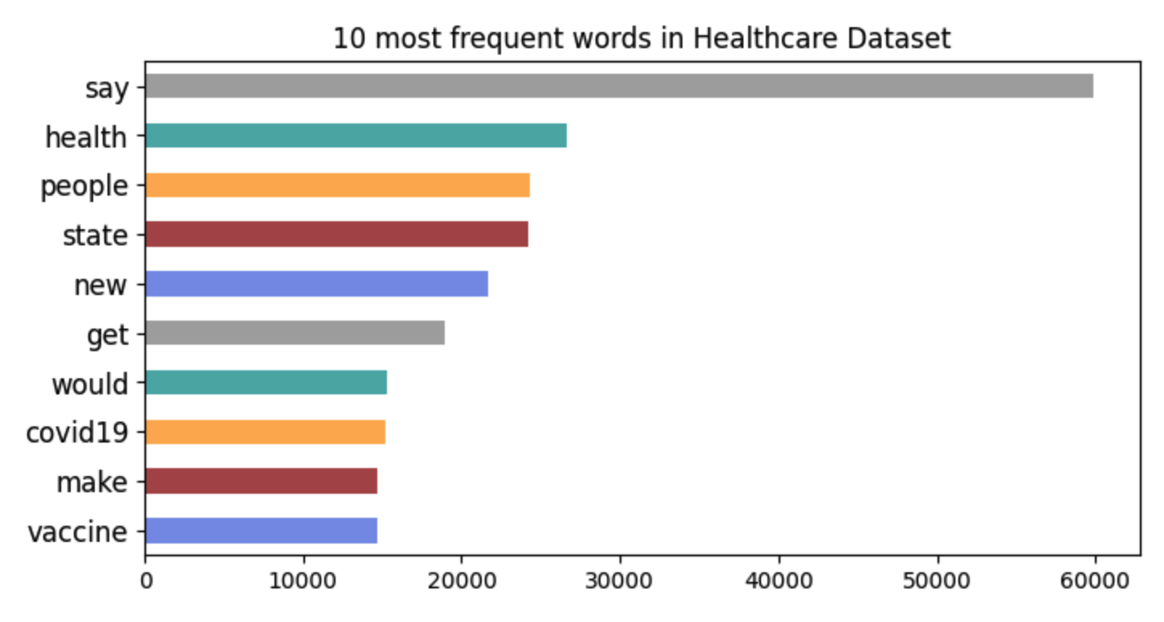
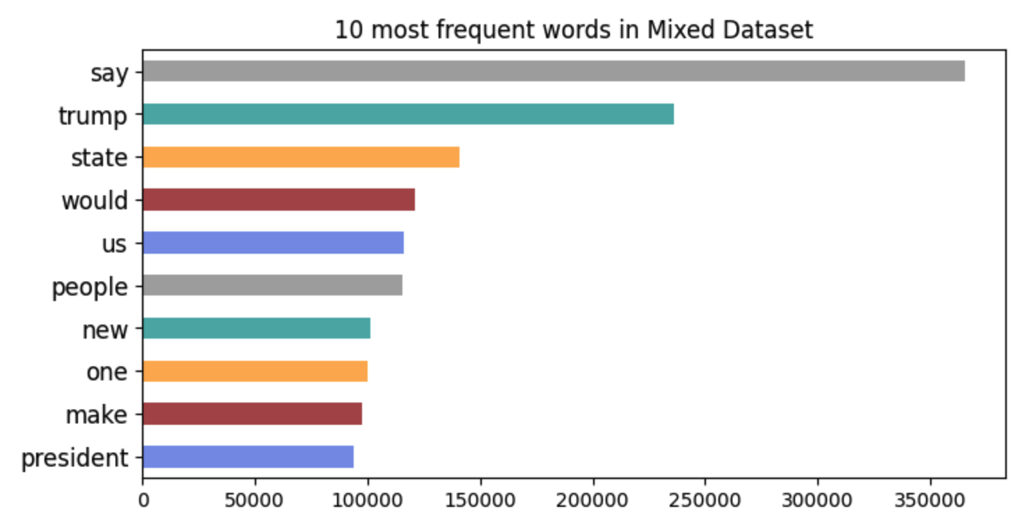
Words Frequency Analysis
Notes:
Each dataset has different most frequent words. But the dominating words in mixed dataset are about politics.

Slide 12
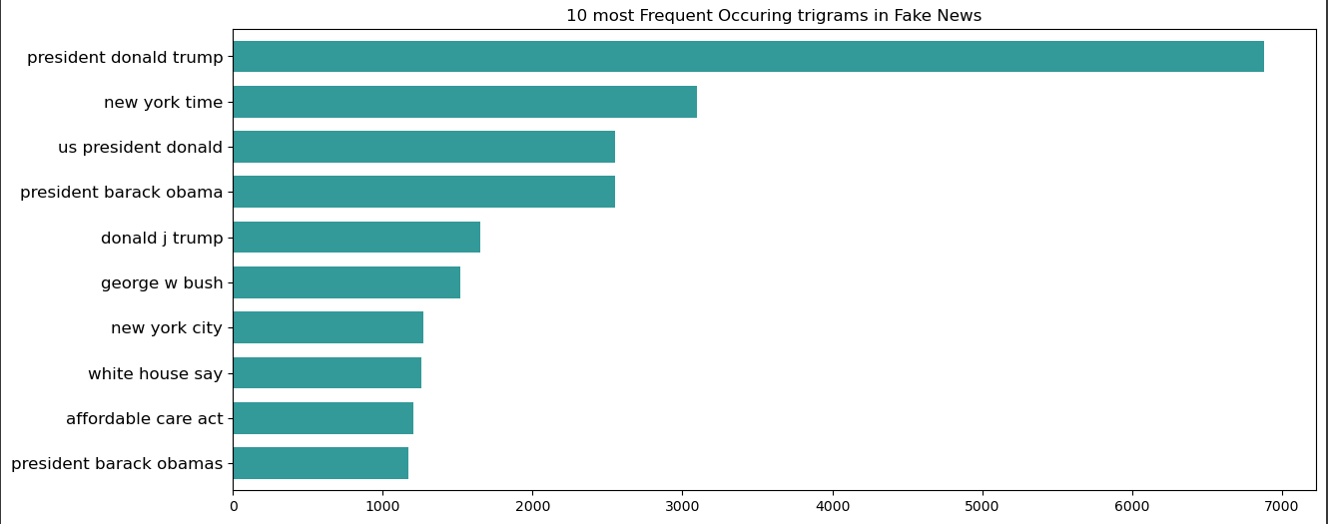
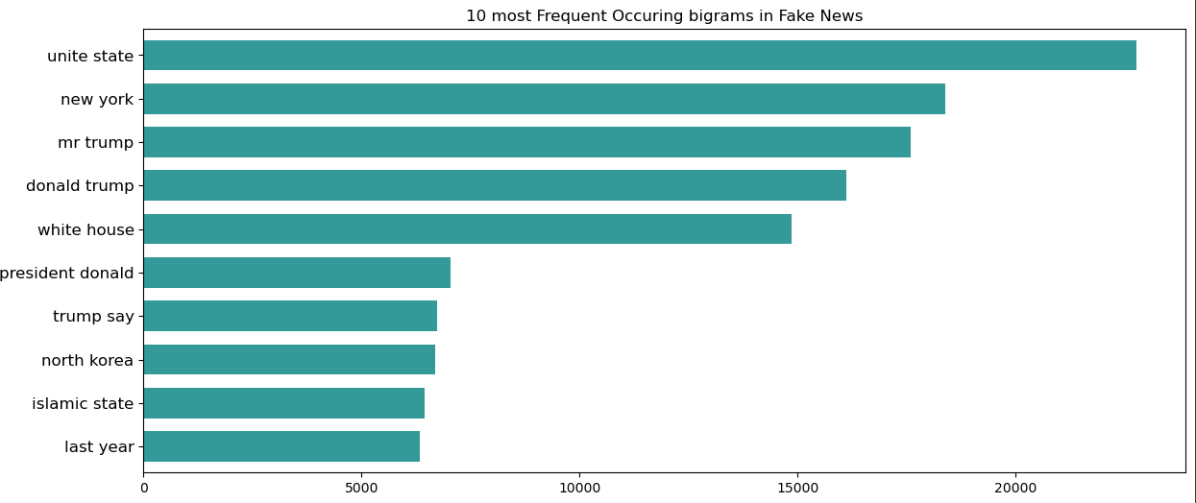
Bigram / trigram analysis
The next step is the Ngram analysis. Ngrams are simply contiguous sequences of n words
Looking at most frequent n-grams can give us a better understanding of the context in which the word is being used
Trigram gives us an understanding of 3 consecutive words which are used frequently in the news
Here are presenting 10 most frequently used words in fake news

Slide 13
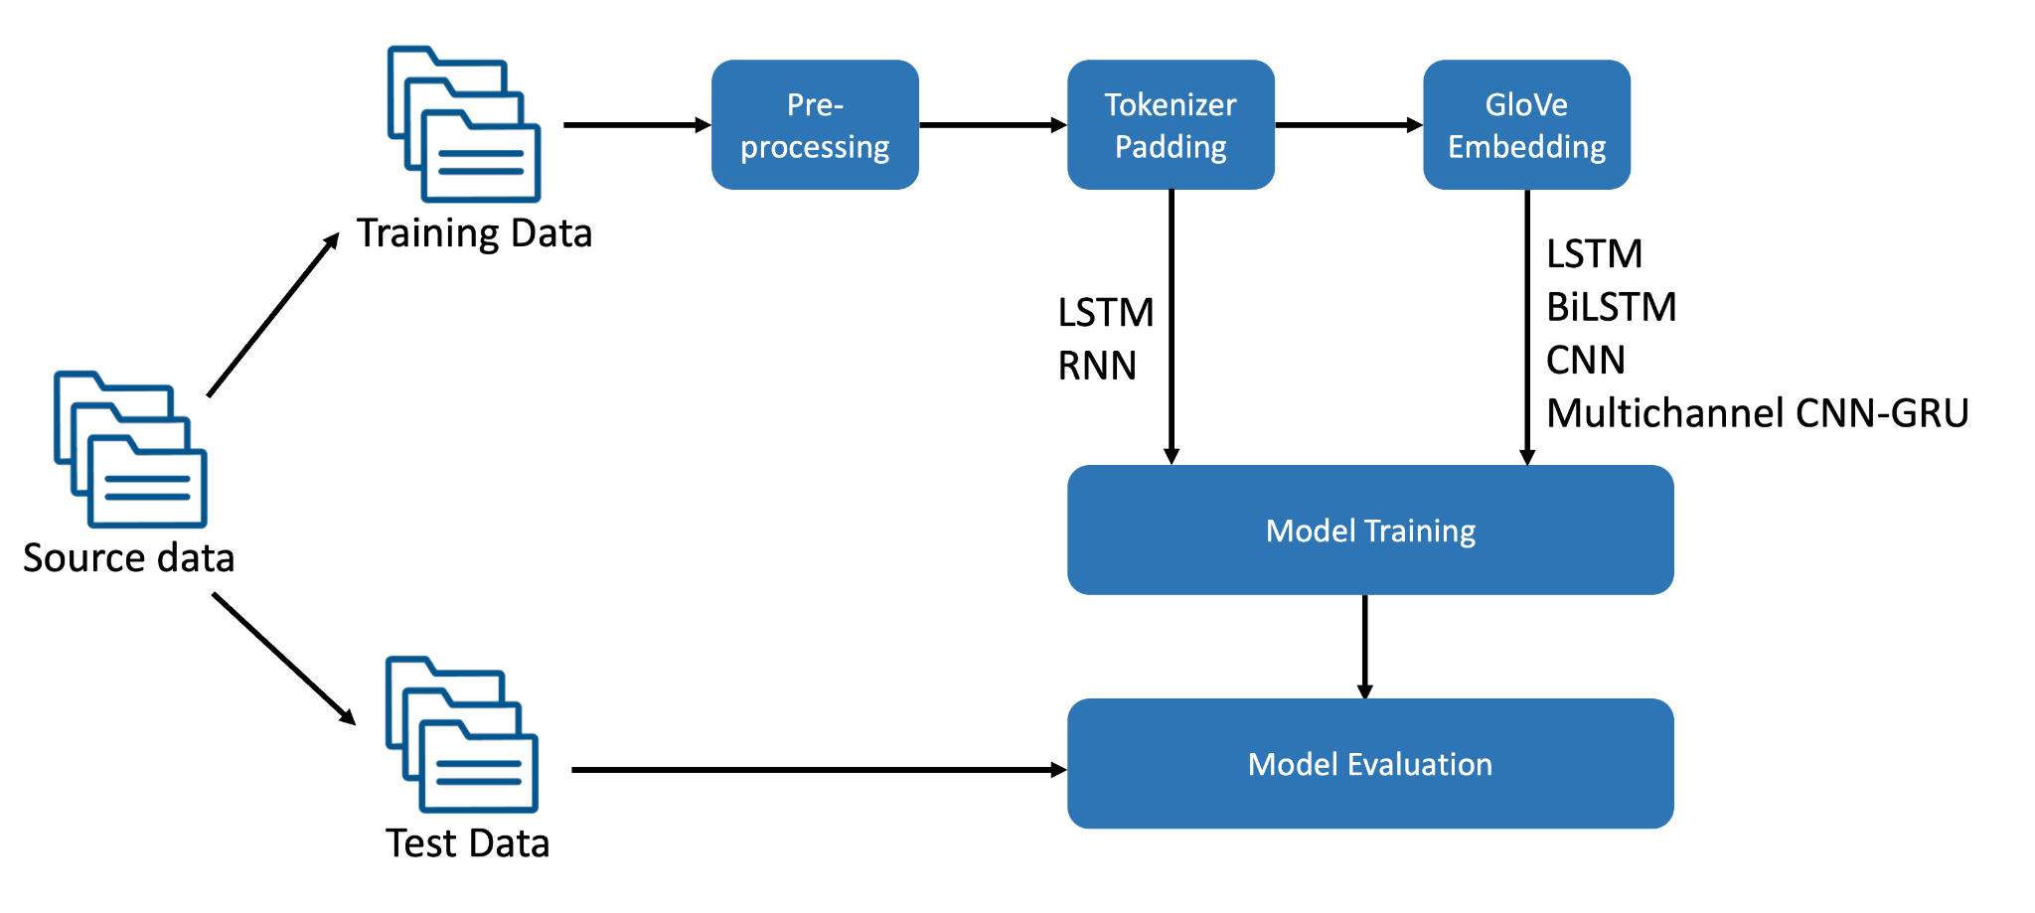
Methodology
Notes:
GloVe is an unsupervised learning algorithm for obtaining vector representations for words

Slide 14
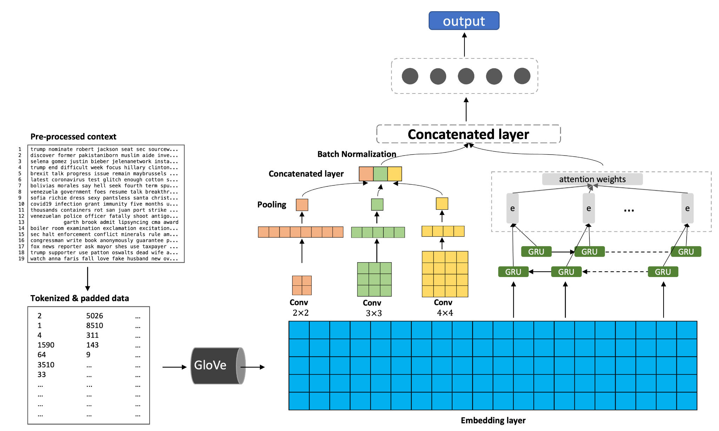
Multichannel CNN-GRU with attention

Slide 15
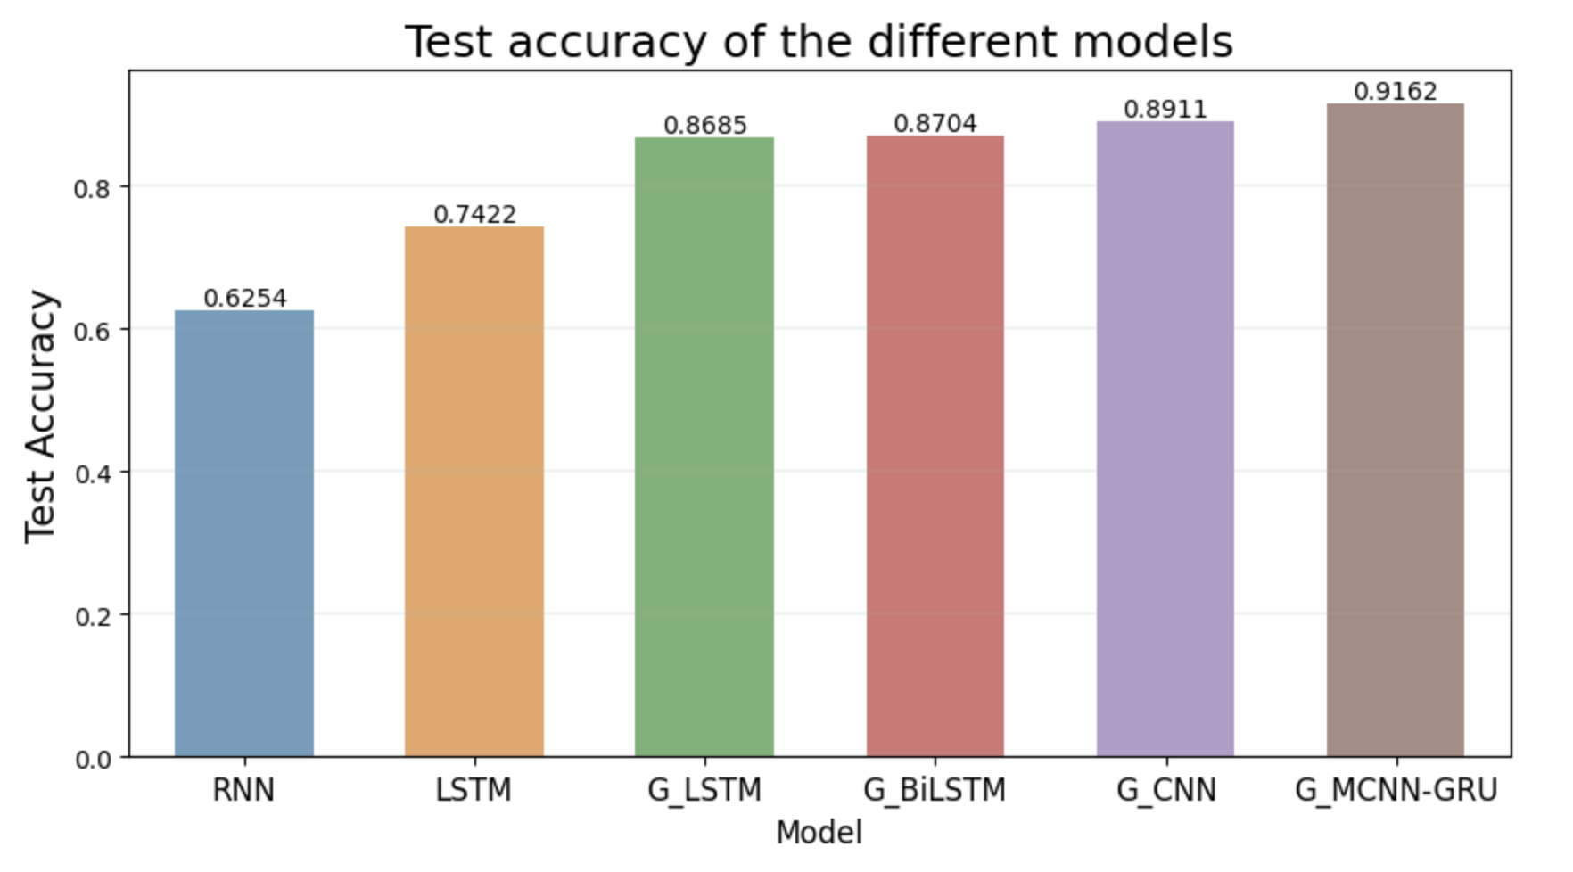
Result and Analysis

Slide 16
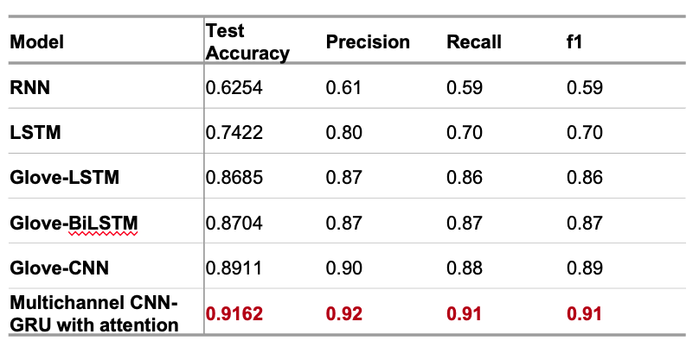
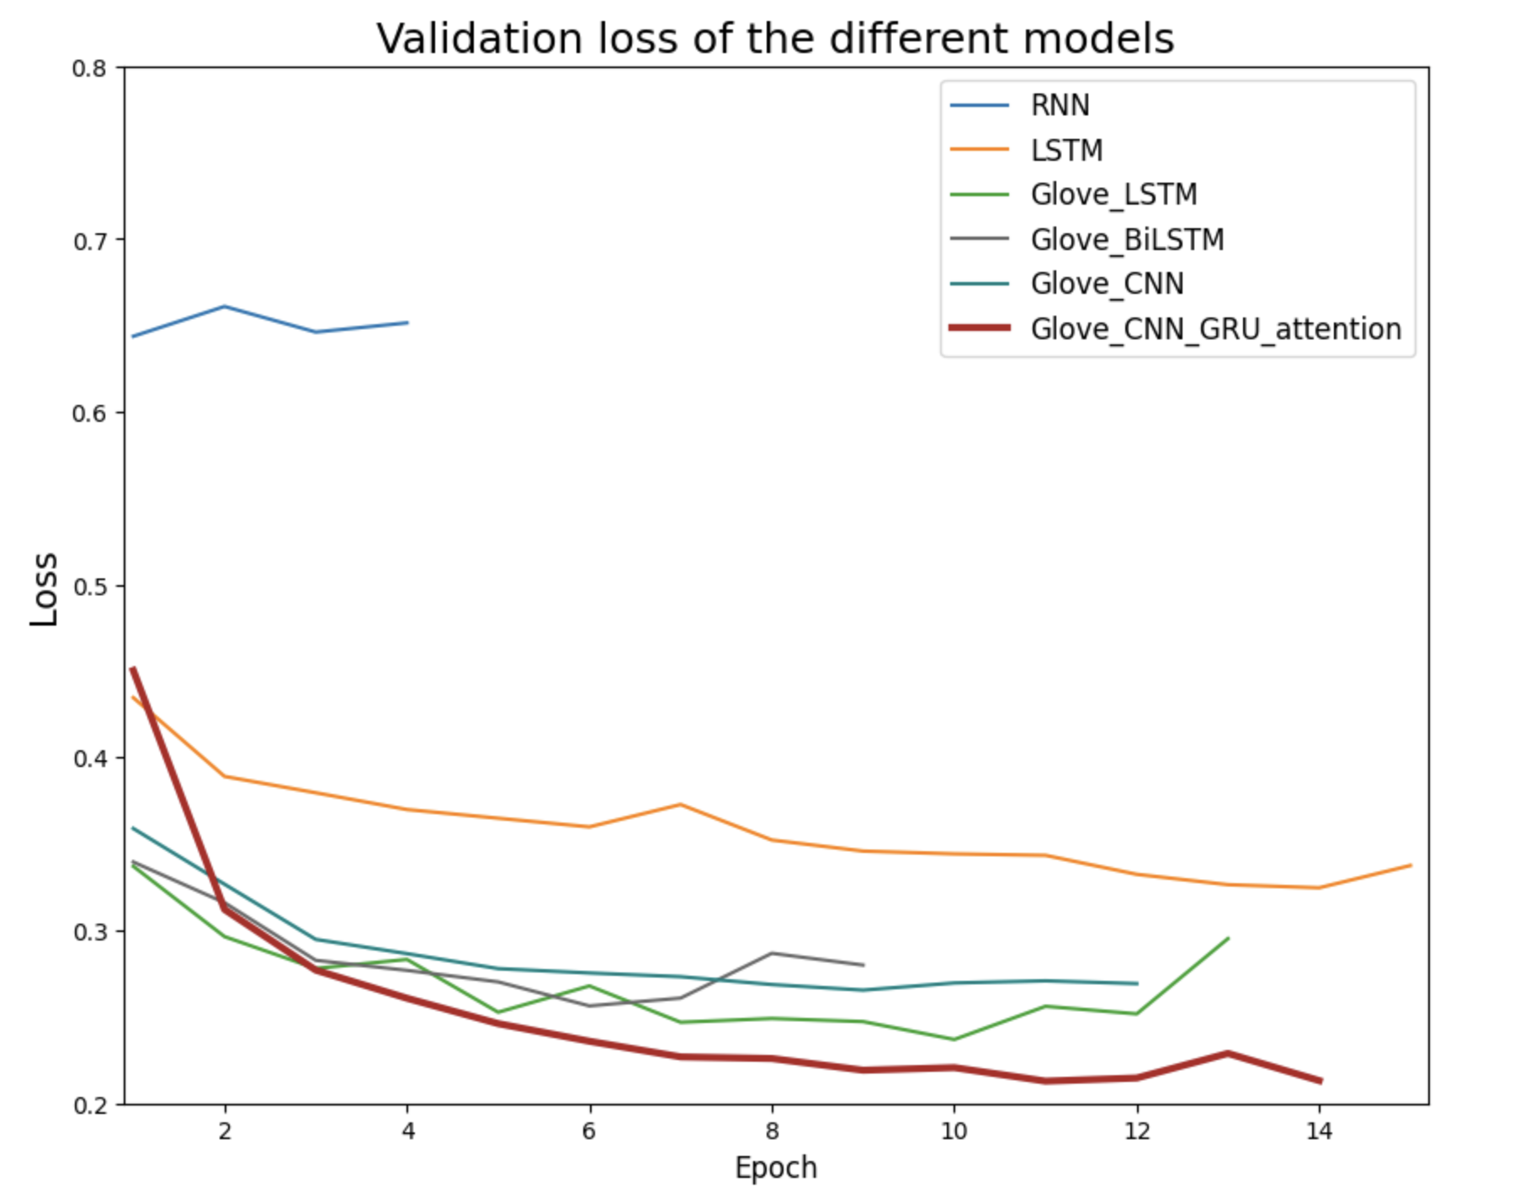
Result and Analysis

Slide 17
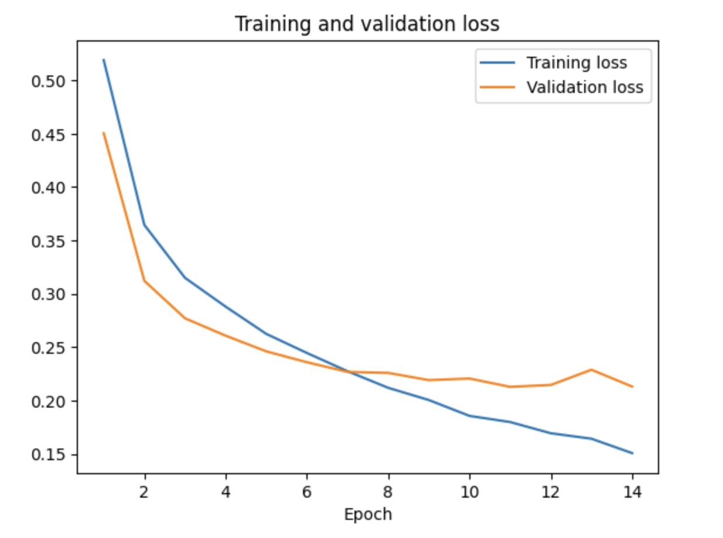
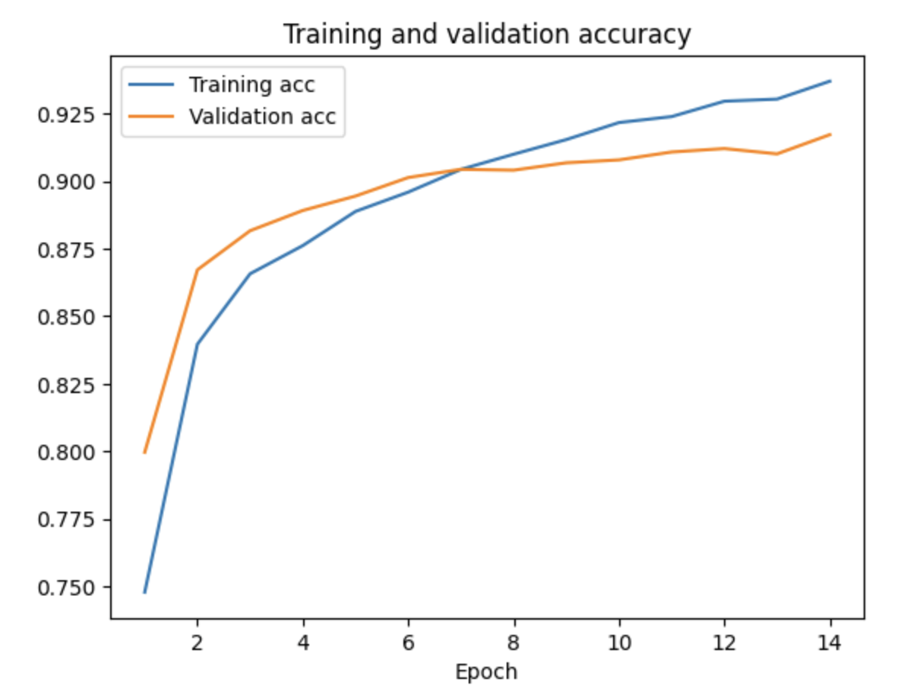
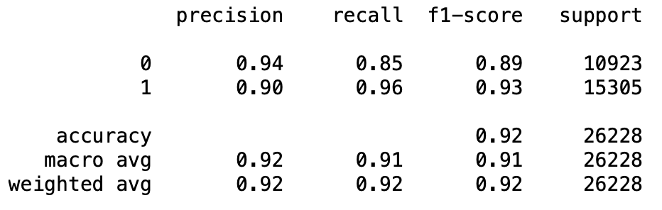
Result and Analysis
Multichannel CNN-GRU with attention model
Optimal hyperparameter :
Kernel size (2×2, 3×3, 4×4)
Number of filters (128)
Size of channels (3 CNN,1 GRU with attention)
Size of hidden state (128)
Applied regularization:
Batch normalization
Spatial dropout and partial dropout

Slide 18
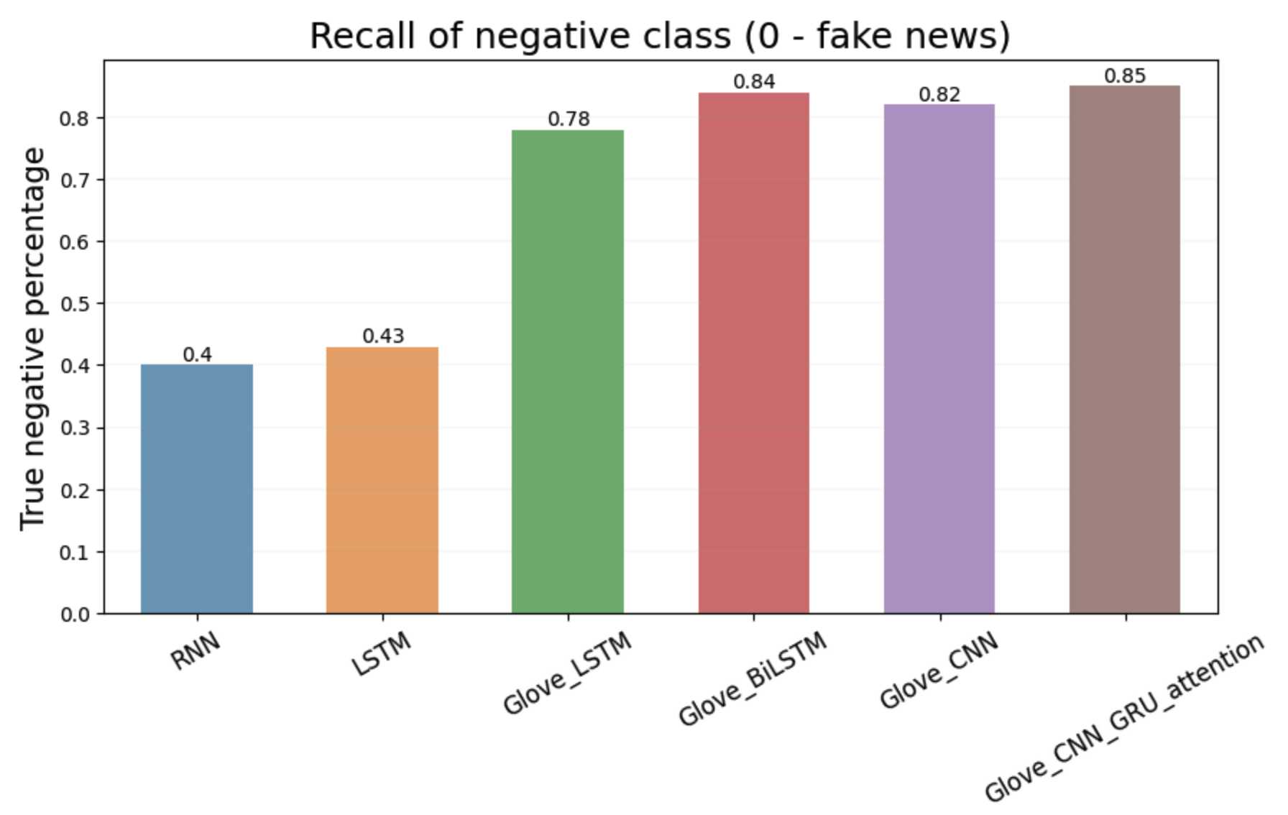
Result and Analysis

Slide 19
Conclusion
Propose multichannel CNN-GRU with attention for fake news detection.
CNN extracted the domaining features and GRU with attention captured the most important information.
The model performance is enhanced by GloVe embedding.
Future work: apply models on character level classification without data preprocessing

Slide 20
Thank You!

Slide 21
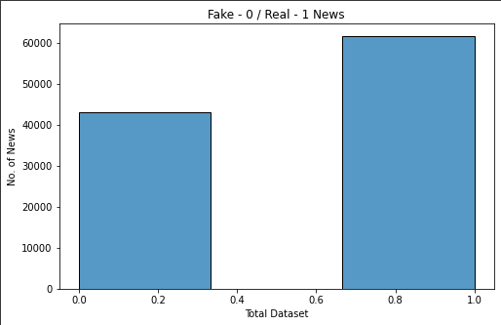
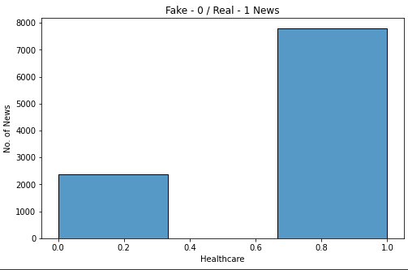
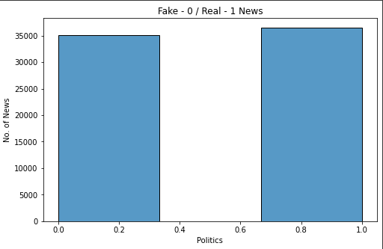
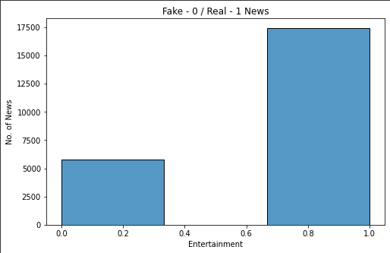

Slide 22
