Slide 2
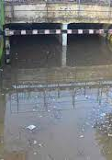
Under Ground Bridges

Slide 3
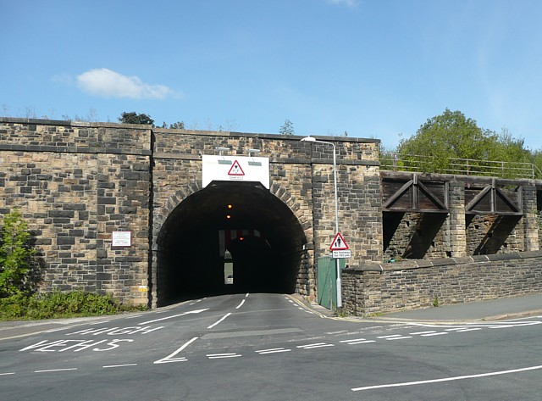
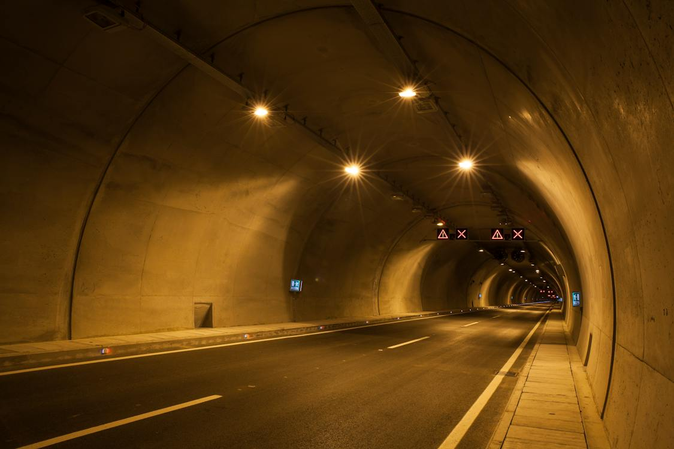
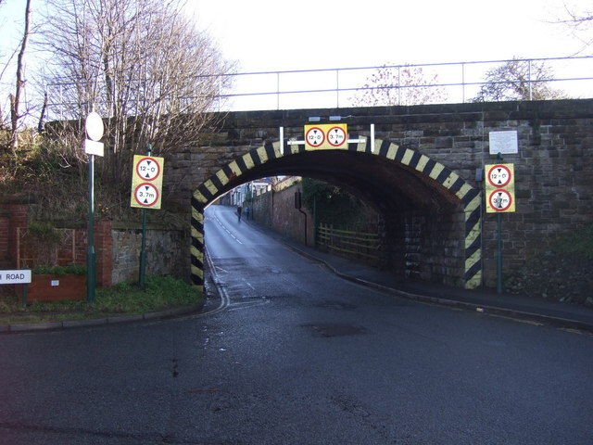
This Photo by Unknown Author is licensed under CC BY-SA
This Photo by Unknown Author is licensed under CC BY-SA

