Slide 1



World Bank Financial Analysis
Presenters:
Ishu
PrithviRaj Naidu
Sanjana Bothale
Sarita Inguava

Slide 2

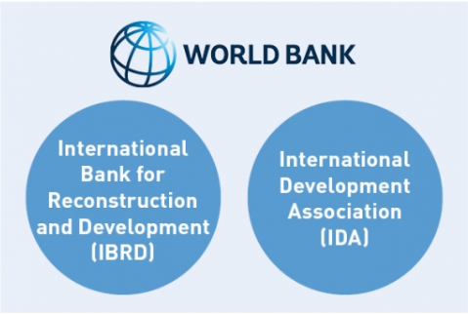

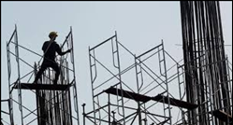
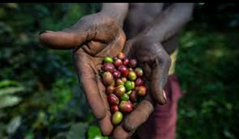
We as Financial Consultants would be helping World bank with their investment decisions.
World Bank aims at reducing poverty by 30% and creating employment for people in developing countries by 2030.As major finances are involved it is very important for world-bank to make a calculated decision for sector wise and country wise investment.

Slide 3
Business Process
For World Bank social contribution is important but at the same time Monetary Recovery is equally important to make them capable of further helping developing nations.
World Bank Financial Organizations
IBRD: Lends to governments of middle-income and creditworthy low-income countries.
IDA: Provides interest free loans-called credits and grants to governments of the poorest countries

Slide 4
About Data
Source: World Bank’s website- https://datacatalog.worldbank.org/
Timeline: The data spans from year 1960 to 2018
Records: We have 17000+ records and 17 columns
Features: Loan Attributes, Country, Project Attributes, Amounts involved, Effective dates etc
Notes:
The data spans from year 1960 to 2018
We have 17000+ records and 17 columns.
Data source : world bank website (paste link)
https://datacatalog.worldbank.org/
Loan Attributes, Country, Project Attributes, Amounts involved, Effective dates etc.

Slide 5
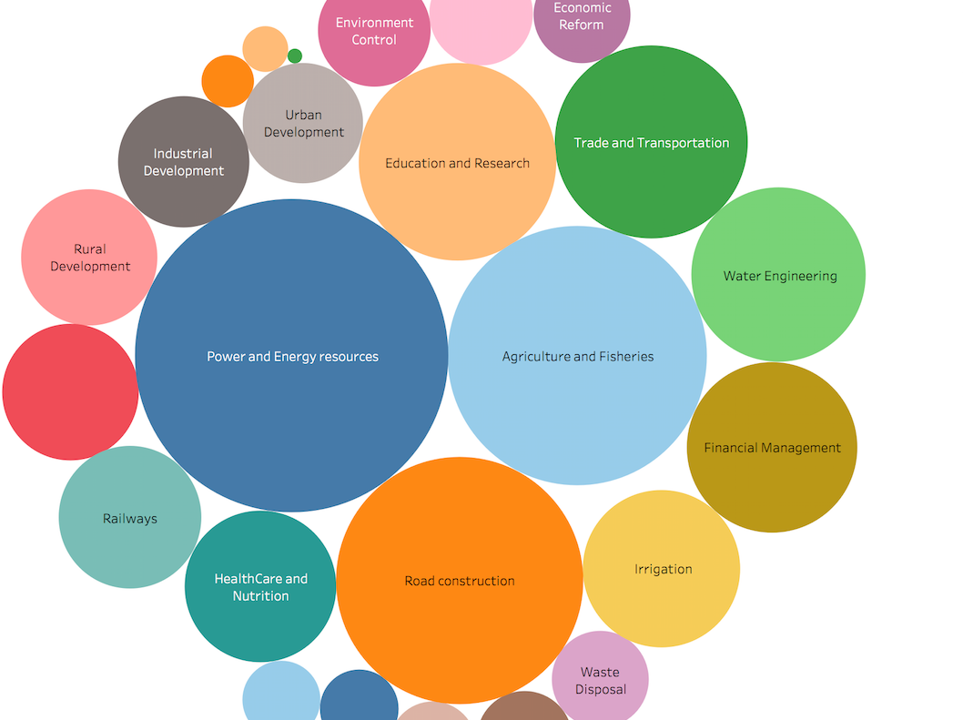
Sectors for which loans are lent

Slide 6
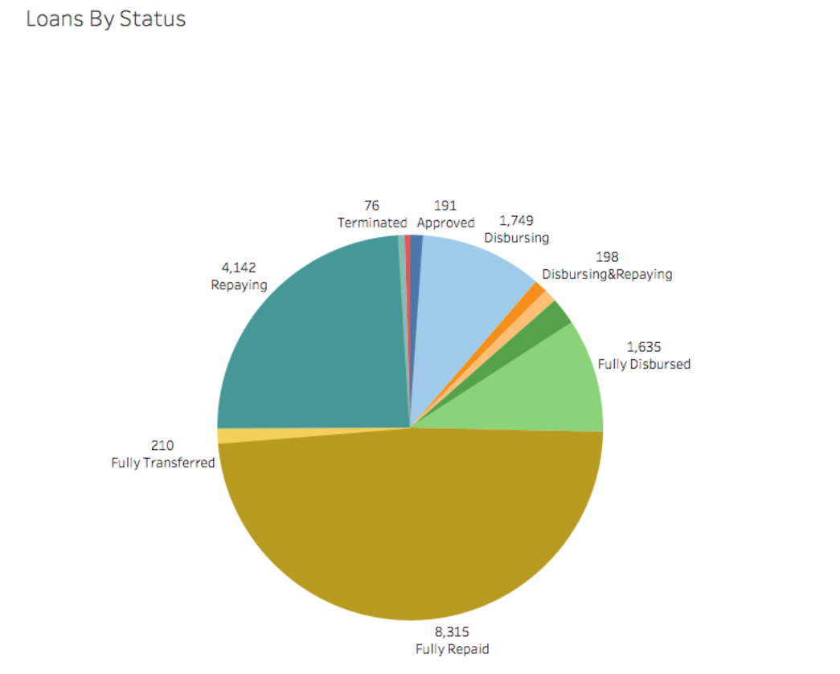
Loan Statuses

Slide 7
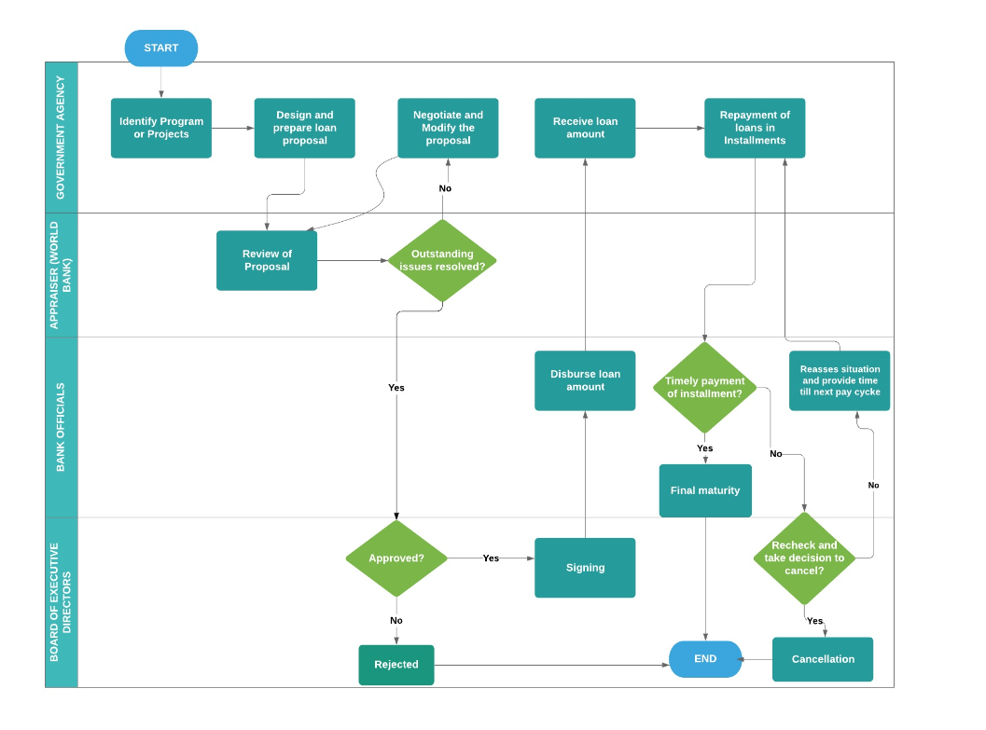
LOAN LIFECYCLE

Slide 8
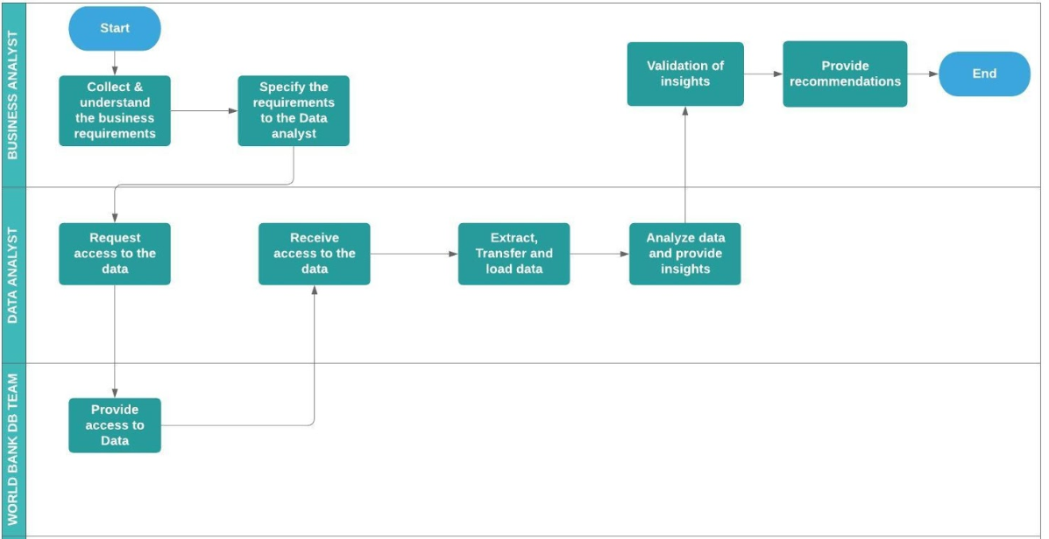
PIPELINE OF OUR PROJECT

Slide 9
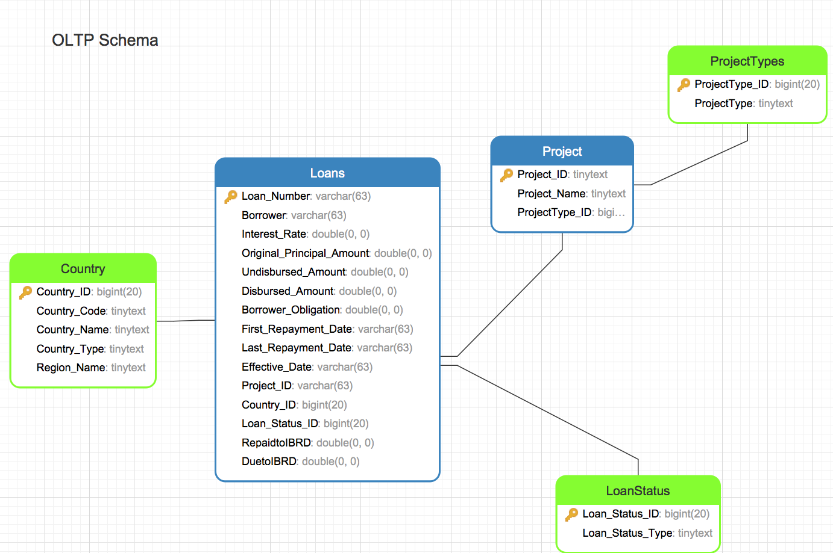
OLTP
Schema

Slide 10
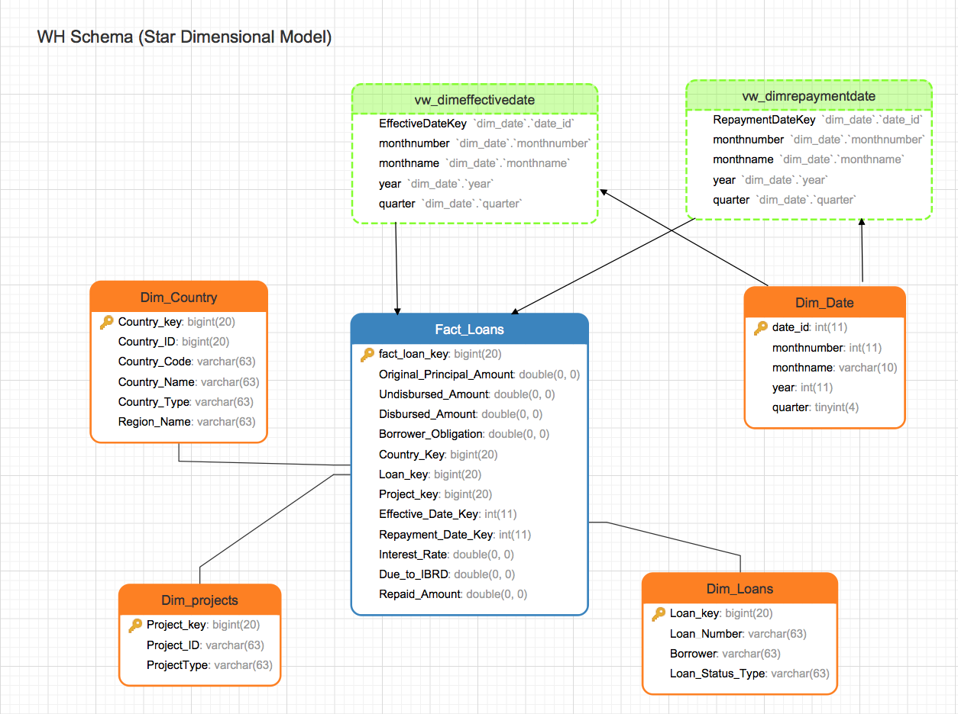
Warehouse Schema

Slide 11
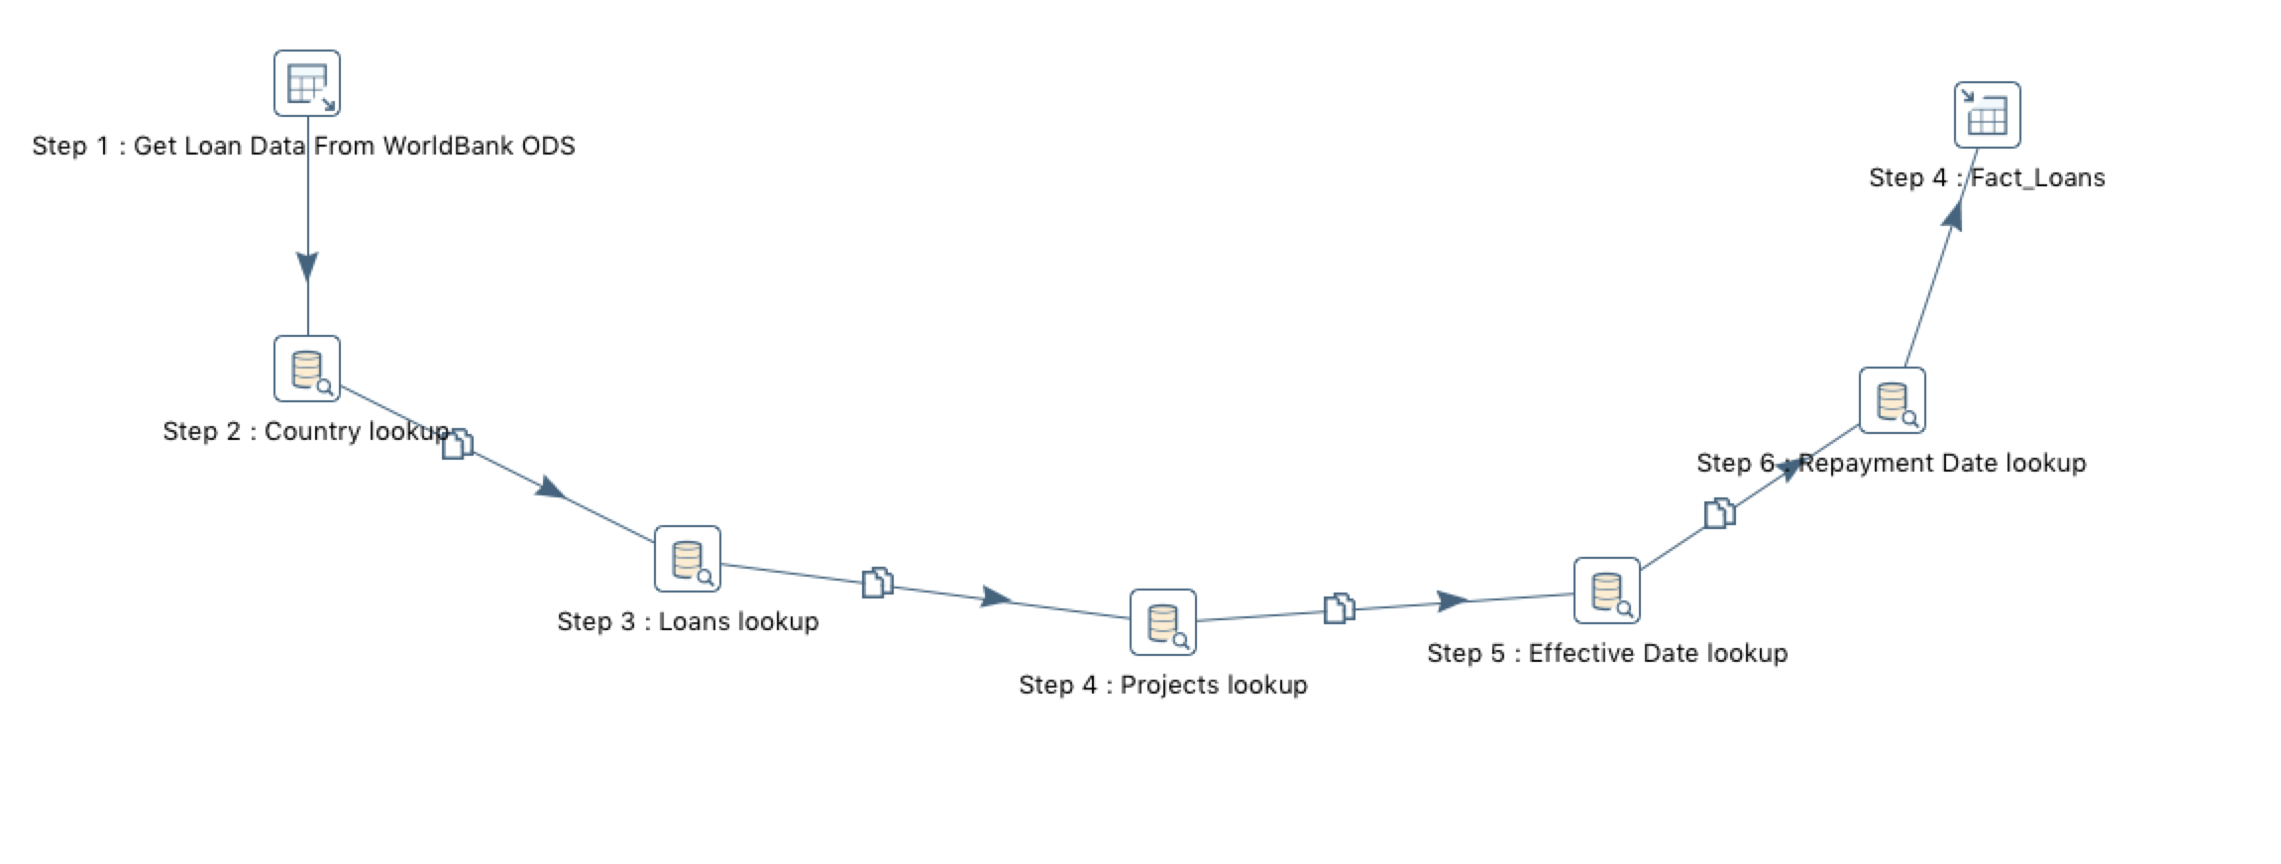
ETL Transformation
Notes:
Ware house

Slide 12
Tableau Demo

Slide 13




This project was an enriching experience as it gave us a practical exposure to the processes of business intelligence and data warehousing applications.
Tools used:
Data Modeler: Erwin, Navicat
ETL tool: Pentaho
Database: Oracle MySql
Visualization tool: Tableau
Challenges: ETL implementation
SUMMARY
Notes:
ETL implementation: After completing the complete ETL implementation according to our schema we needed few more fields for our analysis and we had to go back and merge more columns into our tables.
Tableau:Not everyone from our project group was familiar with Tableau, so we had to invest more time in Tableau implementation.

Slide 14

Thank You

