Slide 1
Battle of the Neighborhoods of Toronto

Slide 2
Introduction/Business Problem
The company I am working for is looking to open a restaurant in the city of Toronto. So im going to leverage the oursqaure data for Toronto city and find a area where there is a large community of residents, easy access to transportation and less competitors
Target an audience: For any company (Small business or large franchises) looking to open a restaurant or cafe in Toronto city.

Slide 3
Description of the data
Boroughs, Postal code, neighborhoods of Toronto
Geo locations for each postal code
Subway metro stations and their geolocation
Apartments/houses in each neighborhood with their details and geolocation
venues for each neighborhood and subway metro stations

Slide 4
How the data was used to solve the problem
Use geopy and Foursquare for venue and geolocation data to map/cluster all the top 10 venues, subway metro stations for Toronto downtown to get a better understanding of all the venues/ammenities near each subway station for analysing accesibility
Map/cluster the rental apartments for Toronto downtown to view the average number of apartments in a set radius around each subway station

Slide 5
Potential questions to analysis
what is the number of apartments near each subway metro station in Toronto downtown?
What are the venues of the two best places cross to metro station with apartments?
How venues distributed in Toronto downtown around metro stations?

Slide 6
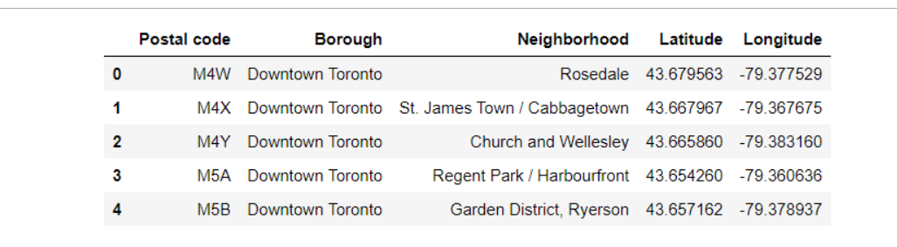
Using geopy and Foursquare obtained the geolocation data for Toronto downtown

Slide 7
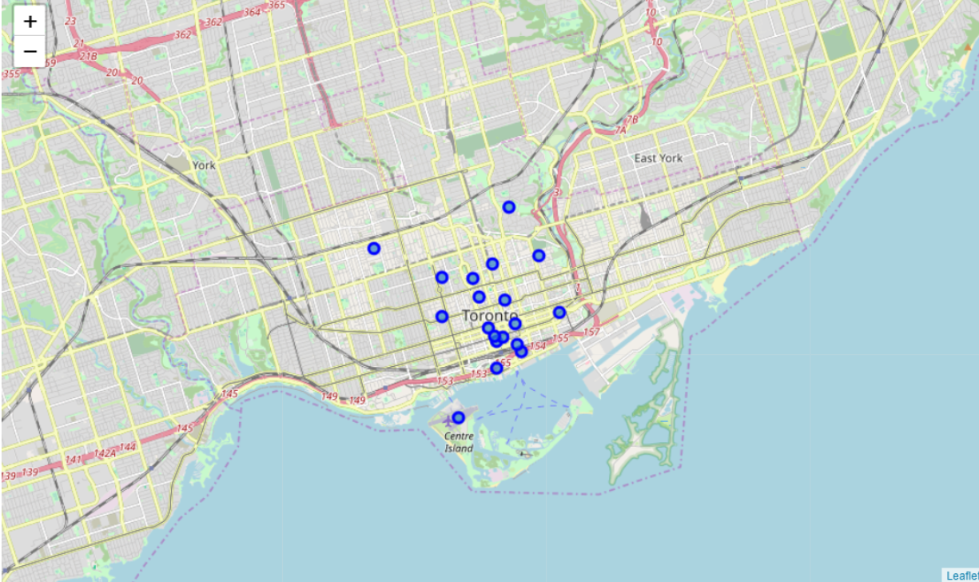
Visualized all the different neighborhoods in downtown Toronto

Slide 8

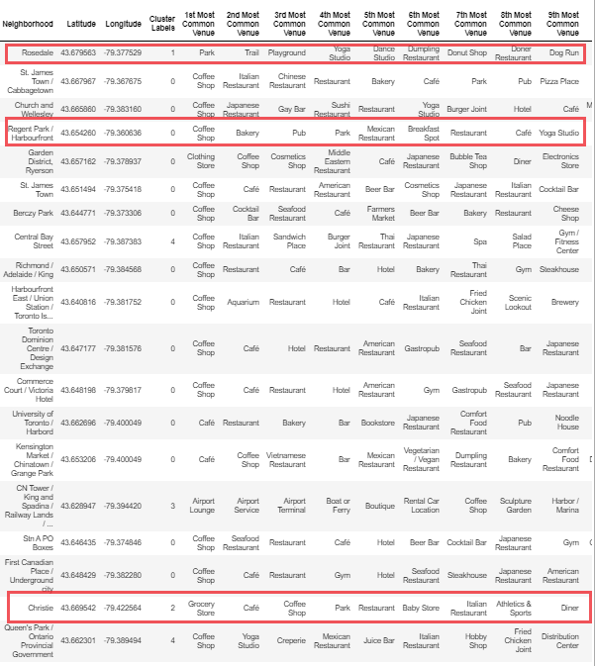
Analysisng the top 9 venues in each of the neighborhoods for downtown Toronto to understand which neighborhoods have lesser restaurants and have parks As seen Rosedale, Christie and Regent park have a parks in their common venues, have lesser resturants and bars. This makes these three locations potential restaurant spot

Slide 9
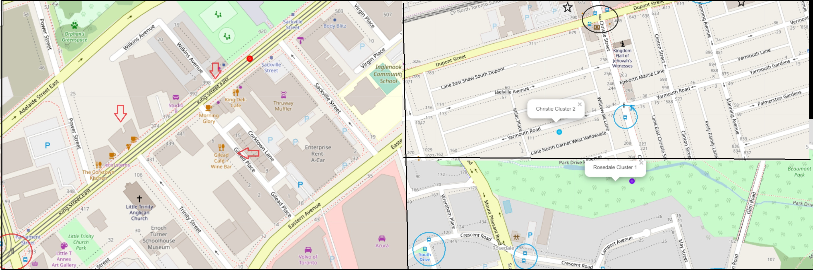
As noted before that the three locations: Rosedale, Christie and Regent park have a parks in their common venues, have lesser restaurants and bars. Now we are going to work towards picking the one with more accessibility to subway and has more residensial area located near it - The arrows point towards the restaurants in the area - The blue circles represent subways - The Black stars represent residensial area

Slide 10
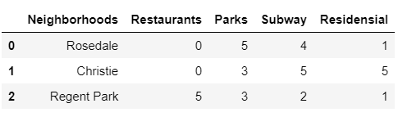
Resultant Scoreboard: 1. Rosedale Neighborhood is noticed to have parks which can attract a large crowd making the restaurant visible, has no competition in terms of restaurants and has accessibility to subways, but residential score is low 2. Christie Neighborhood is notices to have a park, high score for sub way accessibility and residential area, making it a hub for potential customers without much of competition 3. Regent Park, having a high score for restaurants makes it unlikely of choice

Slide 11
Therefore, I would recommend that Christie neighborhood to be the ideal location

