Slide 1

Parallel Processing concepts project batch processing
Sanjana gutta

Slide 2

Batch Processing
Batch processing is when a computer processes a number of tasks that it has collected in a group. It is designed to be a completely automated process, without human intervention. It can also be called workload automation (WLA) and job scheduling

Slide 3
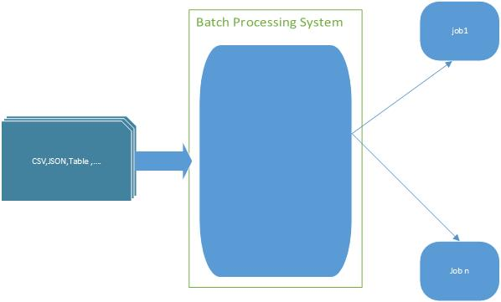

Slide 4
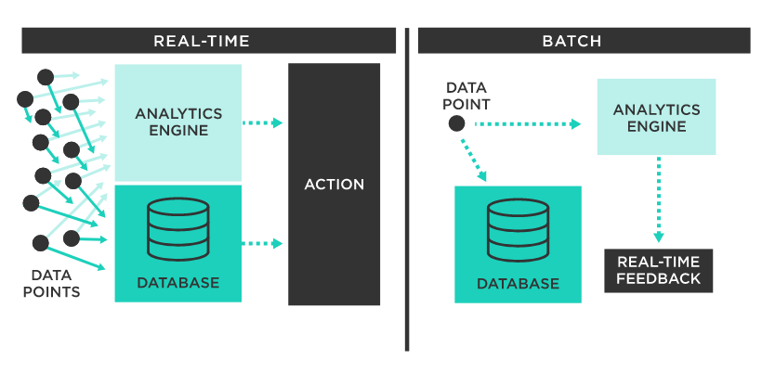

Slide 5
Batch Processing
Batch processing has a range of benefits, but it is ideal in businesses where:
There’s a process that doesn’t need to be addressed immediately and real-time information isn’t needed
Large volumes of data need to be processed
There’s a span of time where a computer or system is idle
A process doesn’t need the input of humans and is repetitive
A good example of batch processing is how credit card companies do their billing. When customers get their credit card bills, it isn’t a separate bill for each transaction; rather, there is one bill for the entire month. That bill is created using batch processing. All the information is collected during the month, but it is processed on a certain date, all at once.

Slide 6
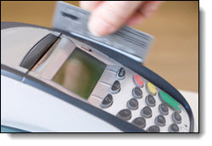
Credit card transaction
This is the very first step where a customers uses his/her credit card for the transaction.
This transaction made will be stacked on merchant database.
EOD they will be sent for the authorization.
The merchant then submits the information of credit card transaction to the gateway.
The credit card gateway sends the transaction information to the merchant's bank processor

Slide 7
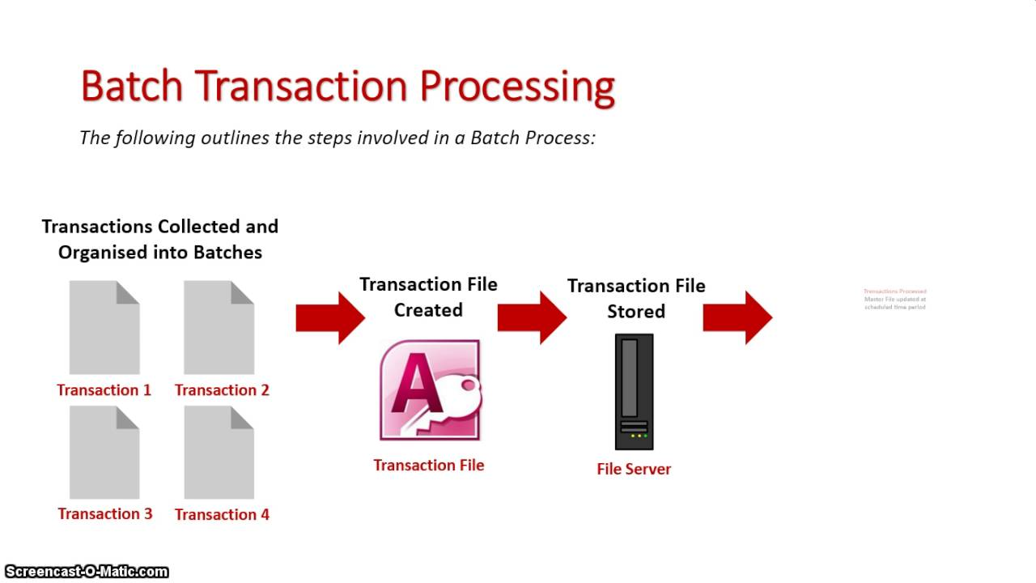
Customer Profile Analyzer/database
The merchants bank submits this transaction to the network that which is connected to customer’s bank.
The customer’s bank will accept or decline the payment by analyzing the customers database.
The network then analyzes the payment with different scenarios and checks the database of customer.

Slide 8
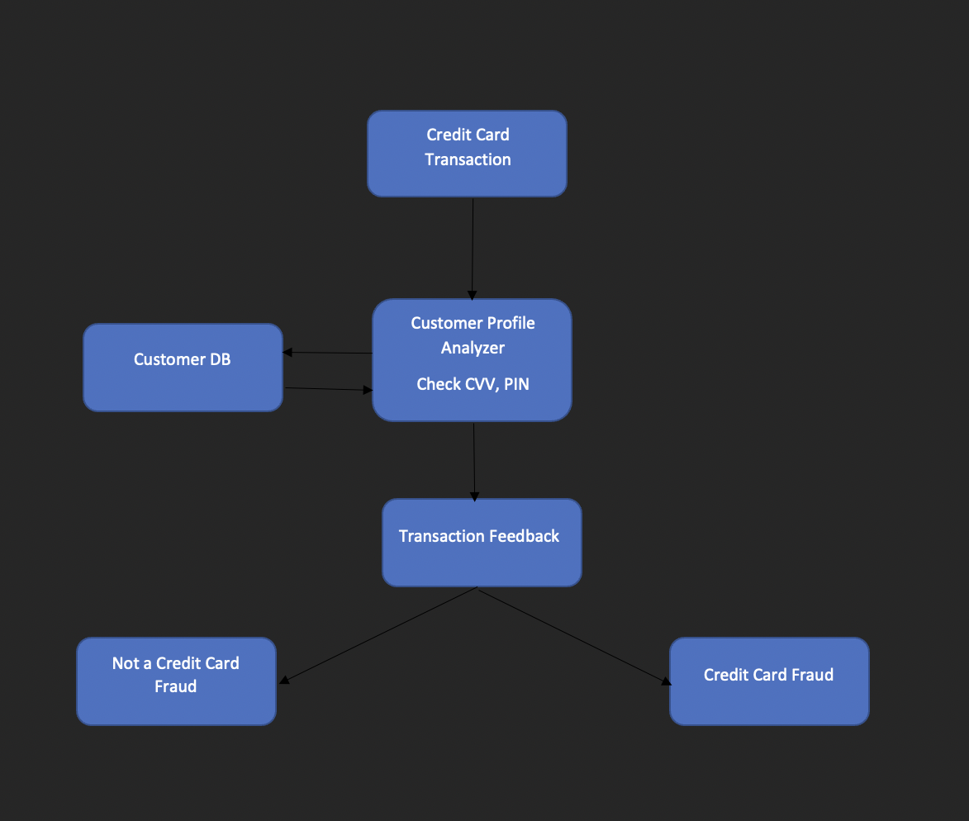
Block Diagram

Slide 9
Feedback
NOT CREDIT CARD FRAUD
CREDIT CARD FRAUD
If the feedback is positive and if funds are available, the credit card network sends the acceptance to the merchant processor and sends a feedback.
This is known as the settlement process.
Else if there is any miscellaneous activity in the transaction, the credit card network sends a fraud feedback to the merchant as well as the security.

Slide 10
Credit card Batch processing
When the transactions are grouped together and massively transmitted for the processing is batch processing.
This is the very next step for a merchant for their customers transactions.
These transactions are filed up for whole day to settle.

Slide 11

pyspark
a Python API for Apache Spark. Apache Spark is an analytical processing engine for large scale powerful distributed data processing and machine learning applications.
PySpark is a general-purpose, in-memory, distributed processing engine that allows you to process data efficiently in a distributed fashion.
Applications running on PySpark are 100x faster than traditional systems.
You will get great benefits using PySpark for data ingestion pipelines.
Using PySpark we can process data from Hadoop HDFS, AWS S3, and many file systems.
PySpark also is used to process real-time data using Streaming and Kafka.
Using PySpark streaming you can also stream files from the file system and also stream from the socket.
PySpark natively has machine learning and graph libraries.

Slide 12

PySpark Architecture
Apache Spark works in a master-slave architecture where the master is called “Driver” and slaves are called “Workers”.
When you run a Spark application, Spark Driver creates a context that is an entry point to your application, and all operations (transformations and actions) are executed on worker nodes, and the resources are managed by Cluster Manager.

Slide 13

Apache airflow
A workflow management platform
Uses python-based workflows
Schedule by time or event
Written in python
Has a wide range of integration options

Slide 14
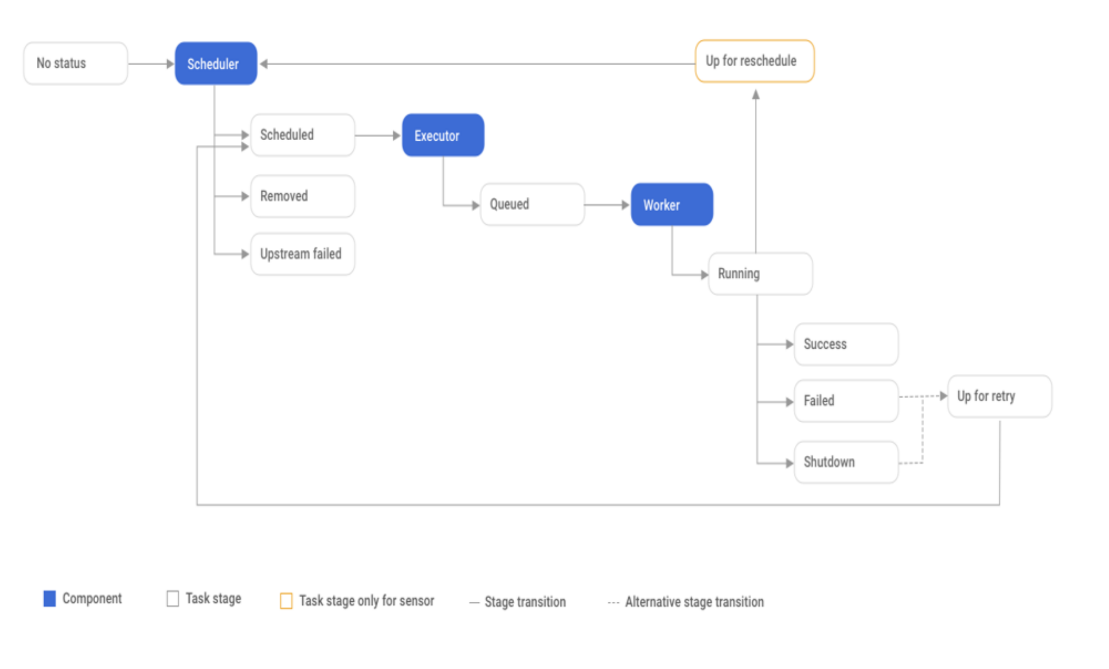
Airflow task life cycle

Slide 15
Dataset
Credit card fraud detection data set, from Kaggle
There are 28 feature variables which are the result of PCA(principal component analysis, used to normalize the data).
There are untransformed features, ‘Time’, ‘amount’ and ‘class’
The feature/variable class represents whether the transaction is fraud or not. The transaction is fraud if class =1, else it is not a fraud.

Slide 16
Dataset
This dataset presents transactions with 492 frauds out of 284,807 transactions.
Dataset is highly imbalanced (only 0.172% accounts for positive class)
It is difficult to create an ML model with the dataset being highly imbalanced.
Hence, we reduce the number of non-fraud records to make it something close to fraud records. Converting an imbalanced dataset to a balanced dataset.

Slide 17
Classification Model
Classification model is created, which will be later used to predict if a transaction is fraud or not.
From the new data, we spilt the data further for training and testing. The train/test split taken is 80/20.
Different classifiers are used to create the model, the best model is selected based on the metrics.

Slide 18
Classification Models Created
Gradient-boosted tree classifier (GBT)
Decision tree classifier
Random forest classifier
Linear support vector machine
Naïve bayes classifier

Slide 19
Metrics to compare ML models
Accuracy: Percentage of results correctly classified
Precision: percentage of the results which are relevant
Recall: percentage of total relevant results correctly classified

Slide 20
comparison of ml Models
Classification Model | Accuracy | Precision | Recall
GBT Classifier | 93.88 | 0.94 | 0.94
Decision Tree Classifier | 94.90 | 0.89 | 0.95
Random Forest Classifier | 94.90 | 0.89 | 0.95
Linear Support Vector Machine | 94.90 | 0.89 | 0.95
Naïve Bayes Classifier | 94.90 | 0.89 | 0.95

Slide 21
Conclusion on Classifiers
From the results, except gbt classifier, all others have obtained the same results. This can be because of limited records in the dataset.
Precision for gbt classifier is higher than other classifiers.
Accuracy and recall of gbt classifier is almost similar like those of other classifiers.
Hence, for the data generated, gbt classifier is the best choice.

Slide 22

Thank you

