Slide 1
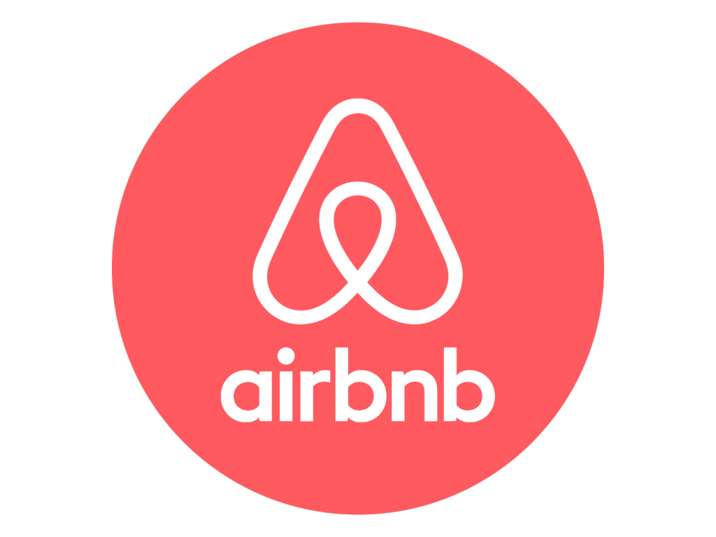
NEW YORK AIRBNB
By Prachi & Sanjana

Slide 2
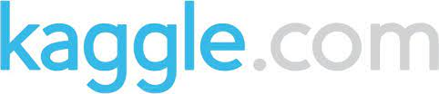
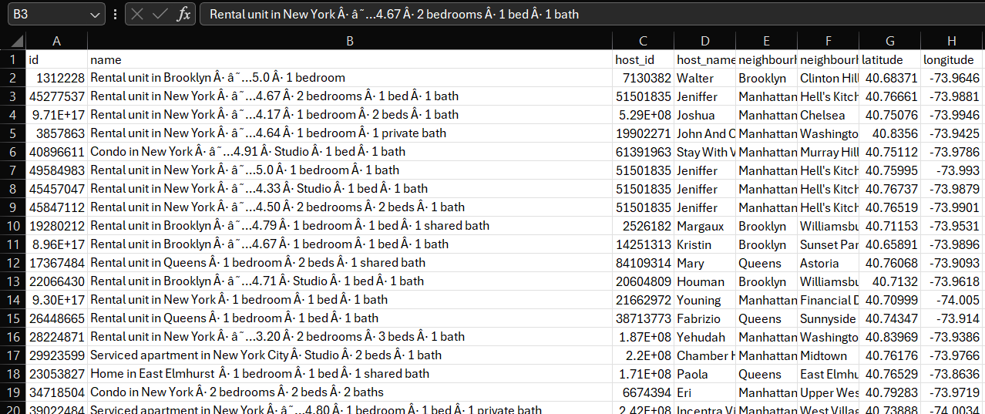
Data collection and Data cleaning
New York Airbnb Open Data 2024 https:/www.kaggle.com/datasets/vrindakallu/new-york-dataset
Airbnb originally known as AirBedandBreakfast.com, operates an online marketplace for short- and long-term home stays and experiences.
This dataset describes the latest listing activity in New York City, New York as of January 5th, 2024.

Slide 3

NEIGHBOURHOOD INSIGHTS FOR NEWYORK AIRBNB

Slide 4
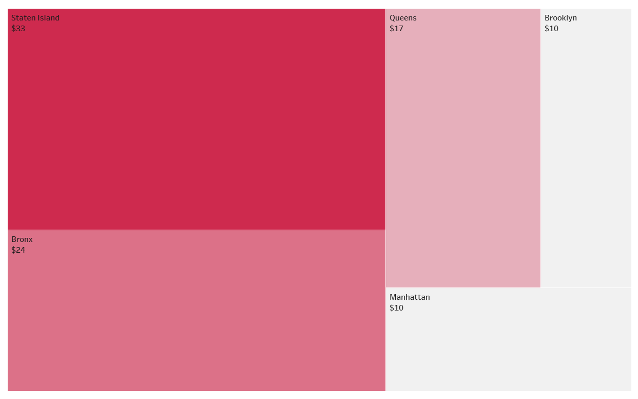
Minimum price of Airbnb
The minimum price of Airbnb is in Manhattan and Brooklyn which is $10.
The minimum number of days for which the clients stayed was 30 days for this price which indicates that if you stay for a longer period, you get cheaper rates.
The interesting insight that we gathered was that Brooklyn has the highest rent of $100000 but also has stays with $10 per night price. This indicates that there are a wide range of stays in Brooklyn catering all income clients.

Slide 5
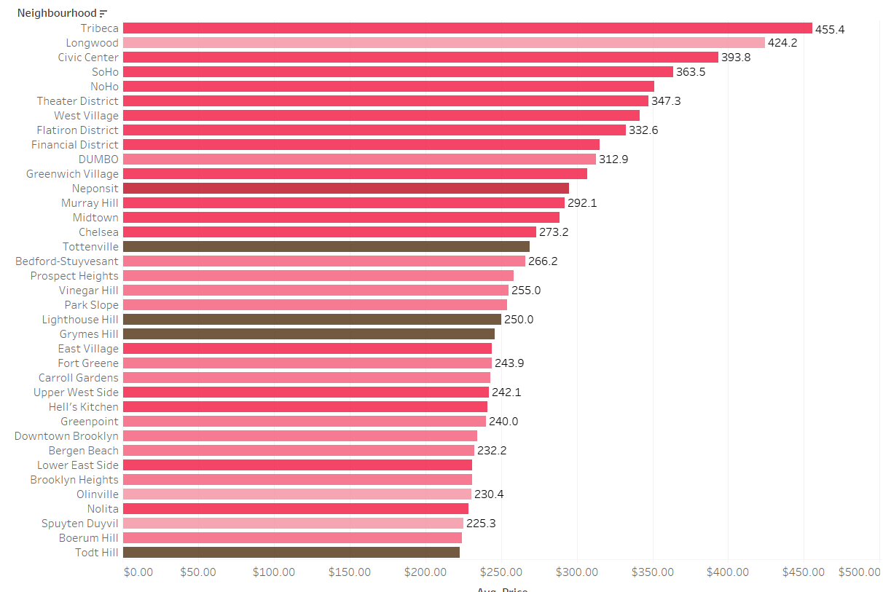
Average Price per Night across different Neighborhoods
This visualization displays the average 1 day stay rates at the Airbnb's across different neighborhoods of New York.
The neighborhood with highest average price per night is Tribeca in the Manhattan with $455.4 per night.

Slide 6
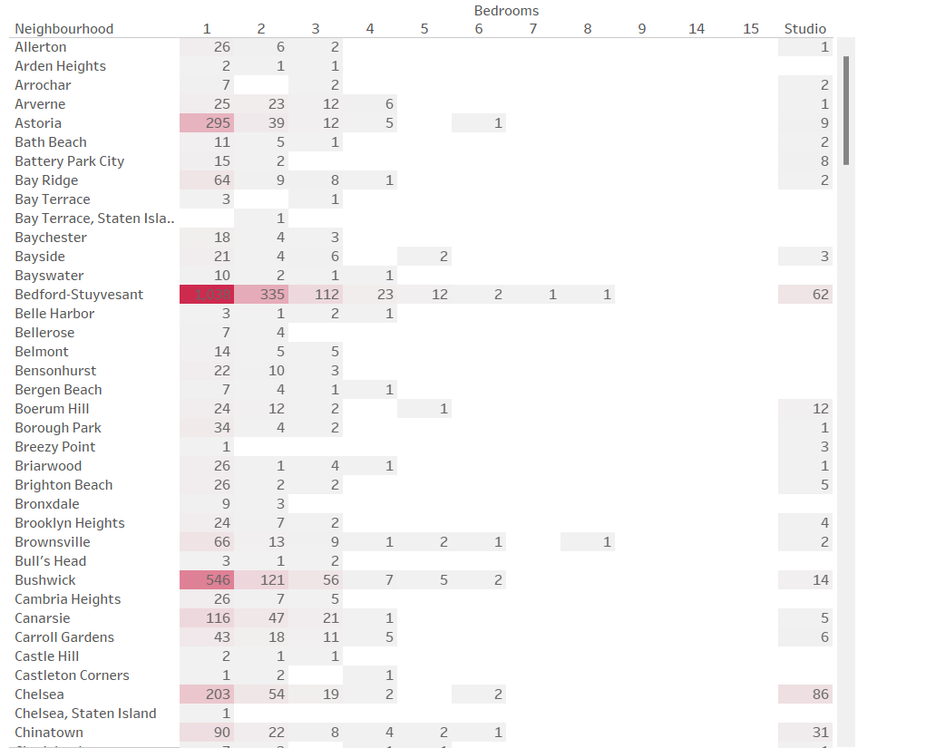
Number of bedrooms across Airbnbs
This visualization displays the distribution of number of bedrooms from studio to 15 across Airbnb's in all the neighborhoods.
Bedford has the highest 1 Bedroom apartments available for a stay.

Slide 7
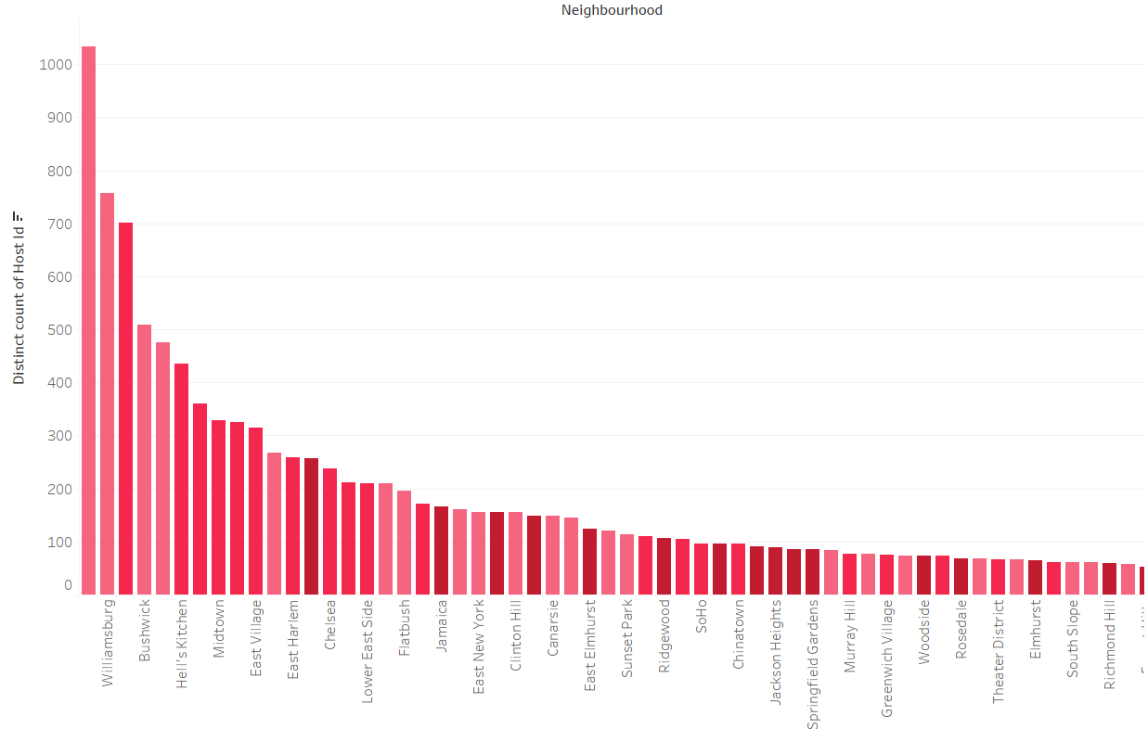
Popular Airbnbs
This visualization displays the Airbnb's as per their ranking of highest number of hosts, the greater number of hosts indicates more popularity.
Bedford has the highest number of hosts which is more than 1000.

Slide 8
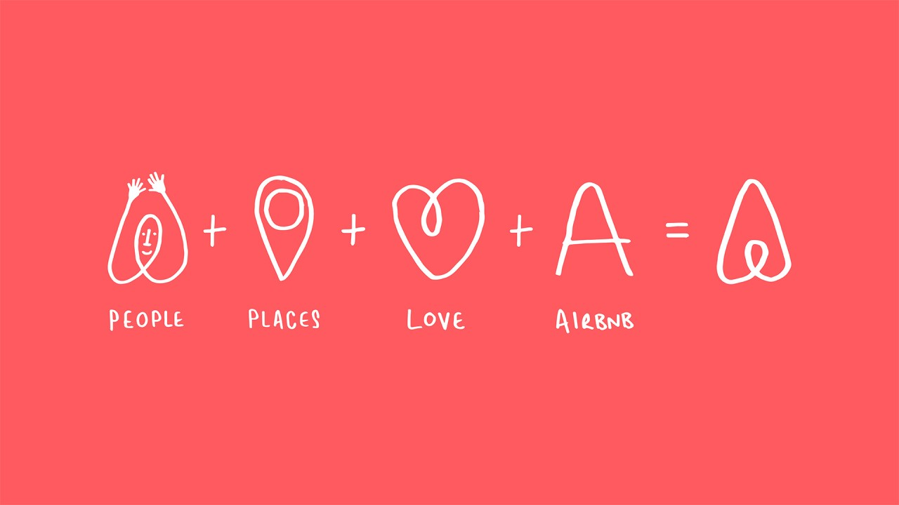
CUSTOMER EXPERIENCES FOR THEIR STAY

Slide 9
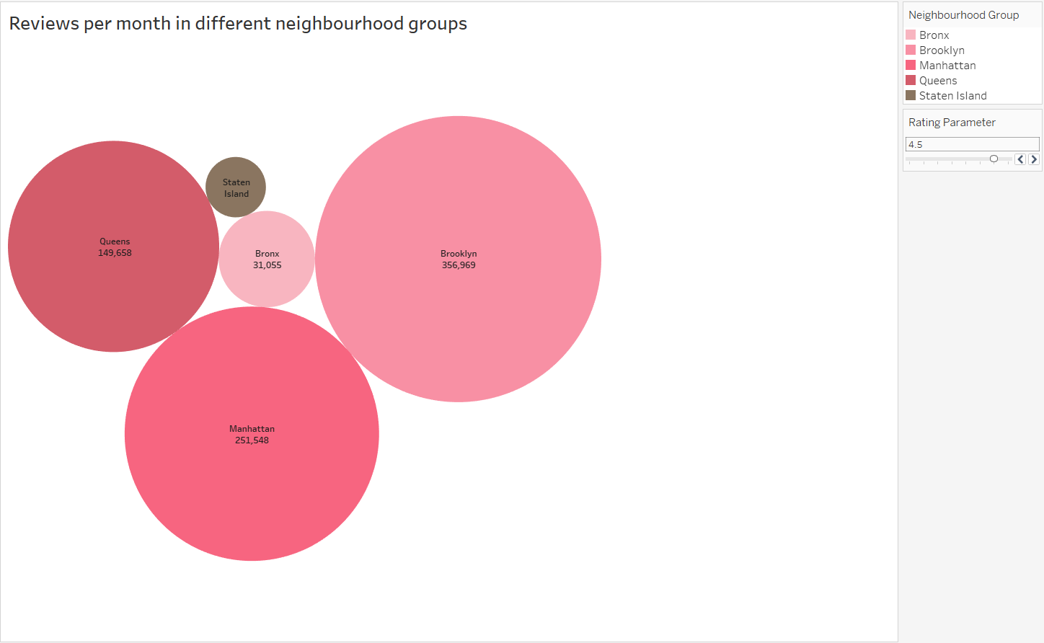
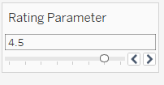
Total number of reviews as per Ratings
This visualization displays the total number of reviews in different neighborhood groups of Queens, Staten Island, Bronx, Brooklyn and Manhattan.
We can see that Brooklyn has the highest number of hosts with more than 4.5 rating.
We can increase or decrease the rating according to our needs.

Slide 10
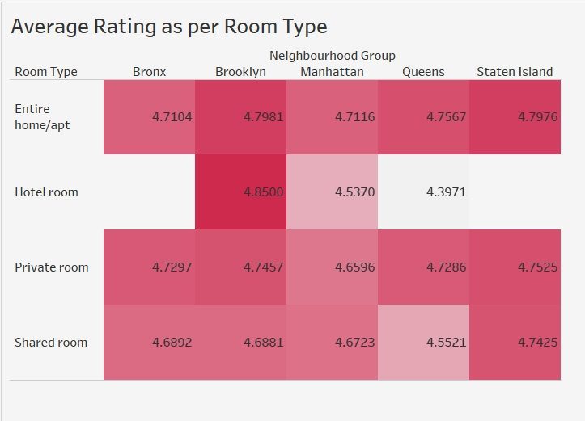
Average Rating as per Room Type
This visualization displays the average rating as per the room type across the neighborhood groups of Queens, Staten Island, Bronx, Brooklyn and Manhattan.
From the visualization we see that a Hotel Room in Brooklyn has the highest average rating of 4.8500.
This indicates that Hotel Rooms could be a good option to consider in Brooklyn, Newyork

Slide 11
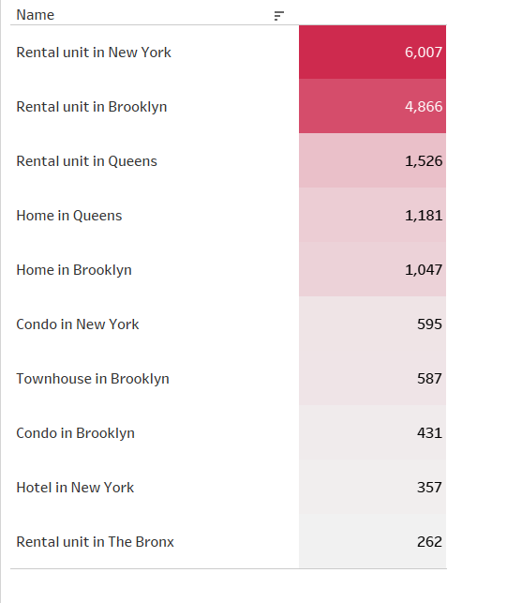
Top 10 Airbnb's in New York with Highest Number of Reviews Per Month
This visualization gives a list of TOP 10 Airbnb in New York that has the highest number of reviews per month.
Rental unit in New York has the highest number of reviews per month.

Slide 12
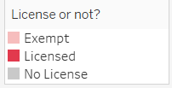
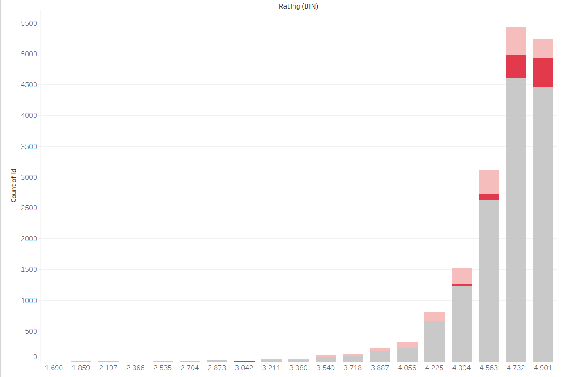
Do Airbnb’s in New York have license?
This visualization displays the number of Airbnb's with and without License.
Here we see that even the highest rated Airbnb's in New York do not have license.

Slide 13
Conclusion
In conclusion, our analysis of New York Airbnb data has provided valuable insights into the landscape of short-term rentals in the city.
Through visualizations showcasing metrics such as minimum price, average nightly rates, popular listings, distribution of bedrooms, total reviews per ratings, and average ratings by room type, we have gained a comprehensive understanding of the Airbnb market in New York.
These visualizations offer actionable information for both hosts and guests, enabling informed decision-making regarding pricing, property selection, and overall satisfaction.
As the hospitality industry continues to evolve, leveraging data-driven insights becomes increasingly essential for optimizing experiences and maximizing value for all stakeholders involved.

