Slide 1
StudyOps AI
🧠
Multi-Agent Study Decision System
Student Name: M. Sanjana
Roll number: 24071A67H3
Course: B. Tech Computer Science
Agentic AI Training Project | LangChain · Groq Llama 3 · DuckDuckGo · Telegram Bot API

Slide 2
The Problem
70%
❓
⏰
🤖
No clear priority
Poor time planning
Generic AI answers
of students don't have
a structured study plan
Students study random topics instead of their weakest areas first
No structure = hours wasted on low-impact topics before exam
ChatGPT gives one-size-fits-all text — not a personalized action plan
This is a decision problem — not an information problem. Students need a system that THINKS, not just answers.

Slide 3
Our Solution — Agentic AI
Instead of one AI answering everything, we use specialized agents — each doing one job, handing results to the next.
01
02
03
04
🔍
📅
🌐
📱
Analyzer Agent
Schedule Builder
Resource Finder
Notifier Agent
→
→
→
Identifies weak topics, urgency & difficulty scores
Receives analyzer output → builds day-by-day timetable
DuckDuckGo live search — finds free resources, no API key
Sends complete plan to Telegram — real-world action
HANDOFF PATTERN — each agent's output becomes the next agent's input. This is the core of Agentic AI.

Slide 4
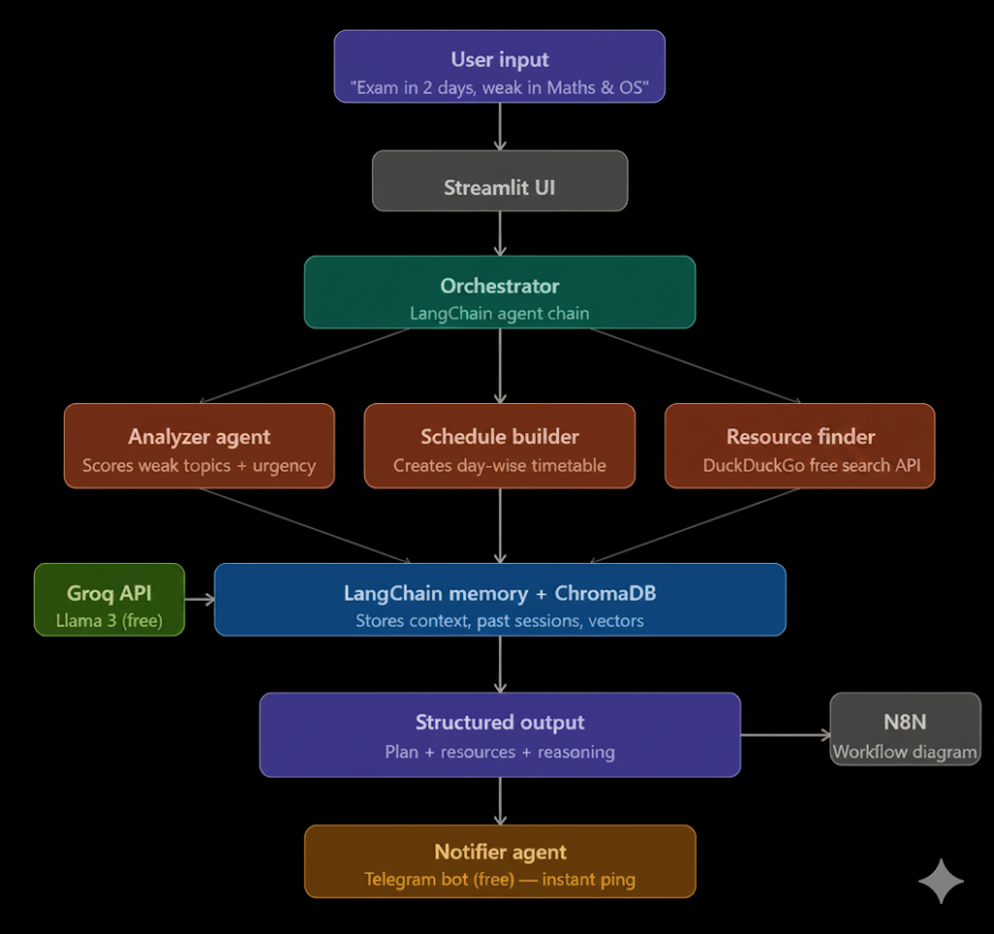
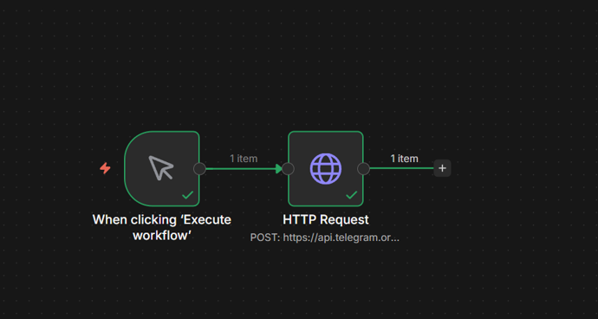
System Architecture
n8n Workflow

Slide 5
Tech Stack — 100% Free
Cost: ₹0
Groq API (Llama 3)
Free
DuckDuckGo Search
Free
🤖
🔍
Free LLM powering all agents
Live web search — no API key required
LangChain
Open Source
Telegram Bot API
Free
🔗
📱
Agent orchestration, prompt templates, handoffs
Real-world notification to student's phone
LangSmith
Free Tier
Streamlit
Open Source
📊
🖥️
Tracing and monitoring every agent call
Web UI for the application

Slide 6
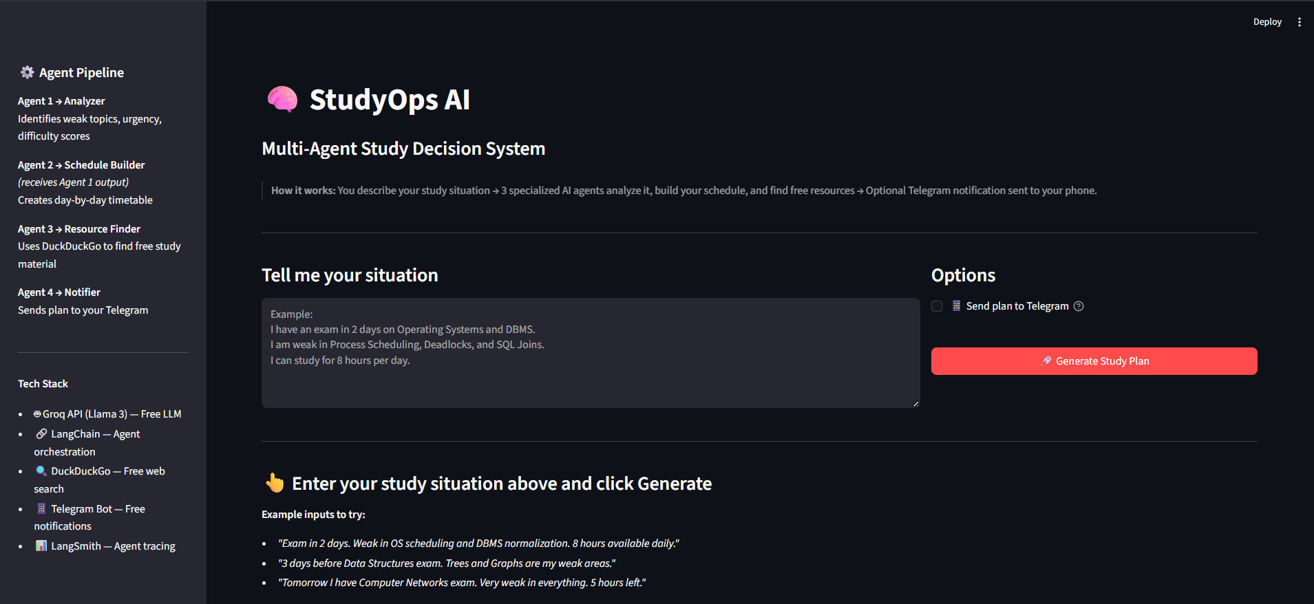
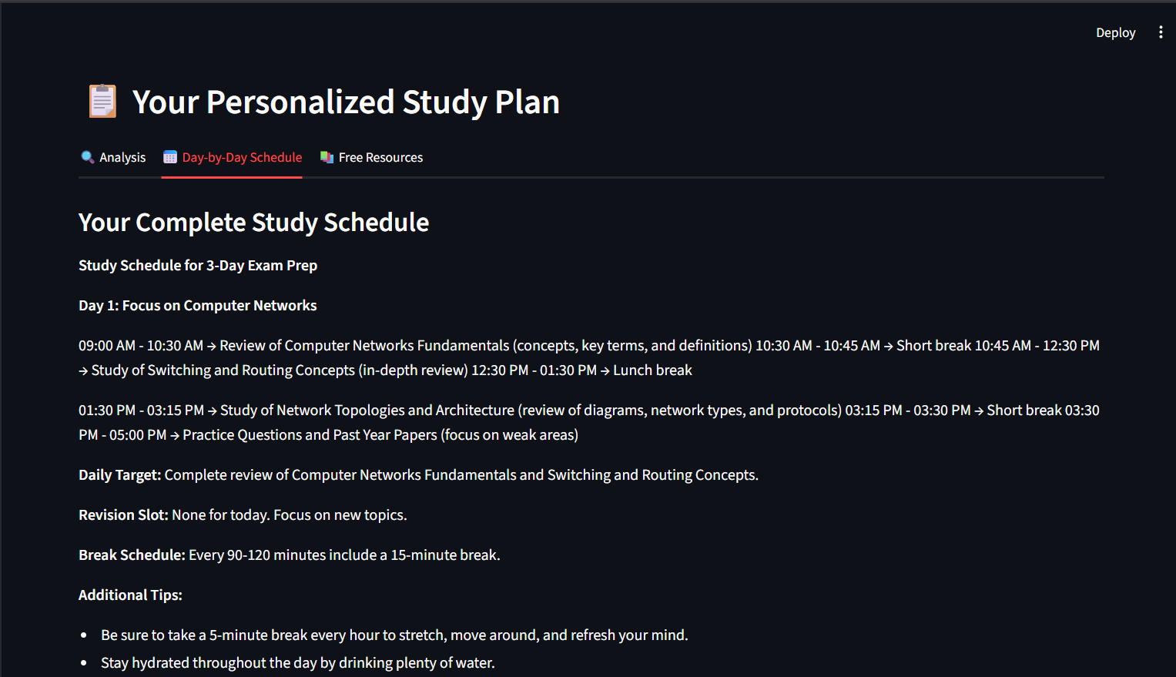
Live Application
[ REPLACE WITH SCREENSHOT ]
App Input Screen
[ REPLACE WITH SCREENSHOT ]
Analysis + Schedule Output
Input Screen
Agent Output Tabs
→ Live demo follows

Slide 7
Future Scope
☁️ HuggingFace Hosting
⚙️ N8N Workflow
Deploy on HuggingFace Spaces — publicly accessible, still free
Scheduled daily reminders via N8N self-hosted automation
📅 MCP + Google Calendar
🧠 Persistent Memory
MCP integration to push generated schedule into student's calendar
ChromaDB memory so system learns from past study sessions

Slide 8
🧠
StudyOps AI
Not just an AI that answers —
an Agentic system that thinks.
LangChain
Groq Llama 3
DuckDuckGo
Telegram Bot
LangSmith
ChromaDB
Thank you

