Slide 1
Smart Door-Lock System

Slide 2
Requirements
Hardware (HW) Requirements:
Raspberry Pi: Serves as the central unit, handling communication and logic for password verification.
Bluetooth Module (BLE): Facilitates communication between the Raspberry Pi and mobile devices.
LED/Buzzer: Provides status indication (lock open, lock closed), controlled via the Raspberry Pi’s GPIO pins.
Power Supply: Powers the Raspberry Pi and associated components.
Software (SW) Requirements:
Raspberry Pi OS: Operating system to run the server-side program.
Python: Programming language for cloud communication, password comparison, and GPIO control.
ThingSpeak API: Cloud platform to store and manage the password.
Bluetooth Libraries (BlueZ): To handle Bluetooth communication on the Raspberry Pi.
Mobile Application (MIT App Inventor or Android Studio): For user interaction, password input, and
feedback display.

Slide 3
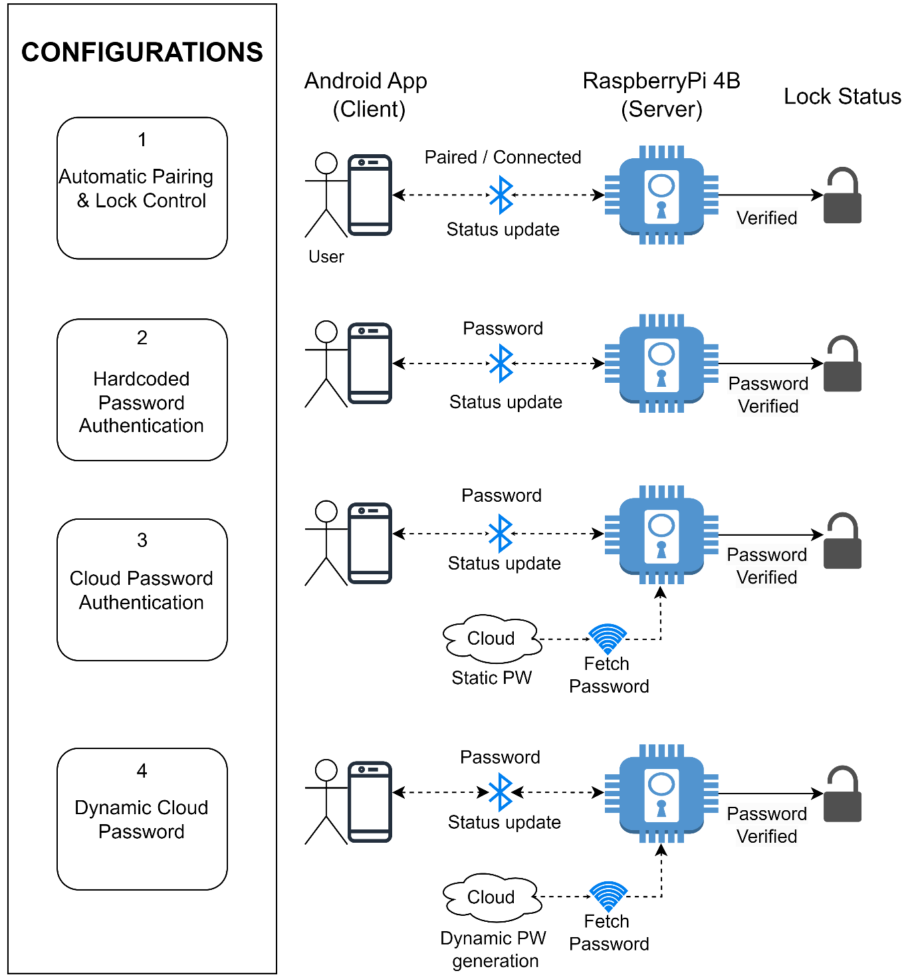
Block Diagram

Slide 4
Achievements as a Developer
Technical Skills Developed:
Proficiency in Python/C for Raspberry Pi programming.
Developed a BLE-based communication protocol between the mobile app and Raspberry Pi .
Controlled the smart lock by configuring GPIO pins based on password matching.
Incorporated comprehensive feedback for successful and failed authentication.
Created a user-friendly mobile interface for password submission and status updates using MIT App Inventor/Android Studio.
Understanding of cloud services and APIs for data storage and retrieval.
Project Management:
Successfully integrated multiple technologies (IoT, mobile app development, cloud services).
Implemented efficient communication protocols between devices.

Slide 5
Achievements as a Product
Security: Enhanced security with cloud-based authentication, making the lock system more
robust.
User-Friendly: Simple app interface that allows users to unlock the door with minimal steps.
Scalability: The system is designed to support multiple users for a single door lock, with
the potential for future expansion to additional locks or integration with other smart
home systems.
Real-Time Feedback: Immediate response via the app, showing lock status updates
(locked/unlocked) and password match verification.
Low Cost: Utilizes cost-effective hardware like Raspberry Pi and MIT App Inventor for
development.

