Slide 1
Exploring Bluetooth Technology
Implementing BLE-profiles

Slide 2
What is Bluetooth
Wireless technology standard for short-range communication.
Operates over the 2.4 GHz ISM band for exchanging data wirelessly.
Commonly used in IoT devices, wearables, mobile phones, and more.
Types-
Bluetooth Classic:
Suited for higher data rates and more continuous connections.
Used in applications like file transfer, audio streaming, and other high-bandwidth tasks.
Bluetooth Low Energy (BLE):
Optimized for low-power consumption and intermittent data transmission.
Primarily used in sensor data, health devices, and other low-bandwidth, battery-sensitive applications.

Slide 3
Classic vs BLE
Feature | Bluetooth Classic | Bluetooth Low Energy (BLE)
Data Rate | Up to 3 Mbps | 125 Kbps to 2 Mbps
Power Consumption | Higher (continuous connection required) | Lower (designed for intermittent communication)
Latency | Higher (due to continuous connection) | Lower (optimized for quick, short bursts of data)
Range | Typically up to 100 meters | Typically up to 100 meters, can be extended
Use Cases | File transfer, Audio streaming, Headsets | Sensor data, Health monitors, Wearables, IoT
Connection Time | Longer (due to handshakes and setup time) | Faster (quick connection and disconnection)
Power Optimization | Not optimized for low-power devices | Specifically designed for low-power applications
Devices Supported | Mostly used in high-data-rate devices like speakers | Mostly used in low-power, battery-sensitive devices like fitness trackers
Profiles Supported | Includes many legacy profiles like A2DP, HFP | Focuses on GATT-based profiles (e.g., HRP, IAS)

Slide 4
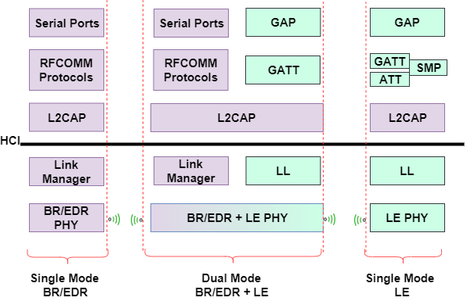
Bluetooth Protocol Stack
Understanding the basic architecture of Bluetooth Classic and Low Energy
Worked on GATT, GAP profiles and ATT protocol.

Slide 5
Achievements
PROFILES | Heart Rate Profile (HRP) | Immediate Alert Profile (IAS) | Link Loss Profile (LLP)
Definition | Monitors real-time heart rate data. | Triggers alerts based on immediate conditions (e.g., proximity). | Notifies loss of connection between devices.
Service UUID | ‘0000180d-0000-1000-8000-00805f9b34fb' | ‘1802’ | ‘1803’
Characteristic UUID/s | HeartRateControlPoint: '00002a39-0000-1000-8000-00805f9b34fb' BodySensorLocation: '00002a38-0000-1000-8000-00805f9b34fb‘ HeartRateMeasurement: '00002a37-0000-1000-8000-00805f9b34fb' | ‘2A06’ | ‘2A06’

Slide 6
Achievements (Contd...)
Working scenarios for the mentioned Profiles:
The Raspberry Pi functions as a server, advertising the profiles. Monitoring and control are done via the nRF Connect app (client), which uses read, write, and notify properties, also integrated LED indications for the same.
For data transfer, two Raspberry Pi devices are utilized: One acts as the server, advertising services, and the other acts as the client, handling scanning, discovery, and connection.

Slide 7
Throughput Calculation
“Throughput is the amount of data transmitted between two devices over a set period".
Throughput Calculation in BLE-
Factors: connection interval, packet size (MTU), PHY layer speed (e.g., 1M, 2M PHY).
Methods: Monitored and logged data transfer time for a large file and calculated
throughput based on packet exchange and connection interval settings. Throughput=(Total File Size) / (Total Time taken for Reception)
Custom Services and Characteristics
Custom UUIDs for GATT services and characteristics. SERVICE_UUID = '12345678-1234-1234-1234-1234567890ab‘ CHRC_UUID = 'abcd1234-ab12-cd34-ef56-abcdef123456'
Implemented GATT client-server communication to exchange text messages/ large file

Slide 8
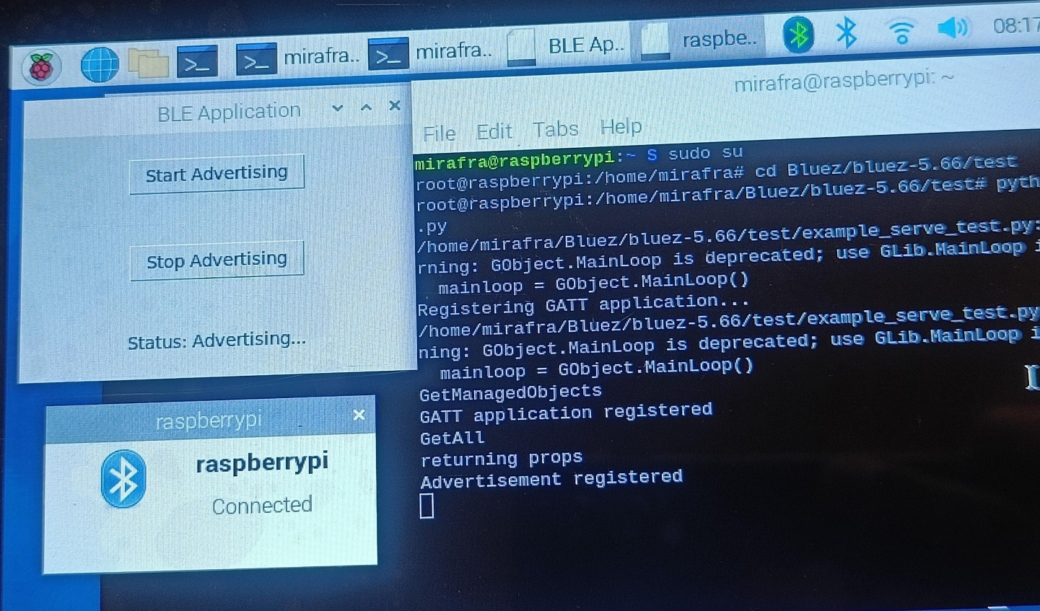
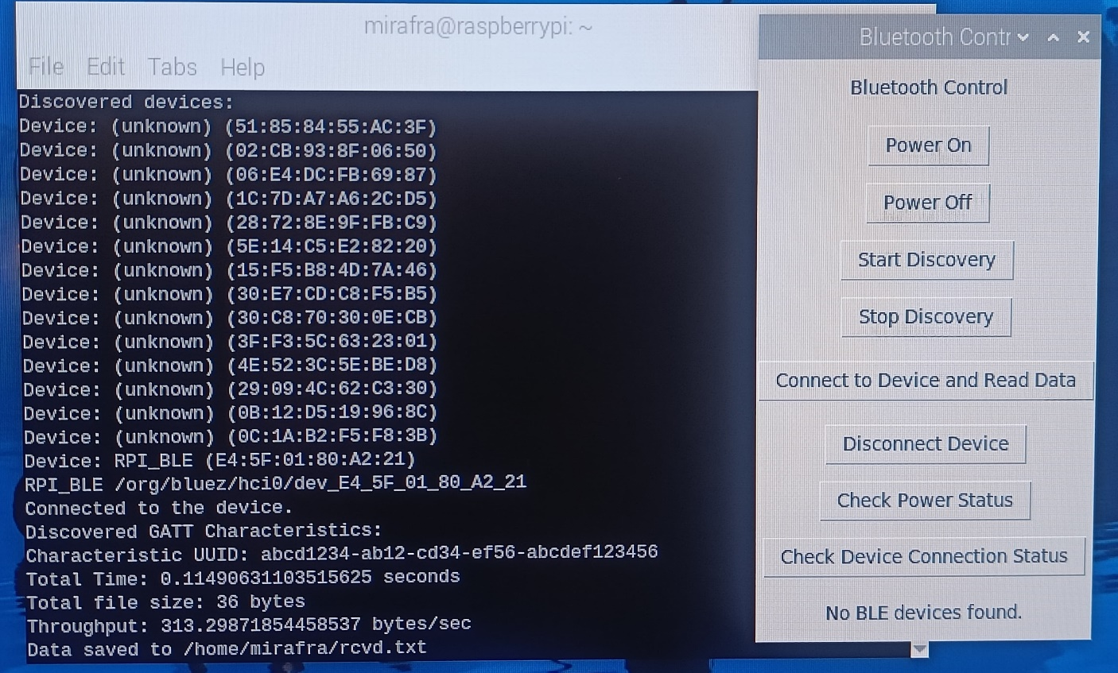
Server_RPI
Client_RPI

