Slide 1
INVESTMENT ASSIGNMENT SUBMISSION
Name: Sanjana.R

Slide 2
INVESTMENT ANALYSIS OF SPARK FUNDS
OBJECTIVE -
Spark Funds wants to make investments in a few companies.
invest between 5 to 15 million USD per round of investment.
invest only in English-speaking countries because of the ease of communication with the companies it would invest in.
STRATEGY -
We should invest where most other investors are investing.

Slide 3
PROBLEM SOLVING METHODOLOGY
Importing the data
Cleaning the data
Univariate Analysis
Removing col. with more than 85% null values
Changing the data type of col.
Removing unnecessary info from col.
Removing behavioral variables.
Data Analysis
Categorizing paid to 0 and charged to 1
Comparing loan_status with other col.
Segment Analysis
Segment across various factors.
Bivariate Analysis
Compare two col.

Slide 4
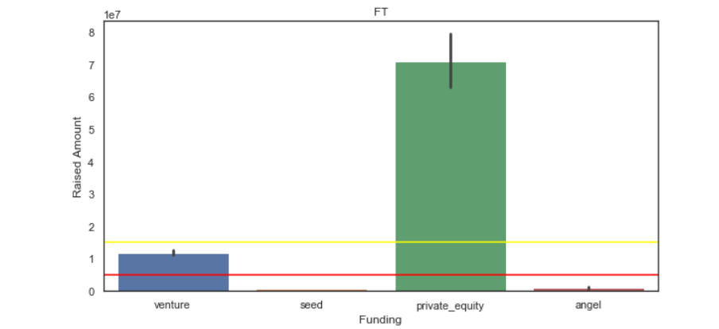
ANALYSIS
Funding Type Analysis – The sector which lies between 5 – 15M is VENTURE

Slide 5
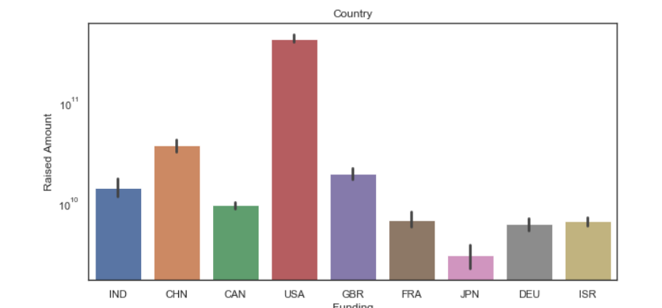
ANALYSIS
Country Analysis – Selected top 3 English speaking countries for Investment.

Slide 6
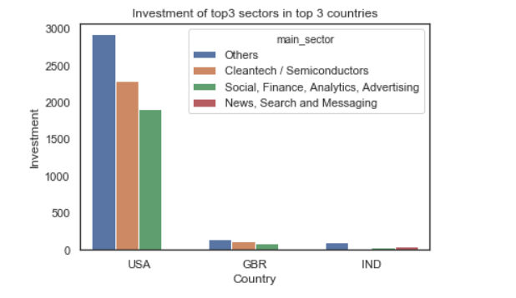
ANALYSIS
SECTOR ANALYSIS – Investment of top 3 sectors in top 3 Countries

Slide 7
CONCLUSION
COUNTRY | SECTOR
USA | 1. Others 2. Cleantech / Semiconductors 3. Social, Finance, Analytics, Advertising
GBR | 1. Others 2. News, Search and Messaging 3. Social, Finance, Analytics, Advertising
IND | Others News, Search and Messaging Entertainment
Therefore, we can conclude by looking at the data that which country do we need to invest and which sectors in those countries will be more profitable.

Slide 8
THANK YOU

