Slide 1




WEB-BASED MATHEMATICAL EXPRESSION EVALUATOR
BY:-
Harshal Kature (24006034)
Sanjana Reddy (24006040)

Slide 2

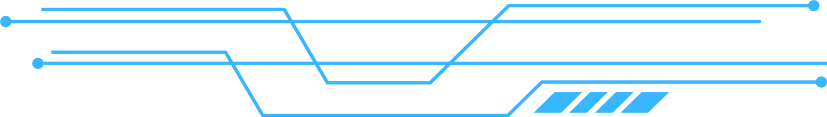

OVERVIEW
Infix to Postfix Conversion & Evaluation using Stack Data Structure
Key Focus: Bridging Low-Level C Logic with Modern Web Interfaces.

Slide 3


Frontend: A web interface built with HTML/CSS/JS
Connector : A Python Flask server that acts as a bridge.
WORKFLOW :
Backend : A compiled C program that performs the stack operations.

Slide 4
WHAT IS STACK ?
A Stack is a linear data structure that follows the LIFO (Last-In-First-Of) principle.
Push: Adding an element at top.
Pop: Removing the top element.
INFIX:
POSTFIX:
The way humans write math (A + B). The operator is between operands. This requires parentheses and BODMAS rules to understand priority.
The way computers prefer math (A B +). The operator follows the operands. No parentheses are needed, and there is no ambiguity in the order of operations.

Slide 5

ALGORITHMS
INFIX TO POSTFIX CONVERSION :
Postfix Evaluation :
Operands : Append directly to Output.
Open Bracket ( : Push to Stack.
Close Bracket ) : Pop to Output until ( is found.
Operators : While Stack Top precedence >= Current precedence: Pop to Output.
Push Current Operator.
End of String: Pop remaining stack to Output.
Number : Push to Stack.
Operator :
Pop two operands (A then B).
Apply operation (B [operator] A).
Push result back to Stack.
Final Result : The last value in the Stack.

Slide 6
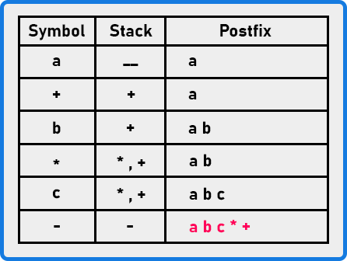
EXAMPLE
INFIX EXPRESSION : a + b * c

