Slide 1




BIG DATA
ARCHITECTURE
INFO8116 Big Data Architecture Sec 1
Group 1:
Vats Sanghvi
Siddhesh Otari
Harshrajsinh Chavda
Sanjana Upender
Saksham Maggoo

Slide 2

WHAT WE WILL TALK ABOUT
Introduction
Normalization
Business Intelligence Tools
Data Warehouse and BI Data Tools
Data Integration Tools
Data Sources
References
INFO8116-24W-SEC1, Group 1 (Vats Sanghvi, Siddhesh Otari, Harshrajsinh Chavda, Sanjana Upender, Saksham Maggoo)

Slide 3
RACI MATRIX
Project Deliverables | Harshraj | Saksham | Sanjana | Siddesh | Vats
Normalization | C | I | I | I | R , A
Snowflake schema | I | I | I | C | R , A
Business Intelligence | R , A | I | I | I | C
Data Warehouse and BI Data | C | I | R , A | I | I
Data Integration | I | C | I | R , A | I
Data Sources | I | R , A | C | I | I
R – Responsible
A - Accountable
C- Consulted
I - Informed.
INFO8116-24W-SEC1, Group 1 (Vats Sanghvi, Siddhesh Otari, Harshrajsinh Chavda, Sanjana Upender, Saksham Maggoo)

Slide 4

NORMALIZATION
Normalization is a process in database design that reduces data redundancy by organizing information into multiple related tables.
It ensures data integrity and minimizes anomalies by structuring data according to specific normalization rules, such as 1NF, 2NF, and 3NF.
INFO8116-24W-SEC1, Group 1 (Vats Sanghvi, Siddhesh Otari, Harshrajsinh Chavda, Sanjana Upender, Saksham Maggoo)

Slide 5
Customer Address
44 Main Street, Toronto John.Smith@gmail.com
31 Main Street, Kitchener Jane.Wright@gmail.com
1 NORMALIZATION FORM
Rule 1 (Atomic Values) − Every column of a table should contain only atomic values. An atomic value is a value that cannot be divided further.
Rule 2 (No Repeating Groups) − There are no repeating groups of data. This means a table should not contain repeating columns.
Customer Address | Email
44 Main Street, Toronto | John.Smith@gmail.com
31 Main Street, Kitchener | Jane.Wright@gmail.com
INFO8116-24W-SEC1, Group 1 (Vats Sanghvi, Siddhesh Otari, Harshrajsinh Chavda, Sanjana Upender, Saksham Maggoo)

Slide 6
Sales Fact Table
Date_ID ( FK )
Transaction_ID ( PK )
.
Product_Description
Department_Name
Manufacturer_Name
Cost
.
.
2 NORMALIZATION FORM
Product
Product_ID ( PK )
Product_Description
Department_Name
Manufacturer_Name
Cost
2NF eliminates redundant data by requiring that each non-key attribute be dependent on the primary key. This means that each column should be directly related to the primary key, and not to other columns.
INFO8116-24W-SEC1, Group 1 (Vats Sanghvi, Siddhesh Otari, Harshrajsinh Chavda, Sanjana Upender, Saksham Maggoo)

Slide 7
3 NORMALIZATION FORM
3NF builds on 2NF by requiring that all non-key attributes are independent of each other. This means that each column should be directly related to the primary key, and not to any other columns in the same table.
Address
Address_ID ( PK )
Address
Postalcode_ID ( FK )
Postal_Code
Postalcode_ID ( PK )
Postalcode
City_ID ( FK )
City
City_ID ( PK )
City_Name
Province_ID ( FK )
Province
Province_ID ( PK )
Province_Name
Country_ID ( FK )
Country
Country_ID ( PK )
Country_Name
INFO8116-24W-SEC1, Group 1 (Vats Sanghvi, Siddhesh Otari, Harshrajsinh Chavda, Sanjana Upender, Saksham Maggoo)

Slide 8
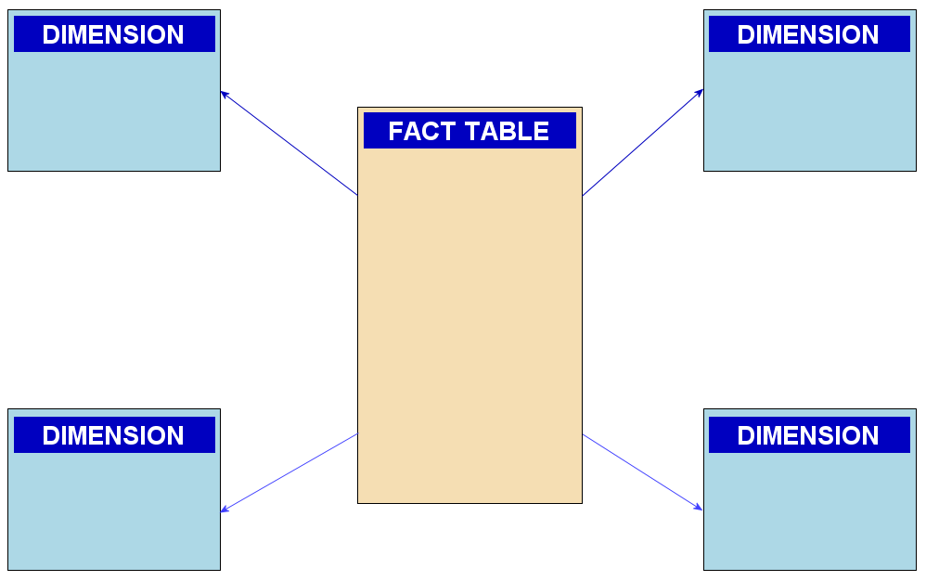
STAR SCHEMA
A star schema is a multi-dimensional data model used to organize data in a database so that it is easy to understand and analyze.
INFO8116-24W-SEC1, Group 1 (Vats Sanghvi, Siddhesh Otari, Harshrajsinh Chavda, Sanjana Upender, Saksham Maggoo)

Slide 9
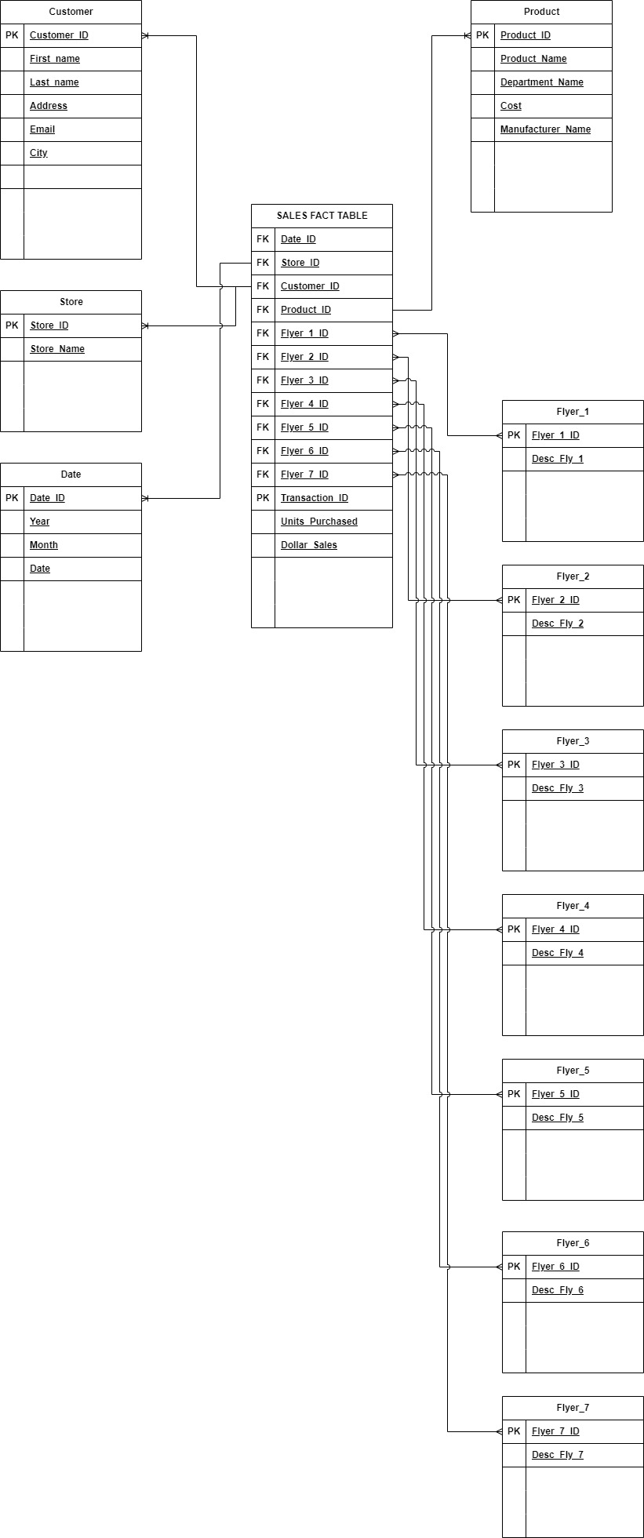
STAR SCHEMA

Slide 10
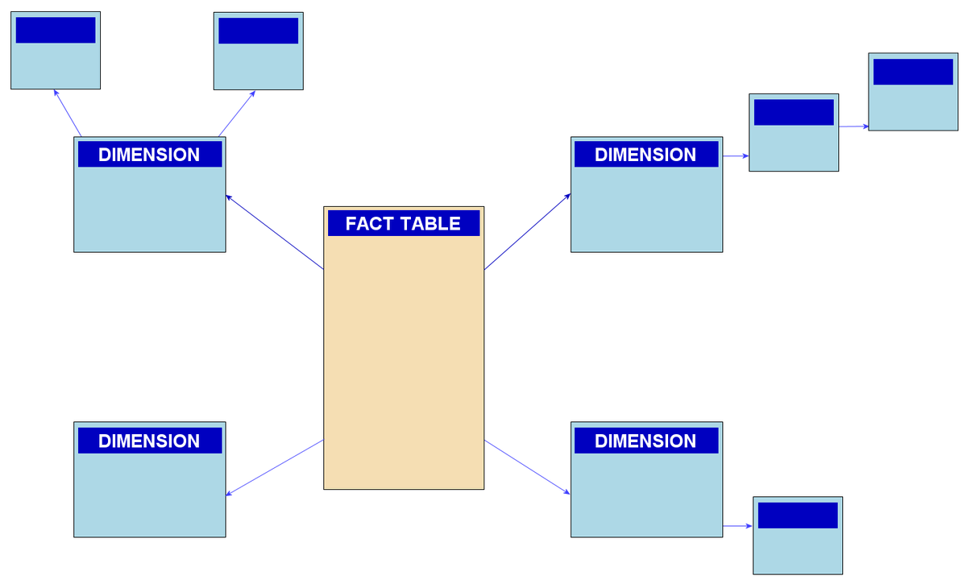
SNOWFLAKE
SCHEMA
A snowflake schema is a multi-dimensional data model that is an extension of a star schema, where dimension tables are broken down into subdimensions
INFO8116-24W-SEC1, Group 1 (Vats Sanghvi, Siddhesh Otari, Harshrajsinh Chavda, Sanjana Upender, Saksham Maggoo)

Slide 11
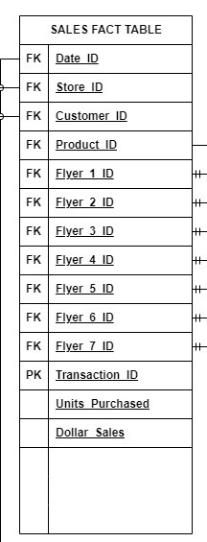
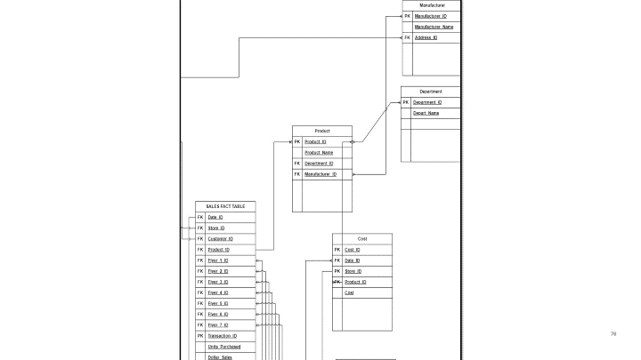
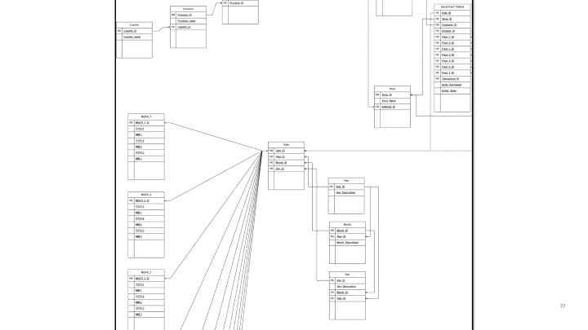
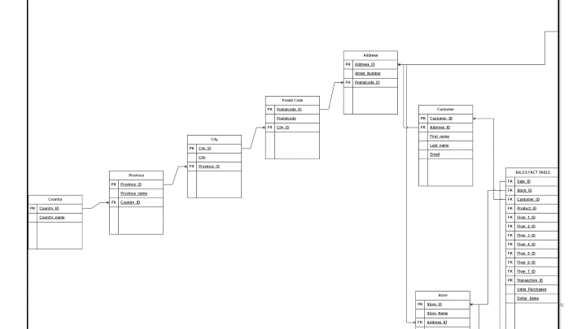
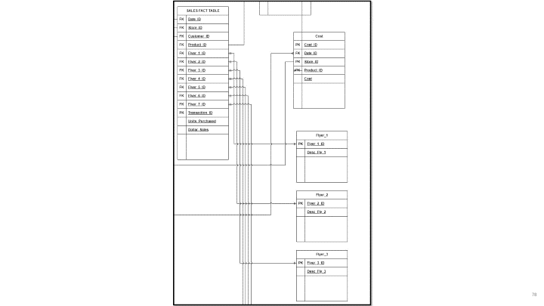
SNOWFLAKE SCHEMA

Slide 12
Case Study - Big Data Architecting for new company
The new Company has the following datasets that need to be integrated into a solution for Big Data reporting.
Operational/Transactional systems
Finance
Marketing
Sales
In-house solutions
Finance Excel spreadsheets
Web Based
Product Reviews (unstructured and millions of entries)
A Data Governance team will be formed so require Master Data Management
The company will be significant is size so will require an ETL and related solutions to move data
The company wants to have standard reports, dashboards, predictive analytics including an area for Data Scientists to analyze without requiring IT resources.
Don’t worry about cost of the tools. You can as well if you want provide options, i.e., one that you know is free and another one that has a cost associated with it.
Try to minimize the number of tools required to be purchased/supported overall.
INFO8116-24W-SEC1, Group 1 (Vats Sanghvi, Siddhesh Otari, Harshrajsinh Chavda, Sanjana Upender, Saksham Maggoo)

Slide 13

Tools for Data Sources
Components
Applications Services
Cloud Application and databases
Business Processes
Enterprises Application
Data Services
Extract
Unstructured Documents
Spreadsheets

Slide 14

Application services (1/2)
Application services are software solutions that enhance an application's functionality, security, and speed. Applications are optimized, deployed, and managed by businesses through the use of an interconnected pool of internal and external services known as application services.
Recommendation: SigNoz
Description: SigNoz is an open source, full-stack APM and observation tool. Under a single pane of glass, it offers traces, metrics, and logs. It utilizes Click house, a potent OLAP database, for quicker aggregations and ingestion.
Compatibility: Work with both Microsoft Windows, macOS but 8 GB of memory , 30 GB of storage and 4 cores CPU is required
Cost: Free(open source)
Additional Cost : while the software is free it includes addition cost for Cloud

Slide 15

Application services (2/2)
Why ?
SigNoz is open source and based on open standards. SigNoz is built to support Open Telemetry natively.
SigNoz provides metrics, traces, and logs under a single pane of glass. Rather than running different projects like Prometheus for metrics and Jaeger for traces and stitching them together, you can use SigNoz as your one-stop observability solution.
SigNoz uses columnar datastores, which makes aggregating queries very fast. It also helps in slicing and dicing the data using Group BY and aggregates. You can identify the root cause of performance issues quickly.

Slide 16

Cloud Application and Database (1/2)
A cloud database is a database that is deployed, delivered, and accessed in the cloud. Cloud databases organize and store structured, unstructured, and semi-structured data.
Recommendation: Microsoft Azure
Description : Microsoft Azure, often referred to as Azure, is a cloud computing platform run by Microsoft. It offers access, management, and the development of applications and services through global data centers.
Compatibility: Microsoft Windows , Linux , macOS
Cost:Subscription-based pricing model

Slide 17
Cloud Application
and Database (2/2)
Why ?
Learning of the host app's data access patterns, adaptive performance tuning, and automatic improvements to reliability and data protection.
Management and monitoring of multi-tenant apps with isolation benefits of one-customer-per-database.
Integration with open-source tools

Slide 18
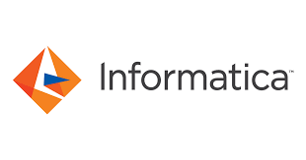
Business Processes (1/2)
A business process refers to a set of activities that have to be performed to complete an end-to-end business scenario.
Recommendations : Informatica Intelligence Data Management Cloud : Business Process Management
Description: Informatica is a data processing platform that helps companies process and manage large amounts of data. With Informatica, you can combine data from different sources, such as customer records, sales figures, and market trends, to gain valuable insights and make informed decisions.
Compatibility: Microsoft Windows , Linux , macOS
Cost: Free (open source)

Slide 19
Business Processes (2/2)
Why ?
Robust and Easy Process Automation
Runtime Environment that scales well while maintaining high performance
Visual creation of application integration to business processes, anyone can automate- not just developers .

Slide 20

Enterprises Application (1/2)
An enterprise application is specialized software that helps organizations integrate and automate their core processes, streamline workflows, improve efficiency, and gain valuable insight into their data and performance.
Recommendation: Datapine
Description : Datapine is an enterprise software company focused on delivering business intelligence solutions to industries and companies across the world. Users can simply connect their data source(s) and explore various enterprise possibilities such as data analysis via drag-and-drop interface or advanced SQL mode.
Compatibility: Windows, macOS, Linux
Cost: $ 249 -$1000

Slide 21
Enterprises Application (2/2)
Why ?
Beginner and advanced data analysis for every industry and department
Modern data visualizations through interactive Business dashboard
Numerous sharing options (via public URL, automated reports, e-mail, embedding)

Slide 22

Data Services (1/2)
Data services play a crucial role in integrating, transforming, and providing access to data from various sources. Data services can refer to various categories of software that facilitate access to data, management of data, or analysis of data.
Recommendation: Apache Kafka
Description: Kafka is a distributed streaming platform that is commonly used for building real-time data pipelines and streaming applications. It can be used to ingest data from various sources, such as databases, applications.
Compatibility: Windows, macOS, Linux
Cost: Free (open source)

Slide 23
Data Services (2/2)
Why ?
By dividing a topic into multiple partitions, Apache Kafka provides load balancing over a pool of servers. This allows you to scale production clusters up or down to fit your needs and to spread clusters across geographic regions or availability zones.
By decoupling data streams, Apache Kafka is able to deliver messages at network limited throughput using a cluster of servers with extremely low latency (as low as 2ms).
Apache Kafka makes the data highly fault-tolerant and durable in two main ways. First, it protects against server failure by distributing storage of data streams in a fault-tolerant cluster. Second, it provides intra-cluster replication because it persists the messages to disk.

Slide 24

Extract (1/2)
Data Extract is used to select specific data elements from a given data source, in order to make the data ready for analysis and analytics through subsequent steps involving transformation and loading.
Recommendation: Octoparse
Description : Octoparse is an easy-to-use web scraping service that enables users to extract data from websites without needing to code. It offers a free plan with up to 10 crawlers, and the standard plan starts at $75/month. Octoparse's main features include point-and-click data extraction, support for extracting text, links, image URLs, and more, and the ability to schedule and run automated tasks.
Compatibility: Windows, macOS, Linux
Cost: Starter plan starts at 75 per month
Professional plan starts at 209 per month

Slide 25
Extract (2/2)
Why ?
Visual point-and-click interface for web data extraction
Automatic data extraction from multiple pages and websites
Built-in browser for handling JavaScript-rendered pages
Data deduplication and data validation options
Proxy rotation and IP address rotation support
Optical Character Recognition (OCR) for extracting data from images

Slide 26

Unstructured Documents (1/2)
Unstructured documents in data sources refer to documents that lack a predefined data model or organization. These documents typically contain free-form text, images, or other types of media without a strict format. Examples of unstructured documents include text files, PDFs, emails, social media posts, and web pages.
Recommendation : MongoDB
Description : MongoDB is a NoSQL database that is well-suited for storing and querying unstructured data. It allows for flexible schema design and supports features like indexing and aggregation for analytics purposes.
Compatibility: Windows, macOS, Linux
Cost: It has 3 Plans which are
Shared for $0/month
Serverless for $0.10/million reads
Dedicated for $57/month

Slide 27
Unstructured Documents (2/2)
Why ?
MongoDB makes it easy for developers to store structured or unstructured data. MongoDB can also handle high volume and can scale both vertically or horizontally to accommodate large data loads.
It uses a JSON-like format to store documents. This format directly maps to native objects in most modern programming languages, making it a natural choice for developers, as they don’t need to think about normalizing data.
MongoDB is designed to scale horizontally, allowing organizations to seamlessly handle increasing data volumes and concurrent user loads. Features like sharding enable distribution of data across multiple servers, ensuring high performance and scalability as data grows.

Slide 28
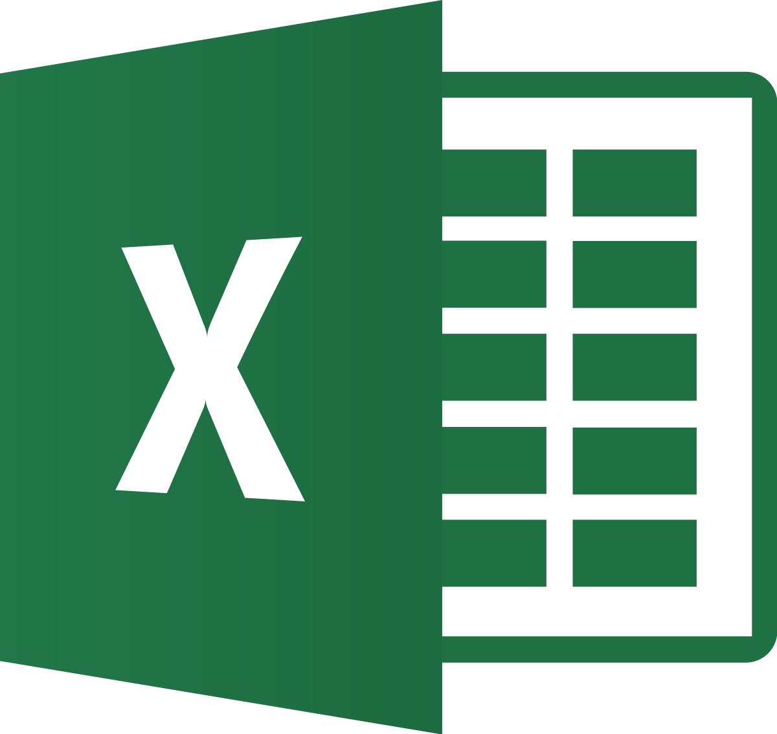
Spreadsheets (1/2)
A spreadsheet is a tool that is used to store ,manipulate and analyze data. Data in a spreadsheet is organized in a series of rows and columns and can be searched, sorted, calculated and used in a variety of charts and graphs.
Recommendation Microsoft Excel
Description : Microsoft Excel is a spreadsheet editor developed by Microsoft for Windows, macOS, Android, iOS and iPad. It features calculation or computation capabilities, graphing tools, pivot tables, and a macro programming language called Visual Basic for Applications. Excel forms part of the Microsoft 365 suite of software.
Compatibility: Windows, macOS
Cost: Subscription cost $80 per year .

Slide 29
Spreadsheets (2/2)
Why ?
Analyze, comprehend and visualize your data with ease
Let Excel learn your patterns, organize your data, and save you time. Easily create spreadsheets from templates or on your own and use modern formulas to perform calculations.
Visualize data in compelling ways with new charts and graphs, and make it easier to understand using formatting, sparklines, and tables to predict trends
Excel will help you analyze and explore your data so you can make the best decisions. It will help identify trends, propose what-if scenarios, suggest ideas for improving your business, and will even build everything into an easy-to-read dashboard

Slide 30
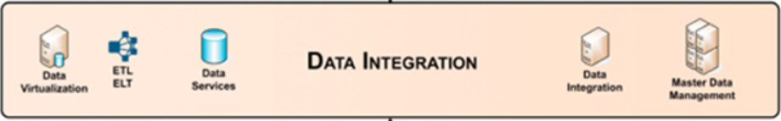
Tools for Data Integration Layer
Components:
Data Virtualization
ETL ELT
Data Services & Data Integration
Master Data Management

Slide 31

Data Virtualization (1/3):
Recommendation: Denodo
Description: The next generation of data management embraces distributed data across on-premises, hybrid, and multi-cloud environments; it uses a logical/semantic-model approach to integrating and managing data; and it leverages artificial intelligence (AI) to simplify and automate manual tasks.

Slide 32
Data Virtualization (2/3):
Operating System: Windows, Linux and Unix-based systems
Cost:
Denodo's pricing model typically involves licensing fees based on factors such as the number of cores, data sources, and concurrent users.
The cost can vary depending on the specific requirements of the organization, such as the scale of deployment, features needed, and level of support.
INFO8116-24W-SEC1, Group 1 (Vats Sanghvi, Siddhesh Otari, Harshrajsinh Chavda, Sanjana Upender, Saksham Maggoo)

Slide 33
Data Virtualization (3/3):
Why?
Accelerates Business Value by adopting a logical-first approach, and it saves money, time, and resources by not having to move any data.
Provides Flexibility to businesses users, so they can swiftly adapt to changes in business conditions, competitive landscapes, and market trends.
Future Proofs changes to the data infrastructure, with a data abstraction layer that enables business users to operate without interruption.
INFO8116-24W-SEC1, Group 1 (Vats Sanghvi, Siddhesh Otari, Harshrajsinh Chavda, Sanjana Upender, Saksham Maggoo)

Slide 34

ETL /ELT : (1/2)
(Extract Transform Load)/(Extract Load Transform)
Recommendation: Apache Nifi
Description: Apache NiFi is a software project from the Apache Software Foundation designed to automate the flow of data between software systems. Leveraging the concept of extract, transform, load (ETL), it is based on the "NiagaraFiles" software previously developed by the US National Security Agency (NSA), which is also the source of a part of its present name – NiFi. It was open sourced as a part of NSA's technology transfer program in 2014.
Operating System: Windows, macOS, Linux, Unix
Cost:
•Apache NiFi is an open-source project distributed under the Apache License 2.0, which means it is free to download, use, and modify.
•There are no licensing costs associated with Apache NiFi itself.
INFO8116-24W-SEC1, Group 1 (Vats Sanghvi, Siddhesh Otari, Harshrajsinh Chavda, Sanjana Upender, Saksham Maggoo)

Slide 35
ETL /ELT : (2/2)
(Extract Transform Load)/(Extract Load Transform)
Why?
An easy to use, powerful, and reliable system to process and distribute data.
NiFi automates cybersecurity, observability, event streams, and generative AI data pipelines and distribution for thousands of companies worldwide across every industry.
INFO8116-24W-SEC1, Group 1 (Vats Sanghvi, Siddhesh Otari, Harshrajsinh Chavda, Sanjana Upender, Saksham Maggoo)

Slide 36
Data Services and Data Integration (1/2):
Recommendation: Apache Kafka
Description: Apache Kafka is a distributed event store and stream-processing platform. It is an open-source system developed by the Apache Software Foundation written in Java and Scala. The project aims to provide a unified, high-throughput, low-latency platform for handling real-time data feeds. Kafka can connect to external systems (for data import/export) via Kafka Connect and provides the Kafka Streams libraries for stream processing applications.
Operating System: Windows, macOS, Linux
Cost:
•Apache Kafka is an open-source project distributed under the Apache License 2.0, which means it is free to download, use, and modify.
•There are no licensing costs associated with Apache Kafka itself.
INFO8116-24W-SEC1, Group 1 (Vats Sanghvi, Siddhesh Otari, Harshrajsinh Chavda, Sanjana Upender, Saksham Maggoo)

Slide 37
Data Services and Data Integration (2/2):
Why?
Kafka provides scalability by allowing partitions to be distributed across different servers.
Increase the number of consumers to the queue to scale out processing across those competing consumers.
Policy based, for example messages may be stored for one day.
The user can configure this retention window.
INFO8116-24W-SEC1, Group 1 (Vats Sanghvi, Siddhesh Otari, Harshrajsinh Chavda, Sanjana Upender, Saksham Maggoo)

Slide 38
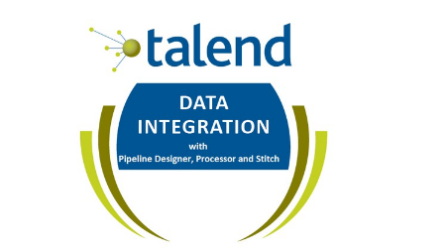
Master Data Management (1/2):
Recommendation: Talented Community Edition
Description: Talend MDM Server is where the live version of the master data is stored. The MDM Repository contains a working copy of the data, and can be stored locally (that is, on the same machine as Talend Studio) or remotely, based on a Git server. The data from the MDM Repository must be deployed to Talend MDM Server before it can be accessed by users of Talend MDM Web UI.
Operating System: Windows, macOS, Linux
Cost:
Talented MDM Server is an open-source project distributed under the Apache License 2.0, which means it is free to download, use, and modify.
There are no licensing costs associated with Talented MDM server itself.
Organizations can download, install, and use the software without any upfront fees or subscription charges. However, it's essential to consider the total cost of ownership (TCO), which may include costs related to infrastructure, maintenance, support, and training.
INFO8116-24W-SEC1, Group 1 (Vats Sanghvi, Siddhesh Otari, Harshrajsinh Chavda, Sanjana Upender, Saksham Maggoo)

Slide 39
Master Data Management (2/2):
Why?
Data consistency
Enhanced data quality
Streamlined operations
Single version of truth
Improved decision-making
Regulatory compliance
Reduced costs
Enhanced customer experience
Agility in innovation
Risk management
INFO8116-24W-SEC1, Group 1 (Vats Sanghvi, Siddhesh Otari, Harshrajsinh Chavda, Sanjana Upender, Saksham Maggoo)

Slide 40
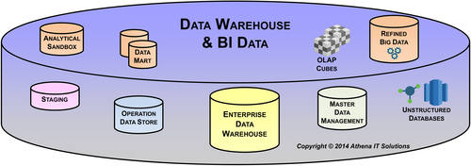
Tools For Data Warehouse And BI Data Layer
COMPONENTS
Enterprise Data Warehouse, Data marts, OLAP cubes
Analytical sandboxes
Refined Big Data and Unstructured Databases
Master Data Management
Operation Data Source

Slide 41

Refined Big Data (1/2):
Recommendation: Apache Spark
Description: Apache Spark is a powerful distributed computing engine that provides high-level APIs in Scala, Java, Python, and R. It's ideal for processing and analyzing large-scale structured and unstructured data, making it suitable for refining big data before storage in the LDW.
Operating System : Microsoft Windows, macOS, Linux
Cost : Free (open-source)
Additional Costs: While the software itself is free, there may be costs associated with infrastructure (e.g., cloud services, compute resources) and support for deployment, configuration, and optimization.

Slide 42
Refined Big Data (2/2):
Why ?
•Speed : In-memory processing
•Ease of Use : User-friendly APIs
•Support for multiple programming languages and available on all operating systems

Slide 43
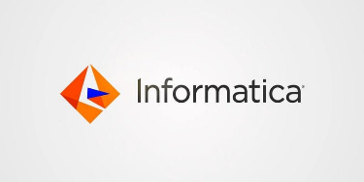
Master Data Management (MDM) (1/2):
Recommendation: Informatica MDM SaaS
Description: Informatica MDM is a comprehensive master data management solution that provides capabilities for data modeling, data quality, data governance, and data integration. It helps organizations manage and govern their master data across multiple domains, such as customers, products, and suppliers.
Operating System: SaaS cloud service
Cost: Subscription-based pricing model, typically priced per user or per server/core. Approx. 40,000 USD for first year for a small sized firm.
Additional Costs: Implementation costs for setup, configuration, and customization. Ongoing costs include maintenance, support, and potential add-on modules for advanced features.

Slide 44
Master Data Management (MDM) (2/2):
Why ?
Data Governance and Compliance: Informatica MDM SaaS offers robust data governance capabilities to ensure data quality, consistency, and compliance with regulatory requirements.
Scalability : As a SaaS offering, it eliminates the need for upfront hardware investments, can manage master data effectively regardless of their size or industry, making it suitable for both small businesses and large enterprises.

Slide 45

Analytical Sandboxes (1/2):
Recommendation: Apache Zeppelin
Description: Apache Zeppelin is an open-source web-based notebook that enables interactive data analytics. It supports multiple interpreters, including Spark, SQL, Python, and more, making it suitable for exploring and analyzing data in analytical sandboxes.
Operating System : Web Based
Cost : Free (open-source)

Slide 46
Why?
Analytical Sandboxes (2/2):
Interactive Data Exploration : interactive and collaborative environment for data exploration and analysis.
Rich Visualization Capabilities: Zeppelin offers a wide range of built-in visualization options, including charts, graphs, and dashboards, allowing users to create compelling visual representations of their data without the need for additional tools.

Slide 47
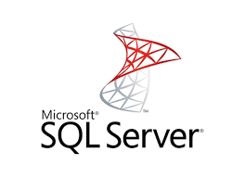
Operational Data Store (ODS) (1/2) :
Recommendation: Microsoft SQL Server (Standard - server)
Description: Microsoft SQL Server is a relational database management system that provides capabilities for building and maintaining operational data stores. It offers robust transaction processing, data integration, and reporting functionalities, making it suitable for storing and managing operational data before loading into the LDW.
Operating System : Windows, macOS (Azure Data Studio), Linux, Ubuntu.
Cost : SQL Server Standard 1,418 USD /year

Slide 48
Why?
Operational Data Store (ODS) (2/2) :
Microsoft SQL Server seamlessly integrates with other Microsoft technologies and platforms, such as Azure Cloud Services, Power BI, and Excel.
Security features : Microsoft SQL Server provides a comprehensive set of data management and security features to support ODS requirements. These include advanced data integration capabilities with SQL Server Integration Services (SSIS) for ETL

Slide 49
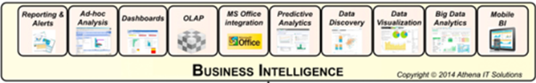
TOOLS FOR BI LAYER
COMPONENTS
Reporting and analytics
Ad-hoc analysis
Dashboards
OLAP, Predictive analytics
Data Discovery and Data visualizations
Big data analytics and Mobile BI

Slide 50

Reporting and Analytics (1/2):
Recommendation: Zoho Analytics
Description: Zoho Analytics helps company users can see and analyze patterns, spot outliers, track company KPIs, create informative reports and dashboards from raw data, and forecast the future with the aid of Zoho Analytics.
Operating System: Web Application (integrate with Zoho or On-premise clouds, such as AWS, Azure, Google)
Cost:
Cloud – CAD 30 – 569/month
On-premise
Personal – Free
Professional – CAD 37/month
Additional Costs: Additional costs/different pricing for custom design for enterprises
INFO8116-24W-SEC1, Group 1 (Vats Sanghvi, Siddhesh Otari, Harshrajsinh Chavda, Sanjana Upender, Saksham Maggoo)

Slide 51
Reporting and Analytics (2/2):
Why?
Offers intelligent suggestions from the app itself when the data is pulled into the platform.
Helps connect data from files, feeds, web URLs, databases, business apps, and more when integrating other apps.
Allows utilization of artificial intelligence, machine learning, and natural language processing and generation.
Provides built-in AI Assistant (Zia) to help make better data-driven decisions.
INFO8116-24W-SEC1, Group 1 (Vats Sanghvi, Siddhesh Otari, Harshrajsinh Chavda, Sanjana Upender, Saksham Maggoo)

Slide 52

Ad-hoc Analysis (1/2):
Recommendation: Looker
Description: Looker takes a simple approach to data discovery, which makes it easy and efficient to promote a culture of inquiry. Business users may leverage the expertise of your data analytics team with an easy-to-use, web-based interface. The data analysts can build mini-applications that enhance the functionality and efficiency of data exploration by using LookML, a versatile and simple-to-learn language. It is not necessary to invest time and money in scripting queries on an ad-hoc basis.
Operating System: Web, Android, IOS
Cost: CAD 60000-120000/year
INFO8116-24W-SEC1, Group 1 (Vats Sanghvi, Siddhesh Otari, Harshrajsinh Chavda, Sanjana Upender, Saksham Maggoo)

Slide 53
Ad-hoc Analysis (2/2):
Why?
It’s not mandatory in Looker to ETL or cube data. It is a 100% in-database, and therefore, data is transformed at query time, so drill paths are unlimited and infinite, leading to true data discovery.
The LookML syntax simplifies the development of robust models for any organization while enhancing the capabilities of SQL.
INFO8116-24W-SEC1, Group 1 (Vats Sanghvi, Siddhesh Otari, Harshrajsinh Chavda, Sanjana Upender, Saksham Maggoo)

Slide 54
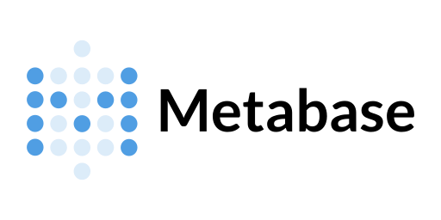
Dashboards (1/2):
Recommendation: Metabase
Description: Metabase is a platform that allows users to exchange data and get various conclusions from the same data using internal analytics. This tool does not require SQL or any other type of coding, and anyone may ask any questions or provide a summary of the data to help them come to useful conclusions. Information can be readily retrieved from the tables by applying filters to the data and browsing through the necessary data within the tool's table or visualization.
Operating System: Cloud-based Application
Cost: Open Source
INFO8116-24W-SEC1, Group 1 (Vats Sanghvi, Siddhesh Otari, Harshrajsinh Chavda, Sanjana Upender, Saksham Maggoo)

Slide 55
Dashboards (2/2):
Why?
It’s a hybrid tool that allows both SQL and without SQL creation of simple dashboards. Users can easily make dashboards through the data, and to make more complex datasets, users can use SQL queries.
The dashboard offers a usage analytics feature to check the previous contributions and an inbuilt SQL editor for advanced datasets.
INFO8116-24W-SEC1, Group 1 (Vats Sanghvi, Siddhesh Otari, Harshrajsinh Chavda, Sanjana Upender, Saksham Maggoo)

Slide 56

Online Analytical Processing (1/2):
Recommendation: Palo
Description: Palo is a multidimensional online analytical processing server (MOLAP) that is commonly used as a business intelligence tool for a range of tasks, including budgeting and control. Jedox AG produces Palo. Its user interface is spreadsheet software. Palo enables several users to collaborate on a single, centralized database that serves as the only source of truth. With this kind of adaptability to complex data models, people can gain a deeper understanding of statistics.
Operating System: Web Application
Cost: Open Source
INFO8116-24W-SEC1, Group 1 (Vats Sanghvi, Siddhesh Otari, Harshrajsinh Chavda, Sanjana Upender, Saksham Maggoo)

Slide 57
Online Analytical Processing (2/2):
Why?
It utilizes real-time data, which can be written back or combined with the aid of multidimensional queries.
Palo keeps run-time data in memory to enable faster data access for all users.
The Palo Suite (OLAP Server, Palo Web, Palo ETL Server, and Palo for Excel) allows users direct access via Microsoft Excel and Open Office Calc by including Palo for Excel.
INFO8116-24W-SEC1, Group 1 (Vats Sanghvi, Siddhesh Otari, Harshrajsinh Chavda, Sanjana Upender, Saksham Maggoo)

Slide 58

MS Office Integration (1/2):
Recommendation: Board
Description: With the Board Office Add-in, you can view and utilize Board reports right within the comfortable Excel environment, going beyond the capabilities of the default Excel reporting tools. While preserving the integrity of the original data source, users can alter analytical dimensions, adjust numbers, and drill down further to related information using a live link to the source data stored in Board.
Operating System: Supports both online and offline
INFO8116-24W-SEC1, Group 1 (Vats Sanghvi, Siddhesh Otari, Harshrajsinh Chavda, Sanjana Upender, Saksham Maggoo)

Slide 59
MS Office Integration (2/2):
Why?
Board provides complete customization options for every industry, including finance, human resources, sales, retail, and supply chain, offering different pricing for every solution.
Its planning platform does not require users to get involved with coding, which makes it easier for users to understand and use the platform.
INFO8116-24W-SEC1, Group 1 (Vats Sanghvi, Siddhesh Otari, Harshrajsinh Chavda, Sanjana Upender, Saksham Maggoo)

Slide 60

Predictive Analytics (1/2):
Recommendation: SAP Analytics Cloud
Description: SAP Analytics Cloud is primarily concerned with planning, predictive analysis, and business intelligence. SAP Analytics Cloud facilitates the consolidation and importation of huge datasets from numerous sources. The capability to tailor data access according to each user's level of authorization is another helpful feature of this program. The obvious option if you operate within the SAP environment, it is a comprehensive predictive analytics tool.
Operating System: Web-based Application
Cost: CAD 22/month
INFO8116-24W-SEC1, Group 1 (Vats Sanghvi, Siddhesh Otari, Harshrajsinh Chavda, Sanjana Upender, Saksham Maggoo)

Slide 61
Predictive Analytics (2/2):
Why?
SAP Analytics Cloud combines planning and analytics. It allows modeling any situation for improved business results and automatically creates plans from projections to support quick decisions that are all possible.
To speed up analytics and planning initiatives, SAP Analytics Cloud includes more than 100 prebuilt best-practice SAP business content packages spanning business lines and industries.
It uses machine learning to automate insights, making it possible to create specialized analytics apps more quickly and provide high-performance analytics at scale.
INFO8116-24W-SEC1, Group 1 (Vats Sanghvi, Siddhesh Otari, Harshrajsinh Chavda, Sanjana Upender, Saksham Maggoo)

Slide 62

Data Discovery (1/2):
Recommendation: ManageEngine Endpoint DLP Plus
Description: ManageEngine Endpoint DLP Plus offers file protection via containerization, data movement controls, and data loss prevention via data discovery and classification. This package is available for Windows Server in a free version that supports 25 endpoints. It has ability to provide a thorough and integrated solution for managing insider threats, preventing data loss, and providing general endpoint security.
Operating System: Windows
Cost: CAD 700-25000/year
INFO8116-24W-SEC1, Group 1 (Vats Sanghvi, Siddhesh Otari, Harshrajsinh Chavda, Sanjana Upender, Saksham Maggoo)

Slide 63
Data Discovery (2/2):
Why?
It prevents data loss and manages insider threats. Against ever-changing security threats, the combination of these features aids enterprises in protecting their confidential information and keeping command over their endpoints.
Depending on the user's data access privileges, this system monitors data movements to USB devices, email, or cloud platforms and either blocks or permits each transfer.
It effectively blocks the uploading of private files to unauthorized websites and also provides visualizations concerning network data trends and thorough audits of user behavior.
INFO8116-24W-SEC1, Group 1 (Vats Sanghvi, Siddhesh Otari, Harshrajsinh Chavda, Sanjana Upender, Saksham Maggoo)

Slide 64

Data Visualization (1/2):
Recommendation: Tableau
Description: Tableau is particularly useful for data analysts and scientists to create custom reports, dynamic charts, and complex visualizations. It is frequently utilized as an entry-level data tool that is difficult for most employees of the firm to use. Tableau incorporates new developments in augmented analytics, including machine learning, statistics, natural language processing, and intelligent data preparation, which enable everyone to gain insights more quickly, from data scientists to business users.
Operating System: Cloud and desktop application
Cost: CAD 15-70/month
INFO8116-24W-SEC1, Group 1 (Vats Sanghvi, Siddhesh Otari, Harshrajsinh Chavda, Sanjana Upender, Saksham Maggoo)

Slide 65
Data Visualization (2/2):
Why?
It is an effective tool for data visualization because of its great flexibility in handling and utilizing data. Additionally, the vast quality and variety of graphics that can be created with it makes this tool even versatile.
Tableau also allows easy integration into its other platforms, such as Pulse, Server, CRM analytics, data management, embedded analytics, etc.
INFO8116-24W-SEC1, Group 1 (Vats Sanghvi, Siddhesh Otari, Harshrajsinh Chavda, Sanjana Upender, Saksham Maggoo)

Slide 66

Big Data Analytics (1/2):
Recommendation: Pentaho Data Integration and Analytics
Description: Hitachi’s Pentaho analytics platform allows organizations to access and blend all types and sizes of data. The product offers a range of capabilities for big data integration and data preparation. Hitachi’s Pentaho analytics platform allows organizations to access and blend all types and sizes of data. The product offers a range of capabilities for big data integration and data preparation.
Operating System: Cloud-based, On-premise
Cost: Undisclosed
INFO8116-24W-SEC1, Group 1 (Vats Sanghvi, Siddhesh Otari, Harshrajsinh Chavda, Sanjana Upender, Saksham Maggoo)

Slide 67
Big Data Analytics (2/2):
Why?
It has high-performance capabilities that make it simple for users to connect, display, and mix data anywhere—on-premises or in any cloud, including Azure, AWS, and GCP.
It allows handling native Kettle and Spark engines with ease and operationalizes AI/ML models based on R, Python, Scala, and Weka.
INFO8116-24W-SEC1, Group 1 (Vats Sanghvi, Siddhesh Otari, Harshrajsinh Chavda, Sanjana Upender, Saksham Maggoo)

Slide 68

Mobile BI (1/2):
Recommendation: Sisense
Description: Sisense streamlines complex data business analytics. Sisense helps with extensive data preparation that business analytics tools often require and offers a single, comprehensive solution for analyzing and visualizing big, heterogeneous data sets without the need for IT resources. It offers statistical functions, including correlation, covariance, and different distributions as one-click formulas straight from Sisense dashboards.
Operating System: Web based Application
Cost: Undisclosed
INFO8116-24W-SEC1, Group 1 (Vats Sanghvi, Siddhesh Otari, Harshrajsinh Chavda, Sanjana Upender, Saksham Maggoo)

Slide 69
Mobile BI (2/2):
Why?
Sisense Fusion Embed is a low- or no-code, AI-driven embedded analytics solution that lets users include personalized analytics into enterprise products and applications.
It offers cloud based solution, which allows users to ditch installation, upgradation, and maintenance of on-premise servers.
INFO8116-24W-SEC1, Group 1 (Vats Sanghvi, Siddhesh Otari, Harshrajsinh Chavda, Sanjana Upender, Saksham Maggoo)

Slide 70
List of Common Tools
Apache Spark:
Refined Big Data Processing, Unified Data Analytics
Apache Nifi:
ETL (Extract Transform Load),ELT (Extract Load Transform), Data Integration, Data Streaming
Microsoft Azure:
Cloud Application, Cloud Database
Tableau:
Reporting, Data Visualization, Business Intelligence
Informatica MDM SaaS:
Master Data Management (MDM), Data Services
SAP Analytics Cloud:
Predictive Analytics, Reporting
ManageEngine Endpoint DLP Plus:
Data Discovery, Endpoint DLP
Meta base:
Dashboards Ad-hoc Analysis
INFO8116-24W-SEC1, Group 1 (Vats Sanghvi, Siddhesh Otari, Harshrajsinh Chavda, Sanjana Upender, Saksham Maggoo)

Slide 71
References:
https://www.geeksforgeeks.org/normal-forms-in-dbms/
https://www.tutorialspoint.com/sql/first-normal-form.htm
https://signoz.io/
https://www.datapine.com/
https://www.octoparse.com/
https://www.microsoft.com/en-ca/microsoft-365/excel
https://www.mongodb.com/
https://www.informatica.com/ca/platform.html
https://kafka.apache.org/
https://azure.microsoft.com/en-ca
INFO8116-24W-SEC1, Group 1 (Vats Sanghvi, Siddhesh Otari, Harshrajsinh Chavda, Sanjana Upender, Saksham Maggoo)

Slide 72
References:
https://www.gestisoft.com/blog/what-are-the-benefits-of-power-bi#:~:text=Data%2DDriven%20Decision%20Making%3A%20Power,up%2Dto%2Ddate%20information.
https://atlan.com/master-data-management-benefits/
https://azure.microsoft.com/en-ca
https://signoz.io/
https://www.datapine.com/
https://www.octoparse.com/
https://www.zoho.com/analytics/features.html?src=top-header
https://www.zoho.com/analytics/pricing.html
https://theworkflowacademy.com/wp-content/uploads/2022/05/zoho-Analytics.png
https://www.betterbuys.com/bi/reviews/datapine/
https://www.datapine.com/blog/ad-hoc-reporting-analysis-meaning-benefits-examples/#ad-hoc-reporting-definition
https://www.metabase.com/pricing/
INFO8116-24W-SEC1, Group 1 (Vats Sanghvi, Siddhesh Otari, Harshrajsinh Chavda, Sanjana Upender, Saksham Maggoo)

Slide 73
References:
https://medevel.com/bi-dashboards/
https://www.softwaretestinghelp.com/best-olap-tools/
https://www.linuxlinks.com/palo/
https://www.board.com/en/ms-office-integration
https://www.board.com/en/why-board
https://www.sap.com/canada/products/technology-platform/cloud-analytics.html
https://www.sap.com/canada/products/technology-platform/cloud-analytics.html
https://www.techradar.com/best/best-data-recovery-software
https://www.stellarinfo.com/windows-data-recovery.php
https://www.comparitech.com/net-admin/best-data-discovery-tools/
https://www.manageengine.com/endpoint-dlp/get-quote.html
https://solutionsreview.com/business-intelligence/the-best-big-data-analytics-tools-and-platforms/
https://www.hitachivantara.com/pentaho/pentaho-plus-platform/data-integration-analytics.html
https://www.predictiveanalyticstoday.com/sisense/
https://www.sisense.com/platform/
INFO8116-24W-SEC1, Group 1 (Vats Sanghvi, Siddhesh Otari, Harshrajsinh Chavda, Sanjana Upender, Saksham Maggoo)

Slide 74
Thank you! Any Questions?
INFO8116-24W-SEC1, Group 1 (Vats Sanghvi, Siddhesh Otari, Harshrajsinh Chavda, Sanjana Upender, Saksham Maggoo)

Slide 75
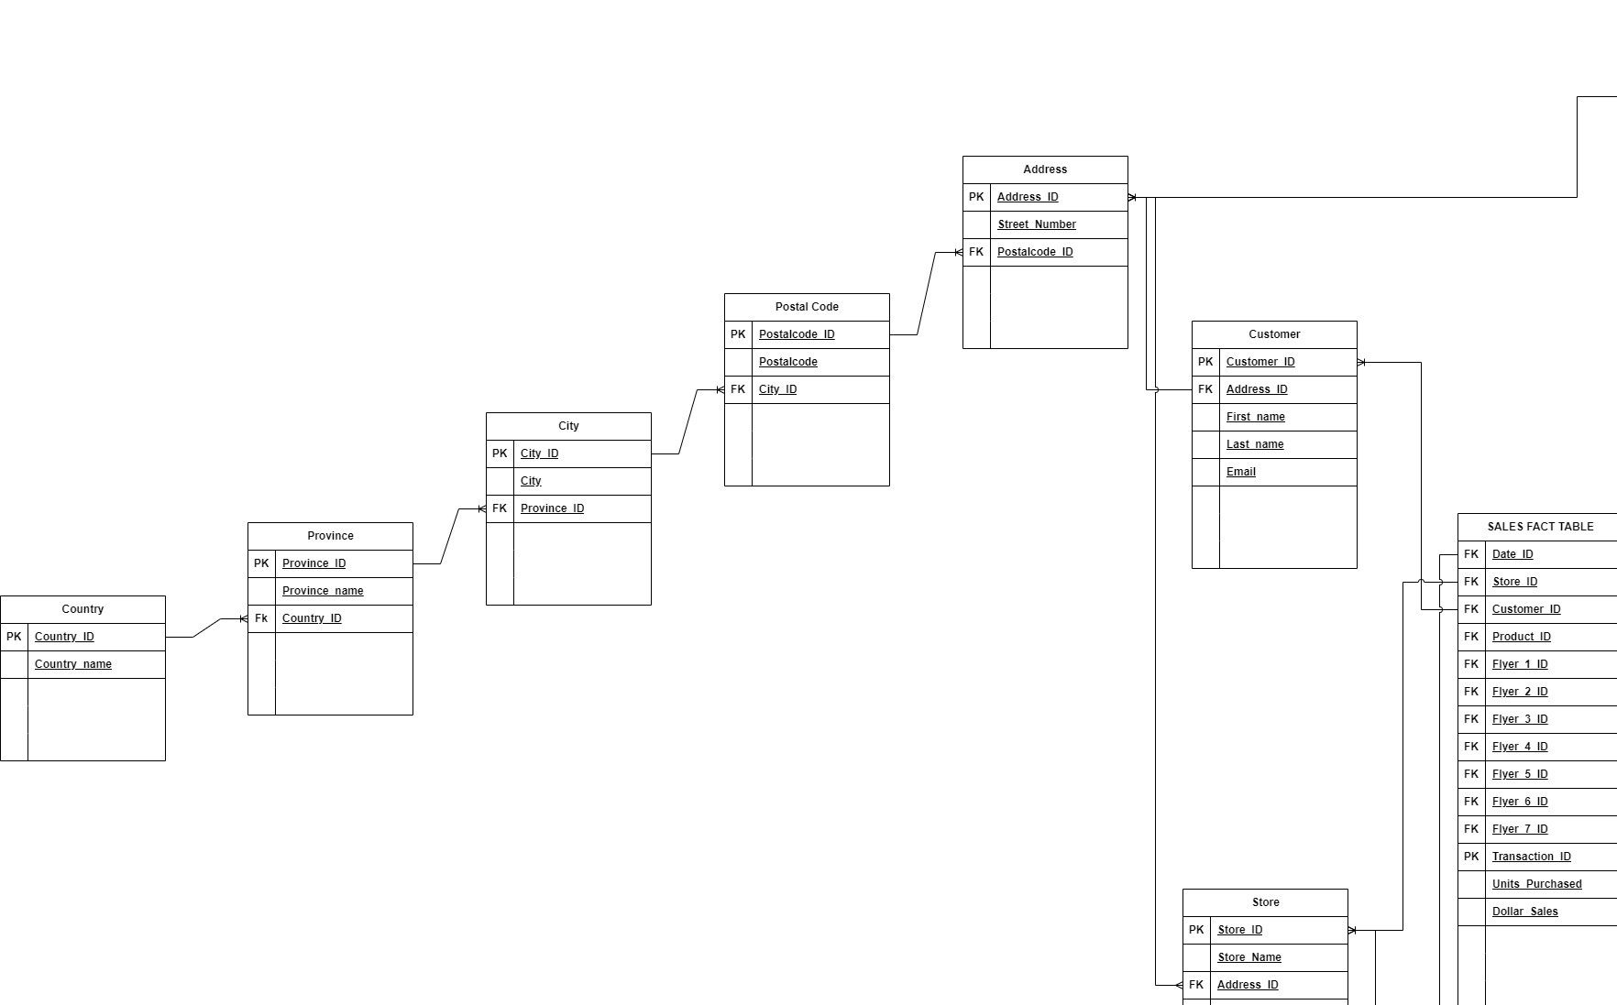

Slide 76
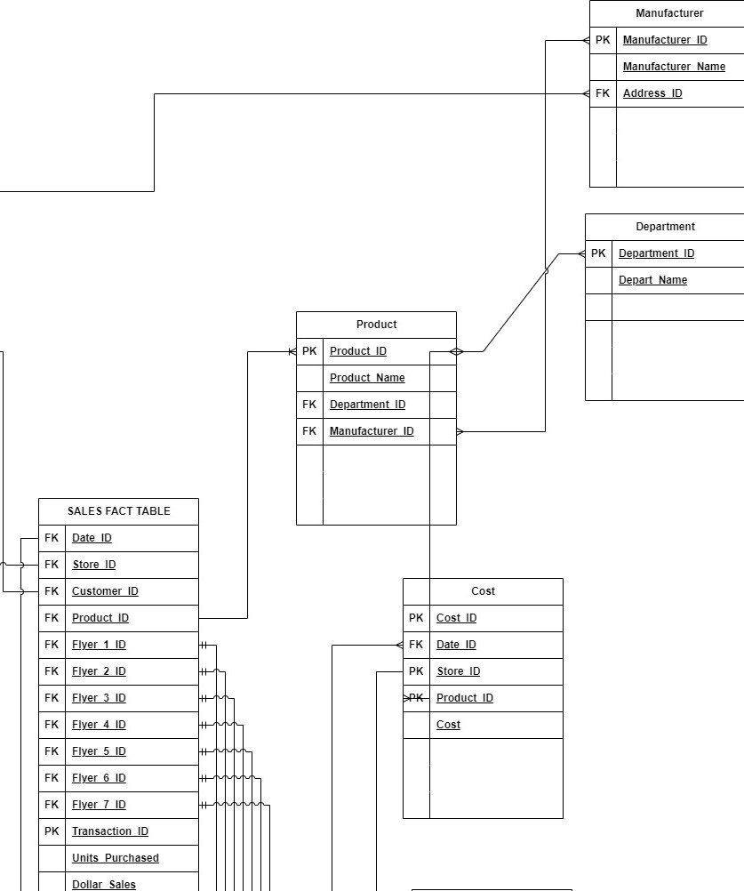

Slide 77
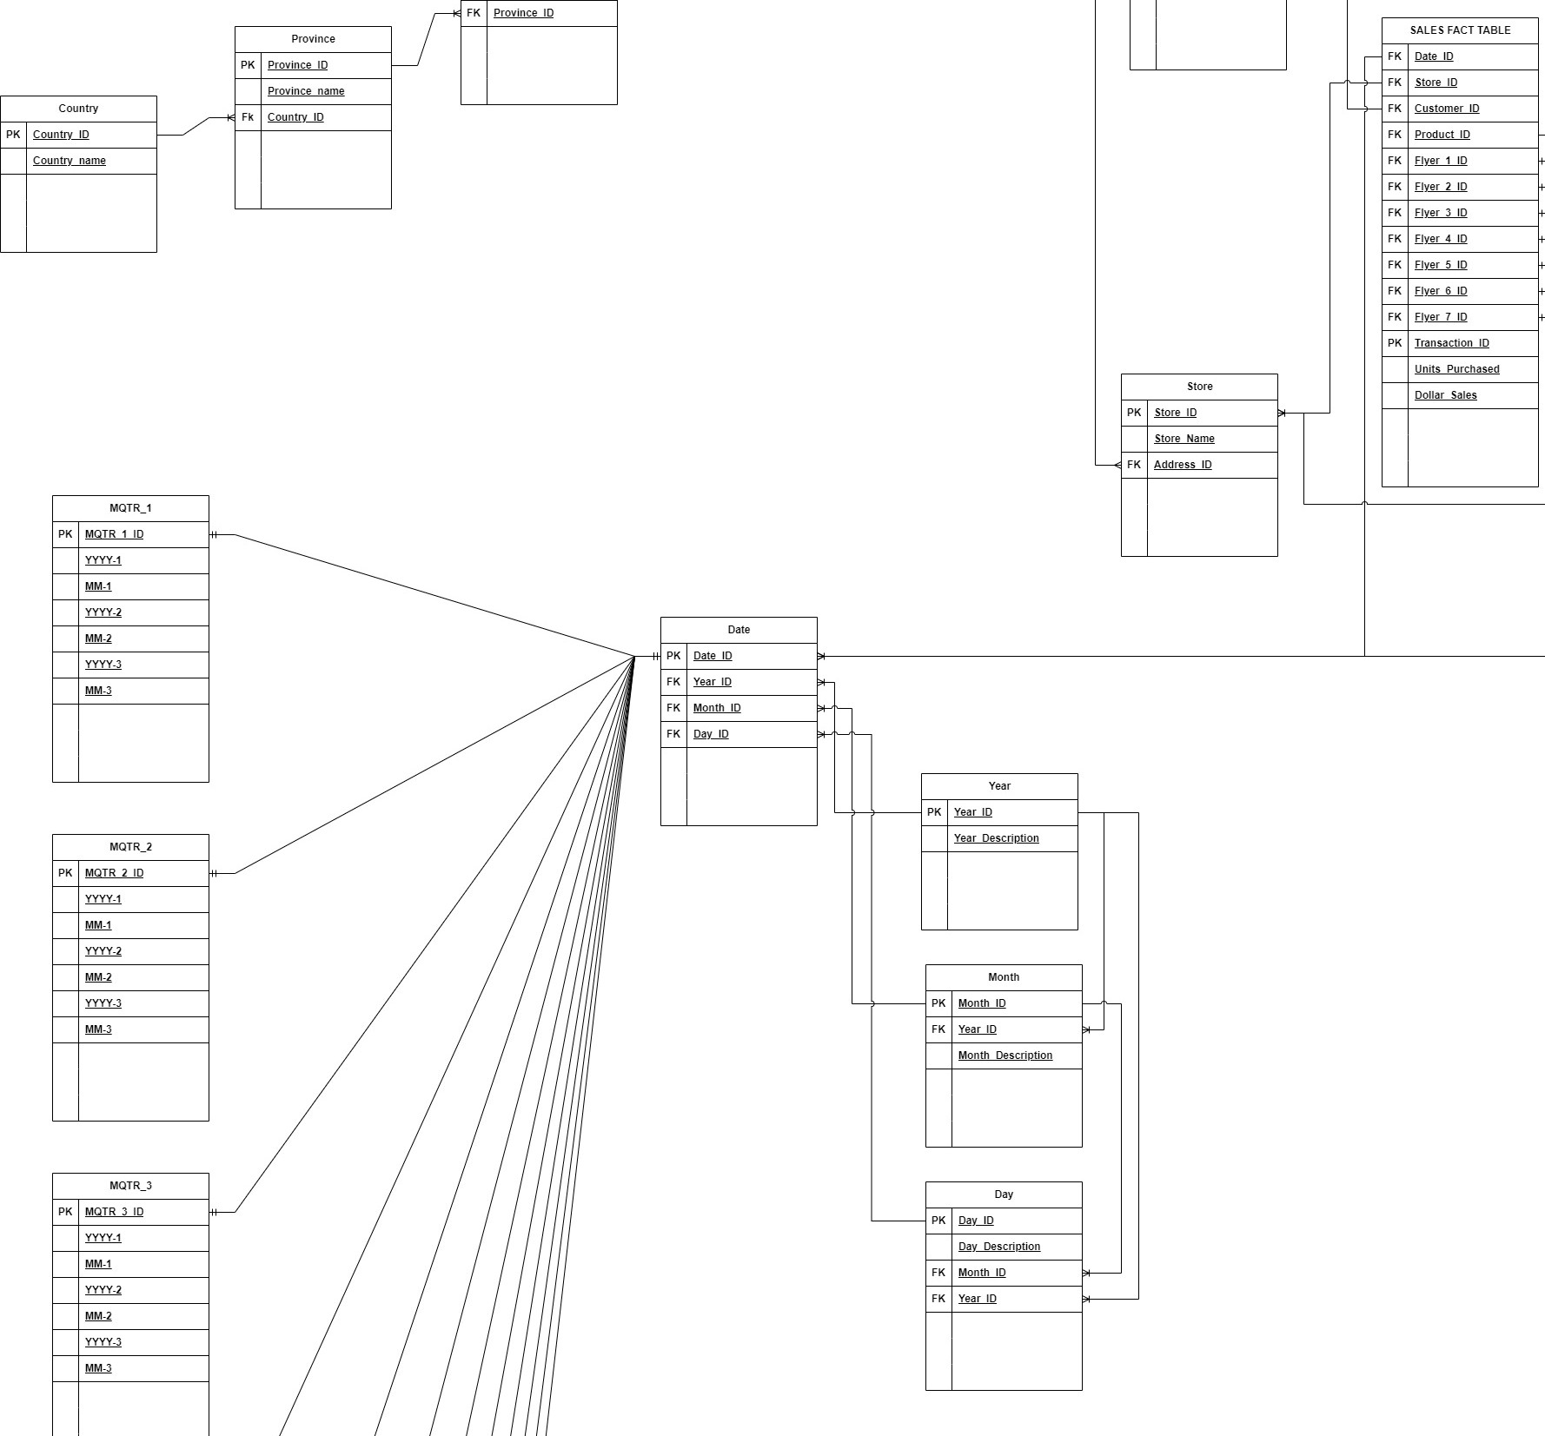

Slide 78
