Slide 1

Big Data Architecting INFO8116-24W-Sec1-Big Data Architecture
Group 1
Team Members:
Siddhesh Otari
Vats Sanghvi
Harshrajsinh Chavda
Saksham Magoo
Sanjana Upender

Slide 2

Table of Contents
Normalization Slides
Business Intelligence Tools
Data Warehouse and BI Data Tools
Data Integration Tools
Data Sources
References

Slide 3
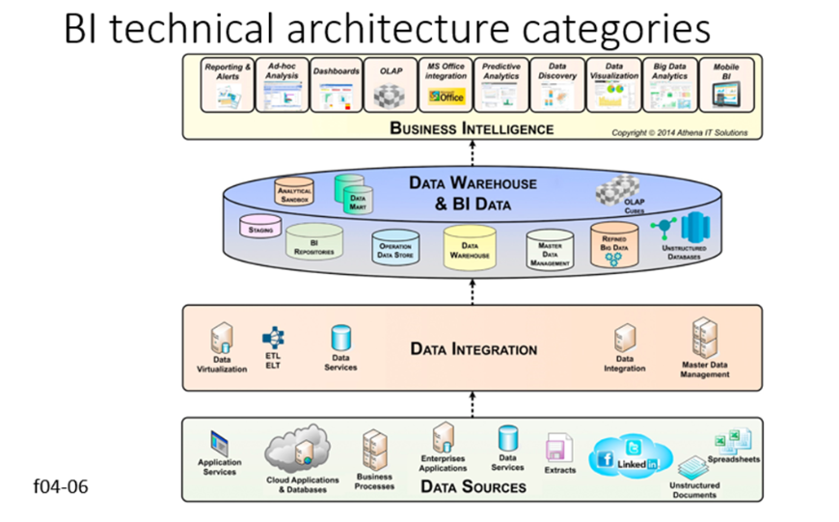

Slide 4
Notes:
Our recommendations include free tools along with tools that need subscription. As we do not have a budget concern, I have picked the ones that are best on the market.
The figure includes all tools used to query, gather, integrate, cleanse, and transform data into information that is delivered to a person, a process, or database.
There isn't a single tool that covers all aspects of LDW components comprehensively, some platforms offer a broad range of capabilities that address multiple requirements within the LDW ecosystem.

Slide 5
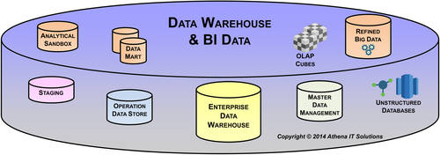
Tools for Data Warehouse and BI Data layer
COMPONENTS
Enterprise Data Warehouse, Data marts, OLAP cubes
Analytical sandboxes
Refined Big Data and Unstructured Databases
Master Data Management
Operation Data Source

Slide 6

Refined Big Data:
Recommendation: Apache Spark
Description: Apache Spark is a powerful distributed computing engine that provides high-level APIs in Scala, Java, Python, and R. It's ideal for processing and analyzing large-scale structured and unstructured data, making it suitable for refining big data before storage in the LDW.
Operating System : Microsoft Windows, macOS, Linux
Cost : Free (open-source)
Additional Costs: While the software itself is free, there may be costs associated with infrastructure (e.g., cloud services, compute resources) and support for deployment, configuration, and optimization.

Slide 7
Why?
•Speed : In-memory processing
•Ease of Use : User-friendly APIs
•Support for multiple programming languages and available on all operating systems

Slide 8

Analytical Sandboxes:
Recommendation: Apache Zeppelin
Description: Apache Zeppelin is an open-source web-based notebook that enables interactive data analytics. It supports multiple interpreters, including Spark, SQL, Python, and more, making it suitable for exploring and analyzing data in analytical sandboxes.
Operating System : Web Based
Cost : Free (open-source)

Slide 9
Why?
Interactive Data Exploration : interactive and collaborative environment for data exploration and analysis.
Rich Visualization Capabilities: Zeppelin offers a wide range of built-in visualization options, including charts, graphs, and dashboards, allowing users to create compelling visual representations of their data without the need for additional tools.

Slide 10
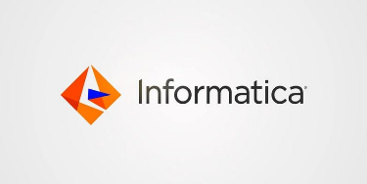
Master Data Management (MDM):
Recommendation: Informatica MDM SaaS
Description: Informatica MDM is a comprehensive master data management solution that provides capabilities for data modeling, data quality, data governance, and data integration. It helps organizations manage and govern their master data across multiple domains, such as customers, products, and suppliers.
Operating System: SaaS cloud service
Cost: Subscription-based pricing model, typically priced per user or per server/core. Approx. 40,000 USD for first year for a small sized firm.
Additional Costs: Implementation costs for setup, configuration, and customization. Ongoing costs include maintenance, support, and potential add-on modules for advanced features.

Slide 11
Why?
Data Governance and Compliance: Informatica MDM SaaS offers robust data governance capabilities to ensure data quality, consistency, and compliance with regulatory requirements.
Scalability : As a SaaS offering, it eliminates the need for upfront hardware investments, can manage master data effectively regardless of their size or industry, making it suitable for both small businesses and large enterprises.

Slide 12
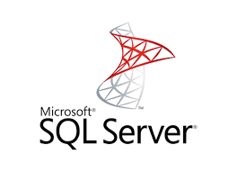
Operational Data Store (ODS):
Recommendation: Microsoft SQL Server (Standard - server)
Description: Microsoft SQL Server is a relational database management system that provides capabilities for building and maintaining operational data stores. It offers robust transaction processing, data integration, and reporting functionalities, making it suitable for storing and managing operational data before loading into the LDW.
Operating System : Windows, macOS (Azure Data Studio), Linux, Ubuntu.
Cost : SQL Server Standard 1,418 USD /year

Slide 13
Why?
Microsoft SQL Server seamlessly integrates with other Microsoft technologies and platforms, such as Azure Cloud Services, Power BI, and Excel.
Security features : Microsoft SQL Server provides a comprehensive set of data management and security features to support ODS requirements. These include advanced data integration capabilities with SQL Server Integration Services (SSIS) for ETL

Slide 14
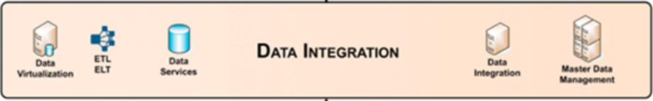
Tools for Data Integration Layer
Components:
Data Visualization
ETL ELT
Data Services & Data Integration
Master Data Management

Slide 15

Data Visualization:
Recommendation: Microsoft Power BI
Description: Power BI is a collection of software services, apps, and connectors that work together to turn your unrelated sources of data into coherent, visually immersive, and interactive insights. Your data might be an Excel spreadsheet, or a collection of cloud-based and on-premises hybrid data warehouses. Power BI lets you easily connect to your data sources, visualize and discover what's important, and share that with anyone or everyone you want.

Slide 16
Power BI consists of several elements that all work together, starting with these three basics:
A Windows desktop application called Power BI Desktop.
An online software as a service (SaaS) service called the Power BI service.
Power BI Mobile apps for Windows, iOS, and Android devices.
Operating System: Windows, macOS, Mobiles, Web
Cost:
Power BI Desktop: Free
Power BI Pro: $9.99 per use per month
Power BI Premium: Starting from $4995 per month.
Power BI Premium per user (PPU): $20 per user per month

Slide 17
Why?
Power BI sets the standard for a data visualization tool, and offers robust features like data analysis expression (DAX) and more.
Power BI enables you to visualize and analyze your data in a way that makes it easier to identify trends, patterns, and anomalies.
Power BI can help you consolidate and integrate data from various databases, spreadsheets, cloud services, and more. This can lead to a unified view of your operations.

Slide 18

ETL (Extract Transform Load)/ELT (Extract Load Transform):
Recommendation: Apache Nifi
Description: Apache NiFi is a software project from the Apache Software Foundation designed to automate the flow of data between software systems. Leveraging the concept of extract, transform, load (ETL), it is based on the "NiagaraFiles" software previously developed by the US National Security Agency (NSA), which is also the source of a part of its present name – NiFi. It was open sourced as a part of NSA's technology transfer program in 2014.
Operating System: Windows, macOS, Linux, Unix
Cost:
•Apache NiFi is an open-source project distributed under the Apache License 2.0, which means it is free to download, use, and modify.
•There are no licensing costs associated with Apache NiFi itself.

Slide 19
Why?
An easy to use, powerful, and reliable system to process and distribute data.
NiFi automates cybersecurity, observability, event streams, and generative AI data pipelines and distribution for thousands of companies worldwide across every industry.

Slide 20

Data Services and Data Integration:
Recommendation: Apache Kafka
Description: Apache Kafka is a distributed event store and stream-processing platform. It is an open-source system developed by the Apache Software Foundation written in Java and Scala. The project aims to provide a unified, high-throughput, low-latency platform for handling real-time data feeds. Kafka can connect to external systems (for data import/export) via Kafka Connect and provides the Kafka Streams libraries for stream processing applications. Kafka uses a binary TCP-based protocol that is optimized for efficiency and relies on a "message set" abstraction that naturally groups messages together to reduce the overhead of the network roundtrip. This "leads to larger network packets, larger sequential disk operations, contiguous memory blocks [...] which allows Kafka to turn a bursty stream of random message writes into linear writes.
Operating System: Windows, macOS, Linux
Cost:
•Apache Kafka is an open-source project distributed under the Apache License 2.0, which means it is free to download, use, and modify.
•There are no licensing costs associated with Apache Kafka itself.

Slide 21
Why?
Kafka provides scalability by allowing partitions to be distributed across different servers.
Increase the number of consumers to the queue to scale out processing across those competing consumers.
Policy based, for example messages may be stored for one day.
The user can configure this retention window.

Slide 22
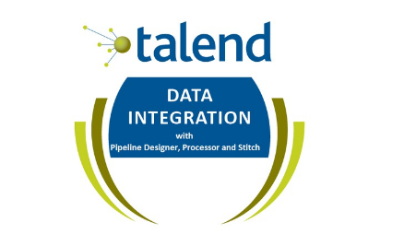
Master Data Management:
Recommendation: Talented Community Edition
Description: Talend MDM Server is where the live version of the master data is stored. The MDM Repository contains a working copy of the data, and can be stored locally (that is, on the same machine as Talend Studio) or remotely, based on a Git server. The data from the MDM Repository must be deployed to Talend MDM Server before it can be accessed by users of Talend MDM Web UI.
Operating System: Windows, macOS, Linux
Cost:
Talented MDM Server is an open-source project distributed under the Apache License 2.0, which means it is free to download, use, and modify.
There are no licensing costs associated with Talented MDM server itself.
Organizations can download, install, and use the software without any upfront fees or subscription charges. However, it's essential to consider the total cost of ownership (TCO), which may include costs related to infrastructure, maintenance, support, and training.

Slide 23
Why?
Data consistency
Enhanced data quality
Streamlined operations
Single version of truth
Improved decision-making
Regulatory compliance
Reduced costs
Enhanced customer experience
Agility in innovation
Risk management

Slide 24

Tools for Data Sources
Components
Applications Services
Cloud Application and databases
Enterprises Application
Extract

Slide 25

Application services
Application services are software solutions that enhance an application's functionality, security, and speed. Applications are optimized, deployed, and managed by businesses through the use of an interconnected pool of internal and external services known as application services.
Tool :SigNoz
Description: SigNoz is an open source, full-stack APM and observation tool. Under a single pane of glass, it offers traces, metrics, and logs. It utilizes Clickhouse, a potent OLAP database, for quicker aggregations and ingestion.
Compatibility: Work with both Microsoft Windows, macOS but 8 GB of memory , 30 GB of storage and 4 cores CPU is required
Cost: Free(open source)
Additional Cost : while the software is free it includes addition cost for Cloud

Slide 26
Why ?
SigNoz is open source and based on open standards. SigNoz is built to support OpenTelemetry natively.
SigNoz provides metrics, traces, and logs under a single pane of glass. Rather than running different projects like Prometheus for metrics and Jaeger for traces and stitching them together, you can use SigNoz as your one-stop observability solution.
SigNoz uses columnar datastores, which makes aggregating queries very fast. It also helps in slicing and dicing the data using Group BY and aggregates. You can identify the root cause of performance issues quickly.

Slide 27
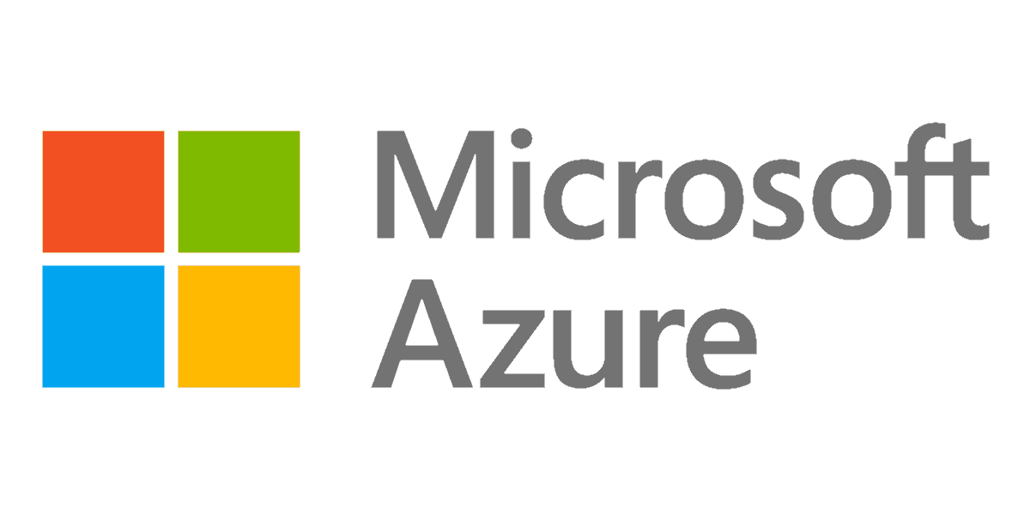
Cloud Application
and Database
A cloud database is a database that is deployed, delivered, and accessed in the cloud. Cloud databases organize and store structured, unstructured, and semi-structured data.
Tool: Microsoft Azure
Description : Microsoft Azure, often referred to as Azure, is a cloud computing platform run by Microsoft. It offers access, management, and the development of applications and services through global data centers.
Compatibility: Microsoft Windows , Linux , macos
Cost:Subscription-based pricing model

Slide 28
Why ?
Learning of the host app's data access patterns, adaptive performance tuning, and automatic improvements to reliability and data protection.
Management and monitoring of multi-tenant apps with isolation benefits of one-customer-per-database.
Integration with open-source tools

Slide 29

Enterprises Application
An enterprise application is specialized software that helps organizations integrate and automate their core processes, streamline workflows, improve efficiency, and gain valuable insight into their data and performance.
Tool: Datapine
Description : Datapine is an enterprise software company focused on delivering business intelligence solutions to industries and companies across the world. Users can simply connect their data source(s) and explore various enterprise possibilities such as data analysis via drag-and-drop interface or advanced SQL mode.
Compatibility: Windows, macOS, Linux
Cost:$ 249 -$1000

Slide 30
Why ?
Beginner and advanced data analysis for every industry and department
Modern data visualizations through interactive Business dashboard
Numerous sharing options (via public URL, automated reports, e-mail, embedding)

Slide 31

Extract
Data Extract is used to select specific data elements from a given data source, in order to make the data ready for analysis and analytics through subsequent steps involving transformation and loading.
Tool: octoparse
Description : Octoparse is an easy-to-use web scraping service that enables users to extract data from websites without needing to code. It offers a free plan with up to 10 crawlers, and the standard plan starts at $75/month. Octoparse's main features include point-and-click data extraction, support for extracting text, links, image URLs, and more, and the ability to schedule and run automated tasks.
‍Compatibility: Windows, macOS, Linux
Cost: Starter plan starts at 75 per month
: Professional plan starts at 209 per month

Slide 32
Why ?
Visual point-and-click interface for web data extraction
Automatic data extraction from multiple pages and websites
Built-in browser for handling JavaScript-rendered pages
Data deduplication and data validation options
Proxy rotation and IP address rotation support
Optical Character Recognition (OCR) for extracting data from images

Slide 33
References:
www.informatica.com
www.6sense.com
https://www.microsoft.com/en-us/sql-server/sql-server-2022
https://zeppelin.apache.org/
https://learn.microsoft.com/en-us/power-bi/fundamentals/power-bi-overview
https://en.wikipedia.org/wiki/Apache_NiFi
https://en.wikipedia.org/wiki/Apache_Kafka
https://help.talend.com/r/en-US/8.0/installation-guide-linux/talend-mdm-server

Slide 34
https://www.gestisoft.com/blog/what-are-the-benefits-of-power-bi#:~:text=Data%2DDriven%20Decision%20Making%3A%20Power,up%2Dto%2Ddate%20information.
https://atlan.com/master-data-management-benefits/
https://azure.microsoft.com/en-ca
https://signoz.io/
https://www.datapine.com/
https://www.octoparse.com/

