Slide 1
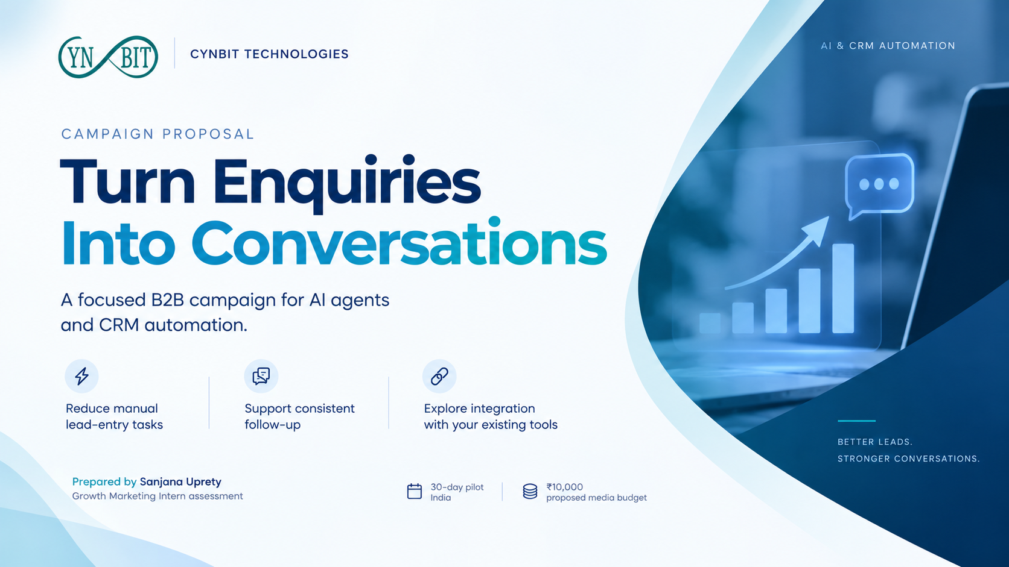

Slide 2
CYNBIT TECHNOLOGIES / AI & CRM AUTOMATION
One audience. One problem. One clear offer.
Audience
Problem
Offer
Proposed segment: founders and sales / operations managers at small Indian B2B service businesses.
They handle enquiries across messages and spreadsheets.
Manual lead entry and inconsistent follow-up can make enquiries difficult to manage.
Validate this pain point in early discovery calls.
A discovery conversation about their current lead workflow and possible automation.
No free audit, guaranteed outcome, or delivery promise.
Qualified lead = a relevant business, a stated workflow problem, and a contact willing to discuss a solution.
SANJANA UPRETY / GROWTH MARKETING ASSESSMENT / PROPOSED CAMPAIGN
02

Slide 3
CYNBIT TECHNOLOGIES / AI & CRM AUTOMATION
Why this campaign should work
Hypothesis: specific lead-follow-up messaging will produce a higher enquiry conversion rate than broad automation messaging, without reducing lead quality.
Service fit
Message fit
Conversion fit
Cynbit lists lead-management AI agents, CRM automation and software integration.
A recognizable business problem makes the service easier to understand and evaluate.
One enquiry form and one CTA guide visitors toward a discovery conversation.
This is a testable proposal—not a claim about Cynbit’s existing customers or campaign performance.
SANJANA UPRETY / GROWTH MARKETING ASSESSMENT / PROPOSED CAMPAIGN
03

Slide 4
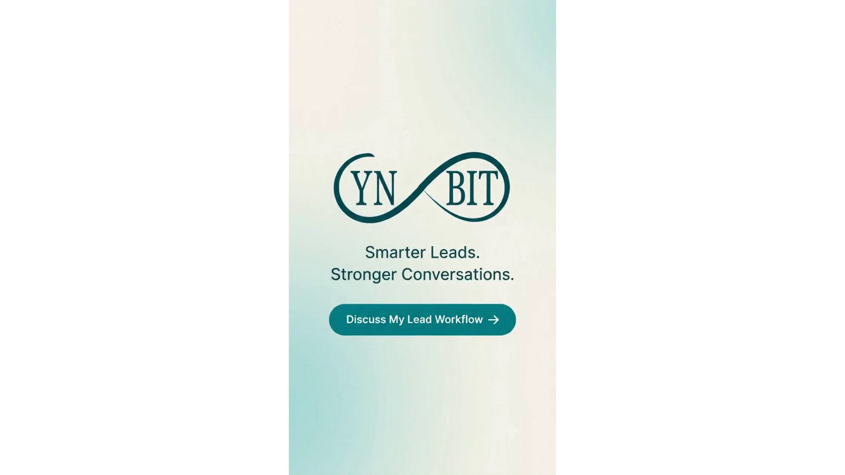
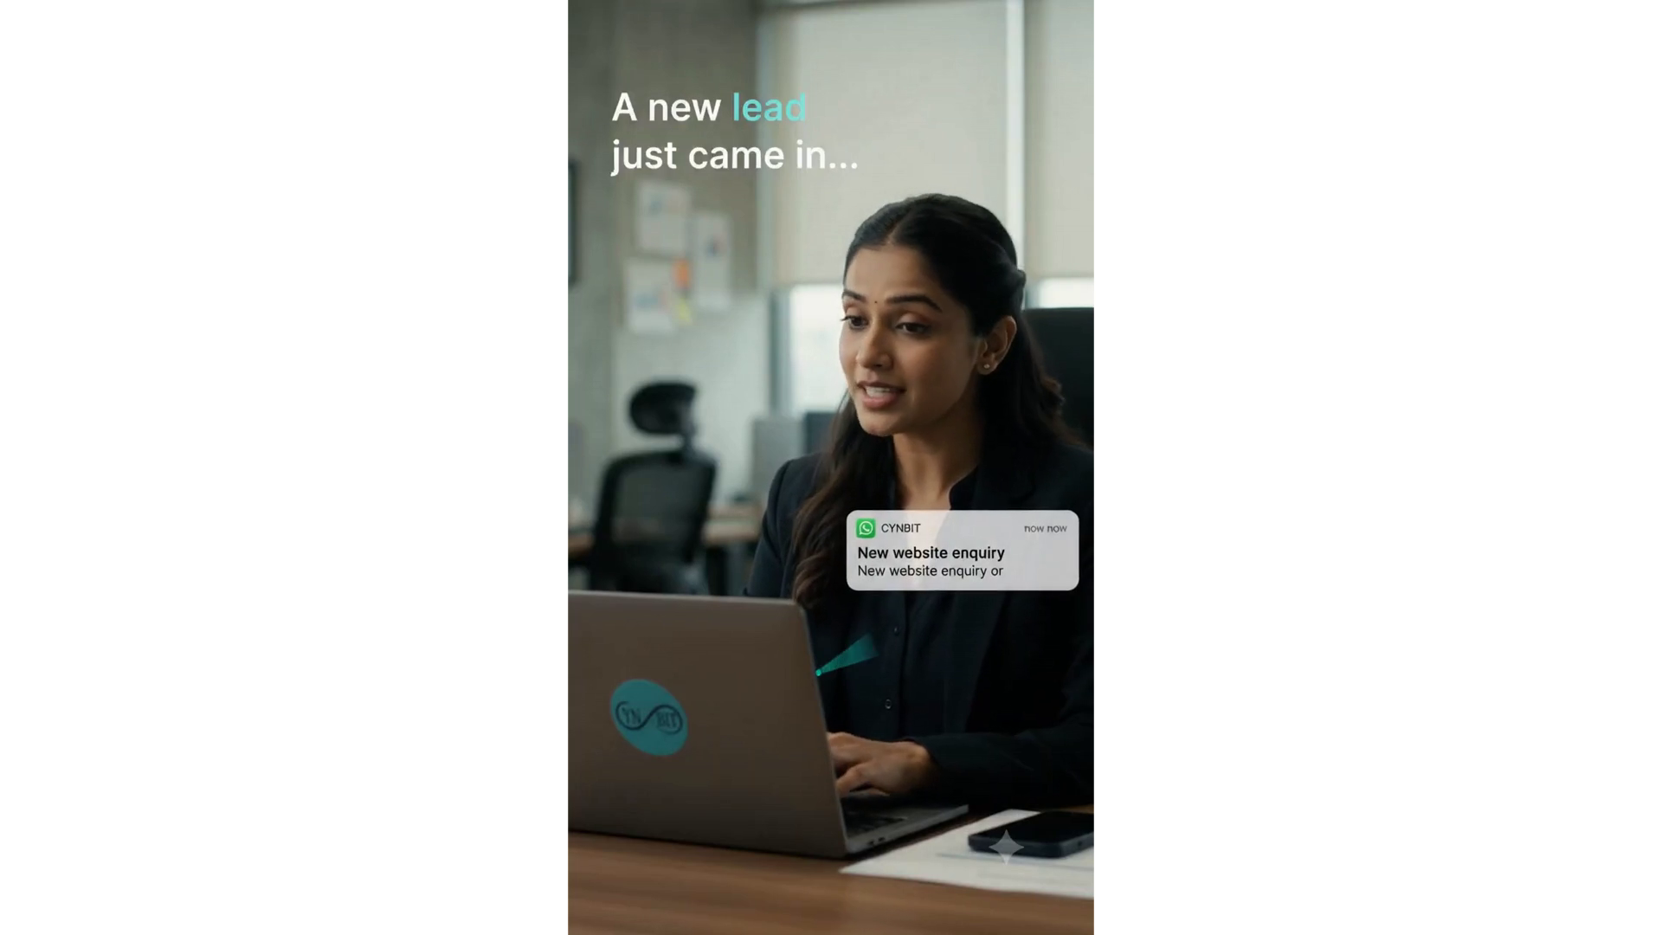
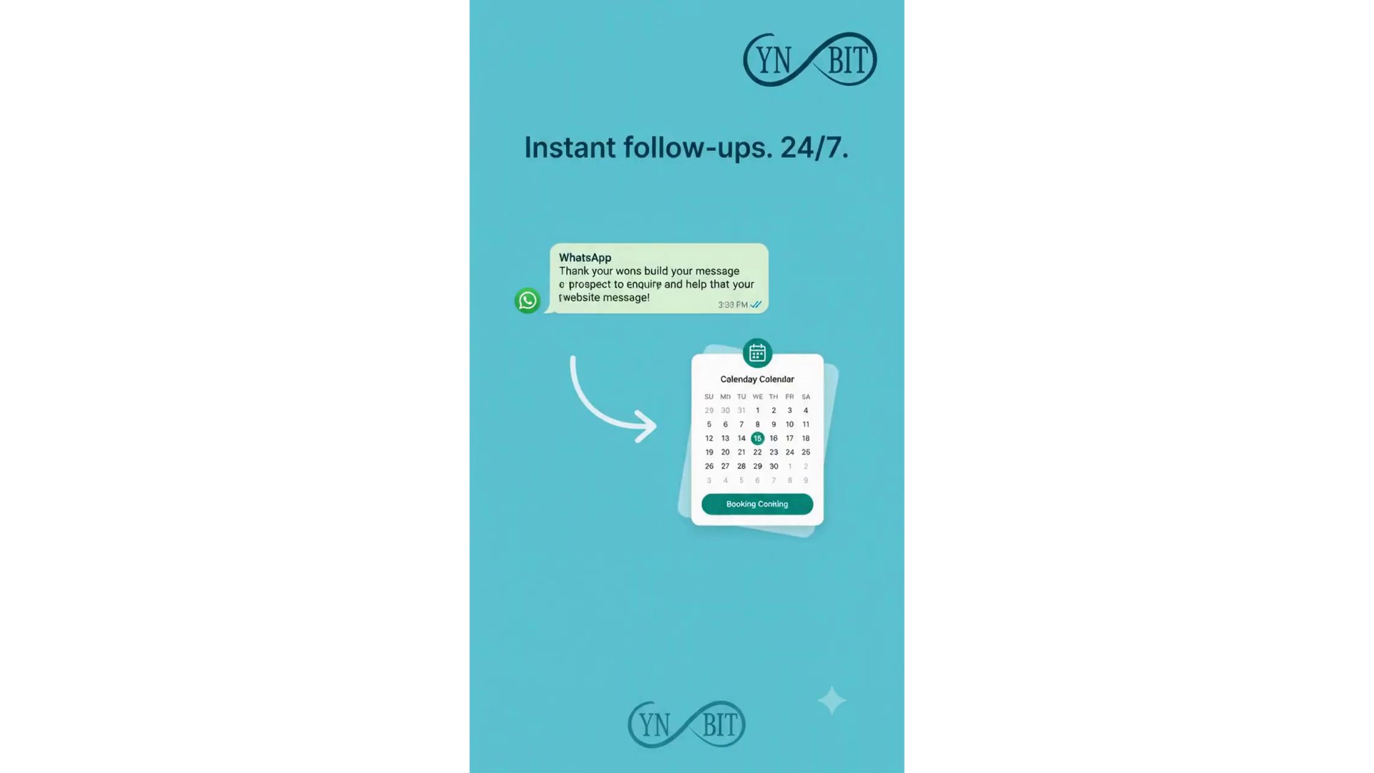
CYNBIT TECHNOLOGIES / AI & CRM AUTOMATION
Video 01 / Alternative campaign creative
PLAY THE ORIGINAL VIDEO
Start Slide Show, then click the video to play.
Original MP4 embedded in this presentation. No internet connection or separate video file is required.
Approximately 10 seconds • audio included
Illustrative campaign concept
SANJANA UPRETY / CAMPAIGN VIDEO COLLECTION / ORIGINAL FILES INCLUDED

Slide 5
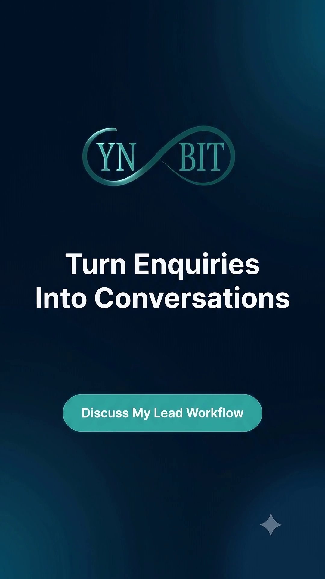

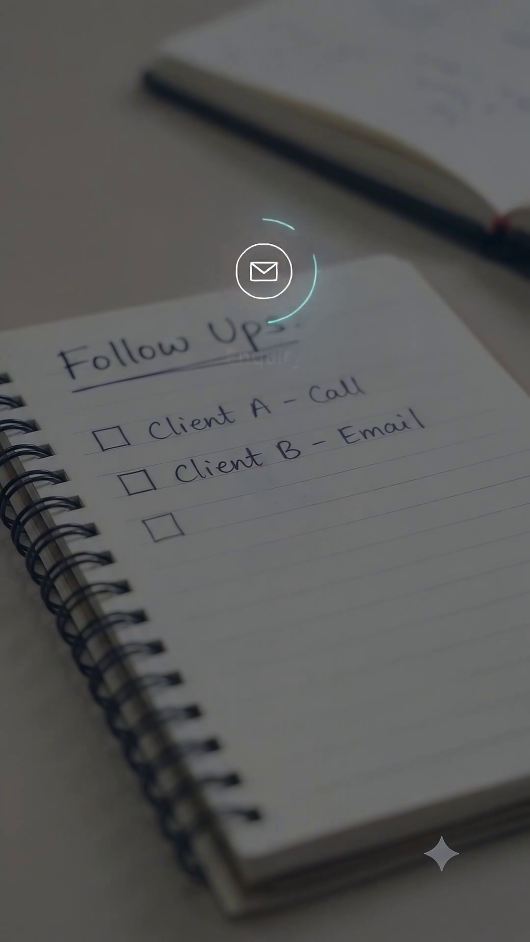
CYNBIT TECHNOLOGIES / AI & CRM AUTOMATION
Video 02 / Main campaign creative
PLAY THE ORIGINAL VIDEO
Start Slide Show, then click the video to play.
Original MP4 embedded in this presentation. No internet connection or separate video file is required.
Approximately 10 seconds • audio included
Illustrative campaign concept
SANJANA UPRETY / CAMPAIGN VIDEO COLLECTION / ORIGINAL FILES INCLUDED

Slide 6
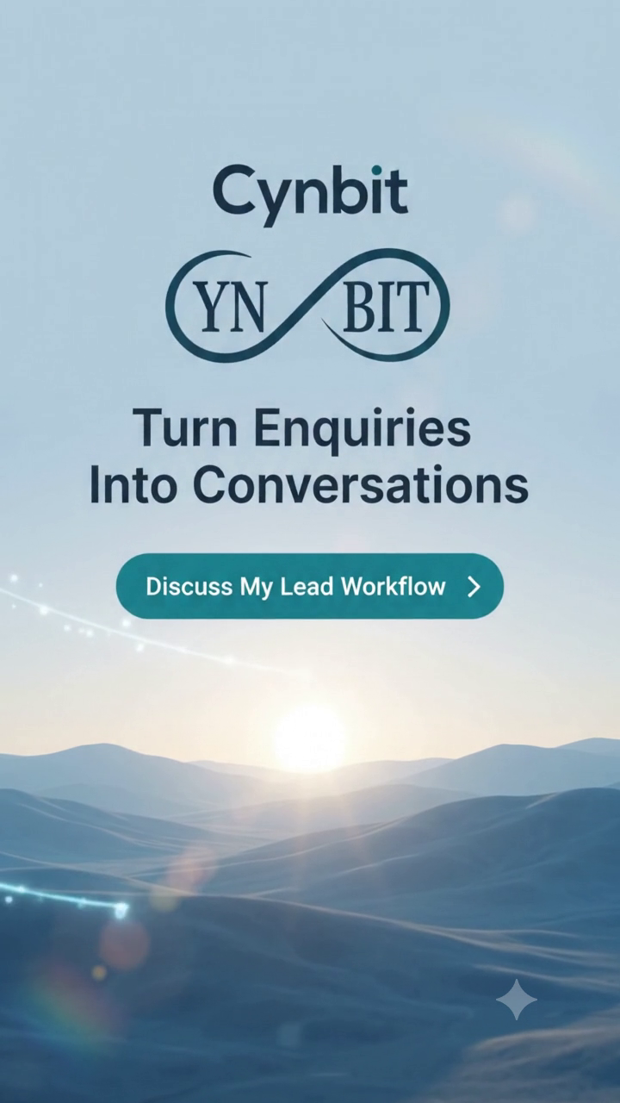
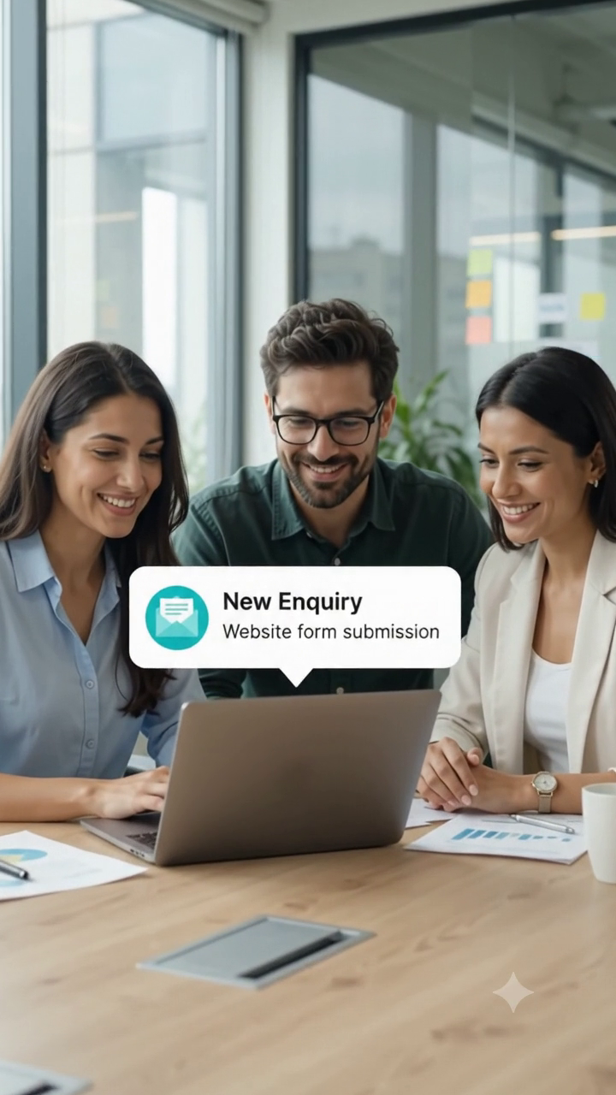
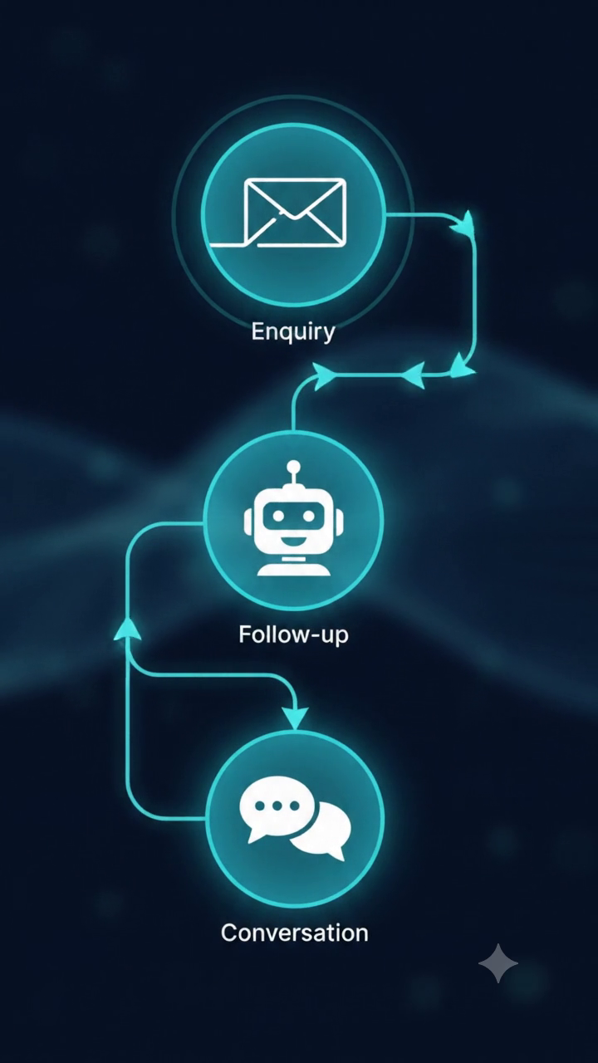
CYNBIT TECHNOLOGIES / AI & CRM AUTOMATION
Video 03 / Alternative campaign creative
PLAY THE ORIGINAL VIDEO
Start Slide Show, then click the video to play.
Original MP4 embedded in this presentation. No internet connection or separate video file is required.
Approximately 10 seconds • audio included
Illustrative campaign concept
SANJANA UPRETY / CAMPAIGN VIDEO COLLECTION / ORIGINAL FILES INCLUDED

Slide 7
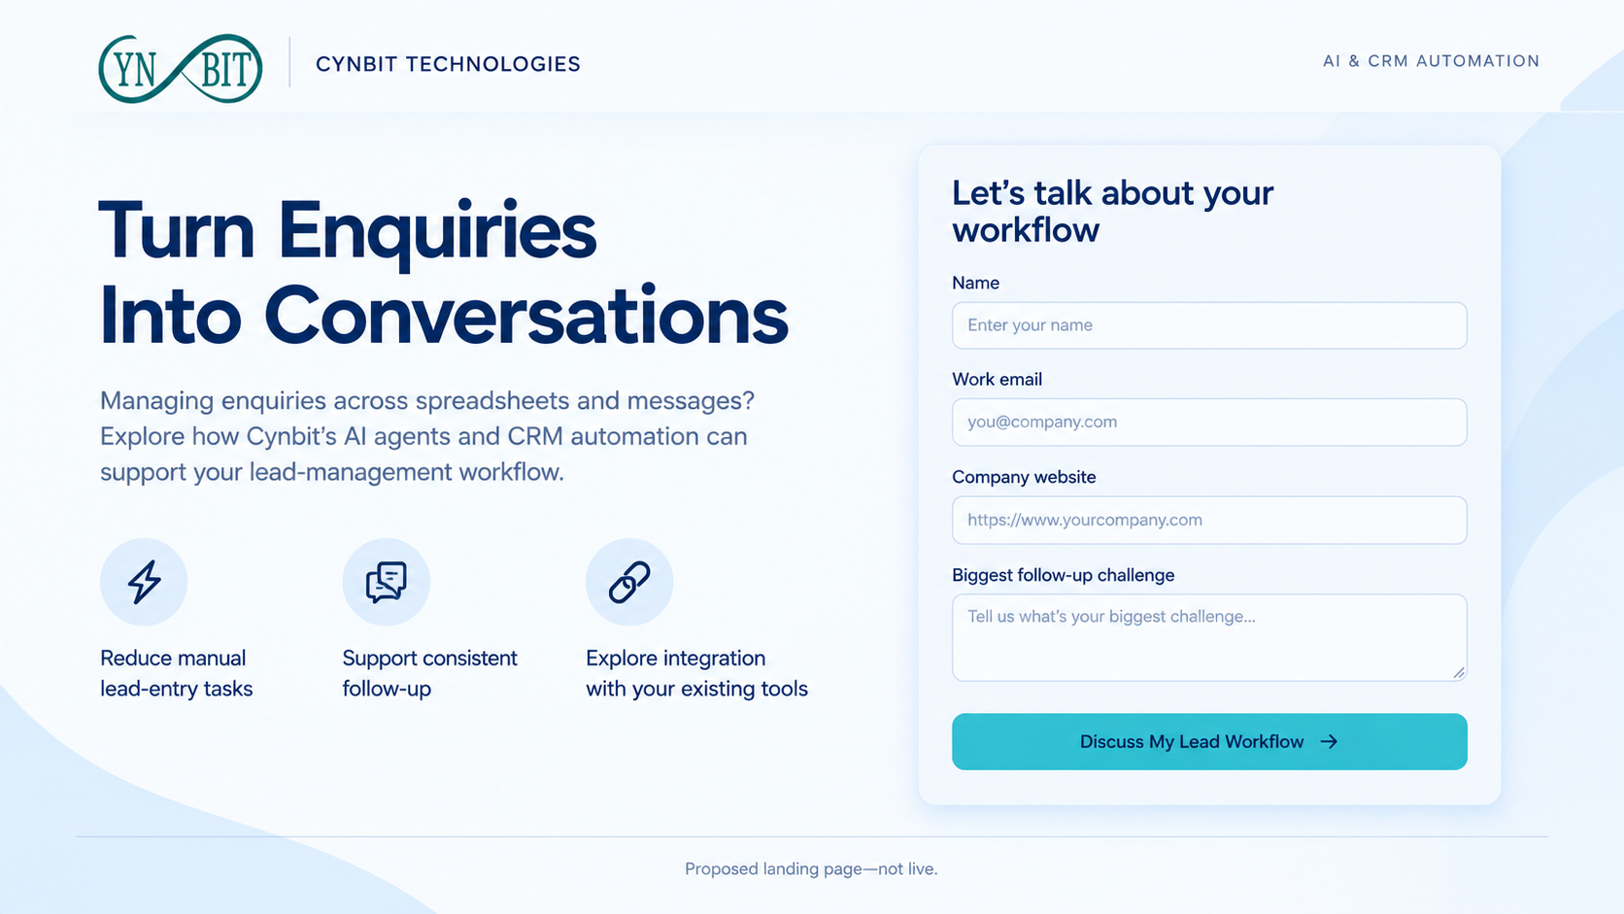
CYNBIT TECHNOLOGIES / AI & CRM AUTOMATION
Creative 02 / A focused landing-page concept
Message match → three service benefits → short enquiry form → one clear CTA. Visual mockup only; not a live form.
SANJANA UPRETY / GROWTH MARKETING ASSESSMENT / PROPOSED CAMPAIGN
07

Slide 8
CYNBIT TECHNOLOGIES / AI & CRM AUTOMATION
Acquisition plan / Capture intent, then learn
Paid: Google Search
Organic: LinkedIn
Allocate the proposed ₹10,000 media budget here.
Start with phrase / exact terms around CRM automation services and lead-follow-up automation.
Review search terms; exclude jobs, courses and unrelated free-tool queries.
Publish the video with a problem-led caption and a tagged landing-page link.
Propose 2 posts per week: video, workflow explanation and practical follow-up tips.
No paid LinkedIn budget; measure this traffic separately.
Before launch: validate keyword demand and CPC, secure Cynbit approval, build the real page and form, confirm branding, and test tracking. Creative production and sales time are outside the media budget.
SANJANA UPRETY / GROWTH MARKETING ASSESSMENT / PROPOSED CAMPAIGN
08

Slide 9
CYNBIT TECHNOLOGIES / AI & CRM AUTOMATION
Pilot economics / Targets, not achieved results
₹10,000
4%
₹50
5%
Media budget
Search CTR target
Assumed CPC
Enquiry CVR target
5,000 impressions → 200 clicks → 10 enquiries → 4 qualified leads → 2 booked calls
Illustrative assumptions: 40% of enquiries qualify; 50% of qualified leads book.
The click-to-enquiry calculation assumes each paid click produces a measured landing-page session.
Implied CPL: ₹1,000 • Cost / qualified lead: ₹2,500 • Cost / qualified booked call: ₹5,000
CAC: ₹10,000 media-only if one customer converts—not a forecast. With zero customers, CAC is not yet measurable. Full CAC adds relevant production and sales costs. Validate acceptable CAC against customer margin.
SANJANA UPRETY / GROWTH MARKETING ASSESSMENT / PROPOSED CAMPAIGN
09

Slide 10
CYNBIT TECHNOLOGIES / AI & CRM AUTOMATION
Experiment / Change the headline, not everything
A / Problem-led
B / Solution-led
“Still managing lead follow-ups manually?”
“AI-powered lead management for growing businesses.”
SETUP
Random 50/50 visitor allocation; persist the variant. Keep traffic source, offer, form and page design unchanged. Exclude internal and bot traffic.
MEASURE
Primary: successful enquiries / eligible sessions. Guardrail: qualified leads / enquiries. Deduplicate submissions and compare like-for-like source traffic.
At 200 visits, this is exploratory. A 5% → 10% lift needs roughly 435 visitors per arm (80% power, 5% two-sided α).
SANJANA UPRETY / GROWTH MARKETING ASSESSMENT / PROPOSED CAMPAIGN
10

Slide 11
CYNBIT TECHNOLOGIES / AI & CRM AUTOMATION
Tracking / Connect marketing to sales outcomes
Ad → visit
Google Ads + GA4
Impressions, clicks, CPC; UTMs and source / medium
Visit → enquiry
GTM + GA4
generate_lead only after confirmed success; capture variant
Enquiry → qualified
CRM / restricted sheet
Lead ID, fit, challenge, qualification date and status
Qualified → booked / attended
CRM / restricted sheet
Booking and attendance tracked separately
Attended → customer
CRM / sales records
Won date, revenue, cost and campaign cohort
Attribution: retain first-touch and latest non-direct UTMs in the CRM; report Search and LinkedIn separately.
Never send names or emails to GA4. Restrict CRM access, follow consent requirements, and test duplicate prevention.
SANJANA UPRETY / GROWTH MARKETING ASSESSMENT / PROPOSED CAMPAIGN
11

Slide 12
CYNBIT TECHNOLOGIES / AI & CRM AUTOMATION
30-day roadmap / Learn before scaling
Days 1–5 / Prepare
Days 6–20 / Launch
Days 21–30 / Evaluate
Approve offer and brand assets.
Build page; QA events and CRM.
Check demand and CPC.
Launch Search and LinkedIn.
Review queries and lead quality.
Log changes; avoid early winners.
Review qualified bookings.
Report test uncertainty.
Follow sales outcomes to day 90.
Decision rules: pause on tracking failure or irrelevant traffic. Investigate any query / ad group spending ₹2,000 with no enquiries. Consider a 20% budget increase only after at least 3 qualified bookings at ≤₹5,000 each, sales-fit confirmation and approval.
The pilot targets only 2 bookings, so it may justify another controlled test—not scaling. No A/B winner without adequate sample size. Track late customer conversions against the original acquisition cohort.
SANJANA UPRETY / GROWTH MARKETING ASSESSMENT / PROPOSED CAMPAIGN
12

Slide 13
CYNBIT TECHNOLOGIES / AI & CRM AUTOMATION
Sources & scope / Transparent by design
Official service descriptions—not independently verified performance claims
Cynbit services: AI agents, CRM automation and integration
https://www.cynbit.in/services
Cynbit contact: discovery conversation and enquiries
https://www.cynbit.in/contact
Creative assets supplied by Sanjana Uprety; AI-assisted creative workflow. Video scenes and dashboard imagery are illustrative. Branding shown in supplied assets requires confirmation before public use.
All budgets, rates and funnel outcomes are proposed assumptions. No ads were launched, no leads collected, and no results fabricated.
Submission scope: 2 creative concepts + campaign plan + growth rationale and measurement framework.
SANJANA UPRETY / GROWTH MARKETING ASSESSMENT / PROPOSED CAMPAIGN
13

