Slide 1
Storage
NAND & NOR Flash,eMMC, SSD,UFS, 3D XPoint Technology
Current Topics Presentation
Dharmik Thakkar
Lakhan Shiva Kamireddy
Sanjana Kalyanappagol
ECEN 5613
04/10/2017

Slide 2
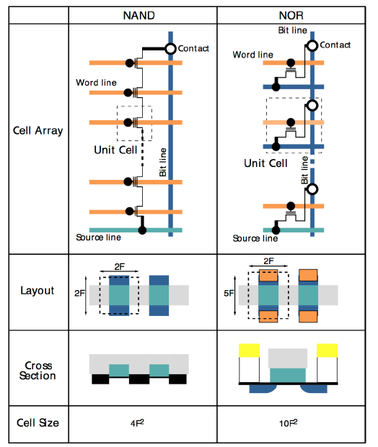
Flash Cell Construction
F = Feature size.
NOR is 2.5x NAND cell size
NAND Flash is very similar to a hard-disk drive. It is sector-based (page-based) and well suited for storage of sequential data. Random access can be achieved at the system level by shadowing the data to RAM, requiring RAM storage.

Slide 3
What type of FLASH for your controller?
Microcontroller
  Smaller code size
  NOR based
    Fast random access to memory locations
    Fast access times
    All good bits
Microprocessor or DSP
  Larger code size
  NAND based and moving to eMMC
    Download executable code into SRAM for execution
    Need ECC support to handle bad bits
    Lower cost for larger code and storage requirements

Slide 4
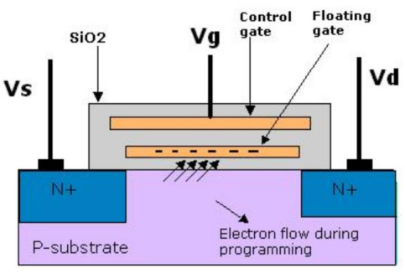
Working Principle:
Flash stores the data by removing or putting electrons on its floating gate (see fig 5). Charge on floating gate affects the threshold of the memory element. When electrons are present on the floating gate, no current flows through the transistor, indicating a logic-0. When electrons are removed from the floating gate, the transistor starts conducting, indicating a logic-1. This is achieved by applying voltages between the control gate and source or drain.

Slide 5
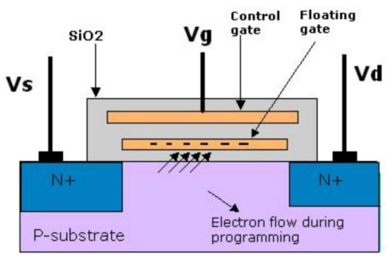
Erase Operation:
The raw state of flash memory cells will be bit 1's, (at default state) because floating gates carry no negative charges. Erasing a flash-memory cell (resetting to a logical 1) is achieved by applying a voltage across the source and control gate (word line). The voltage can be in the range of -9V to -12V. And also apply around 6V to the source. The electrons in the floating gate are pulled off and transferred to the source by quantum tunneling (a tunnel current). In other words, electrons tunnel from the floating gate to the source and substrate.

Slide 6
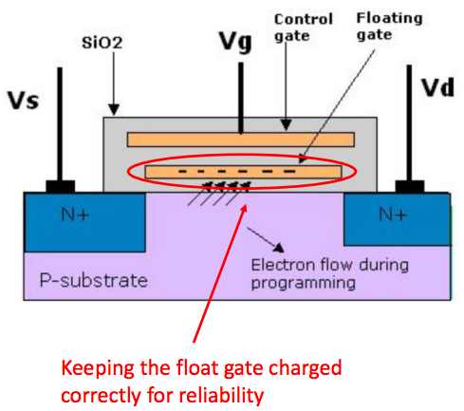
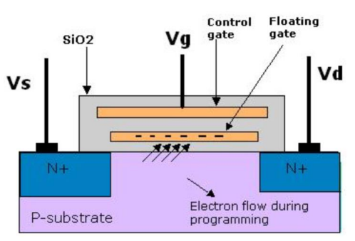
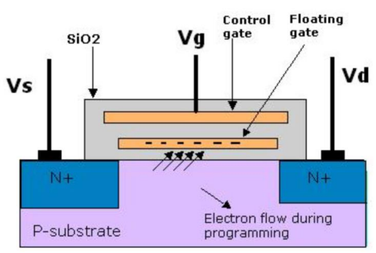

Write Operation.
Read Operation.

Slide 7
Failures due to over cycling Erase/Write operations:
• Cycling Endurance - Each PROGRAM/ERASE operation can degrade the memory cell, and over time, the accumulation of cycles can prevent the device from meeting power, programming, or erasing specifications or from reading the correct data pattern.
• Data Retention - The dominant wear mechanism for charge loss and gain in NOR Flash memory occurs through electron trapping in the tunnel oxide of the Flash cell. This results in leakage through the insulator, and the damage primarily occurs during the ERASE/WRITE operations of a cell.

Slide 8
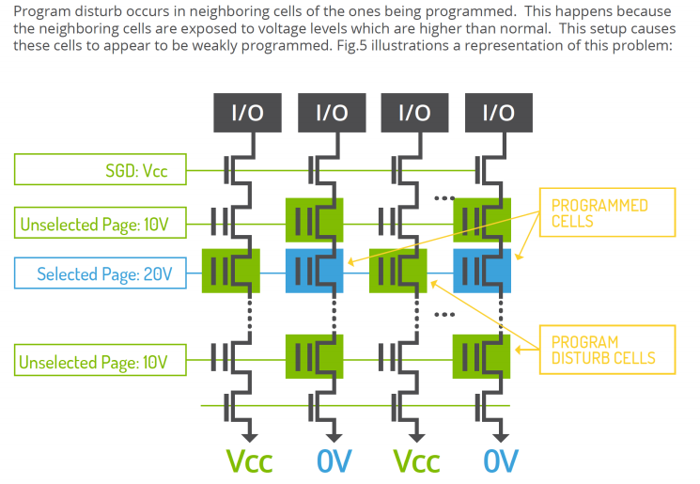
Write Disturb:
A write disturbed error would result in a “1” bit going to a “0.
Note: MLC NAND is more sensitive to Program/Write disturb due smaller voltage margin per state.

Slide 9
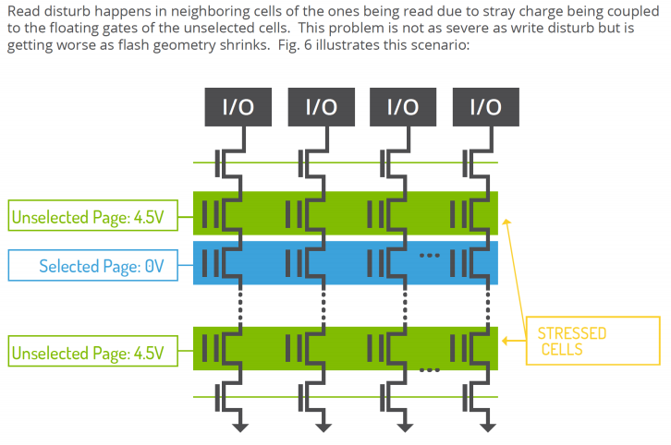
Read Disturb:
A read disturbed error would result in a “1” bit going to a “0.”
Read disturb errors only occur on the adjacent cells, and not the cell read.

Slide 10
How to work around NAND failure modes?
• Dynamic Wear Leveling - When applying the dynamic wear leveling, new data is programmed to the free blocks (among blocks used to store user data) that have had the fewest WRITE/ERASE cycles.
• Static Wear Leveling - With static wear leveling, the content of blocks storing static data (such as code) is copied to another block so that the original block can be used for data that is changed more frequently. Static wear leveling is triggered when the difference between the maximum and the minimum number of WRITE/ERASE cycles per block reaches a specific threshold. With this particular technique, the mean age of physical NAND blocks is maintained constant.

Slide 11
Quick review:
Programming results in a 0 in NAND memory.
0s can be written as a single bit, byte, or words to a NAND flash memory cell. (Not 1s)
1s can be written as segment wise to a NAND flash memory cell. (Not 0s)
Temperature is the main influence on NAND memory data retention.
Single bit data retentions failures are not erroneous 0s, but erroneous 1s.
Write disturb can result in NAND logical 1 becomes erroneous 0.

Slide 12
Differences between NOR and NAND Flash
• NOR
Quick random access to any memory location
100% known good bits for the life of the part
Good for direct code execution
Fast program and erase cycles
Density: 1Mbit – 2Gbit
Larger cell and more expensive
• NAND
Slow initial access read access, then faster sequential reads
98% bits are good when new and additional bits fail over time (ECC is required)
Good for data storage
Slower program and erase cycles
Density: 128Mbit – 1Tbit
Smaller cell and less expensive

Slide 13
SSD - Solid State Drive
Solid State drive uses the industry standard NAND flash memory as the storage medium, as a replacement for traditional rotating disks.
An SSD is better suited for small block, random workloads, where there are lot of concurrent requests for data.
Two major components in an SSD
Multiple NAND flash memory chips (for capacity) 2) SSD Controller
The performance of the NAND-based SSDs is one of the obvious distinction with HDD. SSDs have no mechanical armature to move and thus provide random data read access times that are significantly faster than those of HDDs.
Current NAND flash that is used to construct SSDs is based on two types of technologies: single-level cell (SLC) and multilevel cell (MLC). Today’s MLC NAND effectively stores 2 bits at four different voltage levels in a given cell, as opposed to SLC, which stores only 1 bit at two distinct voltage levels. The result is twice the capacity for the devices using MLC technology compared with SLC technology.
But, because both SLC and MLC NAND use a voltage threshold window with a similar size, the tolerance between adjacent voltage levels in MLC is much smaller than in SLC NAND. This precise distribution of charge is difficult hence, have higher probability of error. Also additional program cycles are required to operate MLC NAND. This causes MLC NAND to wear out faster.

Slide 14
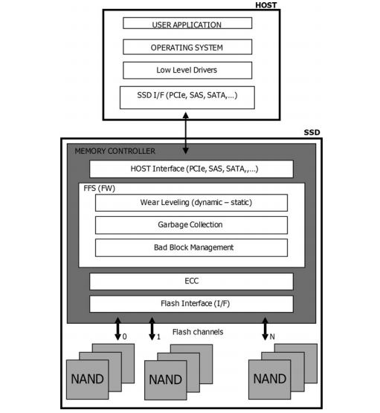
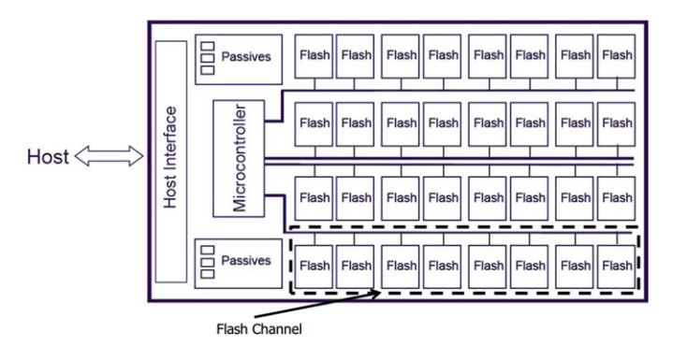
SSD block diagram & Controller
Fig 1. Block diagram of a SSD
Fig 2. Flash Controller

Slide 15
SSD Controller
Another critical component, SSD controller acts as the brain of the SSD and manages all interactions between the different SSD components. The SSD controller typically contains a microprocessor, a buffer memory, and an interface to the host device.
SSD controller must perform the following tasks.
Host Interface Protocol Management – protocols like SATA, SAS, Fibre channel, PCIe
Bad Block Mapping (use of overhead blocks) – when NAND flash block goes bad, SSD remap the block from a pool of spare blocks
Caching and power-fail protection – For data caching as we use small amount of DDR SDRAM for frequent read/write (speed up), note that DRAM is volatile, data lost during power outage or drive removal. To avoid this SSDs have secondary power circuit(batteries or capacitors) to allow time to flush the cached data.
Data Compression – uses compression engine
Data Encryption – prevent data theft, uses encryption engine
Wear Leveling – NAND flash can wear out over time. Each block has finite P/E cycles before wear out. To prevent single block from wearing out earlier, SSD controller maintain a history of how many times each block has been erased/programmed and spread the writes evenly among all available blocks. This is static wear leveling. There is also dynamic WL, writing to free / unused blocks.

Slide 16
PCIe interface
7. Garbage Collection – Previously written-to blocks must be erased before they are able to receive data again, SSD controller must actively pre-erase blocks, so new write commands always get an empty block.
8. Error Correction codes – ECC is used to detect & correct errors by adding additional bits of data. Effective ECC improves time to wear-out.
Emerging Trends ?
PCIe-based SSDs: (Peripheral Component Interconnect Express)
NVMe (Non-Volatile Memory Express) is a communications interface and driver that defines a command set and feature set for PCIe-based SSDs.
NVMe was designed for SSD. It communicates between the storage interface and the System CPU using high-speed PCIe sockets, independent of storage form factor. It provides an optimized command set.

Slide 17
eMMC – Embedded Multimedia Card
eMMC is an embedded non-volatile memory system, combining an embedded flash controller and NAND flash memory integrated on the same silicon die using MCP technology.
eMMC intelligent controller manages functionality like interface protocols, ECC algorithms, wear levelling, bad block management, power management, clock control.
It is a managed memory, which defines a mechanism for indirect memory accesses to the memory array.
This indirect access is often enabled by a separate controller.
The advantage of indirect memory access is that the memory device can perform several background memory management tasks without the involvement of the host software.
The eMMC solution consists of three components - the MMC (multimedia card) interface, the flash memory, and the flash memory controller - and is offered in a standard BGA (ball grid array) package.
eMMC eliminates the need to develop interface software for all types of NAND memory by integrating the embedded controller into the memory chip

Slide 18
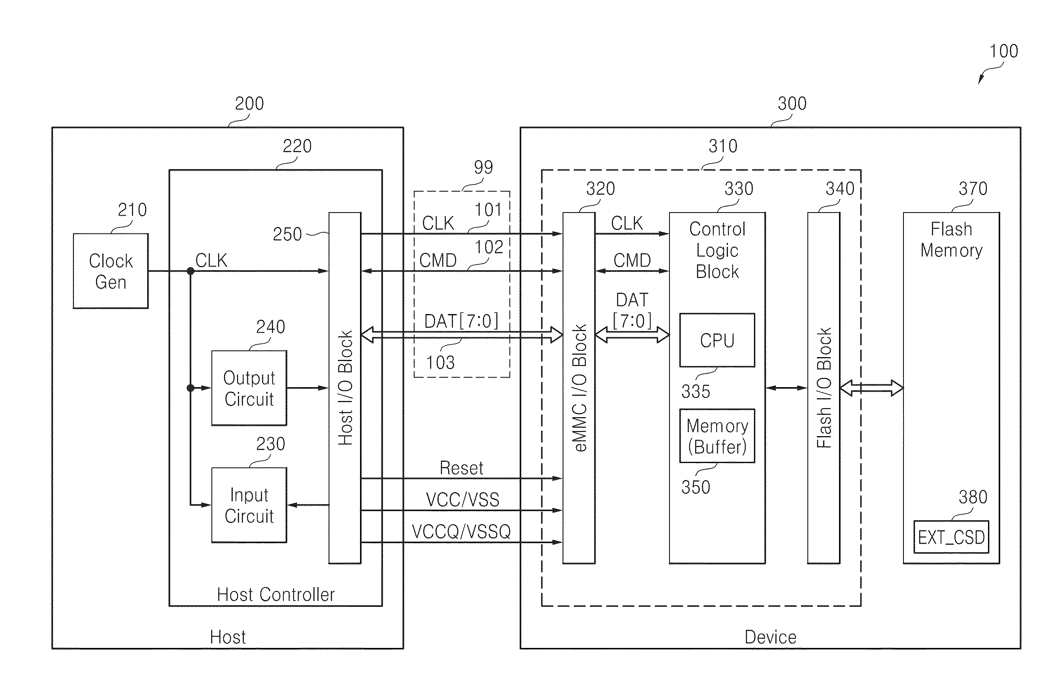
System Overview
Fig 3. eMMC and Host block diagram

Slide 19
Operating Modes of eMMC
The host controls transmission between host and card. Its control commands are two types: Broadcast(all MMC cards) and Addressed(particular MMC card).
The eMMC has 5 operating modes.
Boot mode: After Power ON, if card receives CMD0 with argument of 0xF0F0F0F0 then it will enter Boot Mode. If boot mode is not supported it enters card identification mode.
Card identification mode : If card doesn’t support Boot Mode, card enters this mode after power on, otherwise enters after boot mode. The device will be in this mode, until it receives CMD3 (Send Relative Address) from the host.
Interrupt mode : Host and card this mode at the same time. In interrupt mode there is no data transfer. The only message allowed is an interrupt service request from the card or the host.
Data transfer mode: The card will enter data transfer mode once the device RCA is received from the host. The card waits for read/write command.
Inactive mode : The card will enter inactive mode either due to incorrect voltage or invalid inserting. The device can also enter inactive mode with GO_INACTIVE_STATE command (CMD15). The device will reset to Pre-idle state with power cycle.

Slide 20
Packet and Response
There are 5 packets in eMMC protocol: Command, Response, Block, CRC, Status and Busy.
Command : Command transmitted by the host with parameters.
Response : The response card makes to the command. Its inside parameters indicate device current status.
Block : Basic unit in eMMC transmission protocol.
CRC status: It is after writing the block, used to notify the host about the result of writing the block.
Busy : It is always after writing the block, used to modify the host that the device is busy and can’t write the next block.
Responses: Response type determines response length.
R1, R3,
R4, R5
0 | 0 | CONTENT | CRC | 1
Transmitter bit, Start Bit, Response Content, 7 bit CRC checksum, end bit always 1, total 48 bits
R2
0 | 0 | CONTENT = CID or CSD | CRC | 1
Total 136 bits
R1 – normal response command, R2 – CID, CSD register, R3 – OCR register, R4 – Fast I/O, R5 – Interrupt request

Slide 21
Communication signals and Registers
The communication signals that are used are:
CLK : Host to device signal. Each cycle of this signal directs a one bit transfer on the command and either a one bit or a two bits transfer on all the data lines.
CMD: Bidirectional command channel used for device initialization and transfer of commands. The CMD signal has two operation modes: open-drain for initialization mode, and push-pull for fast command transfer.
(I/O) DAT0-DAT7 : Bidirectional data channels, operate in push-pull mode. Only the device or the host uses at a time. After power up or reset, only DAT0 is used for data transfer.
The registers present in eMMC are listed below:
CID: Card Identification Number
RCA: Relative Device Address, device system address, dynamically assigned by host during initialization.
DSR: Driver State Register, to configure device’s output drivers.
CSD: Device specific data, information about device operating conditions.
OCR: Operating conditions register
EXT_CSD: Extended Device Specific data. Info about device capabilities & selected modes.

Slide 22
eMMC-4.4 & 4.5Emerging Trends
eMMC 4.3 – 2 boot partitions and 1 user data partition.
eMMC 4.4 – RPMB (Replay Protect Memory Block) partition is added, which prevents illegal data copy/access. Only handled by SHA-256 security key, comparing MAC tokens.
TRIM – Mark data that is invalid, Secure TRIM/ERASE – marks data that is logically deleted. Then secure purge operation is executed. (merges valid data into new block)
HPI – High Priority Interrupt, stops ongoing write operation and read data within specific time. If read/write partition is different, additional partition switching time is needed changing partition.
Background Operation – Host gives free time to the device, during this time device can do housekeeping like merge operation.
Legacy read vs Packed read – Packed read reduces # of discrete I/O CMD processing -> higher read/write IOPS.
Packed read – Internal data processing can be pipelined if there are multiple flash chips that can operate in parallel.
Cached Write – Buffers write operations that usually come in burst -> higher write IOPS, shorter write latency.
Sanitize – purge unused data at once

Slide 23
UFS – Universal Flash Storage
Universal Flash Storage (UFS) is a simple, high performance, mass storage device with a serial interface.
It is primarily for use in mobile systems, between host processing and mass storage memory devices.
This could bring higher data transfer speed and increased reliability in flash memory storage, thus reducing market confusion and the varying number of adapters for different number of cards
Target host applications : Mobile phone, UMPC, DSC, PMP, MP3 and any other applications that require mass storage, bootable mass storage, and external card
The electrical interface for UFS uses the M-PHY, developed by the MIPI Alliance organization.

Slide 24
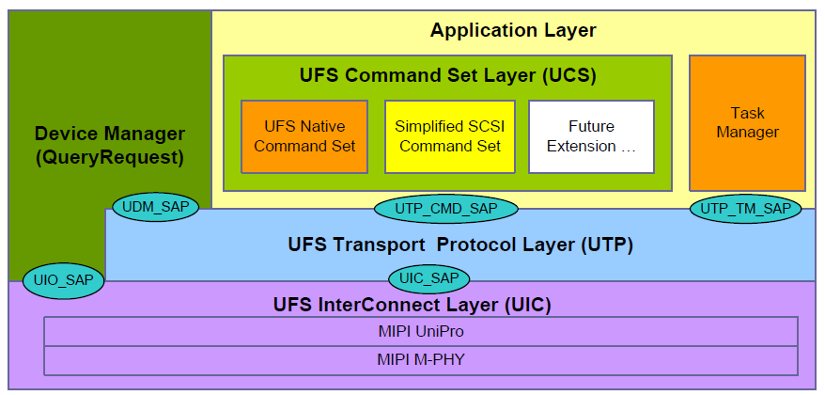
UFS Architecture overview
Source: JESD220B URL: https://www.jedec.org/standards-documents/results/jesd223b

Slide 25
UFS Architecture
Application Layer : The application layer consists of the UFS command set layer (UCS), the device manager and the Task Manager
UFS Interconnect (UIC) Layer : UFS interconnect layer is composed by MIPI UniPro, which provides basic transfer capabilities to the upper layer (UTP), and MIPI M-PHY, adopted as UFS physical layer.
UFS Transport Protocol (UTP) Layer: A design feature of UTP is to provide a flexible packet architecture that will assist the UFS controller in directing the encapsulated command, data and status packets into and out of system memory.
A second feature of the UTP design is that once a device receives a command request notification from the host, the device will control the pacing and state transitions needed to satisfy the data transfers and status completion of the request.

Slide 26
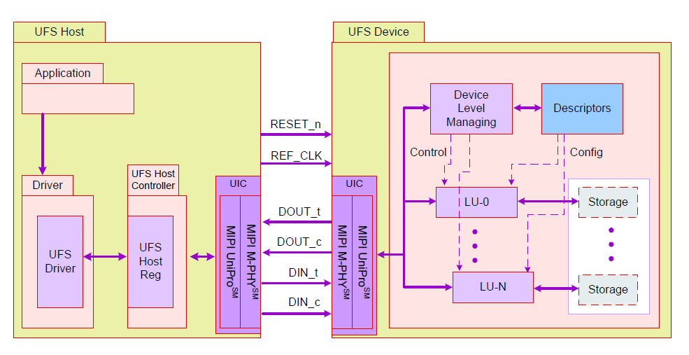
UFS System Model
Source: JESD220B URL: https://www.jedec.org/standards-documents/results/jesd223b

Slide 27
UFS System Model
The UFS host consists of the application which wishes to communicate with the UFS device. It communicates with the device using the UFS driver.
The UFS driver is meant for managing the UFS host controller through the UFS-HCI (UFS Host Controller Interface). The UFS-HCI is basically a set of registers exposed by the host controller.
The UFS Interconnect (UIC) Layer consists of MIPI UniPro and MIPI M-PHY. The physical layer M‐PHY is differential, dual simplex PHY that includes TX and RX pairs.
Potential UFS devices can be memory card (full size and micro size), embedded bootable mass storage devices, IO devices etc.
The device manager performs device level functions like power management while the logical unit performs functions like read, write etc

Slide 28
UFS – host (microcontroller) interface
The UFS host controller must have an MIPI M-PHY interface to communicate with the UFS controller
The REF_CLK and RESET signals need to be provided to the UFS controller by the host.
The Data In and Data Out signals which enable data transfer should be provided to the UFS controller via M-PHY interface.
The host controller can use GPIO to configure and M-PHY interface at its end
The driver software for UFS will include initialisation of UFS controller via M-PHY interface, read and write operations

Slide 29
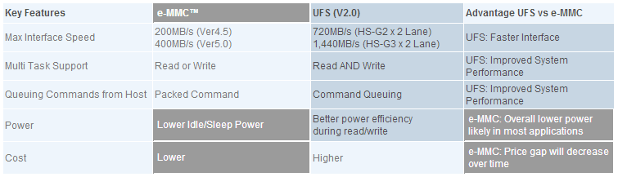
eMMC vs UFS comparison
  High speed serial interface compared to eMMC, which is a parallel interface.
  Ease of integration into embedded applications.
  Full duplex read/write operations.
  Uses the SCSI architectural model, unlike eMMC.
  Overall low power consumption, due to faster read/write operations and more idle time.

Slide 30
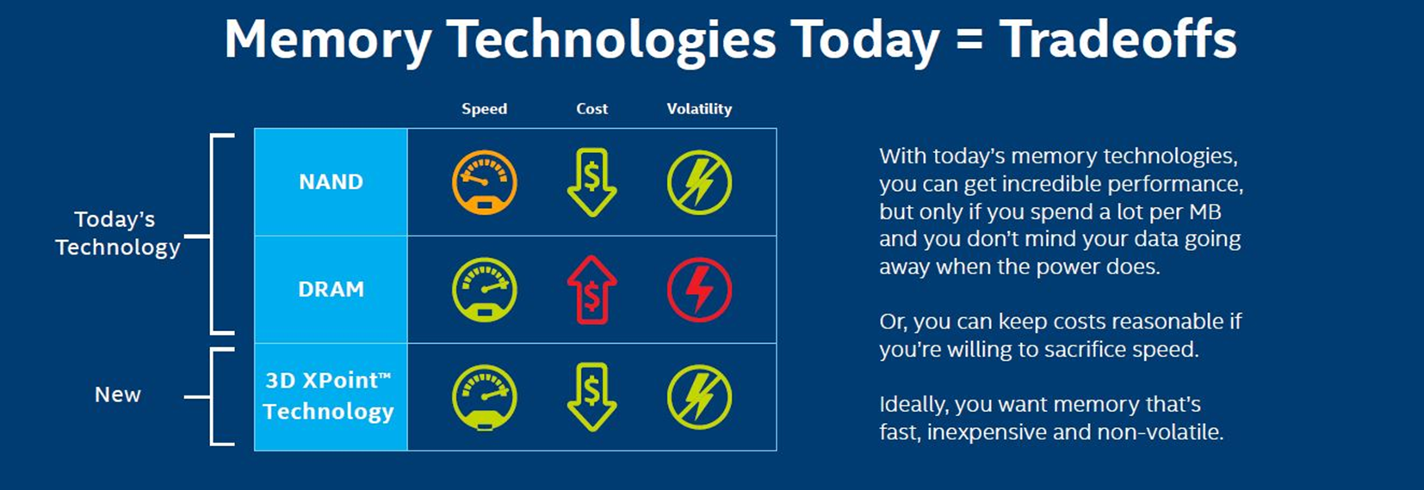
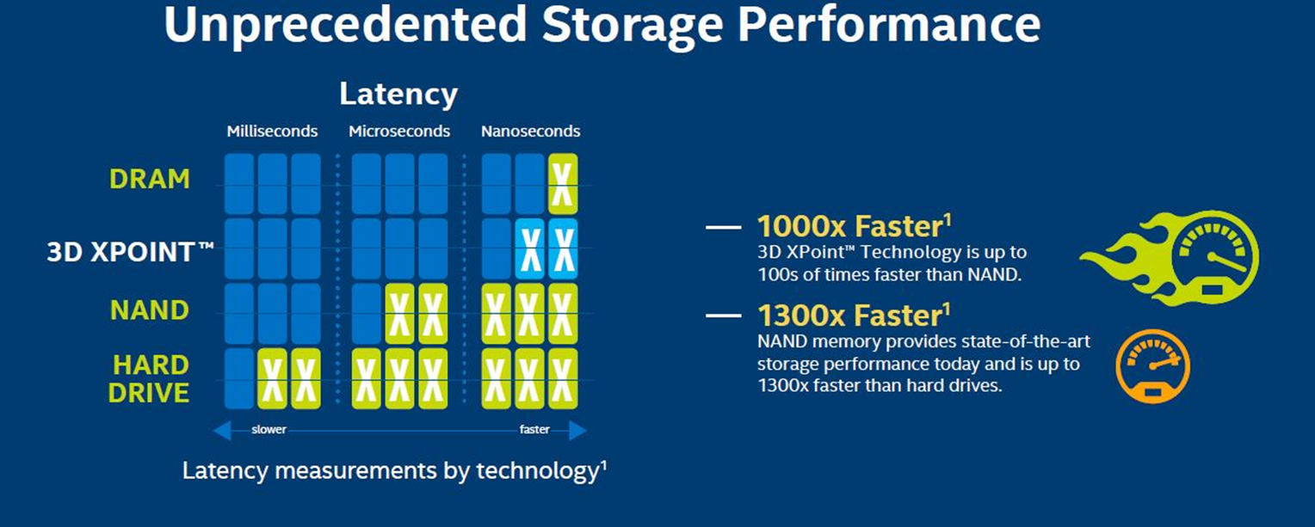
Introduction to 3D XPoint Technology
Intel and Micron have unveiled in July 2015, their all-new memory technology called 3D XPoint (pronounced "cross-point"). This is a new class of memory that can be used both as system memory as well as non-volatile storage. In other words, 3D XPoint can be used to replace both a computer's RAM and its solid-state drive (SSD).
The companies claim that 3D XPoint is a major breakthrough in memory process technology, the first new memory category since the introduction of NAND flash in 1989. It's said to be extremely fast and durable, up to 1,000 times faster (both in read and write speeds), and it will have higher endurance than existing NAND Flash memory currently being used in SSDs. What's more, it also has as much as 10 times greater density, leading to much more storage capacity in the same physical space, while remaining as energy efficient and affordable as existing NAND flash memory.

Slide 31
3D XPoint Technology Architecture
XPoint is made from Phase Change Memory material, a chalcogenide glass, and it has electricity applied to it, causing a bulk change in some aspect of its state that causes a resistance-level change. This can be reversed, leading the resistance levels signaling a binary 1 or zero. The XPoint die has two layers and a crossbar design, hence its full 3D CrossPoint name.
The 3D XPoint technology innovative, transistor-less cross point architecture creates a three-dimensional checkerboard where memory cells sit at the intersection of word lines and bit lines, allowing the cells to be addressed individually. As a result, data can be written and read in small sizes, leading to fast and efficient read/write processes.

Slide 32
Characteristics of 3D XPoint Technology
Cross-point array structure: Perpendicular conductors connect 128 billion densely packed memory cells. Each memory cell stores a single bit of data. This compact structure results in high performance as well as high-density bits.
Stackable: In addition to its tight cross-point array structure, memory cells are stacked in multiple layers. The initial technology stores 128 gigabits per die across two memory layers. Future generations of this technology may increase the number of memory layers, in addition to traditional lithographic pitch scaling, thus further improving system capacities.
Selector: Memory cells are accessed and written or read by varying the amount of voltage sent to each selector. This eliminates the need for transistors, increasing capacity while reducing cost.
Fast-switching cell: With its small cell size, fast-switching selector, low-latency cross-point array and fast-write algorithm, the cell is able to switch states faster than any existing nonvolatile memory technology.

Slide 33
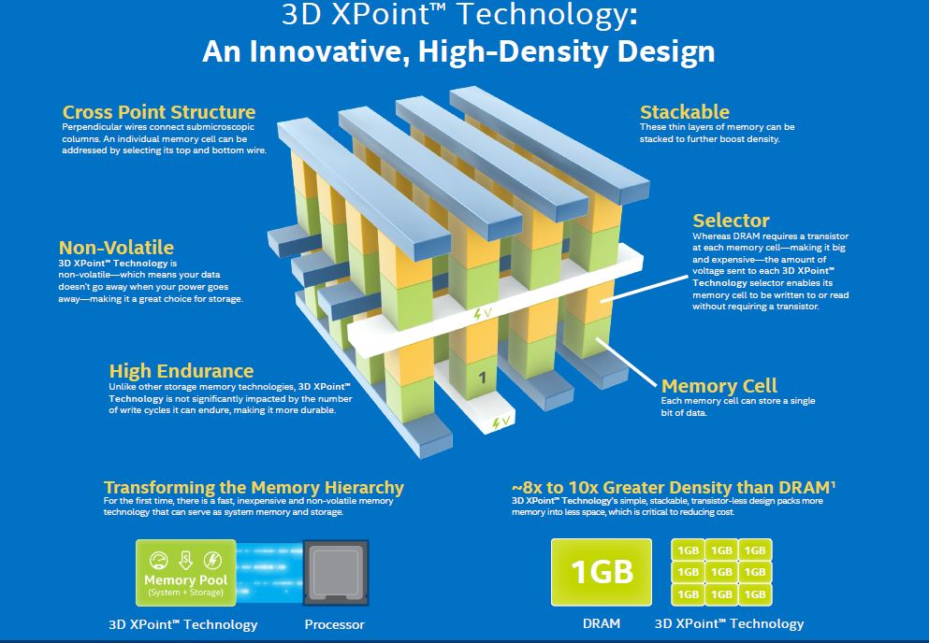
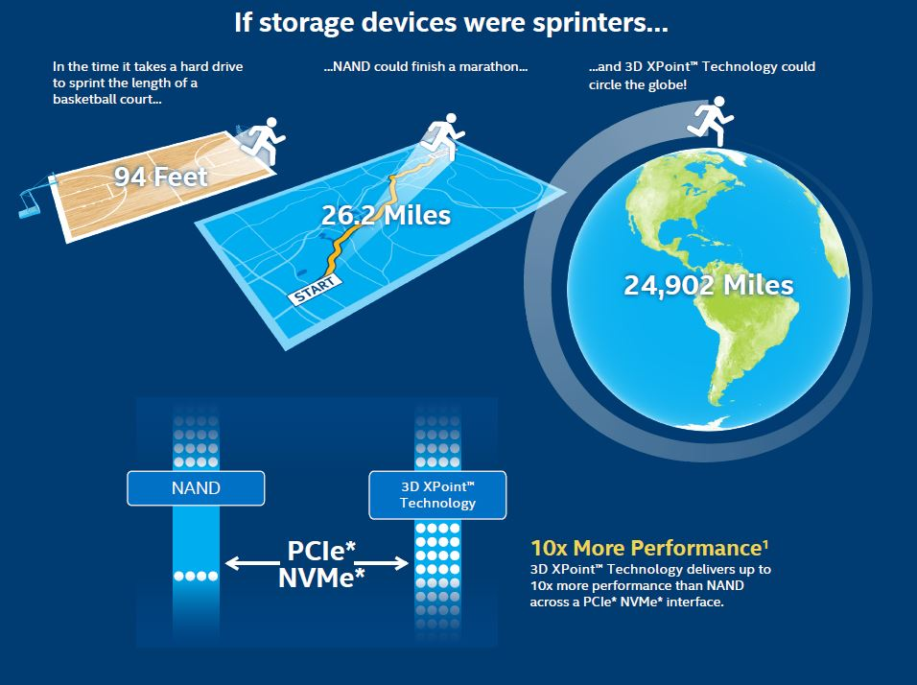
Source : http://www.intel.com/content/www/us/en/architecture-and-technology/intel-optane-technology.html

Slide 34
Intel® Optane™ Technology
This technology is a unique combination of 3D XPoint™ memory media, Intel Memory and Storage Controllers, Intel Interconnect IP and Intel® software. Together these building blocks deliver a revolutionary leap forward in decreasing latency and accelerating systems for workloads demanding large capacity and fast storage.
The first Intel Optane storage products should begin shipping soon, and it’s expected to show up in some laptop and desktop computers that launch in early 2017.
Intel co-developed 3D Xpoint technology with Micron, and PC World reports that Micron plans to launch its own products based on the technology by the end of the year.
While Intel’s first Optane products include relatively small storage drives that’ll be combined with higher-capacity SSDs or hard drives to offer a speed boost to PCs, Micron is said to be focusing on solutions for high-end PCs and servers.
Micron calls its 3D Xpoint products QuantX, and the company plans to offer both SSD and DRAM based on the technology.

Slide 35
THANK YOU!

Slide 36
REFERENCES
SSD and eMMC:
http://www.seagate.com/files/staticfiles/docs/pdf/whitepaper/storage-device-longevity-us.pdf
http://www.panasas.com/sites/default/files/uploads/docs/Whitepapers/SOLID%20STATE%20DRIVES%20AND%20PARALLEL%20STORAGE.pdf
http://docs-asia.electrocomponents.com/webdocs/12b9/0900766b812b9eb5.pdf
https://www.google.ch/patents/US20140082269
http://www.zeroplus.com.tw/software_download/201207-eMMC_en.pdf
https://www.slideshare.net/linaroorg/intro-to-emmc
UFS:
JESD220A URL: https://www.jedec.org/standards-documents/results/jesd223b
http://www.design-reuse.com/articles/25953/vertically-integrated-mipi-solutions.html
http://en.wikipedia.org/wiki/Universal_Flash_Storage
http://www.samsung.com/us/business/oem-solutions/events/techday2013/PDFs/QTD_SCKwon_Yejin%20Moon_Karin_Werder_Mobile_final.pdf
http://universalflash.org/wp-content/uploads/2011/06/1306_UFSA_White_Paper.pdf
http://en.wikipedia.org/wiki/Low-voltage_differential_signaling
http://global.samsungtomorrow.com/emmc-to-ufs-how-nand-memory-for-mobile-products-is-evolving/
3D XPoint Technology
http://www.intel.com/content/www/us/en/architecture-and-technology/intel-optane-technology.html
https://en.wikipedia.org/wiki/3D_XPoint
https://www.intelsalestraining.com/infographics/memory/3DXPointc.pdf
https://www.cnet.com/news/intel-and-micron-debut-3d-xpoint-storage-technology-thats-1000-times-faster-than-existing-drives/
https://newsroom.intel.com/press-kits/introducing-intel-optane-technology-bringing-3d-xpoint-memory-to-storage-and-memory-products/
https://www.micron.com/about/our-innovation/3d-xpoint-technology
https://www.youtube.com/watch?v=Wgk4U4qVpNY
https://www.slideshare.net/JunlinLu1/3d-xpoint-67659714
https://liliputing.com/2017/02/microns-quantx-3d-xpoint-storage-coming-late-2017-will-challenge-intel-optane.html

