Slide 1
Preliminary Design Review
Design and Implementation of Dynamic Scheduler on Real Time OS

Slide 2
Overview
The use of computers to control safety-critical real-time functions has increased rapidly over the past few years. As a consequence, real-time systems — computer systems where the correctness of a computation is dependent on both the logical results of the computation and the time at which these results are produced — have become the focus of much study.
Real-time systems have to complete the execution of a task within the predetermined time while ensuring the execution results are logically correct.
The scheduler forms the most important part of a kernel for a Real Time Operating System as the adherence to the timing requirements of the system largely depends on the algorithm used for scheduling the tasks.
In addition to providing these functions, such systems also have to satisfy basic requirements such as reliability, predictability, and adaptability in single-processor and multiprocessor environments.

Slide 3
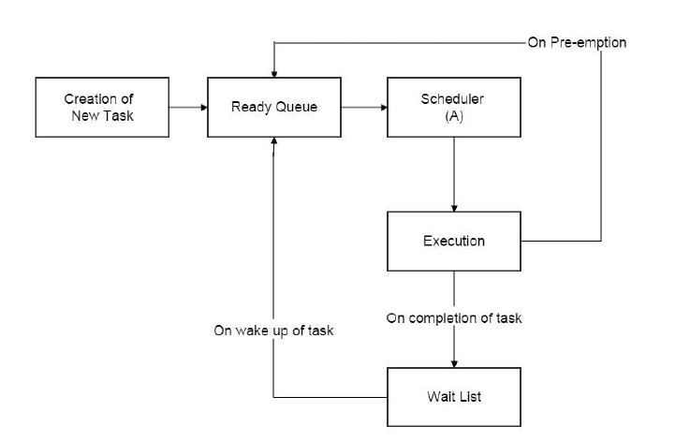
Block Diagram of Implementation

Slide 4
Objectives
Validating that the processor utilization is maximized in the dynamic scheduler under fully loaded conditions and demonstrate cases where a static scheduler fails to be an efficient algorithm, in comparison with a dynamic scheduler, for scheduling tasks in hard real time systems having a single core.
Designing a dynamic scheduling algorithm using Earliest Deadline First (EDF) and Least Slack Time (LST) algorithm.
Validating that the LST is a better algorithm as compared to EDF algorithm.
Considering a pre-emptive kernel running periodic, aperiodic and sporadic tasks with no precedence constraints. Mutex and semaphore concepts will be being used for synchronisation & resource sharing.

Slide 5
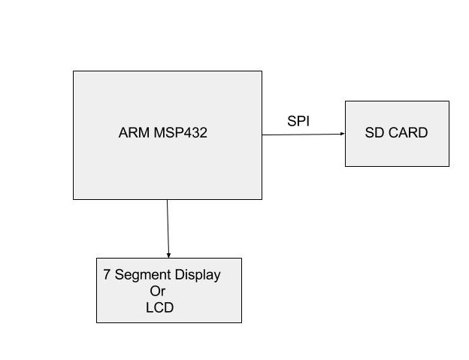
Hardware Block Diagram

Slide 6
Project Deliverables
Display of the current task executing on a 7 segment display or a LCD.
Time stamp of task execution using RTC is logged onto the SD card.
Using an IDE to prove :
Dynamic Scheduling is more efficient than Static Scheduling.
Comparison of LST and EDF scheduling algorithms.

Slide 7
Fall Back Plan
To be able to design an algorithm for dynamic scheduling and log its details successfully into the SD card.
Comparison between dynamic and static scheduling.

Slide 8
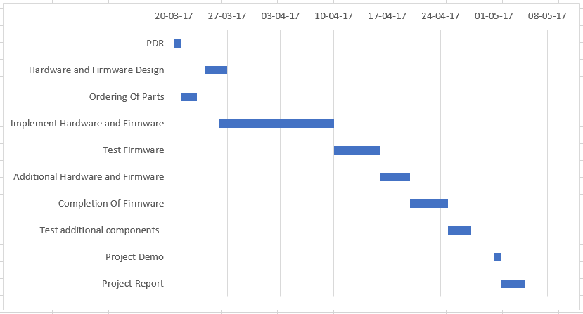
Timeline

Slide 9
Additional Objectives
Interfacing an external EEPROM
Information about which task is being executed is displayed on LCD
Interfacing an external temperature sensor

Slide 10
THANK YOU!

