Slide 1
Final Project Demo
Design and Implementation of Dynamic Scheduler on Real Time OS
ECEN 5613
Embedded Systems Design

Slide 2
Objectives
Validating processor utilization while using a dynamic scheduler under fully loaded conditions and demonstrate cases where a static scheduler fails to be an efficient algorithm, in comparison with a dynamic scheduler.
Designing a dynamic scheduling algorithm using Earliest Deadline First (EDF) and Least Slack Time (LST) algorithm.
Validating that the LST is a better algorithm as compared to EDF algorithm.

Slide 3
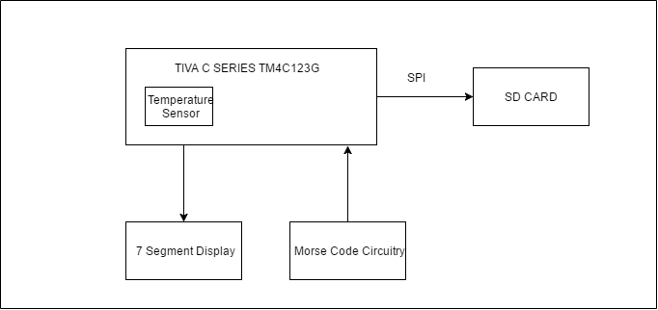
Hardware Block Diagram

Slide 4
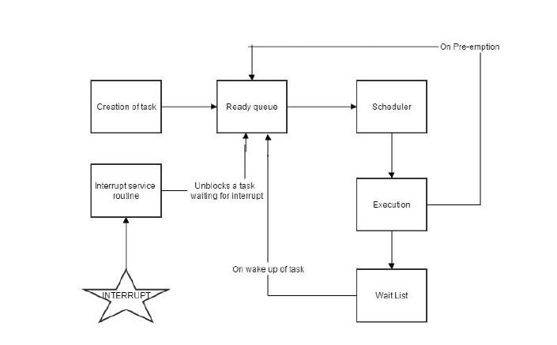
Software Block Diagram

Slide 5
Challenges
Choice of operating system-Sys/BIOS and FreeRTOS.
Understanding and implementing scheduling.
Choosing appropriate execution time and deadline.
SD Card frequency issue.

Slide 6
THANK YOU!

