Slide 1
Wi-Fi and Antenna Diversity
By
Riya Biswas
Shreyas Vasanthkumar

Slide 2

Wi-Fi- Introduction
“Wireless Fidelity” .
Specified in the 802.11b specification from the Institute of Electrical and Electronics Engineers (IEEE).
Operates in the unlicensed 2.4 and 5 GHz radio bands, with an 11 Mbps (802.11b) or 54 Mbps (802.11a) data rate, respectively.
Wi-Fi alliance specifies standards
“Wi-Fi Certified” trademarked by the Wi-Fi Alliance devices.

Slide 3
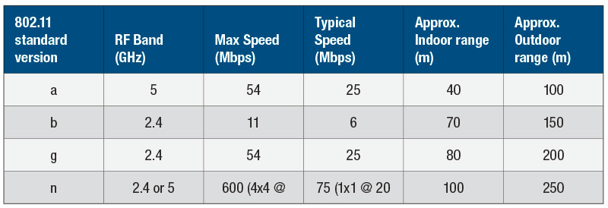
IEEE Standards
IEEE 802.11 is a set of media access control (MAC) and physical layer (PHY) specifications for implementing wireless local area network (WLAN) computer communication in the 900 MHz and 2.4, 3.6, 5, and 60 GHz frequency bands.
Many versions were present within 802.11 standards as mentioned below
Source: www.rtcmagazine.com

Slide 4
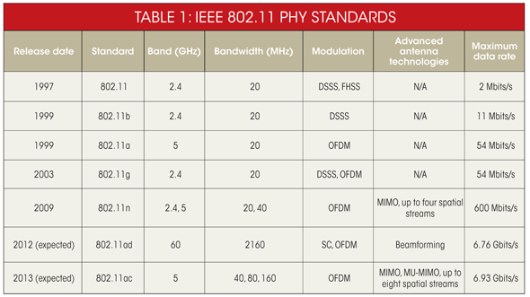
Wi-Fi Standards
2012
2013
802.11ac is the newest generation of Wi-Fi signaling. utilizes dual band wireless technology, supporting simultaneous connections on both the 2.4 GHz and 5 GHz Wi-Fi bands. 802.11ac offers backward compatibility to 802.11b/g/n and bandwidth rated up to 1300 Mbps on the 5 GHz band plus up to 450 Mbps on 2.4 GHz. However it is more expensive and is still prone to interference on the 2.4 GHz band.

Slide 5
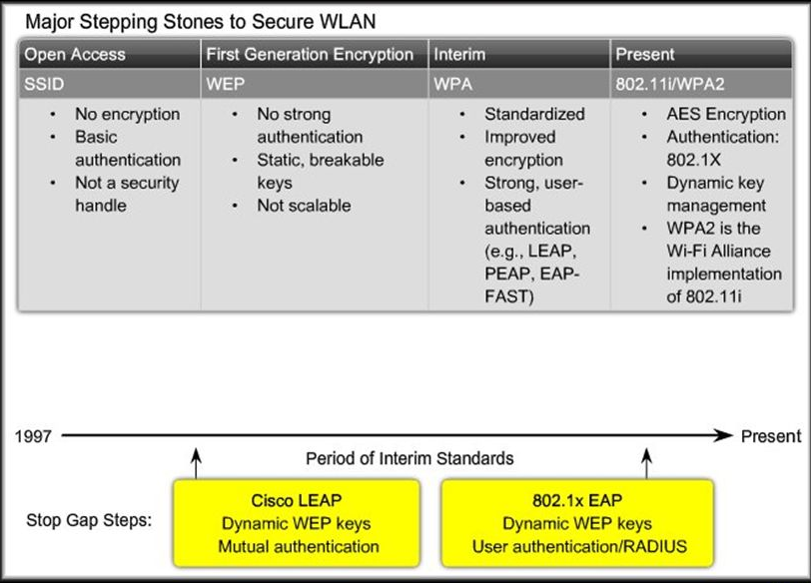
Security Protocols
There are three standard wireless security protocols for WLAN(Wireless Area Networks):
WEP
WPA
WPA2
Source: www.cisco.com

Slide 6
Wi-Fi Operating modes
Infrastructure Mode
Wireless clients are connected to an access point. This is generally the default mode for 802.11b cards.
Ad-Hoc Mode
Clients are connected to one another without any access point.
Wi-Fi Mesh Network
Form of wireless ad hoc network. a communications network made up of radio nodes organized in a mesh topology

Slide 7
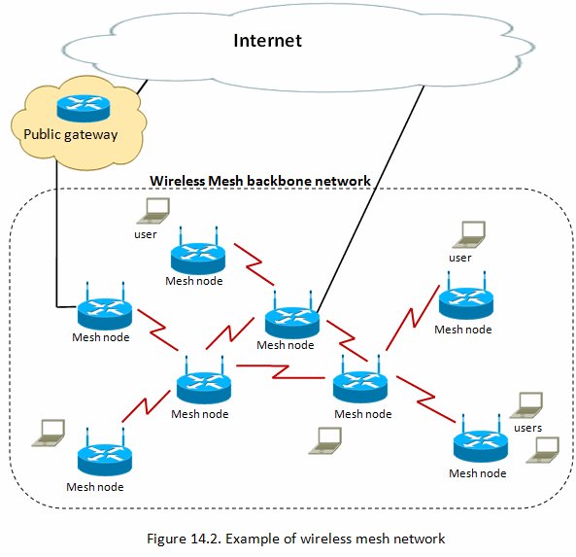
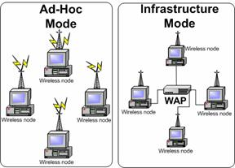
Wi-Fi Operating modes
Source: www.virtual.cpcc.edu
Source: www.extrememetech.com

Slide 8
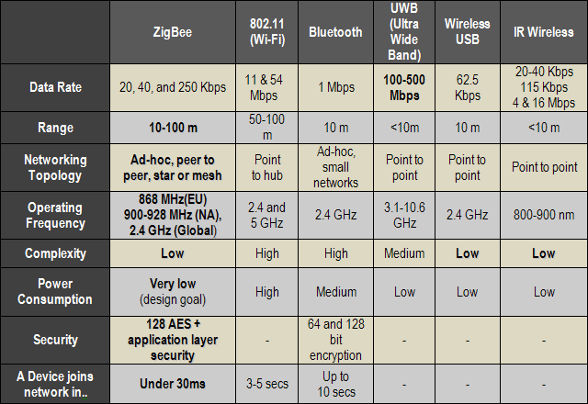
Wi-Fi in Embedded Applications
Advantages
Convenience
Mobility
Productivity
Deployment
Expandability
Cost
Disadvantages
Security
Reliability
Range
Speed
Source: www.dailywireless.org

Slide 9

Wi-Fi and IOT(Internet Of Things)
Wi-Fi is the technology of choice for Internet of Things
Provides Standardized Technology for connecting devices to each other or the cloud.
Needs of protecting privacy and security is very high.
Energy efficiency and maintenance overhead play a major role
Source: www.econais.com

Slide 10
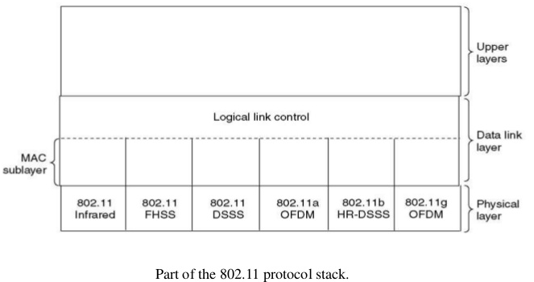
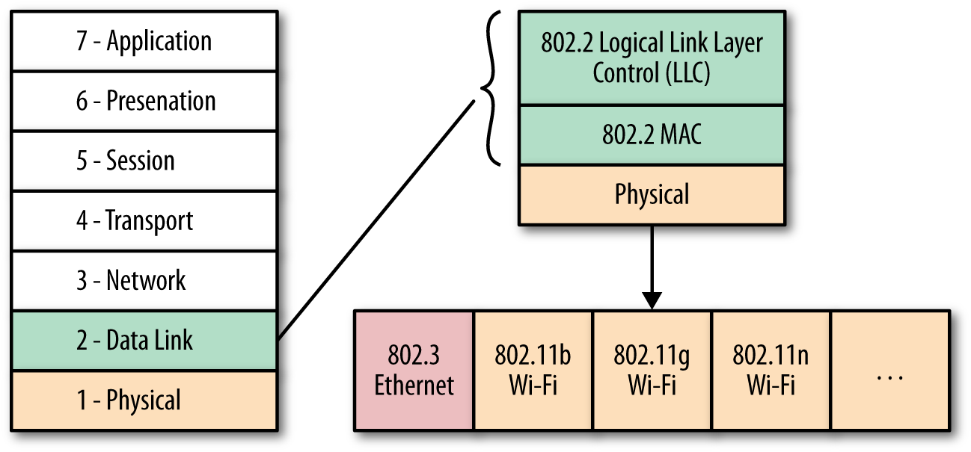
Wi-Fi Protocol Stack
Source:www.johndoyle.ie
source: www.wikimedia.org

Slide 11
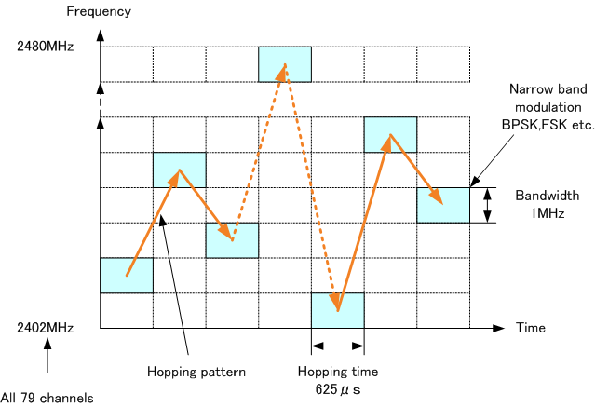
Wi-Fi Physical Layer
Infrared
- Two speeds: 1 Mbps or 2 Mbps.
- Range: 10 m to 20 m, cannot
penetrate walls
FHSS
(Frequency Hopping Spread Spectrum)
-79 overlapping channels each 1 MHz
wide at low end of 2.4 GHz ISM band
-Same pseudo-random number
generator used by all stations
-Cons: Multipath fading
Source:www.cd21.com/resources/Modulation

Slide 12
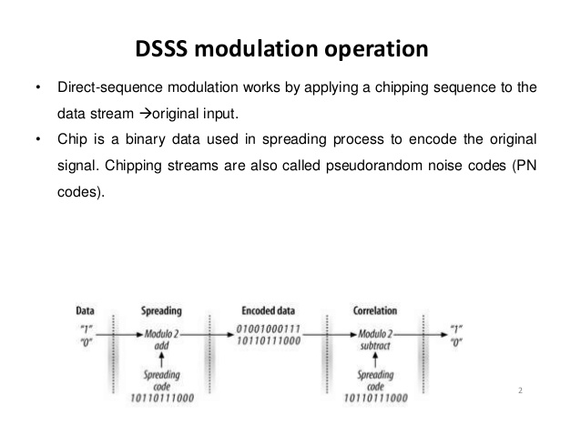
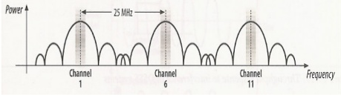
DSSS (Direct Sequence Spread Spectrum)
- Spreads signal over entire spectrum
using pseudo random sequence
-Each bit transmitted using 11 chip
Barker Sequence
-1 or 2 Mbps
DSSS modulation technique
HR-DSSS (High Rate DSSS)
-Up to 11 Mbps in 2.4 GHz band using 11
million chips/sec
-Channels 1, 6 and 11 give maximum number
of channels with minimum interference
-Have to deal with interference from
microwave ovens, cordless phones
HR-DSSS

Slide 13
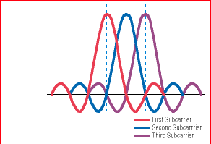
OFDM (Orthogonal Frequency Spread Spectrum)
-54 Mbps in wider 5.5GHz band,
transmission is limited.
-Uses 52 FDM channels (48 for data; 4
for synchronization)
- Although side bands overlap, the
carrier frequencies are orthogonal to
each other, less interference.
OFDM modulation
Source: www.electronicproducts.com

Slide 14
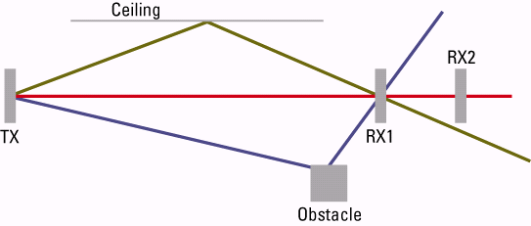
Antenna Diversity
Antenna diversity is a method for combining multiple, independent, fading signals in a diversity receiver.
It is a powerful technique for improving receiver performance in the presence of multipath fading.
At a high level, the advantage of antenna diversity is simple — two signals are better than one.
Two antennas combined optimally will double the average received power and provide a 3 dB improvement in link performance. But if the signals from each antenna are independent and arrive via a Rayleigh fading channel, the potential improvement is much greater than 3 dB
Source: www.cisco.com

Slide 15
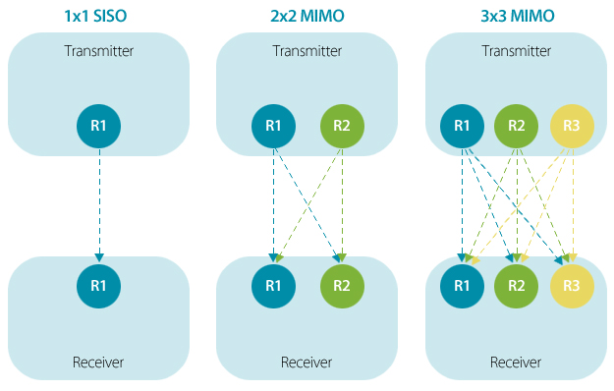
1X1 V/S 2X2 Radio options
1x1 and 2x2 refer to the number of transmit and receive radio chains built into the Wi-Fi card. 2x2 means it has two transmit and two receive radio chains, and usually implies that it supports 2 “spatial streams” (Multiple Inputs Multiple Outputs)
With a 40Mhz channel, the 1x1 wireless card means it has 1 receive antenna and 1 transmit antenna and can do a theoretical max transmission rate of 150Mbps. A 2x2 has 2 antennas for both receive and transmit and can do a theoretical max of 300Mbps. A 3x3 card has 3 antennas for both receive and transmit with a theoretical max of 450Mbps.
Source: blog.dlink.com

Slide 16
Integrating Wi-Fi with Embedded Systems
Wireless connectivity requires both a hardware radio and a software protocol stack.
Modules come in two flavors, stack-on-board and stack-off-board.
Stack-on-board modules:
include the processor on the module, or may have the processor integrated in the radio chip.
These modules have a simple ASCII command interface for configuration, and natively support the majority of Wi-Fi networking protocols, such as UDP, TCP/IP, DHCP, DNS, TELNET, FTP, HTTP, XML, SSL, etc
quickest approach to adding Wi-Fi. You only need to configure the IP address or URL to write the data to the module. The module takes care of the connection, packets and underlying Wi-Fi transport.
Stack-off-board modules:
contain the radio components and provide drivers for running the protocol stack on an external processor (Typically vendors will provide a protocol stack library.)
this approach requires more software integration, while allowing more flexibility
typically support more types of peripherals and provide for additional Wi-Fi security and services.

Slide 17
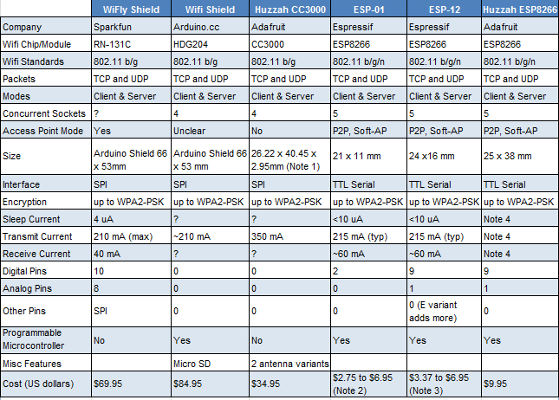
Choosing a Wi-Fi module
Protocol / standard supported
Operating frequency band
Transmit range
Transmit power output, operating supply current or voltage
Data rate (max throughput)
Microcontroller/microprocessor
Operating system (driver support)
Antenna and connector
Secure Wi-Fi authentication schemes
Packaging type
PCB layout
Hardware interfaces
Cost
Source: http://43oh.com

Slide 18
Basic steps to follow
Set up the right connections with microcontroller (SPI/UART/I2C)
Declare the SSID and Password
Select the right wireless security scheme (unsecured, WEP, WPA, or WPA2)
Define the passphrase in case of WEP scheme
Make sure proper connection can be established by running a series of instructions. For eg, Adafruit libraries provide the following set-up routine,
Initialization
SSID Scan
Access Point connection
DHCP address assignment
DNS lookup of www.adafruit.com
Ping www.adafruit.com
Disconnect
Establish client/server communication.

Slide 19
References
[1] https://learn.adafruit.com/adafruit-cc3000-wifi/smartconfigtest
[2] http://urgentcomm.com/mag/diversity-good-thing
[3] https://www.slideshare.net/victerpaul/8-80211-wireless-lan
[4] https://www.semiconductorstore.com/blog/2015/WiFi-standards-802-11a-b-g-n-vs-802-11ac-Which-is-Best/806
[5] http://rtcmagazine.com/articles/view/103315
[6] http://processors.wiki.ti.com/index.php/CC3000_Basic_Wi-Fi_example_application_for_MSP430
[7] http://43oh.com/2015/06/comparing-iot-wi-fi-modules-esp8266-vs-cc3000-vs-rn131-vs-hdg204/

