Slide 1
Sales Dashboard Project (Superstore Dataset)
Task 4: Dashboard Design | Tableau

Slide 2
Dashboard Overview
This dashboard includes:
• KPI Cards – Total Sales, Profit, Profit Ratio, YoY Growth
• Sales Trend (monthly)
• Category & Region breakdowns
• Top N Products (parameter-driven)
• Profitability Scatter (Sales vs Profit)
Interactivity: Filters, Parameter controls, and Dashboard Actions

Slide 3
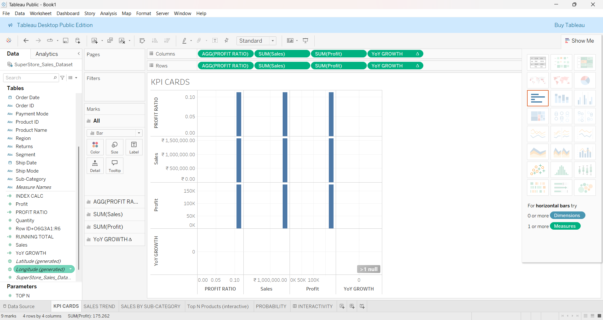
KPI Cards

Slide 4
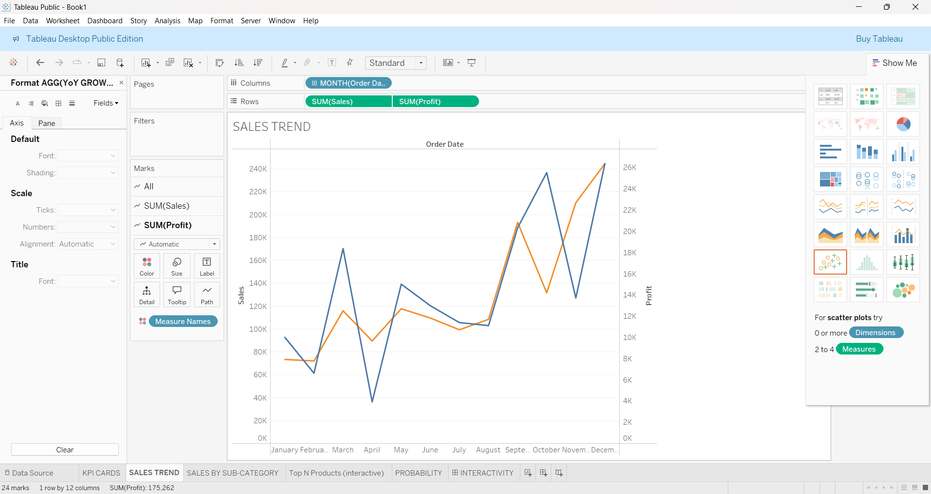
Sales Trend

Slide 5
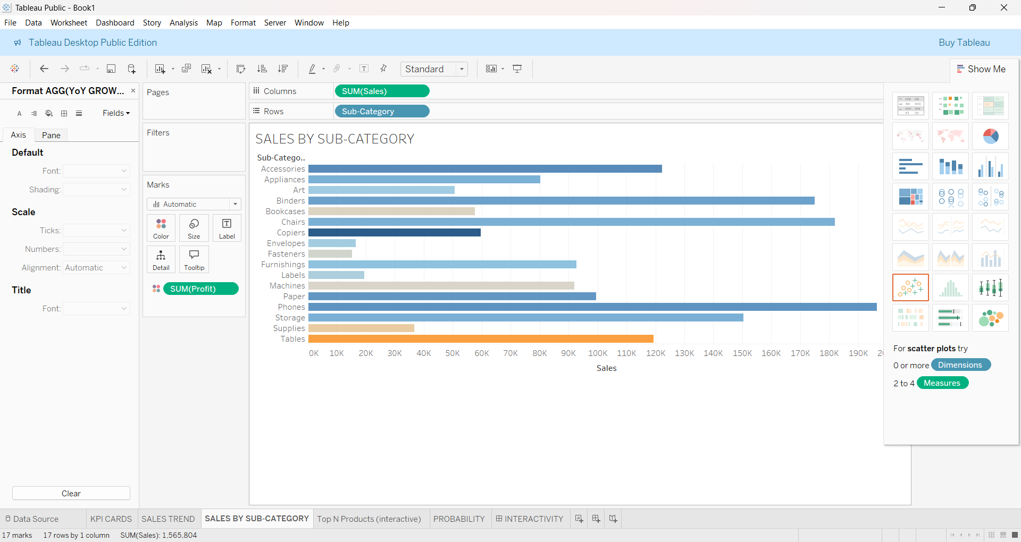
Category & Region breakdowns

Slide 6
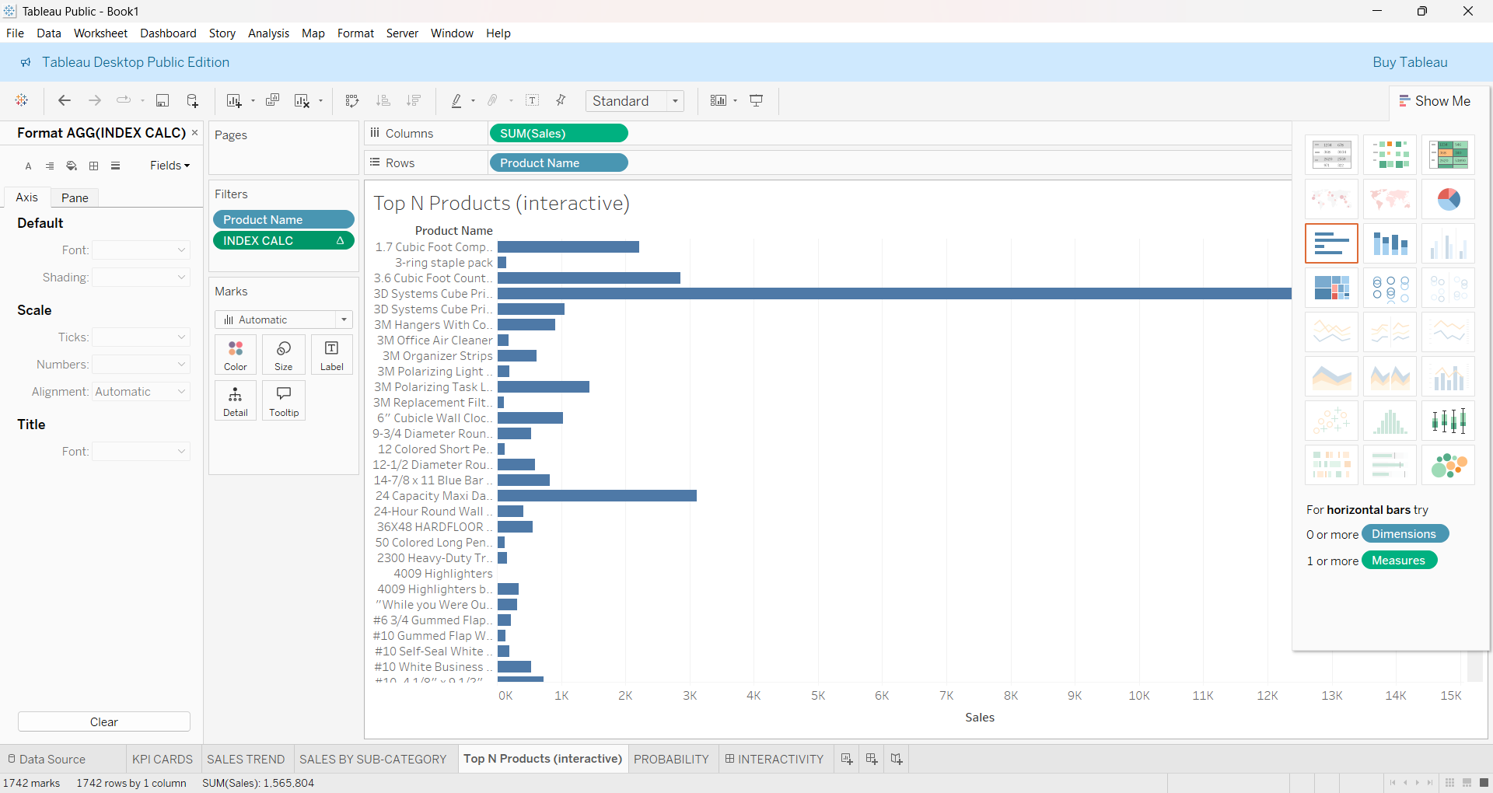
Top N Products (parameter-driven)

Slide 7
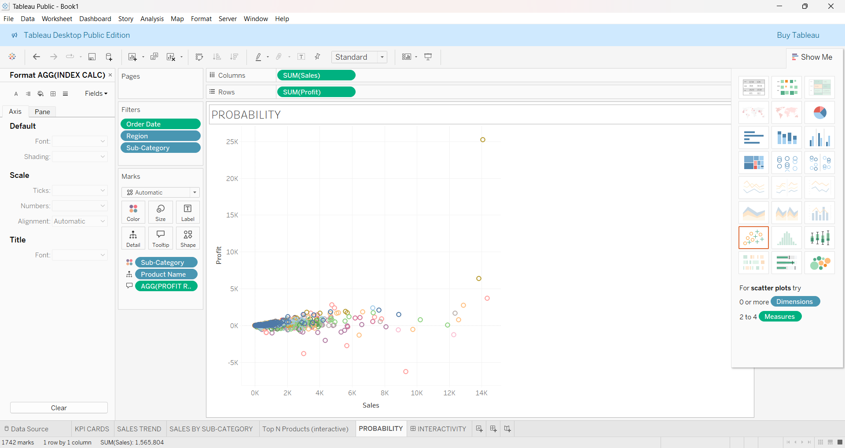
Profitability Scatter

Slide 8
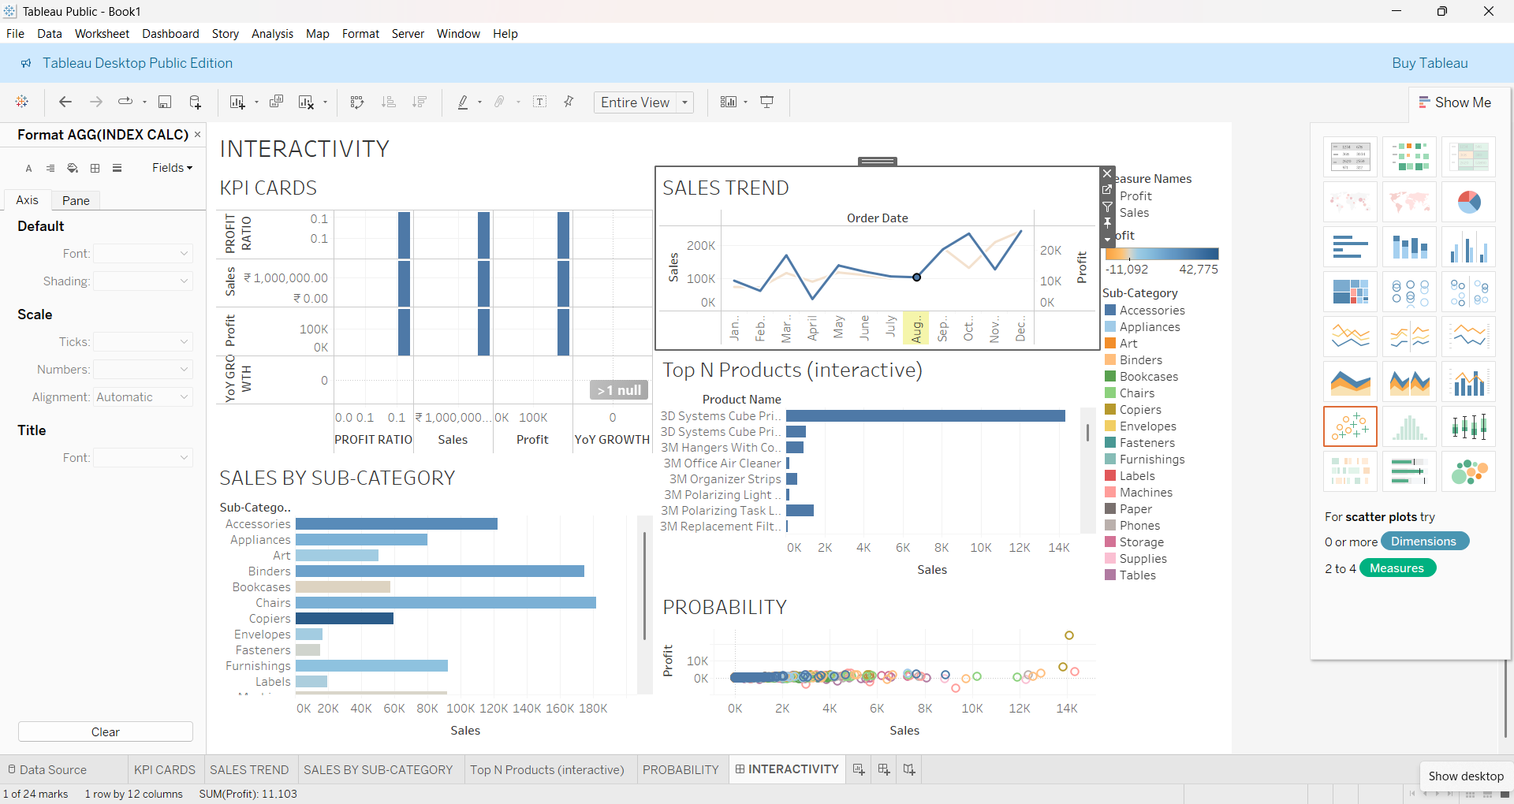
DASHBOARD

Slide 9
Key Insights & Recommendations
• Technology is the most profitable category.
• Some regions show declining YoY growth — require closer analysis.
• Top 10 products contribute ~40% of total sales.
• Discounts negatively impact profit margins in Office Supplies.
• Need to optimize strategy in Central region to boost profitability.

Slide 10
THANK YOU

