Slide 1
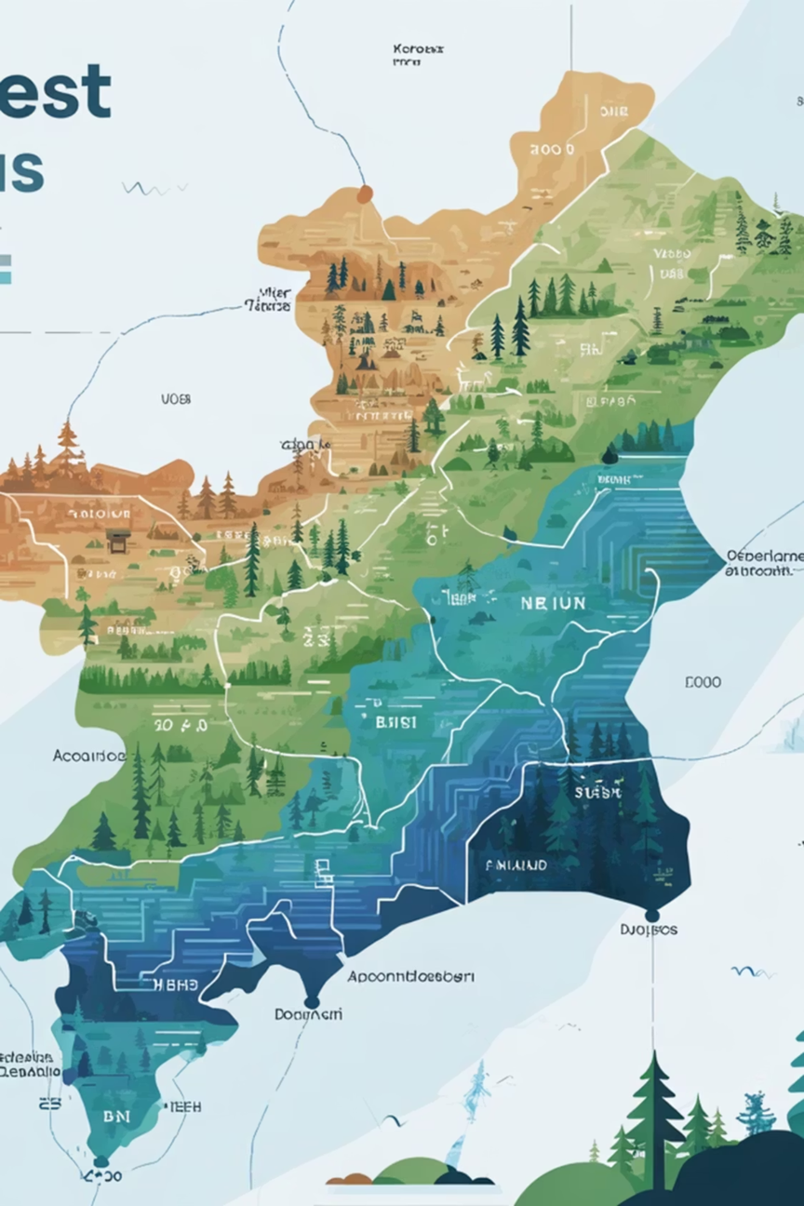

Theme: Web Development
FRA Atlas-A WebGIS-Based Intelligent Frontier For Forest Rights Decision Support
Organization: Ministry of Tribal Affairs (MoTA)
D. Sanjana (1602-23-737-044)
B. Shiva Sai (1602-23-737-049)
P. Kowshika (1602-23-737-022)
Notes:
1

Slide 2
The Background and Challenges
The Forest Rights Act (FRA), 2006 was enacted to recognize and legally ensure the land and forest resource rights of forest-dwelling Scheduled Tribes and Other Traditional Forest Dwellers.
FRA aims to correct historical injustices by conferring individual Forest Rights (IFR), Community Rights (CR), and Community Forest Resource Rights (CFRR).
Challenges
1
Non-digitized and Scattered Records
FRA, DLC, and CFR records are fragmented, hindering easy access and verification.
2
Absence of Centralized Monitoring
There is no unified system to track and oversee FRA implementation progress.
3
Lack of Spatial Data Integration
Claims are not integrated with geographical/spatial and social data for clear boundaries.
4
Manual Decision-Making
Reliance on development schemes relies on manual processes, lacking efficiency.
These gaps limit transparency, verification, and targeted development.
Notes:
2

Slide 3
Existing Solutions
1
2
3
Manual Record Management
State-Level FRA Portals
Government MIS (Monitoring Information System)
FRA claims and approvals maintained in physical files and district registries
Basic portals display claim statistics and data updates for some states
Ministry distributes annual progress reports and data aggregation
Time-consuming, error-prone, and effort, causing delays and errors.
Limited integration with spatial data and asset-level integration.
No direct integration with GIS layers or satellite-based asset mapping.
4
5
GIS-Based Planning Tools
Scheme Management Portals (PM-KISAN, MGNREGA, etc.)
Standalone GIS tools used for land use planning and monitoring
Separate portals for different government schemes/beneficiaries
Not linked to FRA claim records or scheme effectiveness tracking.
No unified system to automatically link FRA beneficiaries.
While these solutions address parts of the problem, they lack integration (records, spatial data, and scheme linkage) limits transparency and efficient targeting.
Notes:
3

Slide 4
Project Objectives
Digitization of FRA Records
Development of WebGIS-Based FRA Atlas
AI-based Asset Classification
Interactive WebGIS Portal
Provide real-time monitoring of FRA claim status and implementation progress.
Use AI-based OCR to convert scanned FRA documents into structured digital records.
Create an interactive web-based mapping platform for structured geographic representation. Visualize FRA claims, approvals, and community forest resources on interactive map interface.
Use remote sensing and pre-trained CNN model to classify land-use categories such as forest, agriculture, water bodies, and settlements.
Decision Support System (DSS)
Secure Role-Based & Blockchain Framework
A smart engine for targeted FRA beneficiaries with eligible schemes. Suggest PM-KISAN, MGNREGA, and other relevant schemes.
Ensure immutability of approved records using a blockchain mechanism to prevent tampering.
Notes:
4

Slide 5
Tech Stack
Layer
Technology Used
Frontend
React.js, Leaflet.js, Bootstrap, TailwindCSS
Backend
FAST API, REST APIs, JWT Auth, MCP middleware
AI / ML
OCR (Tesseract/Google Vision), CNN (TensorFlow/Keras), LLM (LangChain + Google-Gemini)
Data Cleaning
Pandas, Regex
Geo / Spatial
Google Earth Engine (Sentinel-2), OpenStreetMap, GIS Tools
Database
PostgreSQL
RAG System
LangChain (for text chunking, semantic search, and RAG), Vector Database for embedding storage and retrieval
Notes:
5

Slide 6
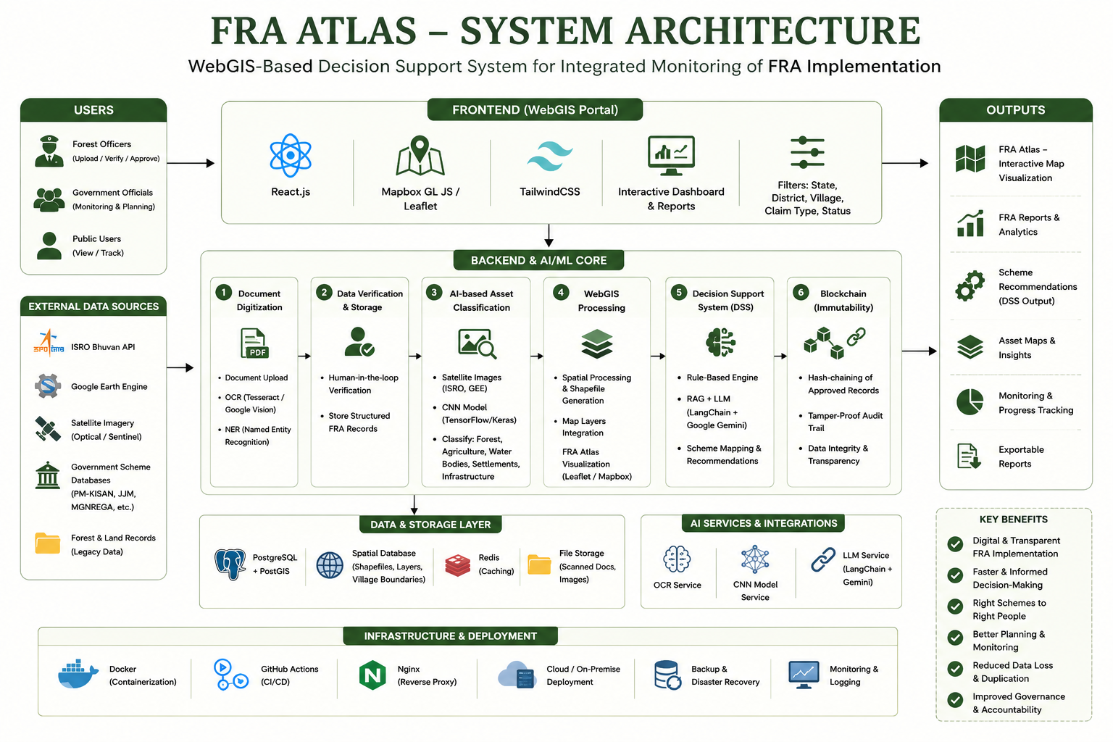
Notes:
6

Slide 7
References & Resources
Ministry of Tribal Affairs, Govt of India, Forest Rights Act 2006 and Rules (FRA Act & Rules) Book
FRA Act & Rules Book
2.Ministry of Tribal Affairs, Govt of India, Guidelines for Interventions under DAIGUA, 2024
DAIGUA Guidelines
3.Ministry of Tribal Affairs, Govt of India, Monthly Progress Report on Implementation of Forest Rights Act, July 2025
Monthly Progress Report
4. J.M. Hemegues et al., "AI-Powered FRA Atlas & WebGIS Decision Support System," IJIRT, Paper ID: IJIRT166660
IJIRT Paper
5. UNDP, "FRA Knowledge Portal: FRA Atlas – Project Payments, Ministry of Tribal Affairs"
UNDP Knowledge Portal
6. World Bank, "Forest Rights Act: Smart Forests Atlas Logistical"
Smart Forests Logistical
Notes:
7

