Slide 1
Event Management Dashboard
Hackathon Project Demonstration

Slide 2
Problem Statement
Organizations often struggle to organize and manage events efficiently.
This dashboard streamlines event creation, task assignment, and progress tracking.

Slide 3
Features Overview
1. Event Management (CRUD operations)
2. Attendee Management (Add, Remove, Assign Tasks)
3. Task Tracker with Progress Visualization
4. User Authentication (Login/Logout)
5. Responsive Design with Validation

Slide 4
Technology Stack
1. Frontend: React.js
2. Backend: Django (RESTful APIs)
3. Database: SQLite
4. Authentication: Django Authentication
5. Styling: CSS and Material-UI

Slide 5
Project Architecture
1. Frontend communicates with Backend via APIs
2. Backend processes requests and interacts with the database
3. Real-time updates for task progress (WebSockets)

Slide 6
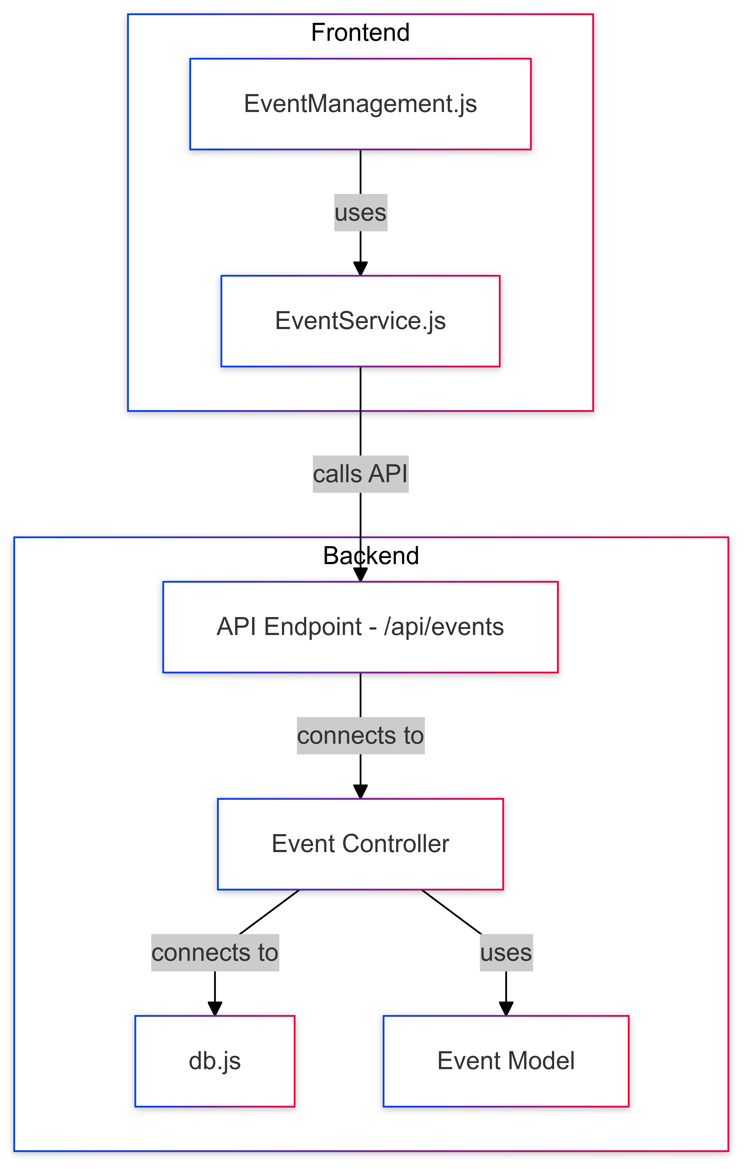

Slide 7
Key Screens
1. Event Management Page: Add, Edit, Delete Events
2. Attendee Management Page: Manage Attendees
3. Task Tracker Page: Update Task Status
4. Authentication Page: Login and Logout

Slide 8
APIs Developed
1. Event APIs: Create, Read, Update, Delete Events
2. Attendee APIs: Add, List, Delete Attendees
3. Task APIs: Create, Update, List Tasks for Events

Slide 9
Demo Flow
1. User Login
2. Create and Manage Events
3. Add Attendees and Assign Tasks
4. Update Task Progress and Visualize
5. Logout

Slide 10
Bonus Features
1. Calendar View for Events
2. Progress Bar for Task Completion
3. Real-time Updates (WebSockets)

Slide 11
Conclusion
1. A comprehensive solution for event management.
2. Enhances efficiency and user experience.
3. Ready for real-world deployment.

