Slide 1

Air Sense: Real-Time Air Quality Index Prediction Using Machine Learning
Department of CSE, School of CS& AI, SR University
Project By – G.Sanjansah , 2503A52L20.

Slide 2
Project Title & Problem Statement
Department of CSE, School of CS& AI, SR University
Title: Air Sense – Real-Time Air Quality Intelligence
Problem Statement: Air pollution is a critical global health concern affecting millions worldwide. Citizens lack accessible, easy-to-understand tools to check the Air Quality Index (AQI) and receive actionable health recommendations. Air Sense addresses this gap by combining ML-based AQI prediction with an intuitive, visually rich web dashboard that provides real-time monitoring, forecasts, city comparisons, and personalized health advisories

Slide 3
Explanation of the Project
Department of CSE, School of CS& AI, SR University
Air Sense is a Machine Learning-powered Air Quality Index (AQI) prediction system with a premium interactive web dashboard. It:
Predicts AQI values from pollutant concentrations (PM2.5, PM10, NO₂, O₃, CO) and environmental parameters (Temperature, Humidity, Wind Speed).
Classifies air quality into 6 health tiers: Good, Moderate, Unhealthy for Sensitive Groups, Unhealthy, Very Unhealthy, and Hazardous.
Delivers personalized health recommendations including Do's & Don'ts based on current AQI levels.

Slide 4
Explanation of the Project
Department of CSE, School of CS& AI, SR University
Provides a 7-day AQI forecast using AI-generated trend predictions.
Supports city comparison – compare air quality between any two cities side by side.
Offers GPS auto-detection and search for 500+ cities globally.
The backend pipeline generates 1,200 synthetic training samples using realistic pollutant distributions, trains a Random Forest model, and exports it as a .joblib artifact. The frontend provides a zero-dependency, single-page interface.

Slide 5
Description of the Model/Algorithm(s) Used
Department of CSE, School of CS& AI, SR University
Model & Implementation Details :
Algorithm: Random Forest Regressor (scikit-learn)
Pipeline: StandardScaler → RandomForestRegressor (using scikit-learn Pipeline)
Model Configuration :
Number of Trees: 300 decision trees (n_estimators = 300)
Max Depth: 12 (max_depth = 12)
Min Samples Split: 4 (min_samples_split = 4)

Slide 6
Description of the Model/Algorithm(s) Used
Department of CSE, School of CS& AI, SR University
Input & Output :
Input Features (8):PM2.5, PM10, NO₂, O₃, CO, Temperature, Humidity, Wind Speed
Target Variable:AQI (Air Quality Index) — continuous range (0–500)
Data & Training :
Data Generation:1,200 synthetic samples using NumPy (AQI calculated via weighted linear equation + Gaussian noise)
Train/Test Split:80/20 split (random_state = 42)

Slide 7
Accuracy / Performance Metrics of the Model
Department of CSE, School of CS& AI, SR University
Model Performance Metrics :
R² Score: 0.9342 (93.42%)
MAE (Mean Absolute Error): 21.78
RMSE (Root Mean Squared Error): 22.19
Dataset Split :
Training Samples: 8
Test Samples: 2 (Note: Based on small sample CSV; full dataset contains 1,200 samples)
Performance Insight :
The model achieves an R² score of 93.42%,
This means it explains ~93% of the variation in AQI values
Conclusion: Predictions are highly accurate and closely match actual AQI

Slide 8
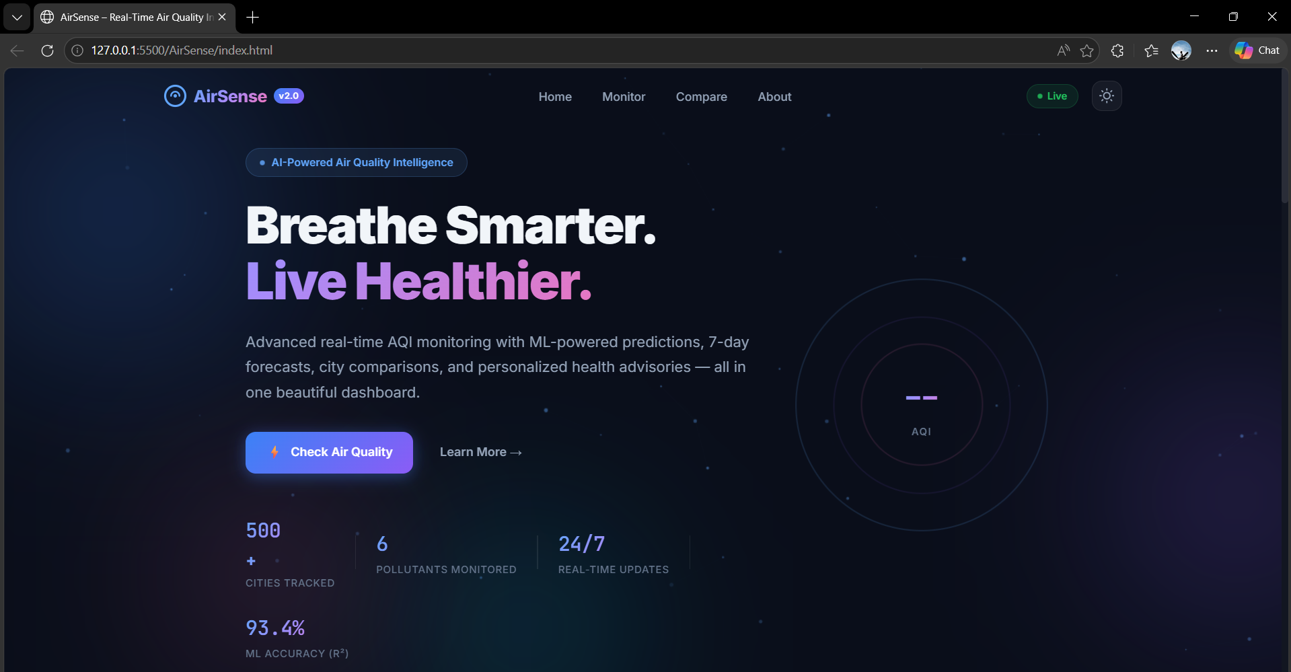
Figures/Plots Showing Results
Department of CSE, School of CS& AI, SR University

Slide 9
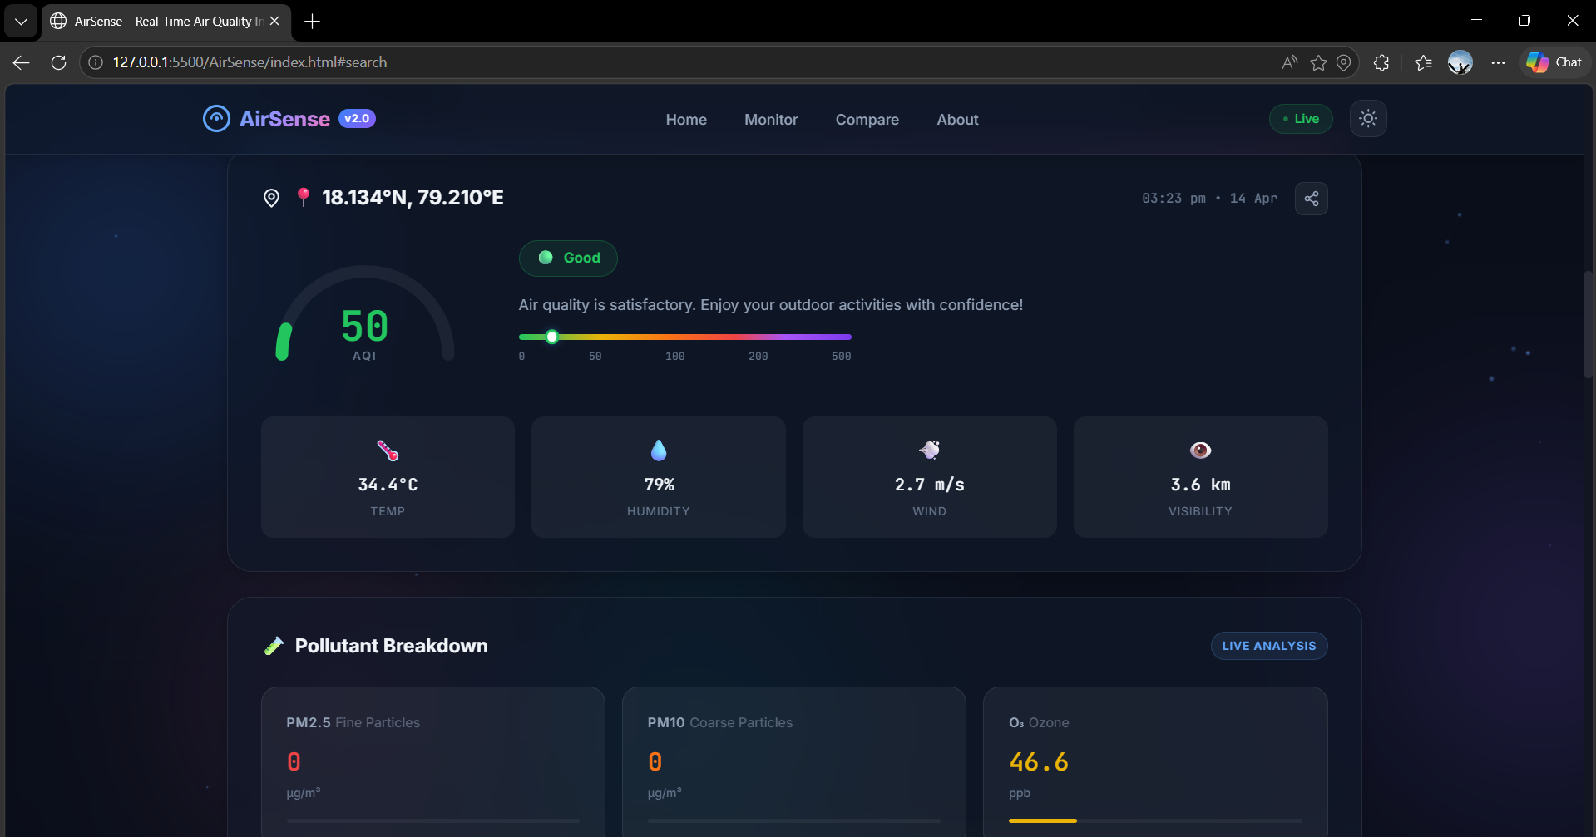
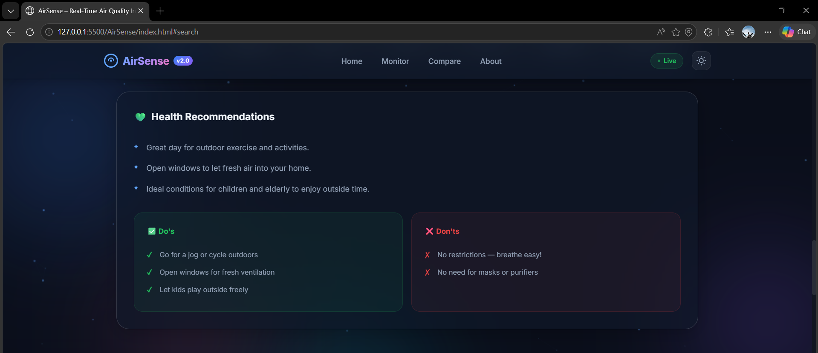
Figures/Plots Showing Results
Department of CSE, School of CS& AI, SR University

Slide 10
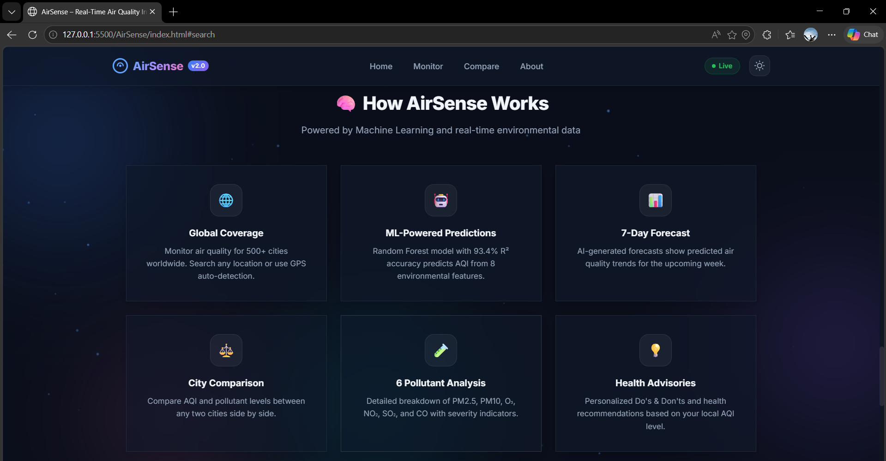
Figures/Plots Showing Results
Department of CSE, School of CS& AI, SR University

Slide 11
Outcome & Conclusion of the Project
Department of CSE, School of CS& AI, SR University
Outcome:
Successfully built an end-to-end ML pipeline that trains a Random Forest model achieving 93.42% R² accuracy in predicting Air Quality Index from 8 environmental features.
Developed a feature-rich, production-quality web dashboard with real-time AQI monitoring for 500+ cities, 7-day AQI forecasting, city-to-city comparison, 6-pollutant analysis, weather integration, and personalized health recommendations (Do's & Don'ts).
The system classifies AQI into 6 WHO-standard health tiers and provides tailored health advisories for each category.

Slide 12
Outcome & Conclusion of the Project
Department of CSE, School of CS& AI, SR University
Conclusion: Air Sense demonstrates that machine learning can be effectively applied to environmental health monitoring. The Random Forest Regressor, combined with feature scaling, yields strong predictive performance (R² = 0.9342) for AQI estimation using common pollutant and weather parameters. The project bridges the gap between raw environmental data and actionable health insights by presenting results through an intuitive, visually engaging dashboard — making air quality information accessible to the general public. It serves as a practical example of combining supervised learning with frontend engineering to address a real-world public health challenge.

