Slide 1
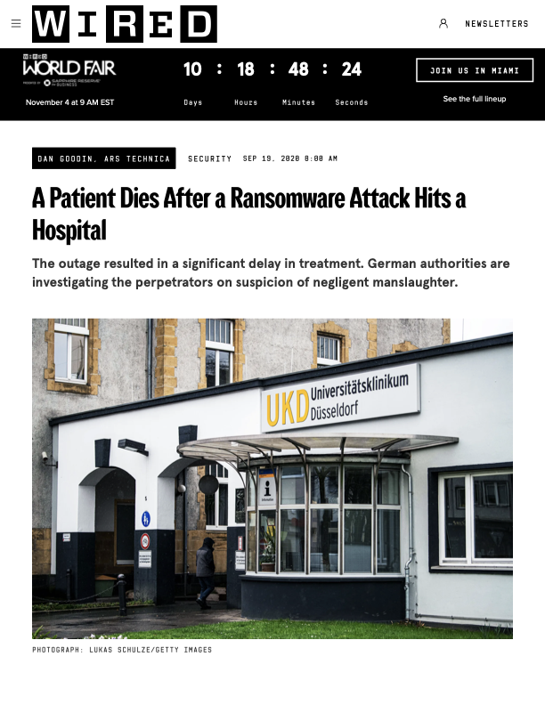
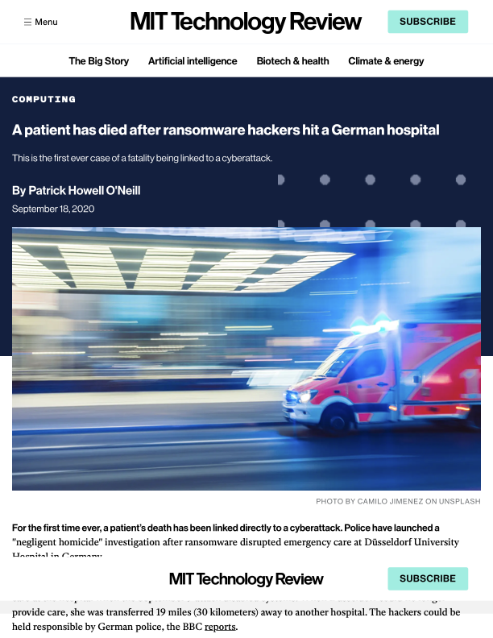
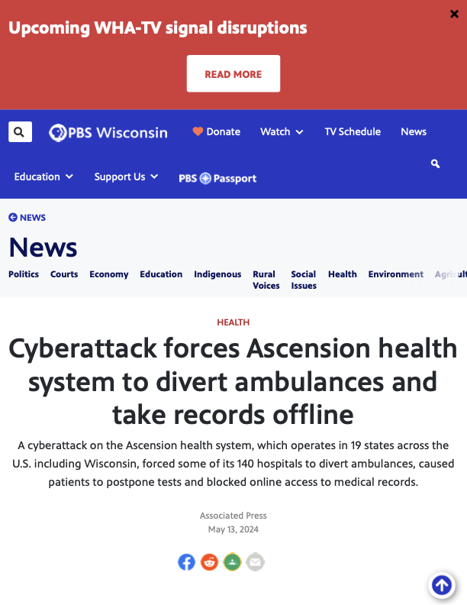
00 — EXHIBIT · THE ATTACK CLASS IS REAL
MIT Technology Review
PBS Wisconsin
PATRICK HOWELL O'NEILL · SEP 18 · 2020
WIRED
ASSOCIATED PRESS · MAY 9 · 2024
first documented ransomware death
4 years later · same attack class
DAN GOODIN · ARS TECHNICA · SEP 19 · 2020
Different outlets. Four years apart. Same known vulnerability class · no tool to find, fix, and verify it at scale.
Notes:
Hero. Three real clippings. MIT + WIRED on same Düsseldorf 2020 incident. PBS covers Ascension 2024 — same attack class four years later.

Slide 2
01 — THE ATTACK IS SILENT
The device keeps reporting "normal."
The patient keeps crashing.
WHAT THE SCREEN DISPLAYS
WHAT THE PATIENT ACTUALLY HAS
HR
SpO₂
HR
SpO₂
72
98%
32
76%
Green reads. Alarm silent. Monitor insists the patient is fine.
Fan stopped. Respiration flat. The alarm was suppressed by the attacker.
No doctor sees the difference. → That is why these attacks kill.
Notes:
Reported vs reality. CWE-306 — unsigned command accepted. The device obeys and lies about it.

Slide 3
02 — THE MARKET WE'RE DEFENDING
Ransomware doesn't break the device —
it pivots through it.
460
~53%
US healthcare cyberattacks in 2025. Up from 249 in 2023.
Of connected medical devices carry a known critical vulnerability. Nobody writes the patch.
FBI IC3 · 2025 ANNUAL REPORT
CLAROTY · MEDIGATE · 2024 FLEET SURVEYS
Notes:
Scale: 460 attacks in 2025 (FBI IC3), ~53% of hospital devices run known-vulnerable firmware.

Slide 4
03 — WHAT WE BUILT
One loop.
Visible end to end.
01
Ground CVE-2019-6538
Cite the real CVE from NVD. Not fabricated.
NVD
02
Scan app.py
SemGrep + Bandit run deterministic rules. Claude triages the real finding.
SEMGREP · BANDIT · CLAUDE
03
Exploit POST /device/command
Open-weight model writes the PoC payload. The device obeys.
PoC PAYLOAD
04
Patch require X-Device-Token
Factory Droid writes a real git diff. 41/41 unit tests green.
FACTORY DROID
05 · gate
Human approve & deploy
Mandatory sign-off. Tool-scoped, process boundary, identity-check.
REQUIRED
06
Verify re-run the same bytes
Replay the exact exploit. Hard-asserted status code — no LLM in the loop.
BYTE-FOR-BYTE REPLAY
07
Restore healthy baseline
Device back online. Receipt signed. Audit queue notified.
SIGNED
Find the hole. Prove the kill. Close it. Show the receipt.
Notes:
Seven stages. Human gate highlighted. One shared truth across hardware + simulator + dashboard.

Slide 5
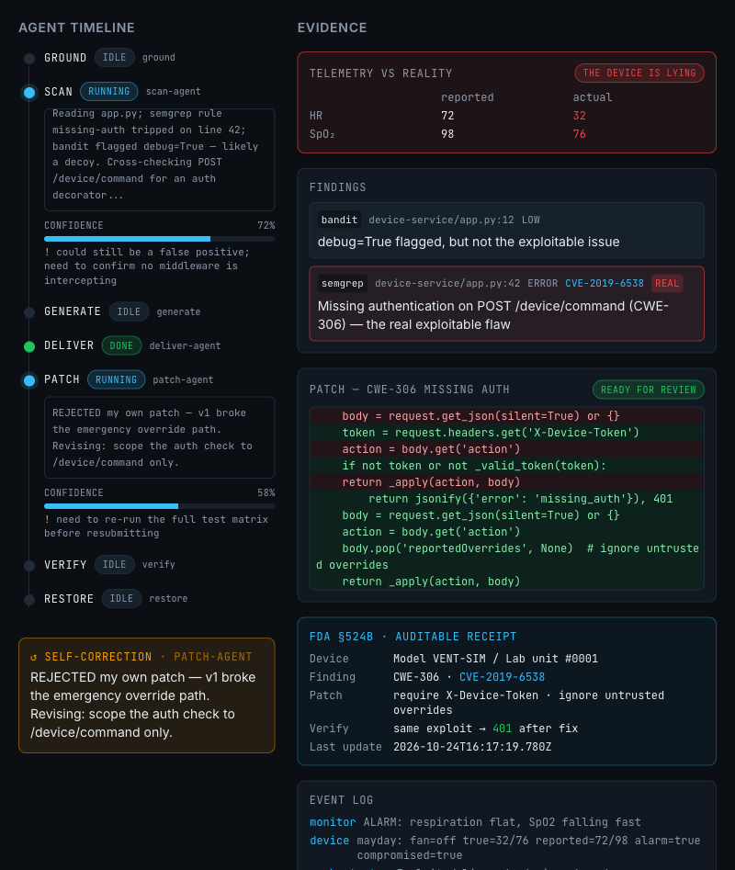
04 — CLAUDE, OUT LOUD
The model shows its work —
and catches itself.
LIVE · PREVENT DASHBOARD
01
STREAMING REASONING
Scan agent reads app.py line-by-line, visibly cross-checks the auth decorator.
02
VISIBLE CONFIDENCE
72% on the real finding. 58% after it rejects its own first patch.
03
SELF-CORRECTION EVENT
"REJECTED my own patch — v1 broke the emergency override path."
04
AUTONOMOUS PATCH
Factory Droid produces a real git diff. 41 / 41 unit tests green.
Notes:
Dashboard screenshot + four live-reasoning behaviors. The model shows its work and rejects its own first patch.

Slide 6
05 — PROOF, NOT PROSE
We re-run the exact exploit.
It must now fail.
BEFORE PATCH
AFTER PATCH
200
401
VERIFICATION · BYTE-FOR-BYTE REPLAY
Before
POST /device/command
→
→ 200 OK
fan stops · alarm silent · patient crashing
After
POST /device/command
→ 401 Unauthorized
fan running · alarm armed · patient breathing
Judged by
hard-asserted status code
no LLM in the loop
Pass or fail. No middle ground.
Notes:
Proof: same bytes, re-sent after patch. 200 → 401. Hard-asserted. No LLM judging.

Slide 7
06 — COMPLIANCE PAYS
A receipt the FDA
already asks for.
FDA §524B · AUDITABLE RECEIPT
Model VENT-SIM / Lab unit #0001
Finding
CWE-306 · CVE-2019-6538
Scanner
SemGrep 1.182.1 · Bandit 1.9.4
Patch author
Factory Droid · scoped CLI
Approved by
human@ops · identity-signed
Verify
same exploit → 401 after fix
SBOM
attached · 73 packages
Reproduce
git · diff + exploit payload sealed to this record
✓ Sealed and queued to clinical engineering · 2026-10-24 11:17 PDT
Notes:
FDA §524B already requires a repeatable find-and-fix process. Every patch leaves this receipt behind.

Slide 8
07 — ONE DEVICE TODAY. THOUSANDS TOMORROW.
Patch one room.
The heal-wave rolls across the ward.
1 of
3,412
devices in a single hospital system
every one a parallel find → fix → verify job
• patched & verified ⬤ one device PreVent is patching today
Notes:
Scale vision: 1 of 3,412. One red bed (today) in a sea of healed green devices (ward.)

Slide 9
08 — THE CLOSE
Make the devices
watch themselves.
Find the hole. Prove the kill. Close it. Show the receipt.
01
02
03
04
Israel
Ogwu
Christian
Ibarbia Ruiz
Saketh
Poori
Sanjavan
Ghodasara
AGENTS · ORCHESTRATION
SECURITY · INTEGRATION
HARDWARE · SIMULATION
REALTIME · FRONTEND
UMD · Anthropic Campus Ambassador · Claude Builder Club.
UF · ex-Google Gmail · agentic full-stack.
14 hackathons · 8 awards · CV + hardware.
Stevens MS ML · 8+ hackathon wins.
Notes:
Close + team. The difference between a patient and a statistic was one button that stopped working — and nobody looking at it.

